Slide 1
CS406 PARALLELIZED DIGITAL IMAGE PROCESSING
EGE ŞENSES, 23570
BERKAY DEMİRELLER, 23810
SELEN ÖZCAN, 23914
GitHub link: https://github.com/brkd/ImageProcessing406

Slide 2
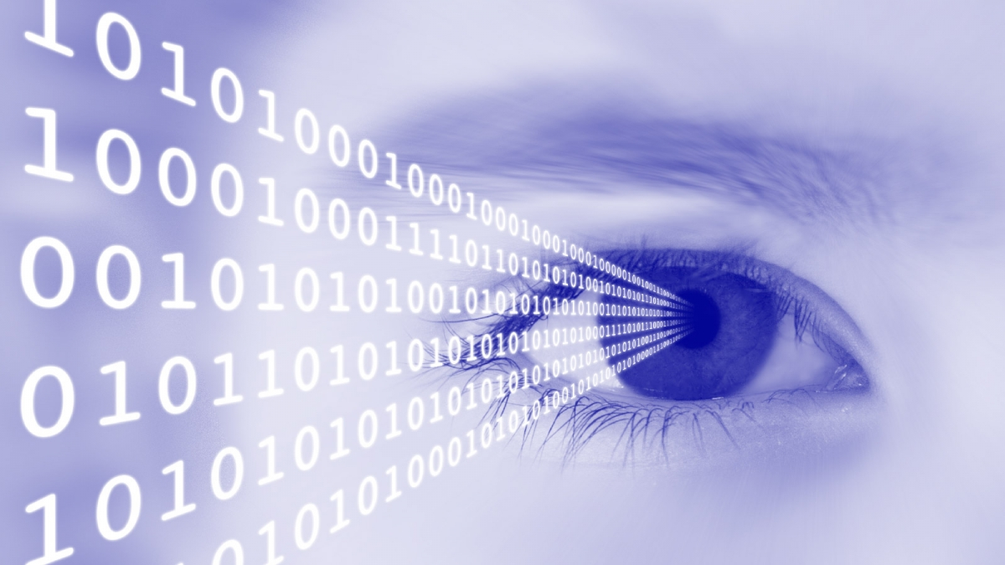
Digital IMAGE PROCESSING
The set of algorithms that operate on the digital representations of images.
Been rapidly developing since the 1960s.
Images comprised of pixels.
Each pixel contains an integer, coded in color models like grayscale, RGB or CMYK.
Domain of applications include computer science, environmental science, military, and medical science.

Slide 3
NEED FOR PARALLELIZATION
Image Processing is done with excessive loops. Any algorithm that relies on an abundance of repeating acts is amply eligible for parallelization.
Image Warping, as an example, is done by applying a transformation onto every pixel, and replacing the old pixel values with the result. This is a technique seen regularly in Digital Image Processing.
We have parallelized multiple Digital Image Processing algorithms, and have seen improvements on runtime for both CPU and GPU code.

Slide 4

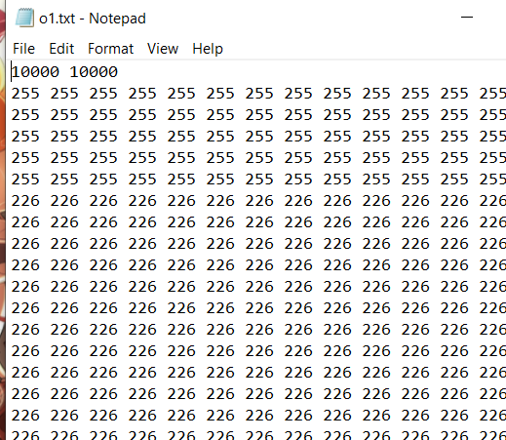
DATA
We use Python scripts to convert .jpg files into .txt files which our code operates on.
The given converted file contains the dimensions of the image on its first line, and then lists the values of its pixels.
Since our data is simply images, there are close to no restraints on how to get our test samples.

Slide 5
algorıthms
The implemented algorithms are given below:
Linear Scaling (sequential, parallel, SIMD, GPU variants)
Median Filtering (sequential, parallel, SIMD, GPU variants)
Sobel Filtering (sequential, parallel variants)
Sobel Edge Detection (sequential, parallel variants)
GrayWorld (sequential, parallel, SIMD, GPU variants)
Reflection (sequential, parallel, SIMD, GPU variants)
Ordered Dithering (sequential, parallel, SIMD, GPU variants)
Rotations (sequential, parallel, SIMD, GPU variants)

Slide 6
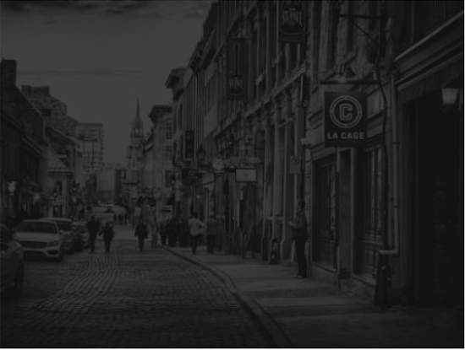
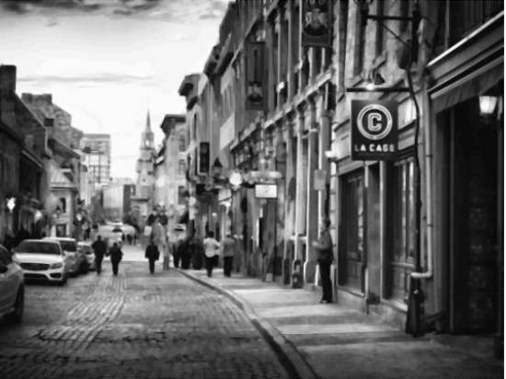
LINEAR SCALING
Finds min and max values.
Scales every pixel accordingly.
Finds a balance in the brightness/contrast of an image.

Slide 7
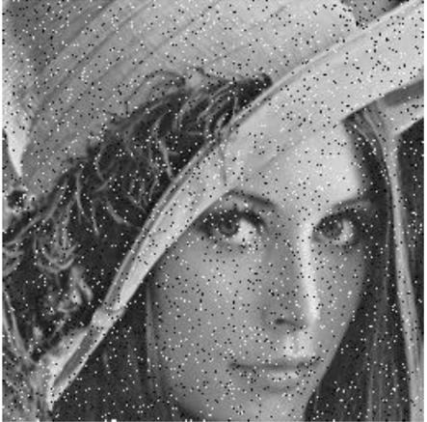
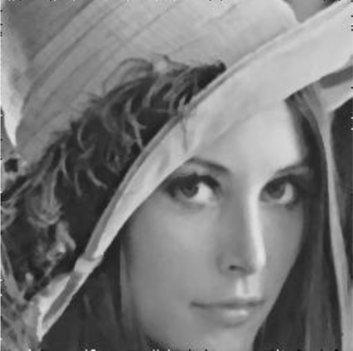
MEDIAN FILTERING
Uses a KxK window.
Replaces each pixel value with the median value in that window.
Removes salt and pepper noise.

Slide 8
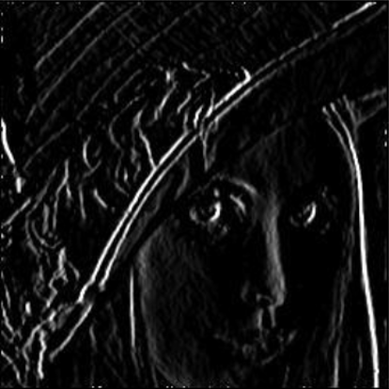
SOBEL FILTERING
Performs 2 convolutions in the horizontal and vertical axes.
Produces a crude gradient approximation that emphasizes the edges.
Preprocessing for Sobel Edge Filtering.

Slide 9
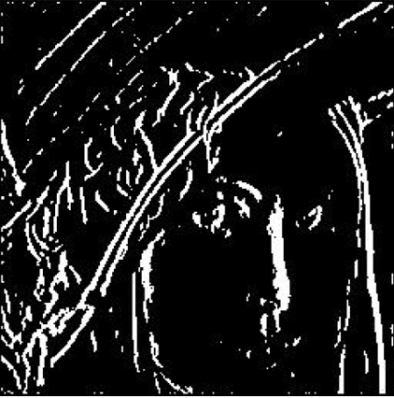
SOBEL edge FILTERING
Takes the Sobel X and Y filtered images as input.
Marks the edges bright white, everything else is pitch black.
Enables machines to “understand” and interpret what they see.

Slide 10
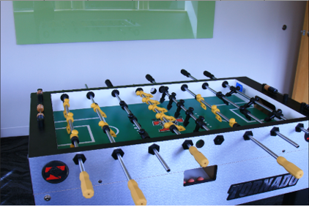
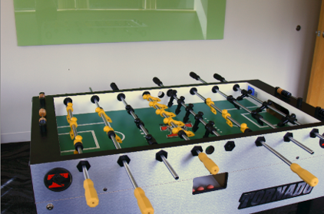
GRAYWORLD
Finds the average value of a pixel and calculates a scaling value.
Rescales the colors of the pixels.
Corrects the illumination in images.

Slide 11
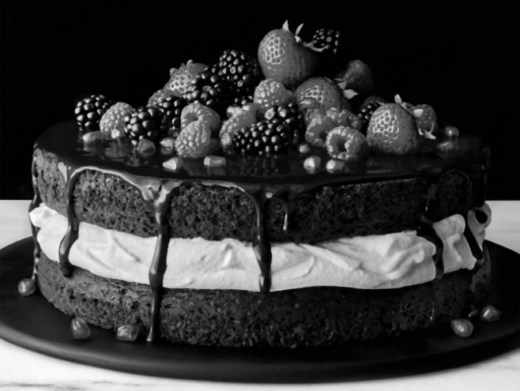
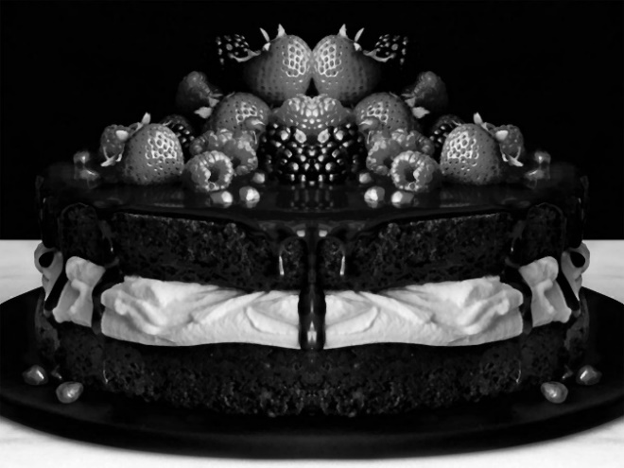
REFLECTION
Places a vertical axis in the middle of the image.
Computes the reflection based on that axis.
Easily rewritable for other variants.

Slide 12
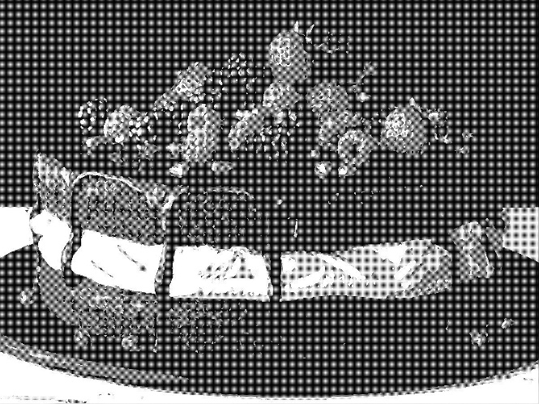
ORDERED DITHERING
Applies noise unto the image for randomizing quantization error.
Uses a threshold map for flicking pixels.
Results in a “crosshatch” pattern.

Slide 13
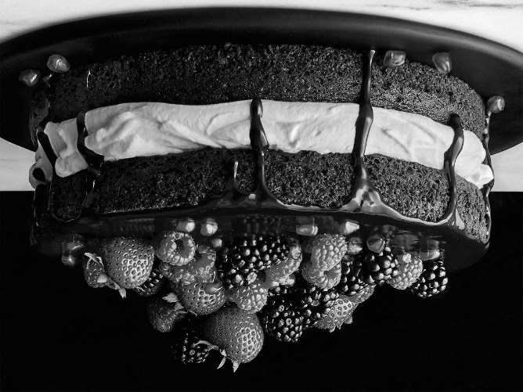
ROTATIONS
90, 180 and 270 degrees of rotation implemented.
180 example given below;

Slide 14
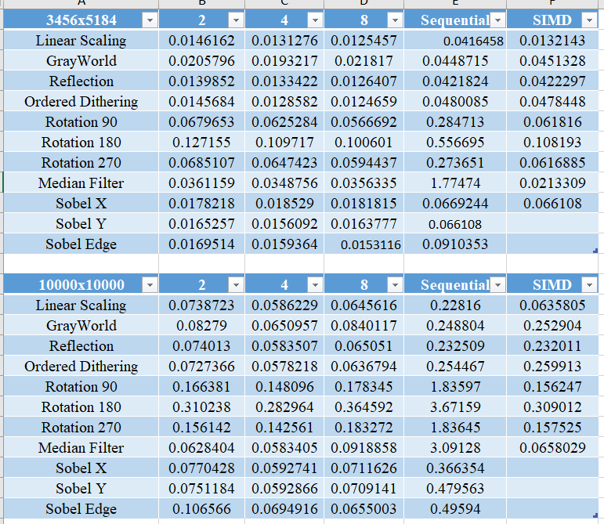
RESULTS - CPU

Slide 15
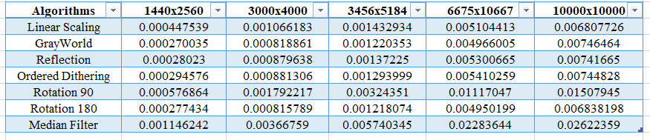
RESULTS - gPU

Slide 16
REFERENCES
GitHub link: https://github.com/brkd/ImageProcessing406
Fig retrieved from https://dopikai.com/digital-image-processing/
Fig retrieved from https://www.mathworks.com/help/images/ref/illumgray.html

