Slide 1
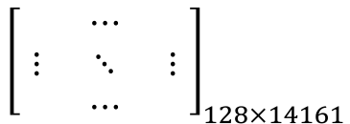
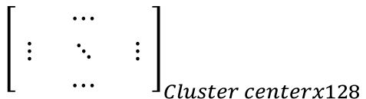
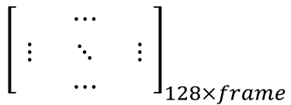
vl_sift descriptor
$${\left[\begin{matrix} & ⋯ & \\ ⋮ & ⋱ & ⋮ \\ & ⋯ & \end{matrix}\right]}_{128×frame}$$
Train Image
Kmeans applied
$${\left[\begin{matrix} & ⋯ & \\ ⋮ & ⋱ & ⋮ \\ & ⋯ & \end{matrix}\right]}_{Cluster centerx128}$$
vl_dsift descriptor
$${\left[\begin{matrix} & ⋯ & \\ ⋮ & ⋱ & ⋮ \\ & ⋯ & \end{matrix}\right]}_{128×14161}$$

Slide 2
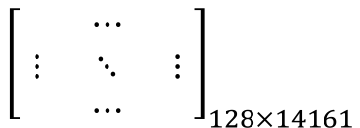
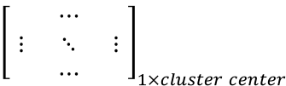
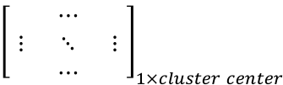
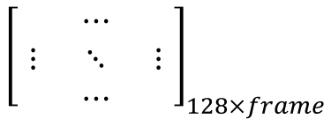
vl_sift descriptor
$${\left[\begin{matrix} & ⋯ & \\ ⋮ & ⋱ & ⋮ \\ & ⋯ & \end{matrix}\right]}_{128×frame}$$
Assign to cluster centers
$${\left[\begin{matrix} & ⋯ & \\ ⋮ & ⋱ & ⋮ \\ & ⋯ & \end{matrix}\right]}_{1×cluster center}$$
Encoding
Train Image
vl_dsift descriptor
$${\left[\begin{matrix} & ⋯ & \\ ⋮ & ⋱ & ⋮ \\ & ⋯ & \end{matrix}\right]}_{128×14161}$$
$${\left[\begin{matrix} & ⋯ & \\ ⋮ & ⋱ & ⋮ \\ & ⋯ & \end{matrix}\right]}_{1×cluster center}$$
Assign to cluster centers
Encoding

Slide 3
vl_sift descriptor
$${\left[\begin{matrix} & ⋯ & \\ ⋮ & ⋱ & ⋮ \\ & ⋯ & \end{matrix}\right]}_{128×frame}$$
Assign to cluster centers
Encoding
Find NN train image
Test Image
vl_dsift descriptor
$${\left[\begin{matrix} & ⋯ & \\ ⋮ & ⋱ & ⋮ \\ & ⋯ & \end{matrix}\right]}_{128×14161}$$
Assign to cluster centers
Encoding
Find NN train image

