Slide 1
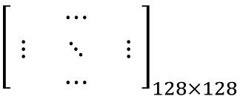
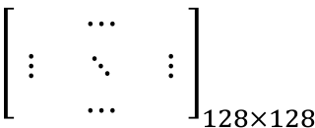
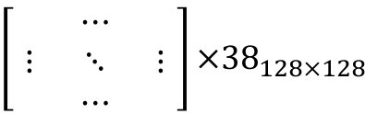
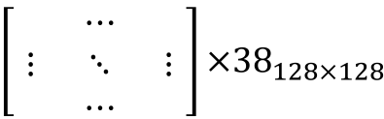
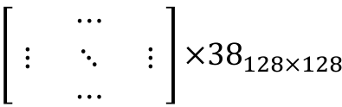
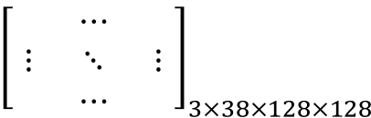
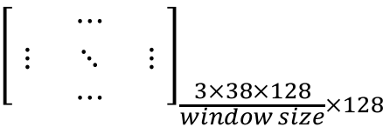
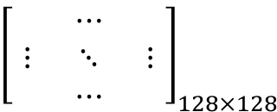
RFS Filter bank for each channel
$${\left[\begin{matrix} & ⋯ & \\ ⋮ & ⋱ & ⋮ \\ & ⋯ & \end{matrix}\right]}_{128×128}$$
Red
$${\left[\begin{matrix} & ⋯ & \\ ⋮ & ⋱ & ⋮ \\ & ⋯ & \end{matrix}\right]×38}_{128×128}$$
Rectified Linear Unit non-linearity
$${\left[\begin{matrix} & ⋯ & \\ ⋮ & ⋱ & ⋮ \\ & ⋯ & \end{matrix}\right]}_{128×128}$$
Green
$${\left[\begin{matrix} & ⋯ & \\ ⋮ & ⋱ & ⋮ \\ & ⋯ & \end{matrix}\right]×38}_{128×128}$$
Train Image_{128x128}
$${\left[\begin{matrix} & ⋯ & \\ ⋮ & ⋱ & ⋮ \\ & ⋯ & \end{matrix}\right]}_{3×38×128×128}$$
$${\left[\begin{matrix} & ⋯ & \\ ⋮ & ⋱ & ⋮ \\ & ⋯ & \end{matrix}\right]}_{128×128}$$
Blue
$${\left[\begin{matrix} & ⋯ & \\ ⋮ & ⋱ & ⋮ \\ & ⋯ & \end{matrix}\right]×38}_{128×128}$$
Spatial window poling
$${\left[\begin{matrix} & ⋯ & \\ ⋮ & ⋱ & ⋮ \\ & ⋯ & \end{matrix}\right]}_{\frac{3×38×128}{window size}×128}$$

