Slide 1

Low Level Features for Visual Attribute Recognition
Burak Onal
Project Proposal
10/03/2017

Slide 2
Problem Statement
Usage of low level features to understand attributes in images.
These attributes are then used to classify images.
Understanding the effect of low-level features in classifying attributes is thus beneficial.
Low-level features are separately as well as together used in attribute classification.

Slide 3
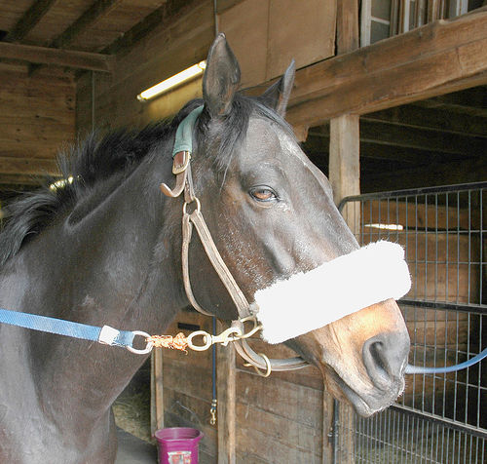
Problem Statement (cont.)
Color: RGB, HSV, LAB
Shape: HOG, SIFT
Texture: Texton, LBP
Has Ear?
Has Nose?
Has Mouth?
Has Hair?
Has Face?
Has Eye?
Has Head?
Has Hand?
…

Slide 4
Definitions
Low-level feature: color, shape, texture, hybrid, deep features.
Color: RGB, HSV and LAB
Color histograms are build via bag-of-words fashion. Cluster size = 128
Shape: HOG and SIFT
HOG: Features are constructed with spatial pyramid; 8x8 blocks, scale factor of 2 and step size of 4 pixels.
SIFT: Difference-of-Gaussian interest points, using 16x16 image patches, a 4x4 spatial grid with 8 orientation bins. This gives a 128-dimensional feature vector per interest point.
HOG and SIFT feature histograms are built via bag-of-words and k-means clustering.
Texture: Texton and LBP
Texton: A filter bank (MR8 ) is applied to the image and k-means (256 k-means) clustering is applied.
LBP: 8 pixel neighborhood (3x3 windows with the center pixel) setting the result binary. Bag of words fashion k-means to 1000 clusters is applied.
Hybrid features: CSIFT
Similar to SIFT extraction; color invariant gradients are used instead of gray gradients.
A special software is used from [33].
Deep Features:
CNN architecture obtained from VGGNet from [40]

Slide 5
Methodology
Feature extraction
Feature selection
Classifier training
Feature extraction done via descriptors.
Feature selection done via L1 regularized logistic regression:
For each class and attribute, best features (having non-zero coefficients) are selected.
These features are pooled for the same attribute (features showing up in all classes are selected).
Classifier training done via L1 regularized logistic regression.
Combine outputs of each feature with different methods.

Slide 6
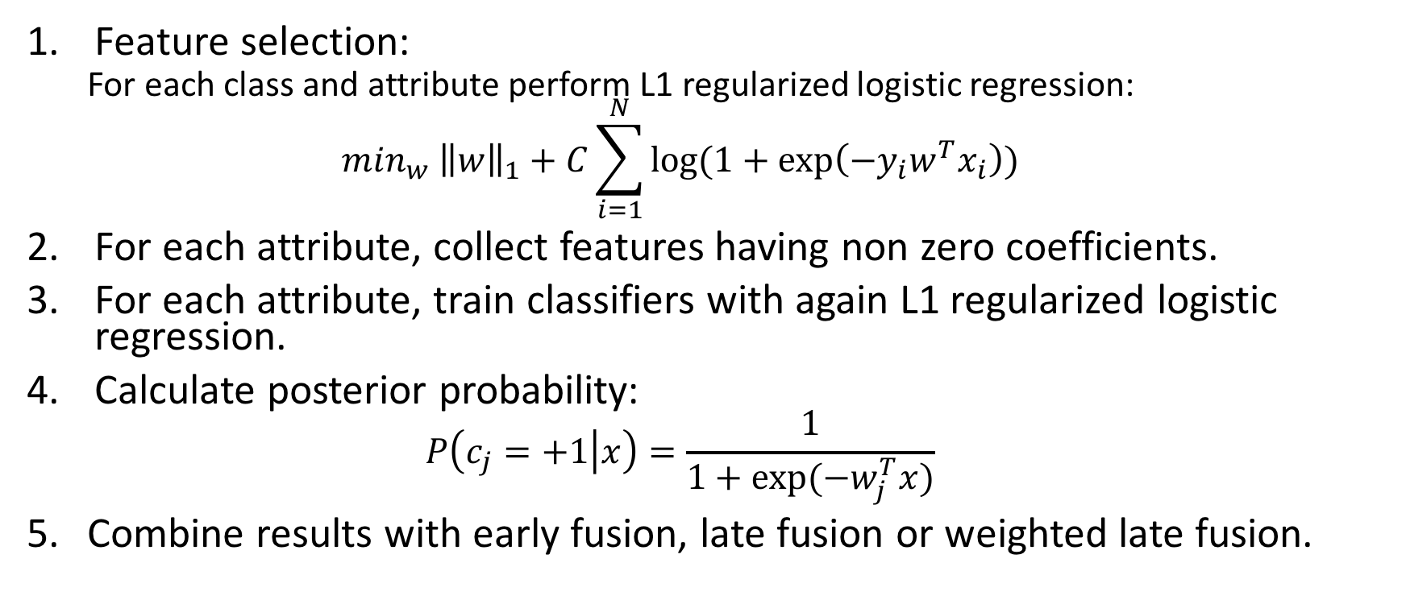
Methodology (cont.)
Feature selection:
For each class and attribute perform L1 regularized logistic regression:
$$\min_{w} {\left\|w\right\|}_{1}+C\sum_{i=1}^{N}{log⁡(1+\exp\left(−y_{i}w^{T}x_{i}\right))}$$
For each attribute, collect features having non zero coefficients.
For each attribute, train classifiers with again L1 regularized logistic regression.
Calculate posterior probability:
$$P\left(c_{j}=+1 | x\right)=\frac{1}{1+exp⁡({−w}_{j}^{T}x)}$$
Combine results with early fusion, late fusion or weighted late fusion.

Slide 7
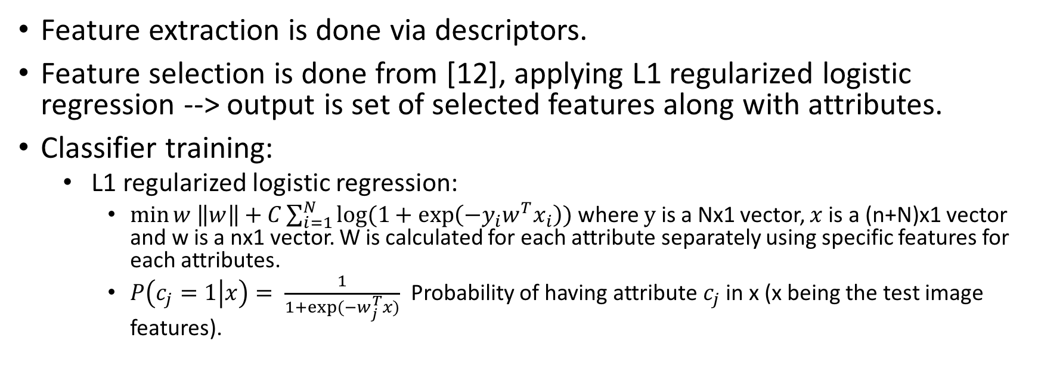
Methodology
Feature extraction
Feature selection
Classifier training
Feature extraction is done via descriptors.
Feature selection is done from [12], applying L1 regularized logistic regression --> output is set of selected features along with attributes.
Classifier training:
L1 regularized logistic regression:
$\min{w \left\|w\right\|+C\sum_{i=1}^{N}{log⁡(1+\exp\left(−y_{i}w^{T}x_{i}\right))}}$ where $y$ is a Nx1 vector, $x$ is a (n+N)x1 vector and w is a nx1 vector. W is calculated for each attribute separately using specific features for each attributes.
$P\left(c_{j}=1 | x\right)= \frac{1}{1+exp⁡(−w_{j}^{T}x)}$ Probability of having attribute $c_{j}$ in x (x being the test image features).

Slide 8
Workflow
Extract Features (RGB, HSV, LAB, HOG, SIFT, Texton, LBP)
Select Features that generalize well over the attributes:
Apply L1 regularized logistic regression
Classifier training for attributes over selected features:
Apply L1 regularized logistic regression
Combine classifier output with late fusion technique.
Build confusion matrix and ROC curves.
DataSet: a-Pascal and a-Yahoo dataset, available online.

Slide 9
References
[33] K.E.A. van de Sande, T. Gevers, C.G.M. Snoek, Empowering visual categorization with the gpu, IEEE Trans. Multimedia 13 (2011) 60–70.
[40] A. Vedaldi, K. Lenc, Matconvnet – convolutional neural networks for matlab, in: ACM International Conference on Multimedia, 2015.

