Slide 1

Low Level Features for Visual Attribute Recognition
Burak Onal
02/06/2017

Slide 2
Problem Statement
Usage of low level features to understand attributes in images.
These attributes can then be used to classify images.
Understanding the effect of low-level features in classifying attributes is thus beneficial.
Low-level features are separately as well as together used in attribute classification.

Slide 3
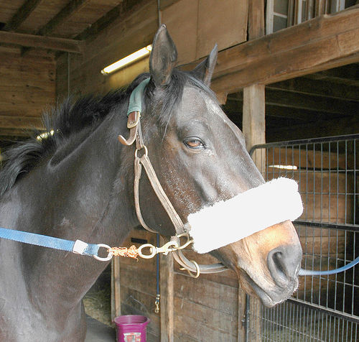
Problem Statement (cont.)
Color: RGB, HSV, LAB
Shape: HOG, SIFT
Texture: Texton, LBP
Has Ear?
Has Nose?
Has Mouth?
Has Hair?
Has Face?
Has Eye?
Has Head?
Has Hand?
…

Slide 4
Data Set aPascal
There are 2113 train images and 2227 test images.
Each image has 64 attribute.
Each image has a bounding box for associated classes.
There are 20 classes.

Slide 5
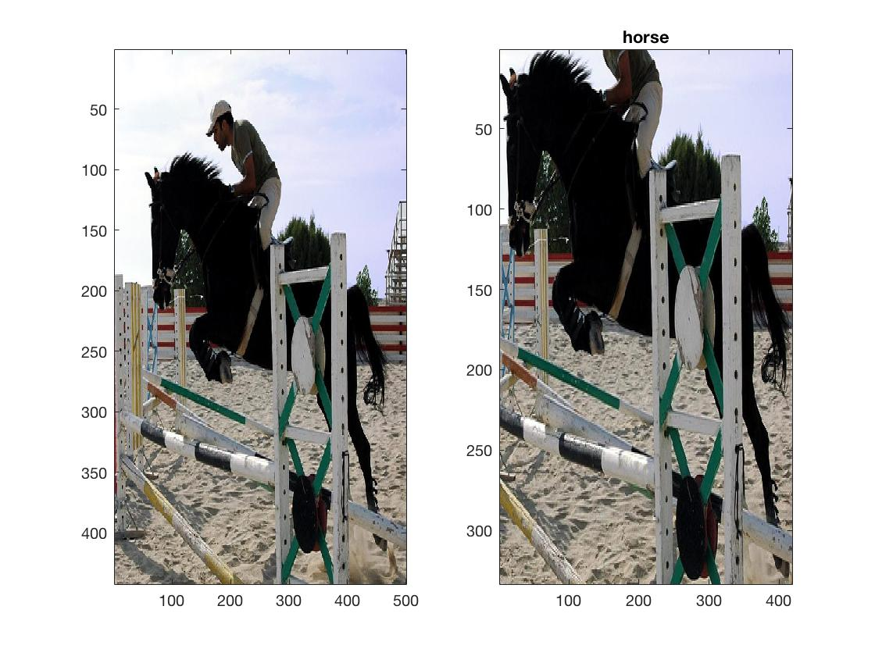
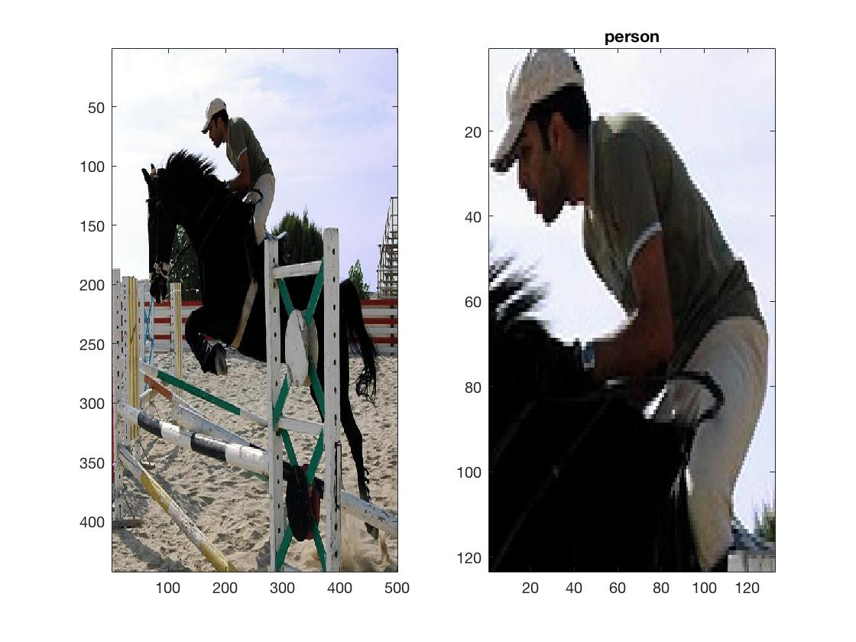
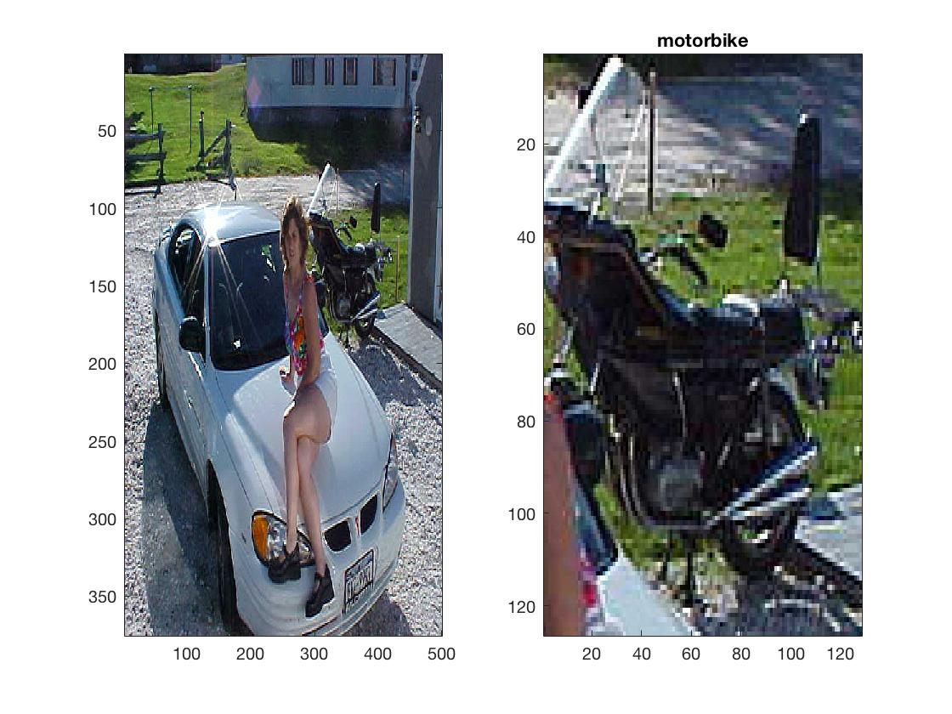
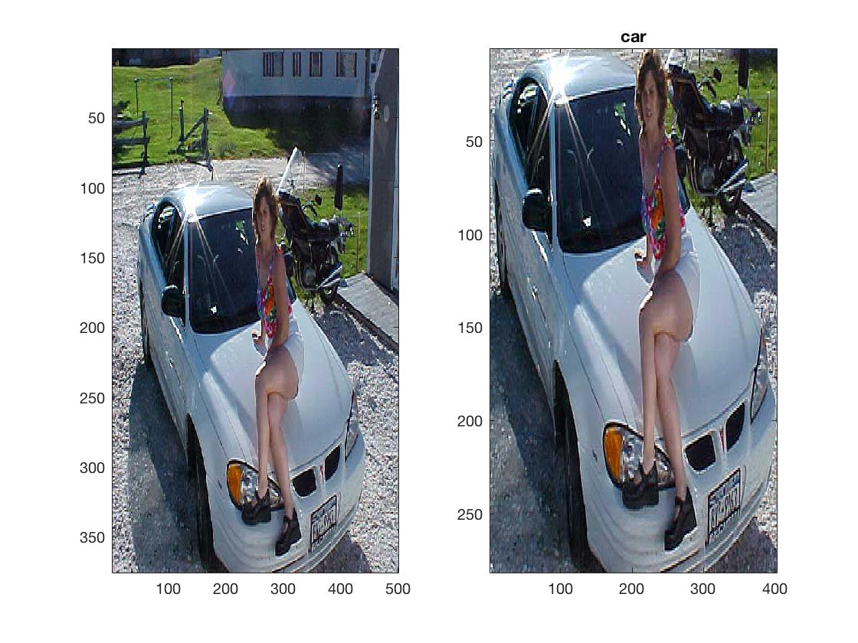
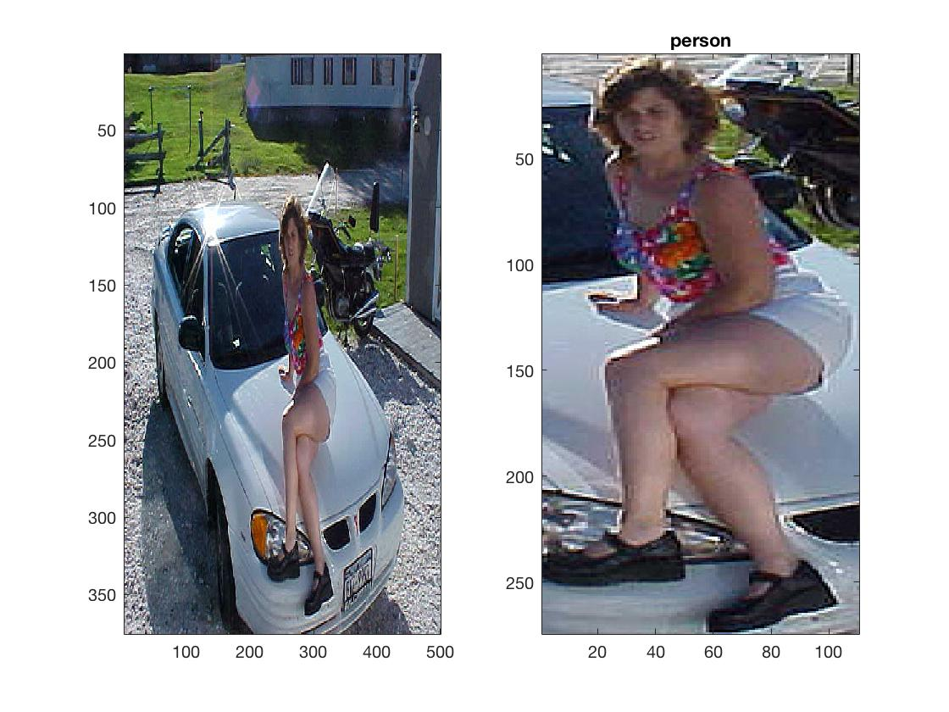
aPascal Examples

Slide 6
aPascal Examples
2008_000008.jpg horse 54 87 471 419 0 0 0 0 0 1 1 0 1 1 1 0 0 0 0 0 1 0 0 1 1 0 0 0 0 0 0 0 0 0 0 0 0 0 0 0 0 0 0 0 0 0 0 0 1 1 0 0 0 0 0 0 0 0 0 0 0 0 0 0 0 0 0 0
2008_000008.jpg person 158 44 289 166 0 0 0 0 0 1 0 0 1 1 0 1 1 1 1 1 1 0 1 1 0 0 0 0 0 0 0 0 0 0 0 0 0 0 0 0 0 0 0 0 0 0 0 0 0 0 0 0 0 0 0 1 0 0 0 1 0 0 0 0 0 0 0 0
2008_000109.jpg motorbike 293 71 420 196 0 0 0 0 0 1 0 0 0 0 0 0 0 0 0 0 0 0 0 0 0 0 0 0 0 0 1 0 1 0 1 0 0 1 1 0 0 0 0 0 0 0 0 0 0 0 0 0 0 0 0 0 1 1 0 0 0 0 0 0 0 1 0 0
2008_000109.jpg car 42 95 443 375 0 1 0 0 0 0 0 0 0 0 0 0 0 0 0 0 0 0 0 0 0 0 0 0 1 0 1 1 1 0 1 0 0 0 0 0 0 0 0 0 0 0 0 0 0 0 0 0 0 0 0 0 1 0 0 0 0 0 0 0 0 1 0 0
2008_000109.jpg person 229 91 338 364 0 0 0 0 0 0 0 0 1 0 0 1 1 1 1 1 1 1 1 1 1 0 0 0 0 0 0 0 0 0 0 0 0 0 0 0 0 0 0 0 0 0 0 0 0 0 0 0 0 0 0 1 0 0 0 1 0 0 0 0 0 0 0 0
According to this mapping:
2008_000008.jpg horse has {Occluded, Tail, Head, Ear, Snout, Torso, Leg, Foot/Shoe, Rein, Saddle}
2008_000008.jpg person has {Occluded, Ear, Mouth, Hair, Face, Eye, Torso, Arm, Leg, Skin, Cloth}
Notes:
Rein=dizginlemek
Snout=burun
Torso=govde
Occluded=tikmis, (fiili tikamak)

Slide 7
Classes and Attributes
Classes: Aero-plane, bicycle, bird, boat, bottle, bus, car, cat, chair, cow, dining table, dog, horse, motorbike, person, potted plant, sheep, sofa, train, TV-monitor, donkey, monkey, goat, wolf, jet-ski, zebra, centaur, mug, statue, building, bag, carriage
Attributes: 2D Boxy, 3D Boxy, Round, Vert Cyl, Horiz Cyl, Occluded, Tail, Beak, Head, Ear, Snout, Nose, Mouth, Hair, Face, Eye, Torso, Hand, Arm, Leg, Foot/Shoe, Wing, Propeller, Jet engine, Window, Row Wind, Wheel, Door, Headlight, Taillight, Side mirror, Exhaust, Pedal, Handlebars, Engine, Sail, Mast, Text, Label, Furn. Leg, Furn. Back, Furn. Seat, Furn. Arm, Horn, Rein, Saddle, Leaf, Flower, Stem/Trunk, Pot, Screen, Skin, Metal, Plastic, Wood, Cloth, Furry, Glass, Feather, Wool, Clear, Shiny, Vegetation, Leather

Slide 8
Methodology
Feature extraction
Classifier training
Feature selection

Slide 9
Feature Extraction
For each image, HOG, LAB and Texton clusters are generated:
HOG → 8x8 block size, 4 pixel step size, 2 scales per octave, clustered to k=1000
LAB → densely sampled for each pixel, clustered to k=128.
Texture → A texton filterbank is used, clustered to k=256.
Once having the cluster centers (code words), each image’s HOG, LAB and Texture descriptors are assigned to one of the code words.
Histogram of cluster assignments are calculated for each image within each bounding box along with a 3x2 cell.
At the end feature vectors are obtained:
HOG = [ ]_{1x7000}
LAB = [ ]_{1x896}
Texton = [ ]_{1x1792}

Slide 10
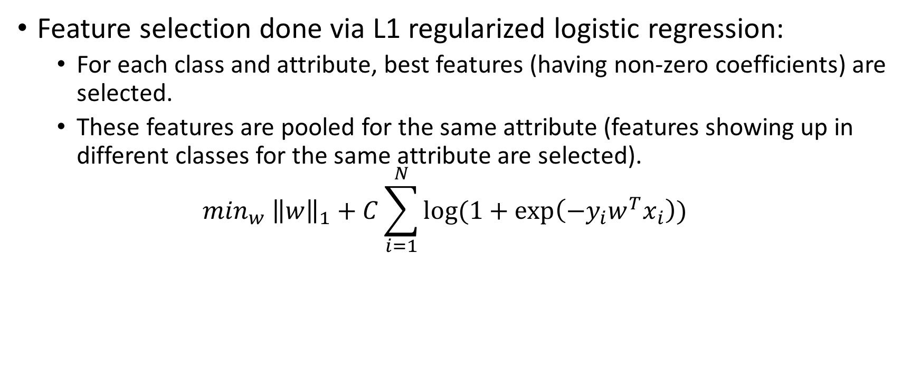
Feature Selection
Feature selection done via L1 regularized logistic regression:
For each class and attribute, best features (having non-zero coefficients) are selected.
These features are pooled for the same attribute (features showing up in different classes for the same attribute are selected).
$$\min_{w} {\left\|w\right\|}_{1}+C\sum_{i=1}^{N}{log⁡(1+\exp\left(−y_{i}w^{T}x_{i}\right))}$$

Slide 11
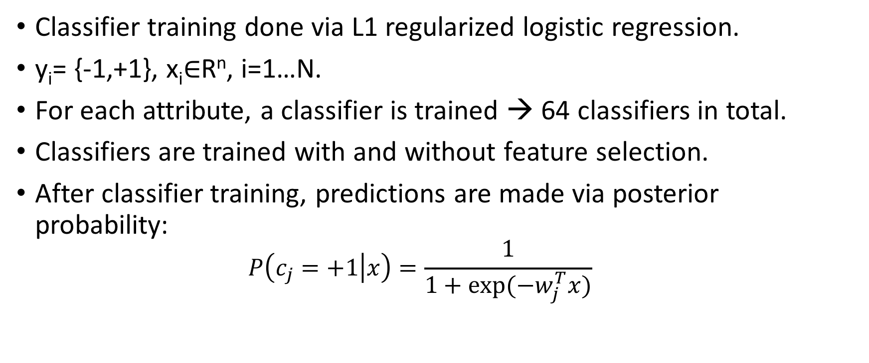
Classifier Training
Classifier training done via L1 regularized logistic regression.
y_{i}= {-1,+1}, x_{i}$∈$R^{n}, i=1…N.
For each attribute, a classifier is trained → 64 classifiers in total.
Classifiers are trained with and without feature selection.
After classifier training, predictions are made via posterior probability:
$$P\left(c_{j}=+1 | x\right)=\frac{1}{1+exp⁡({−w}_{j}^{T}x)}$$

Slide 12
Performance evaluation
ROC Curves and Area Under Curve (AUC)
Accuracy is not a good metric for an unbalanced data set.
ROC is shows relationship between True Positive Rate and False Positive Rate for different decision thresholds.
AUC is a single metric of TP vs FP for various thresholds.
Actual\Predicted | 1 | 0
1 | TP | FN
0 | FP | TN

Slide 13
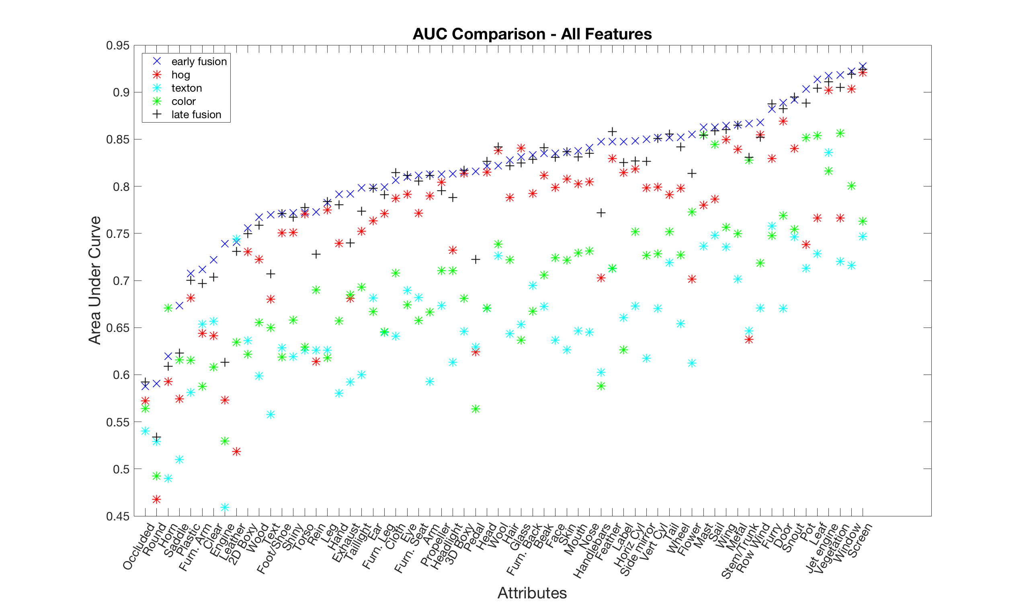

Slide 14
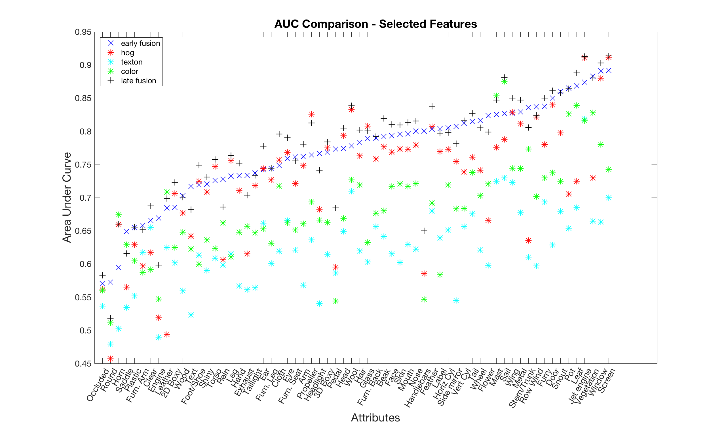

Slide 15
Results – (Mean) AUC
Descriptors\Feature Set | All Features | Selected Features
Early Fusion | 0.8134 | 0.7690
HOG | 0.7549 | 0.7252
LAB | 0.6965 | 0.6827
Texton | 0.6525 | 0.6205
Late Fusion | 0.7987 | 0.7736

Slide 16
Results – (Mean) Number of Features
Descriptors\Feature Set | All Features | Selected Features
Early Fusion | 9688 | ~458 (~4.7%)
HOG | 7000 | ~354 (~5.1%)
LAB | 896 | ~365 (~41%)
Texton | 1792 | ~223 (~12.4)
Late Fusion | x | x

Slide 17
Conclusion
For all features:
early fusion performs best.
For selected features:
Late fusion performs best.
Hog is the best descriptor in both cases.

Slide 18
Technical Details
Liblinear → A library written for Matlab (along with Python, Java, Ruby interfaces) for linear classification specifically of large amounts of data.

Slide 19
References
[1] E.G.Danaci, N. Ikizler, Low-level features for visual attribute recognition: An evaluation.
[2] A. Farhadi, I. Endres, D. Hoiem, D.A. Forsyth, Describing objects by their attributes http://vision.cs.uiuc.edu/attributes/

