Slide 1

ALPhA Fall 2020 Week 1 Presentation
Braden Kronheim
August 28, 2020

Slide 2
Summary
General introduction to the LHC and CMS
Finally obtained an environment in which to use CMSSW
Started developing jet extraction code with John

Slide 3
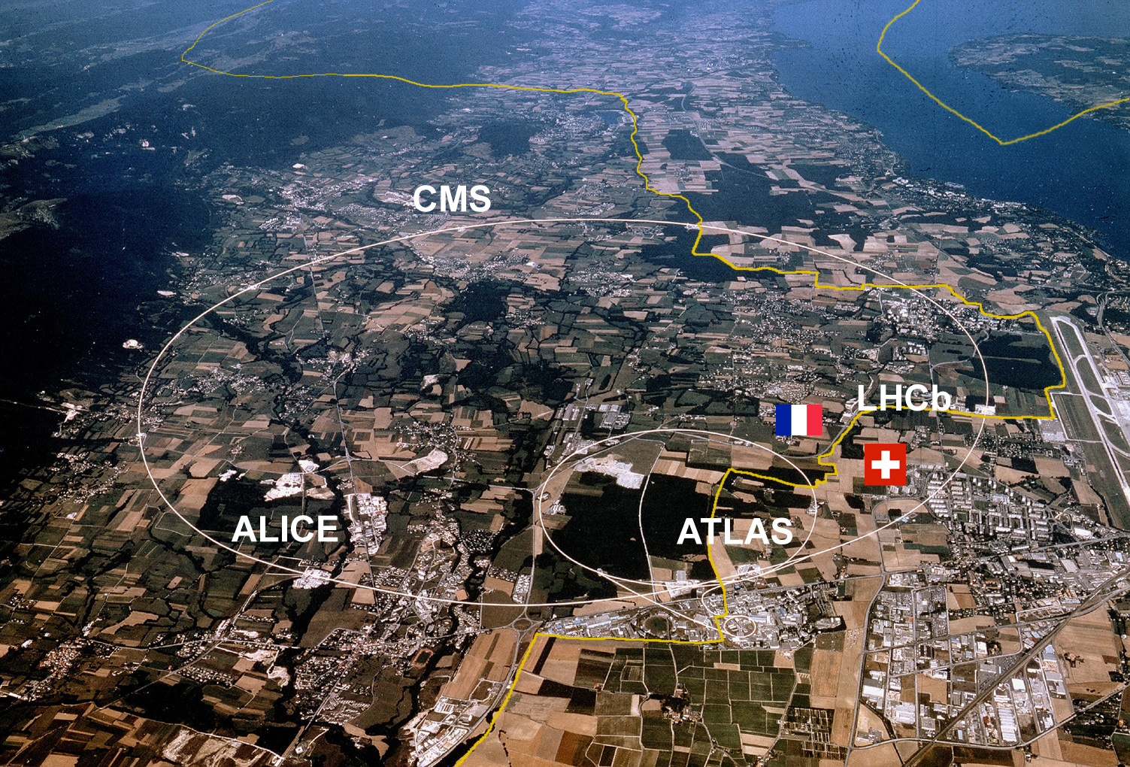
Large Hadron Collider

Slide 4
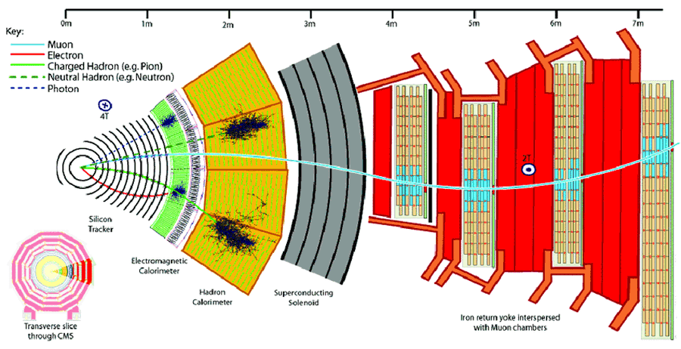
Compact Muon Solenoid (CMS)

Slide 5
CMSSW environment
Getting this setup is a huge pain
This environment can only be run on the Scientific Linux Cern operating system
The recommended virtual machine, VirtualBox does not cooperate with Windows at all, and the VM images simply won’t start in Ubuntu
Using Docker is possible, but seemingly only on Windows and Mac, as it wants to install the images in the Linux root partition which doesn’t have enough memory to accommodate it

Slide 6
Jet Extraction code
This will be used by both John and I
Needs to extract and store the following information from Root files
Particles each gen level jet decays into and how these are reconstructed by the detector
Gen level partons post showering, but pre hadronization
4 vectors of jet clustered partons post showering
Jet flavor
Reco jets
I believe I can easily obtain:
Particles gen levels jets decay into
Reconstructed jets and their constituents
Jet flavor
Things I’m not as sure about:
Partons post showering
Linking gen particles to how they are reconstructed

Slide 7
Goals for next week
Come to Davidson (tomorrow)
Figure out how to find the rest of the data John and I need from the files
Work with John to figure out a file format we can both use to store the data
Extract the data we need from a bunch of root files

