Slide 1

ALPhA Fall 2020 Week 11
Braden Kronheim
October 30, 2020

Slide 2
Summary
Got algorithm working in ROOT, finally
Made some plots to look at algorithm’s performance

Slide 3
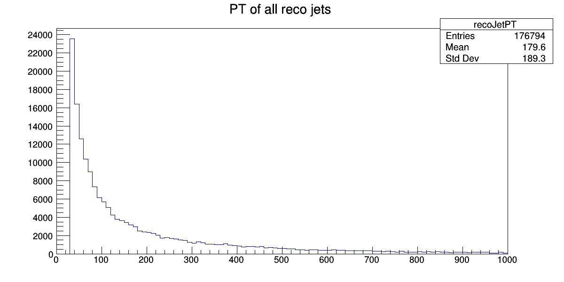
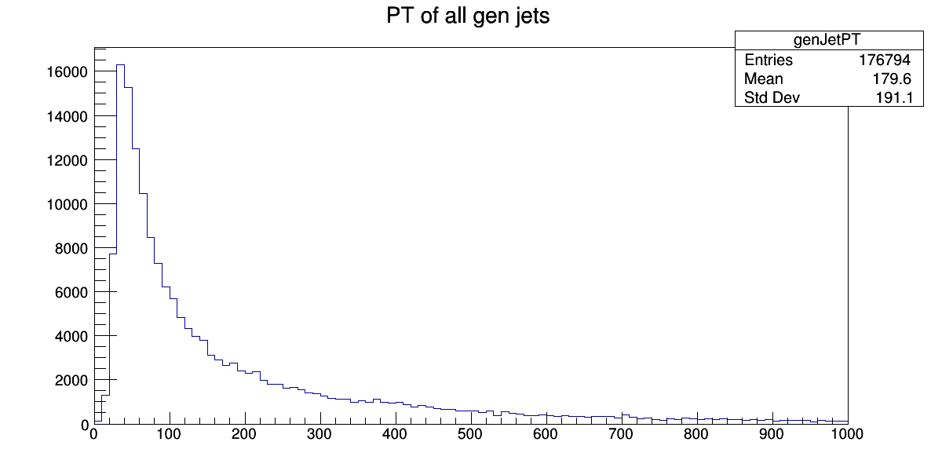
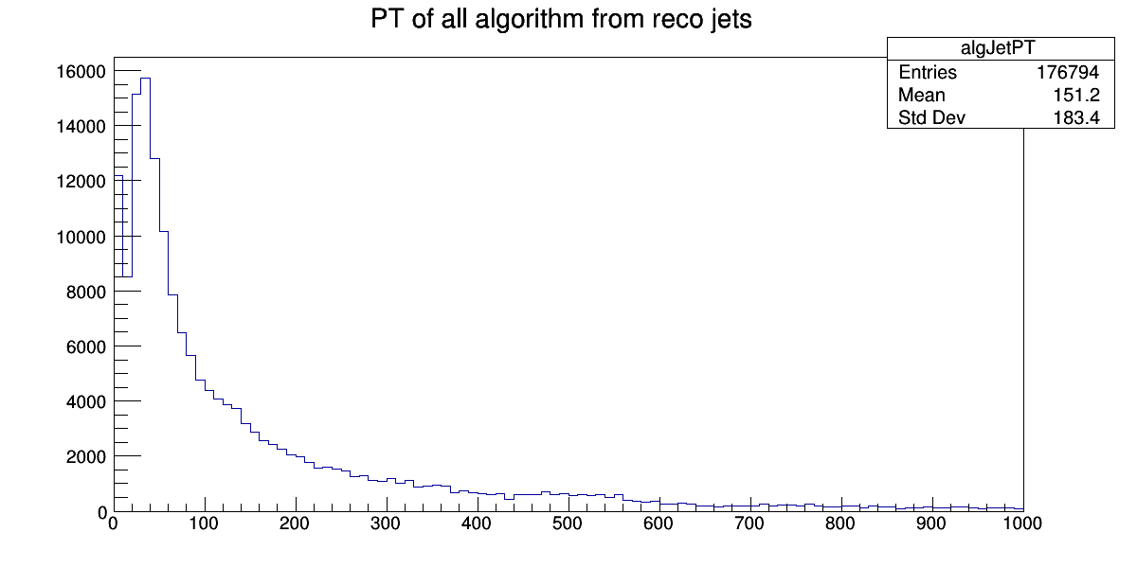
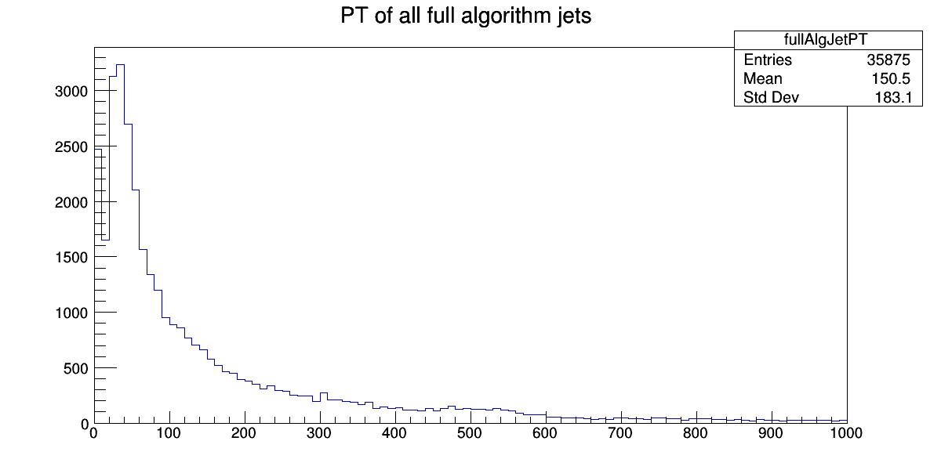
Full mass range
rawRecoP4

Slide 4
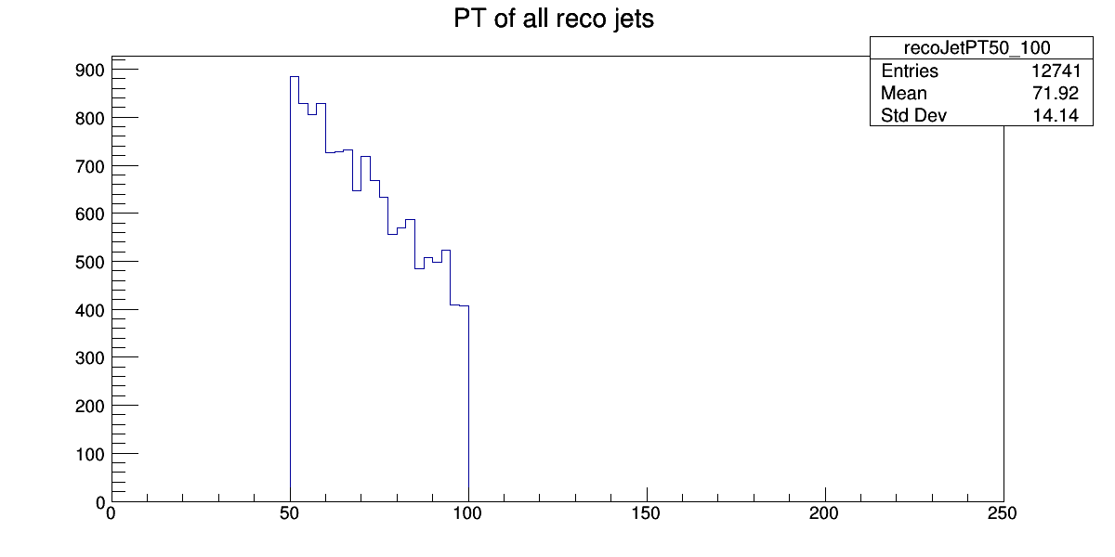
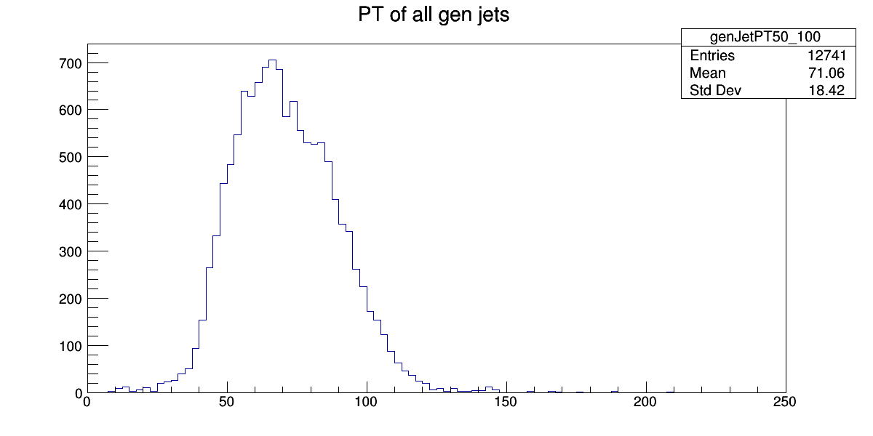
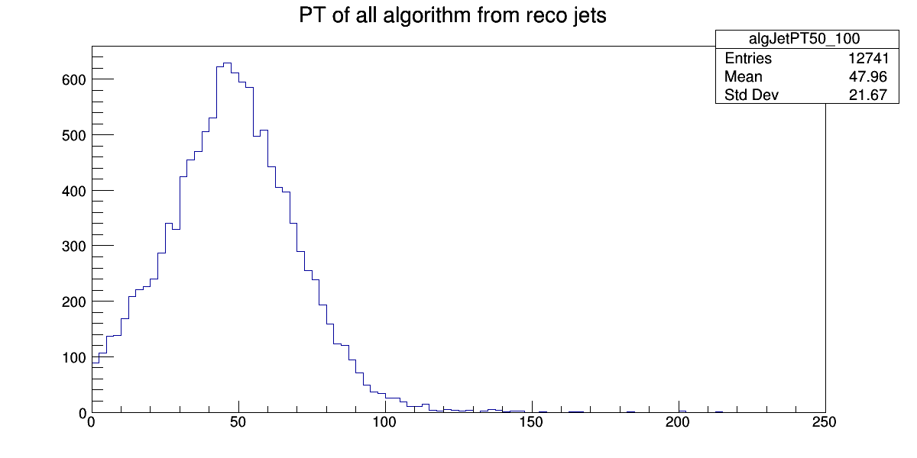
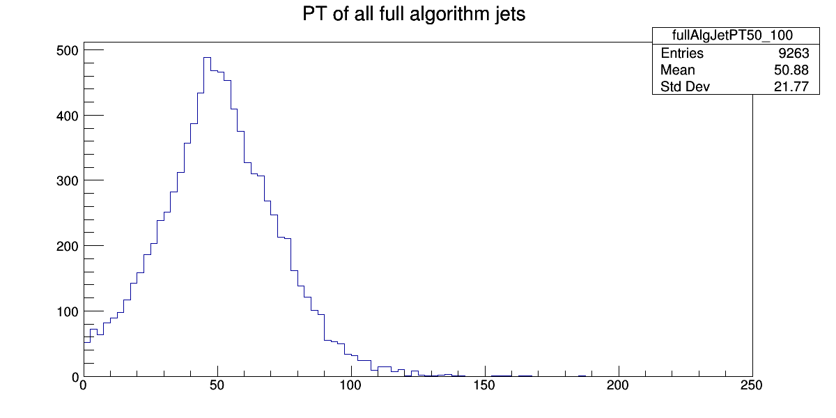
Reco PT 50-100

Slide 5
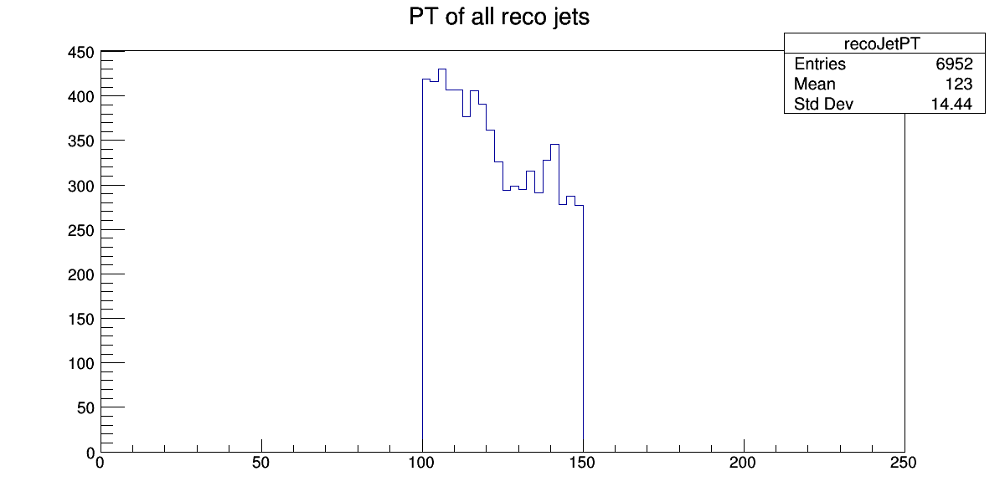
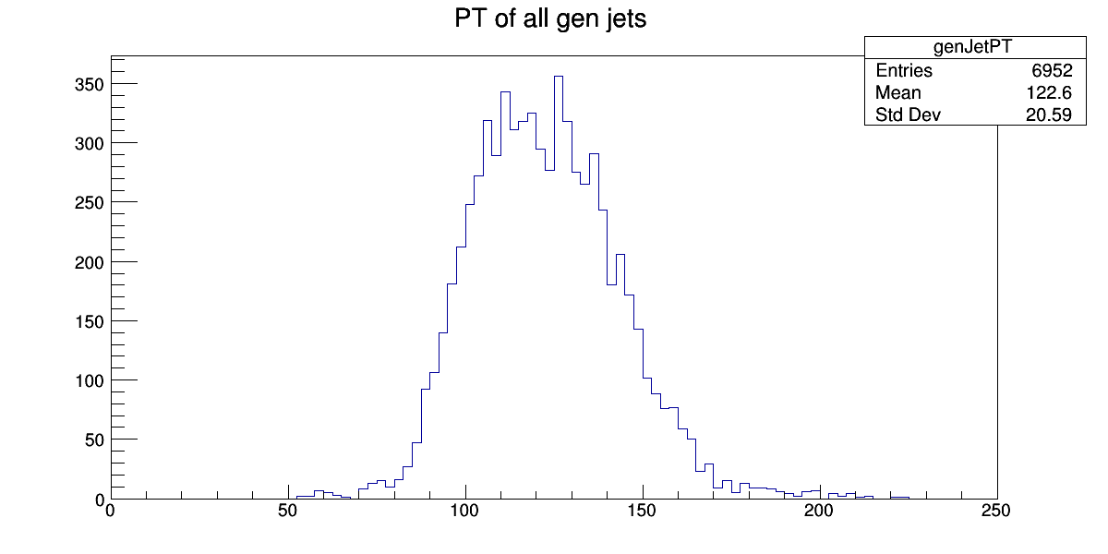
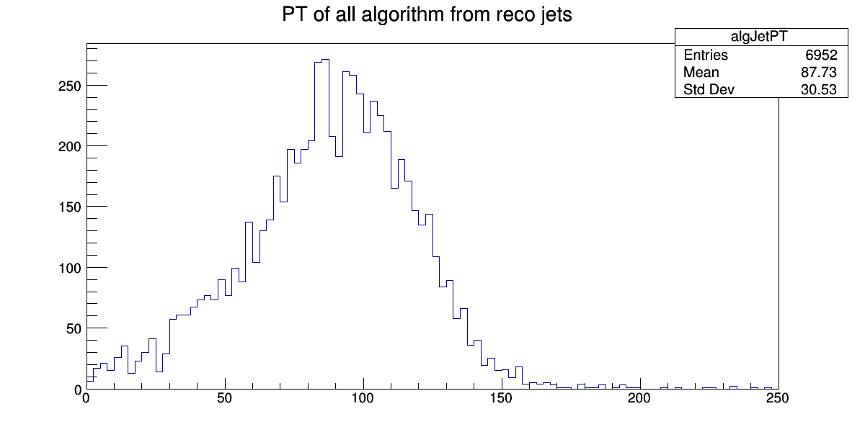
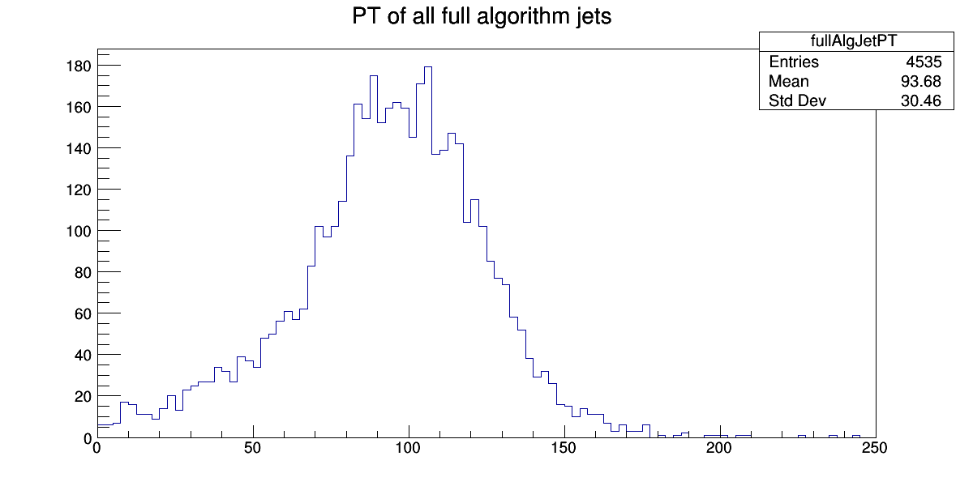
Reco PT 100-150

Slide 6
Goals for next week
Make more graphs of network’s performance
Possibly train a third network
Contemplate a new training set
Contemplate alternative training methods

