Slide 1

ALPhA Fall 2020 Week 12
Braden Kronheim
November 6, 2020

Slide 2
Summary
Installed an slc6 docker image using John’s instructions, was able to perform some test simulations
Spent a while trying to understand how simulations work with CMS and where (if) the information linking gen and reco particles exists
Made some updated gen/reco/algorithm plots

Slide 3
General Simulation information
GEN step: Pythia to determine the particle content
SIM step: GEANT4 to determine what the detector does
DIGI step: Simulation of the detector electronics to determine the digitai response
L1: Simulation of the l1 trigger
DIGI2RAW: digi signals into RAW format
HLT: high level trigger
RAW2DIGI: conversion from RAW format to digi
RECO: event reconstruction based on digi signals

Slide 4
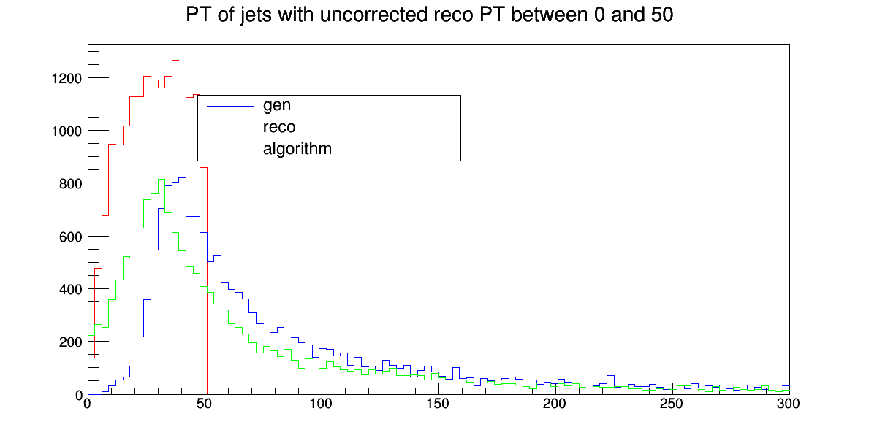
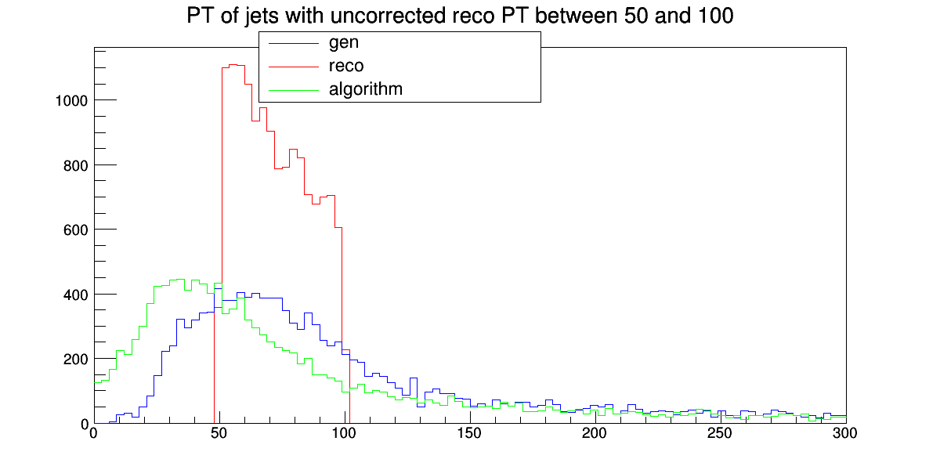
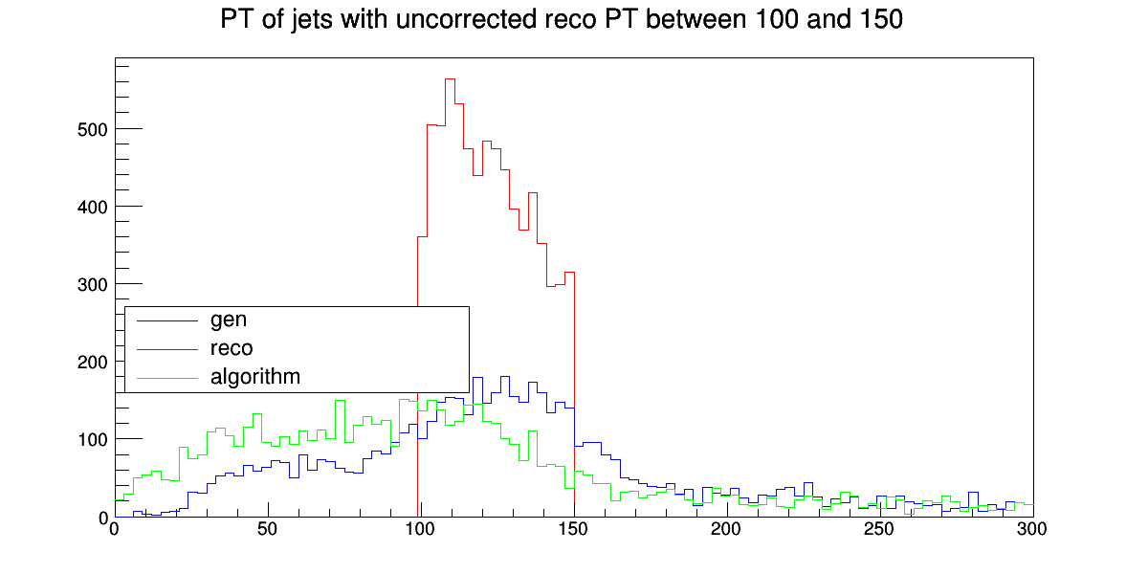
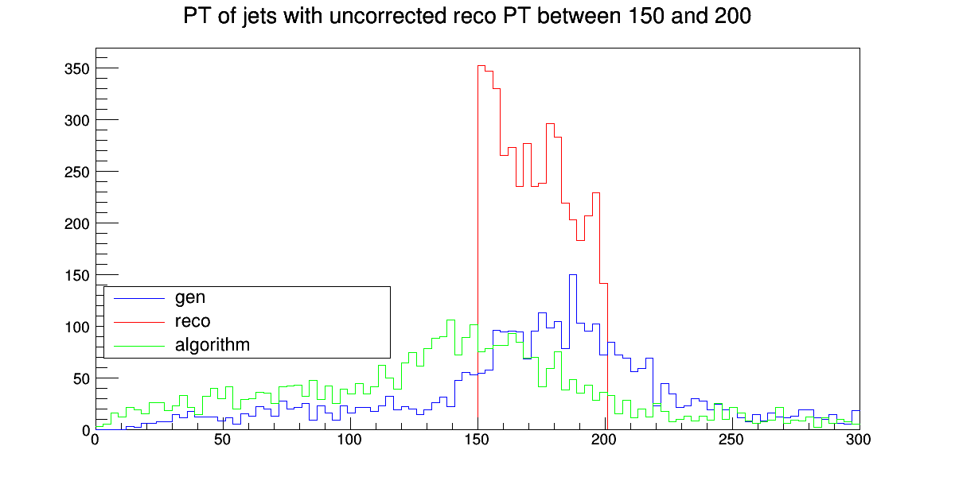
Plots

Slide 5
Goals for next week
Make more graphs of network’s performance
Possibly train a third network
Contemplate a new training set
Contemplate alternative training methods

