Slide 1

ALPhA Fall 2020 Week 13
Braden Kronheim
November 13, 2020

Slide 2
Summary
Emailed one of Dr. Prosper’s contacts about the gen-reco matching
He’s only ever used dR matching
Trained neural network to go from algorithm output to gen and to go from corrected reco to gen
Five hidden layers with 50 perceptrons each
Val loss from algorithm to gen: 0.0376
Val loss from reco to gen: 0.0134

Slide 3
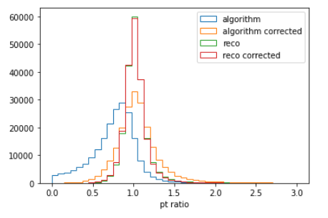
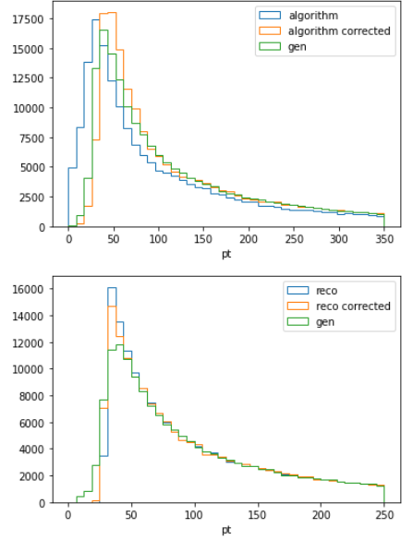
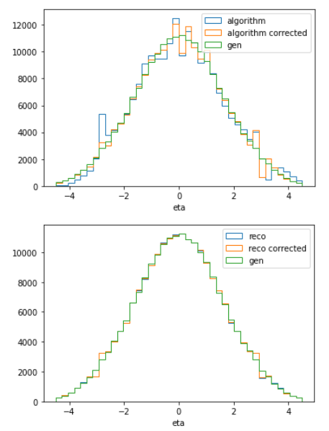
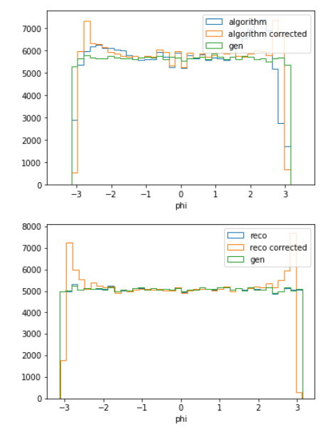
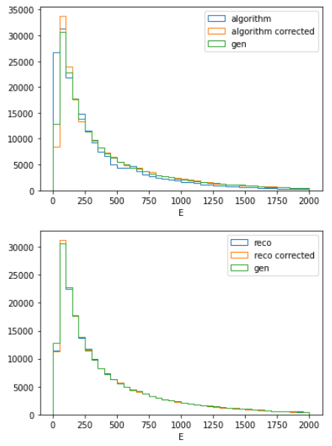
All test examples

Slide 4
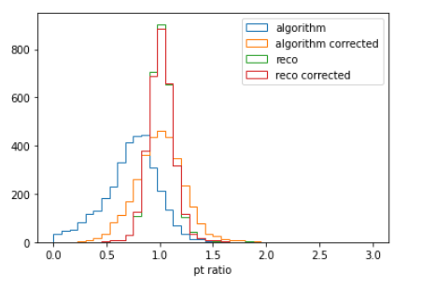
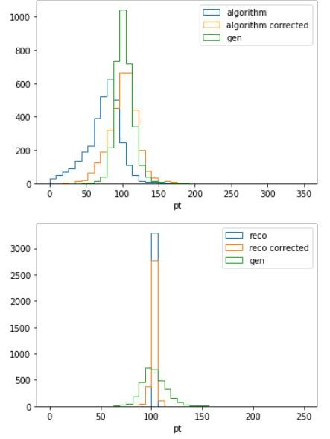
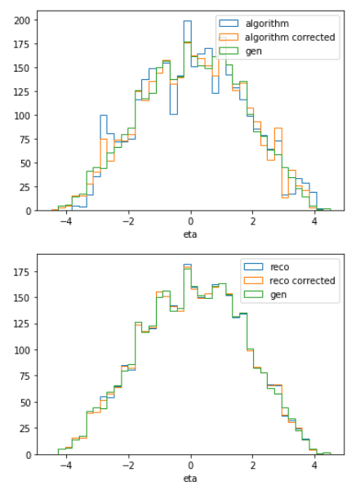
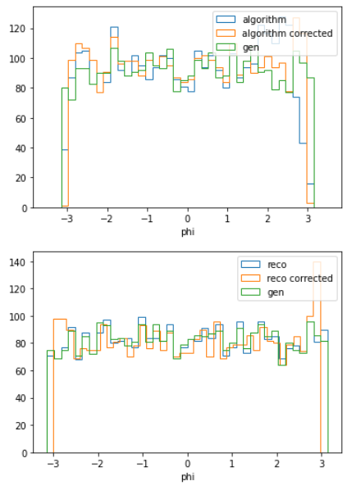
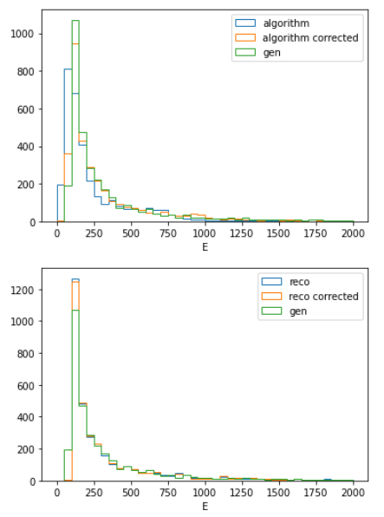
Raw reco pt: 100 GeV < pt < 105 GeV

Slide 5
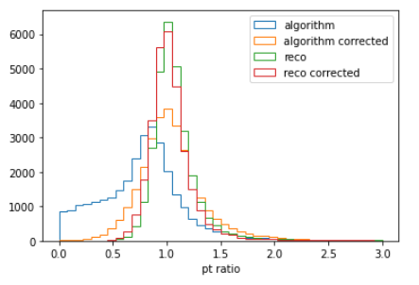
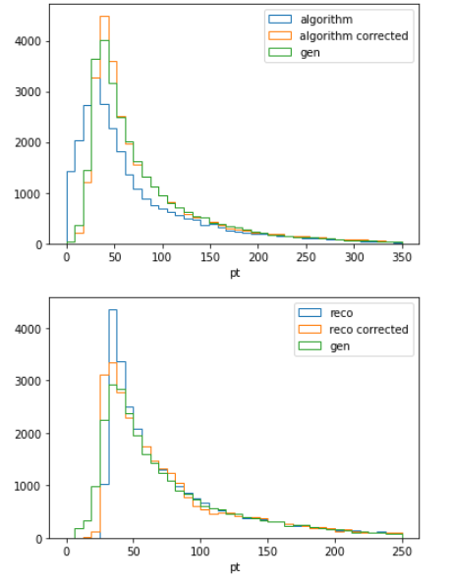
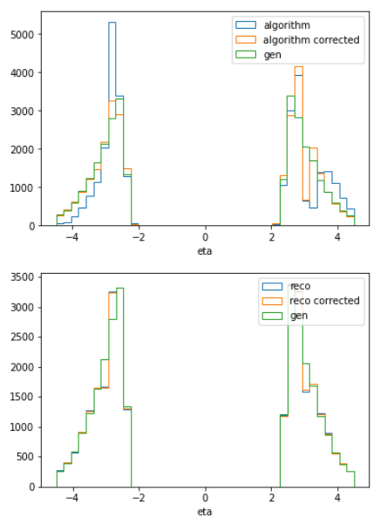
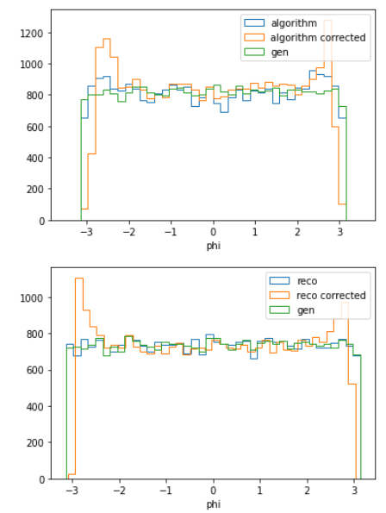
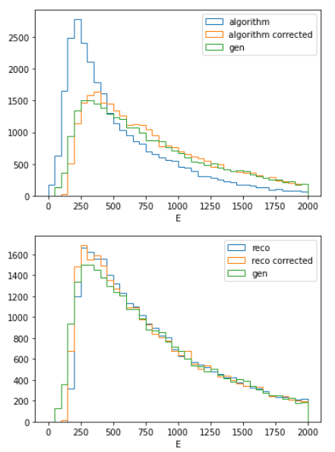
Raw reco eta: |eta| > 2.4

Slide 6
Goals for next week
Make presentation for next week
Train from raw reco to gen
Reconsider my matching methods
Think about the next architecture to use

