Slide 1

ALPhA Fall 2020 Week 13
Braden Kronheim
November 10, 2020

Slide 2
Summary
Spent a while trying to understand how simulations work with CMS and where (if) the information linking gen and reco particles exists
Found something linking tracks between sim and reco, but this will only work for charged particles
The simulation I ran gave errors saying that these links “are not valid”
At this point, I don’t think it is a good use of time for me to try and find this on my own, so I’m going to move to working on correction neural networks, and revisit this after the end of the semester
Made some updated gen/reco/algorithm plots

Slide 3
General Simulation information
GEN step: Pythia to determine the particle content
SIM step: GEANT4 to determine what the detector does
DIGI step: Simulation of the detector electronics to determine the digitai response
L1: Simulation of the l1 trigger
DIGI2RAW: digi signals into RAW format
HLT: high level trigger
RAW2DIGI: conversion from RAW format to digi
RECO: event reconstruction based on digi signals

Slide 4
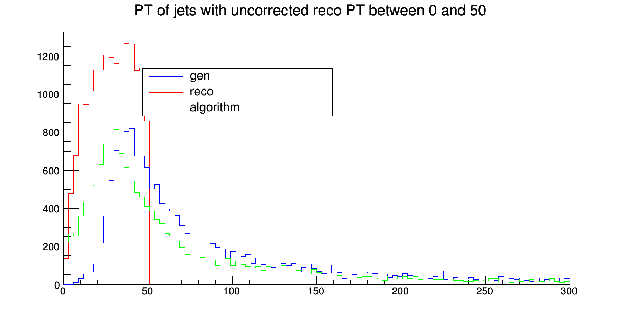
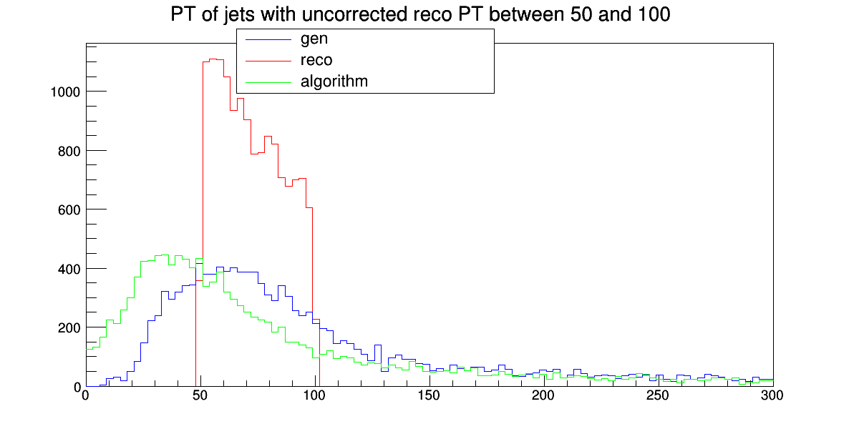
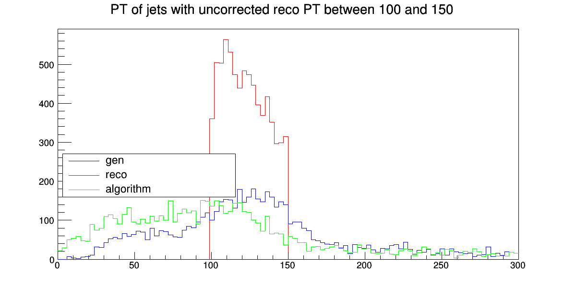
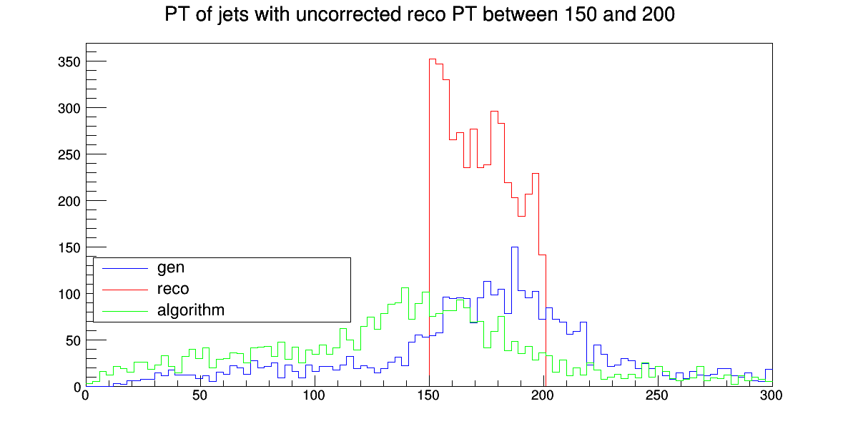
Plots

