Slide 1

ALPhA Fall 2020 Week 14
Braden Kronheim
November 20, 2020

Slide 2
Summary
Corrected issue with phi in loss function
Retrained networks using fixed loss function
Made performance plot of full algorithm with final correction network

Slide 3
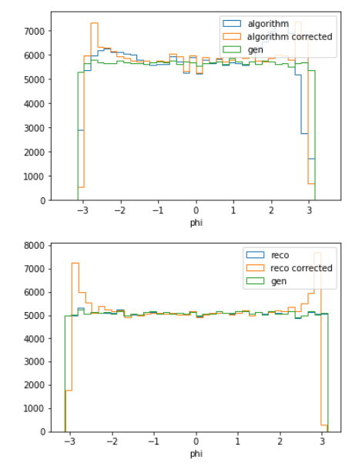
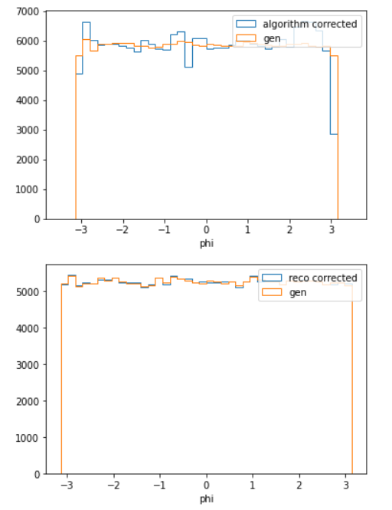
Fixing phi

Slide 4
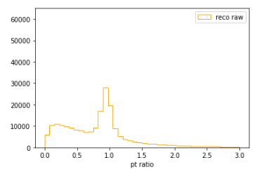
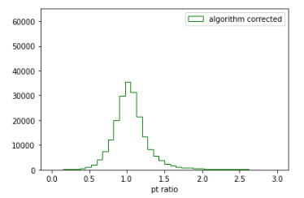
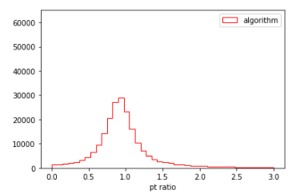
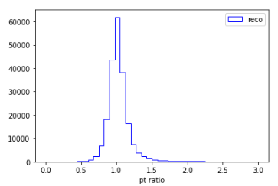
pT behavior

Slide 5
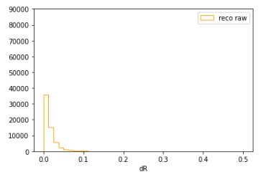
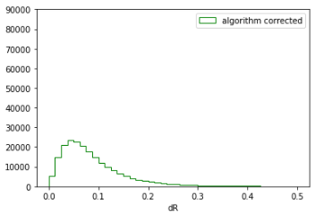
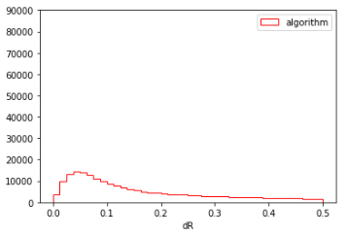
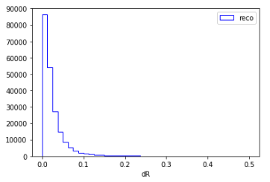
dR behavior

Slide 6
Idea for new architecture
Train four networks using the quantile loss function to predict either the each component of the new four vectors, or correction factors to summing them
Instead of predicting the raw components, perform PCA first to decrease correlation

Slide 7
Goals for next week
Go home
Revise particle matching to have no duplicates
Train some quantile nets based on PCA

