Slide 1

ALPhA Fall 2020 Week 16
Braden Kronheim
December 4, 2020

Slide 2
Summary
Went home
Adjusted matching to prevent the same reco particle from matching multiple gen particles
Trained regression/classification networks using new matches and ran algorithm
Examined normalization of data for networks and adjusted it
Trained regression/classification networks using new matches and ran algorithm
Started training a quantile network to make pT predictions

Slide 3
Matching
Match gen particles in order of pT, and once a reco particle is matched don’t consider it again
Previously, 97.72% of particle matched, now 96.80% match.

Slide 4
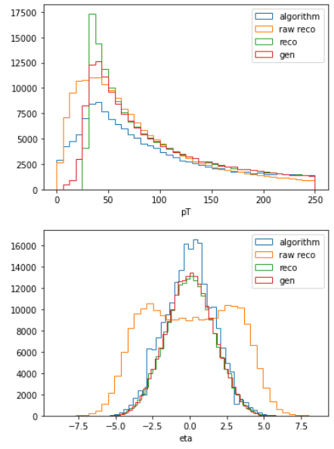
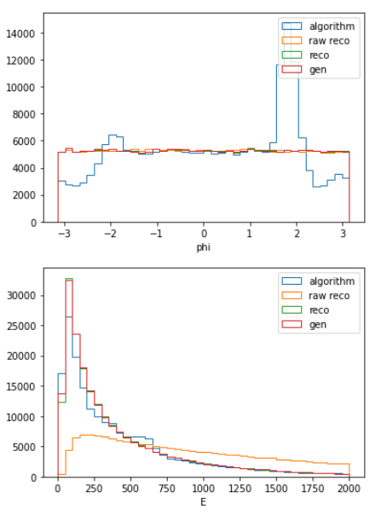
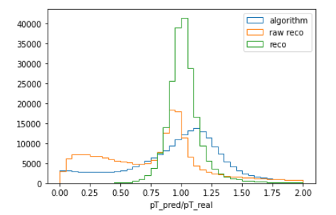
Algorithm with networks trained on new data

Slide 5
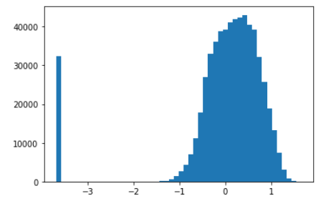
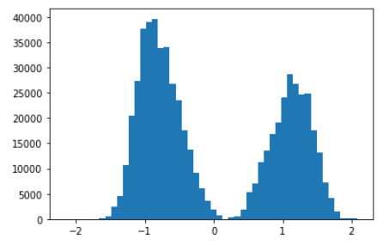
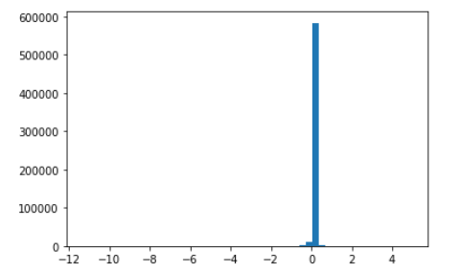
Normalization
Added log scaling to pT and E to remove tails
Instead of starting at 0 pT and E, start at 0.1
Took cube root of vertex locations
pT
Vertex_Z
Vertex_Y

Slide 6
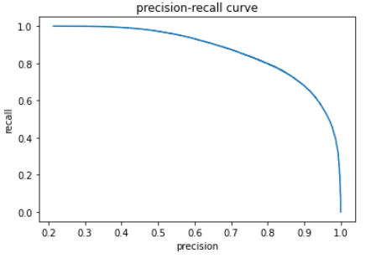
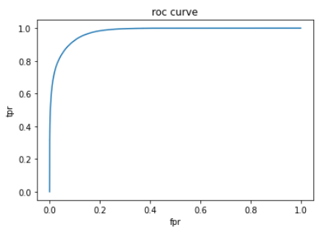
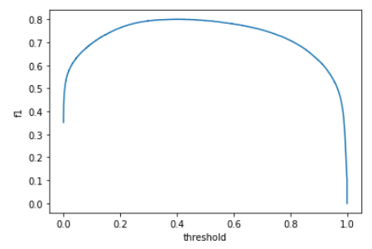
Performance of new classifier
Optimal f1 of 0.800 with a cutoff of 0.411
Best f1of previous was 0.802 at 0.376
Area under ROC curve is 0.976
Previously was 0.975

Slide 7
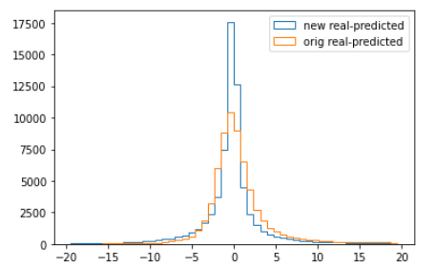
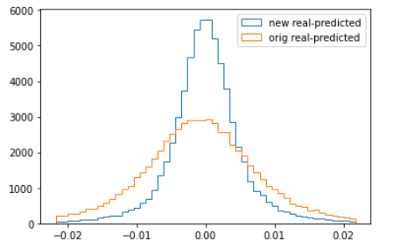
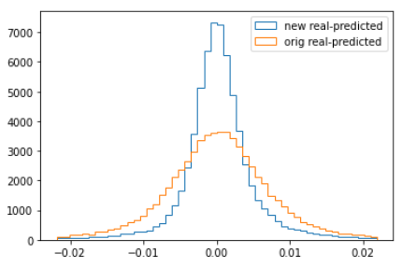
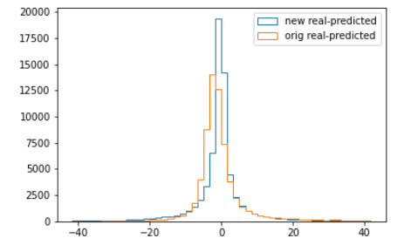
Performance of regression network
pT error
eta error
phi error
E error

Slide 8
Goals for next week
Finish training quantile networks and look into their performance

