Slide 1

ALPhA
Fall 2020 Week 3 Presentation
Braden Kronheim
September 4, 2020

Slide 2
Summary
Decided to start from some pre-written Jet N Tuple extraction code written for the CMS Opendata
Found out there isn’t an easy way to got from gen particles in the jet to reco particles in the jet
  Must find a way to match them myself

Slide 3
Matching gen/reco jet particles
From my REU over the summer, we matched gen and reco jets if their dR was less than 0.4
  dR = (dPhi^2 + dEta^2)^(0.5), where phi and eta are angular measures of a particle location in the detector
  This won’t work here, because all particles in the jet generally have a dR of 0.4 or less to the center of the jet
  Could use a stricter dR cut, a cut on the percent error on transverse momentum, or a combination of both
  Could also just match gen particles to the reco particle with the lowest dR + dPT

Slide 4
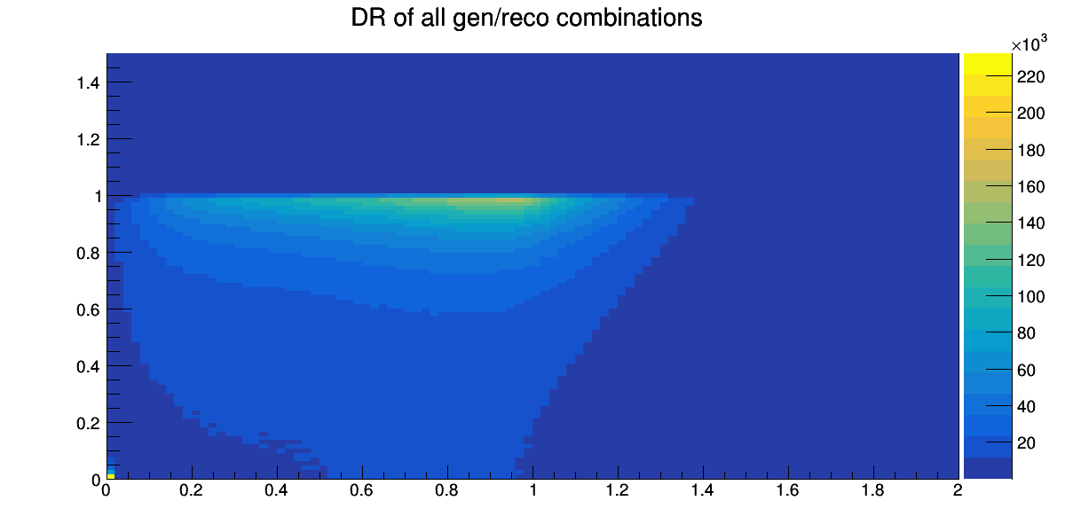
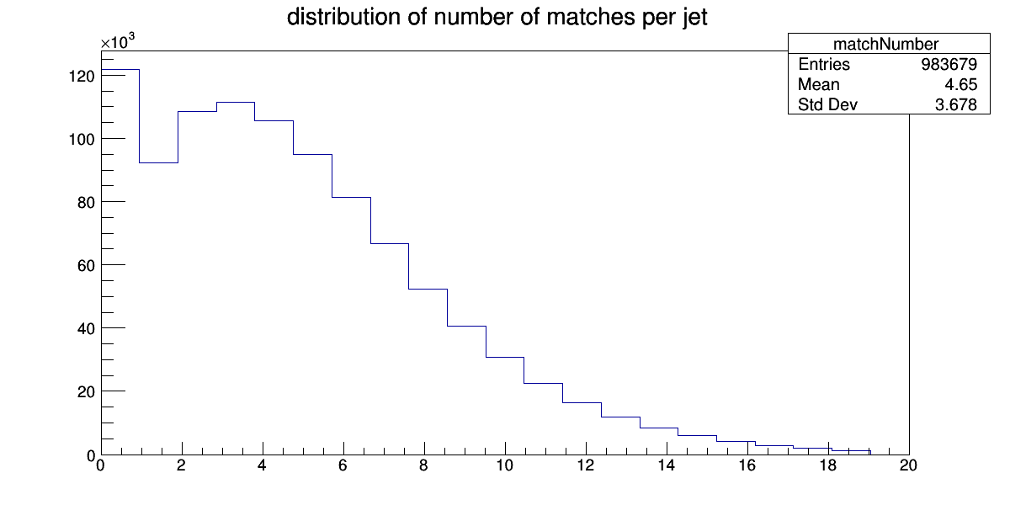
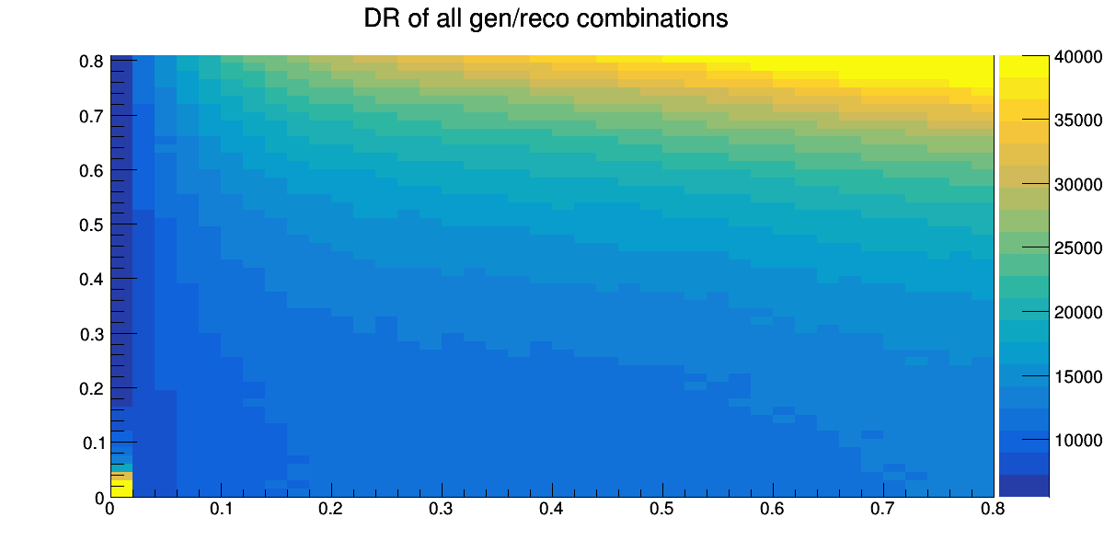
Using a generous dR, dPT cut
dPT
dR
About 88% of gen particles are matched here
dPT
dR

Slide 5
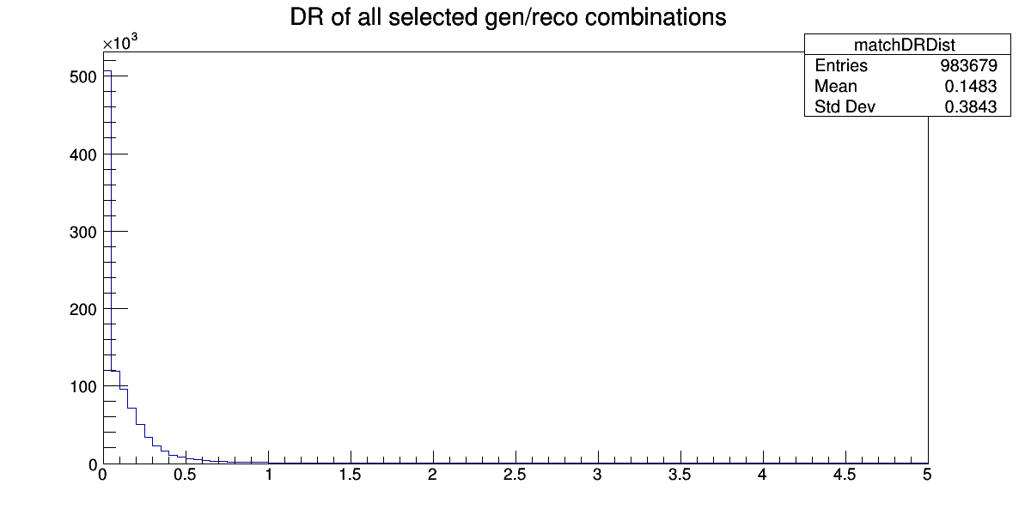
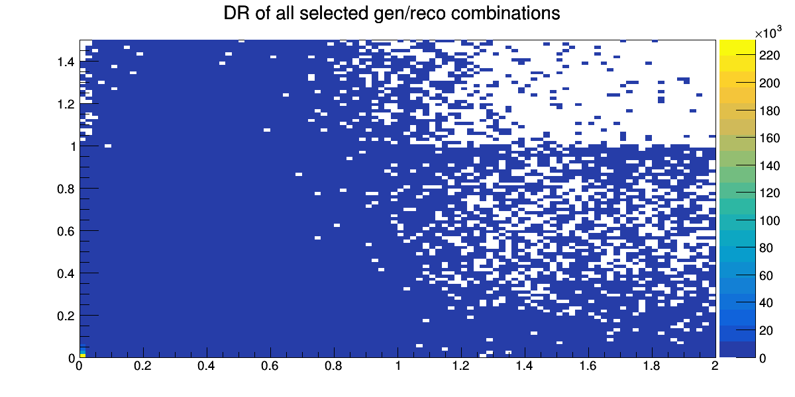
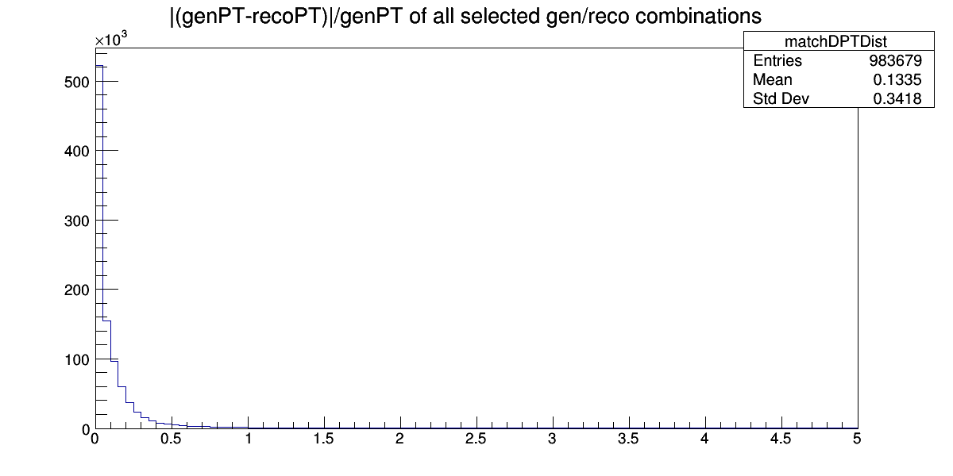
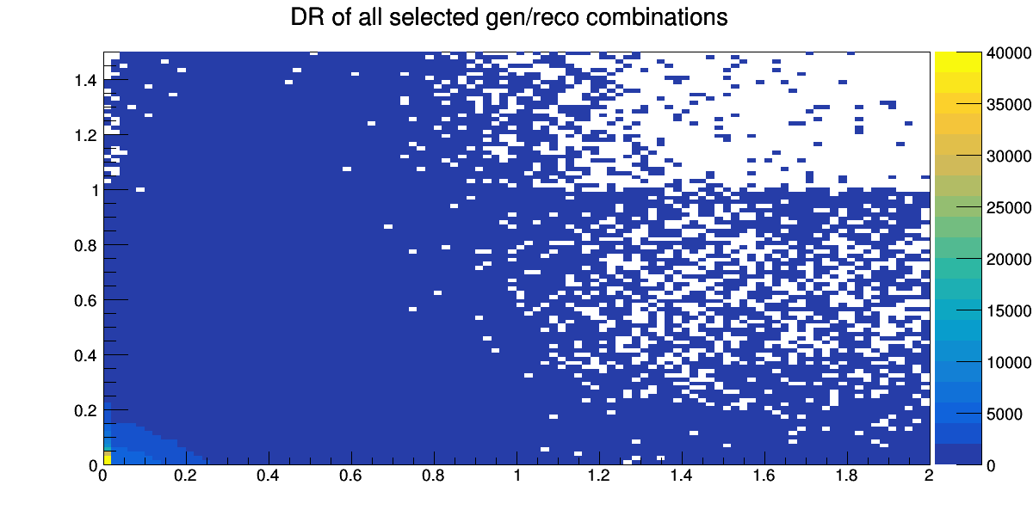
Matching to the best dR + dPT
dPT
dR
dPT
dR

Slide 6
Goals for next week
Determine exact matching method
Generate training set
Start building the network for training

