Slide 1

ALPhA Fall 2020 Week 4 Presentation
Braden Kronheim
September 11, 2020

Slide 2
Summary
Locked down my matching method
Generated a training set
Trained some basic models

Slide 3
Matching gen/reco jet particles
Method:
Let dR = (dEta^2 + dPhi^2)^0.5, dPT = recoPT/genPT
For each gen particle, find the reco particle for which dR + abs(1-dPT) is the smallest
Accept this as a match if the final dR is less than 0.2
97.7% match rate

Slide 4
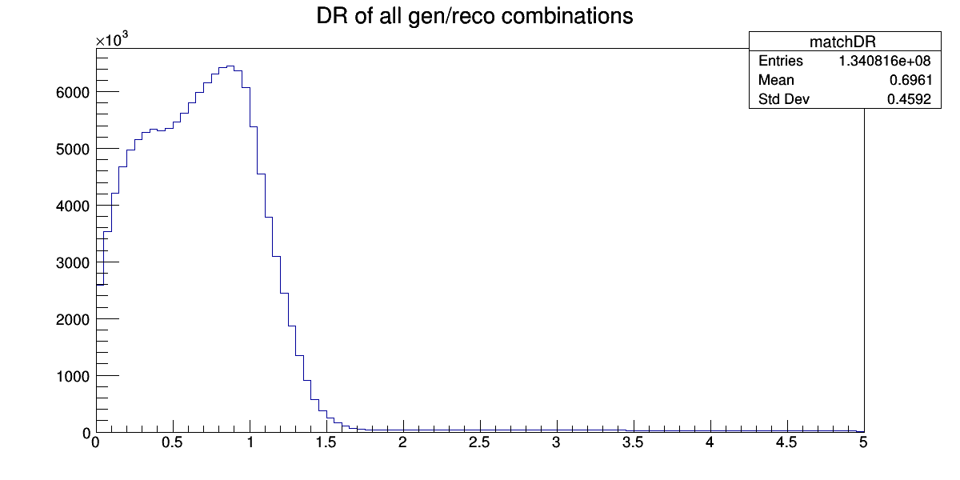
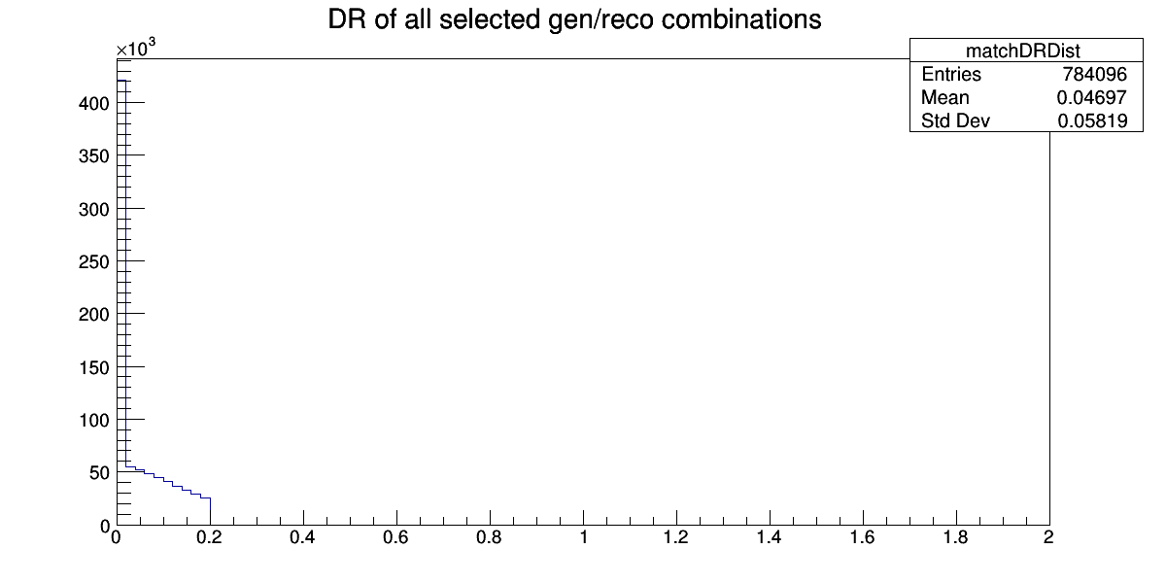
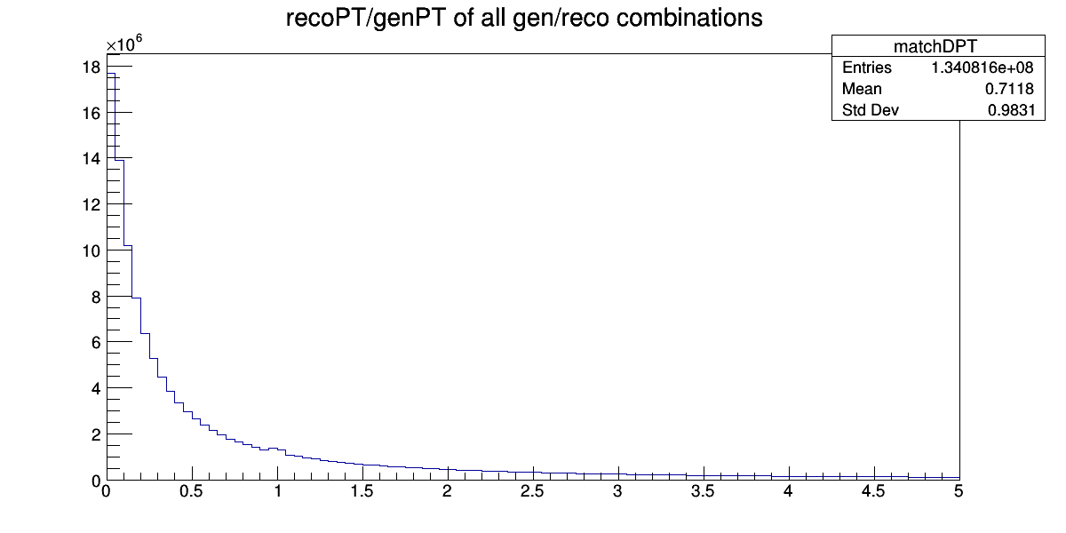
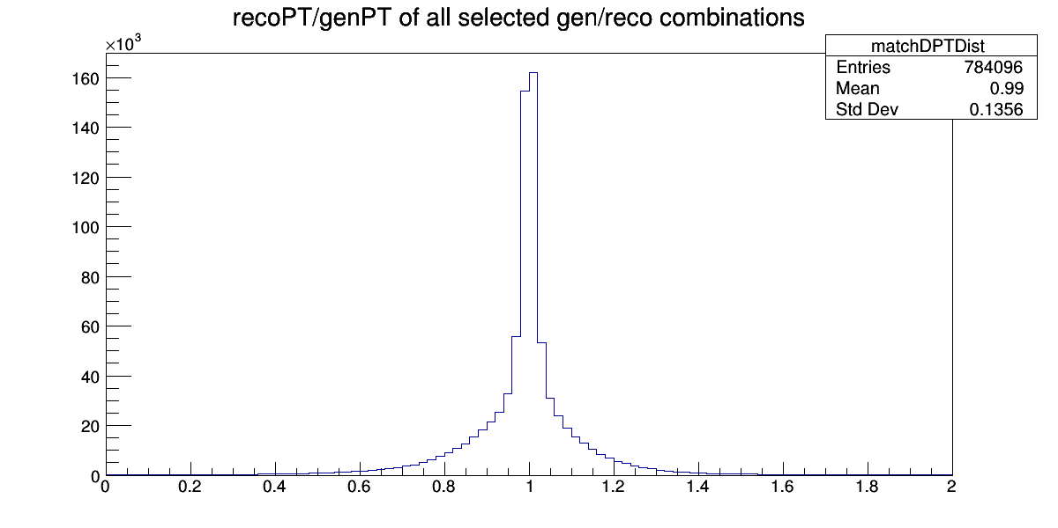
Graphs

Slide 5
Data Extracted:
Each output line consists of:
A 1 to indicate the start of a jet, a 0 to indicate otherwise
The gen particle px, py, pz, E, pdg ID
The matched reco particle px, py, pz, E, pdgID
If the reco particle is not matched to anything, the gen particle is just a list of zeros.
I reassigned the reco pdgIDs to a numbering system between -1 and 1. The dictionary is:
newPDGID = {-11.0:-1.0, -13.0:-0.8, -211:-0.6, 22.0:-0.4, 1.0:-0.2, 0.0:0.0, 2.0:0.2, 130.0:0.4, 211.0:0.6, 13.0:0.8, 11.0:1.0 };

Slide 6
Models
Given reco 4-vector and pdg ID, predict gen 4-vector, ignoring unmatched reco particles
MSE of simply predicting the reco 4-vector: 0.4178
Val MSE after training: 0.0938
Given “current jet 4-vector” and new reco particle with pdgID, predict the “new jet 4-vector”, ignoring unmatched reco particles
Val MSE: 8.10e-4
Same as previous, but after all matched reco particles, also using the unmatched with an unchanging target:
Val MSE: 5.32e-4

Slide 7
Goals for next week
Perform a training where the unmatched reco particles are interspersed
Create and run quantile-based training
Add metrics of dPT and dR to the training loops

