Slide 1

ALPhA Fall 2020 Week 5 Presentation
Braden Kronheim
September 18, 2020

Slide 2
Summary
Made a more detailed explanation of network architecutre
Added dR and dPT as evaluation metrics while training
Made a reordered dataset where particles are ordered by pT within a jet
Trained a network on this dataset and checked its performance in a realistic manner where the output of the network is recycled into its next input
Substituted my pdgID system for a one-hot encoding system

Slide 3
Reco particles
Potentially in jet
4-vector of zeros
Gen Jet
Training inputs:
Training outputs
1
High pT
particles
0
1
A
A
,
B
2
A
2
A
4-vectors of
Reco particles
,
C
A
,
3
A
+
B
3
4-vectors of
particles in gen jet
A
+
B
,
4
A
+
B
4
A
+
B
,
5
A
+
B
5
A
+
B
,
6
A
+
B
+
C
6
Low pT
particles

Slide 4
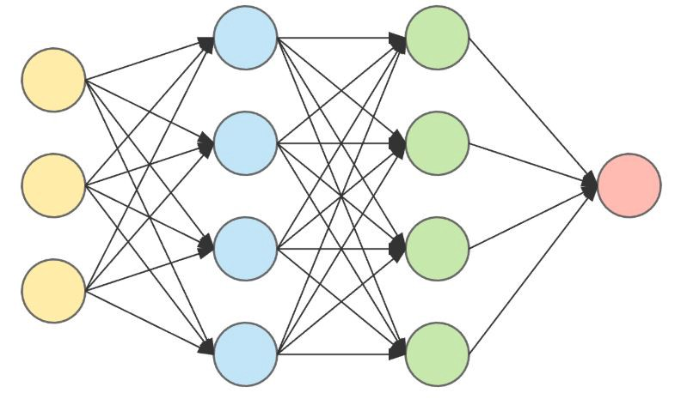
Current jet 4-vector
Updated jet
4-vector
New reco particle
4-vector
One-hot encoded
reco particle pdg id
4 inputs from current jet, 4 inputs from new particle, 11 inputs from pdg id -> 4 outputs from updated jet

Slide 5
Potential Reco particles
Real use inputs:
Real use output
1
High pT
0
,
1
A
2
A
,
2
B
B
,
3
C
3
C
,
4
D
4
D
,
5
E
5
E
,
6
F
Final jet 4-vector
6
Low pT

Slide 6
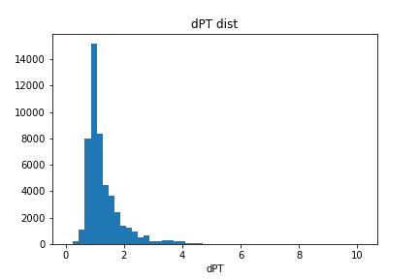
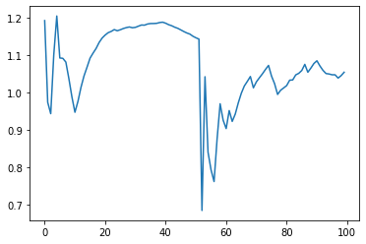
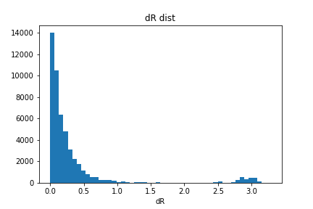
Interspersed non-jet particles
continuous val loss:
mse: 2.7543e-04 - dPT: 1.0044 - dR: 0.0186
onehot val loss:
mse: 2.6408e-04 - dPT: 1.0058 - dR: 0.0196
dPT
particle

Slide 7
Goals for next week
Determine how to do a multiple output quantile training and see how it performs

