Slide 1
Matching gen/reco jet particles
Method:
Let dR = (dEta^2 + dPhi^2)^0.5, dPT = recoPT/genPT
For each gen particle, find the reco particle for which dR + abs(1-dPT) is the smallest
Accept this as a match if the final dR is less than 0.2
97.7% match rate

Slide 2
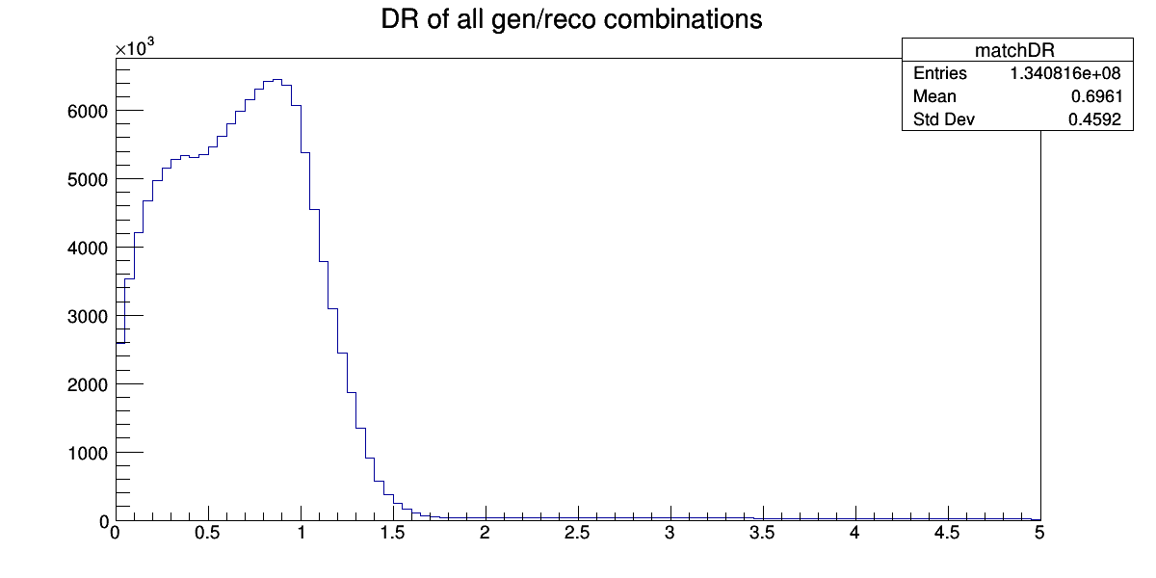
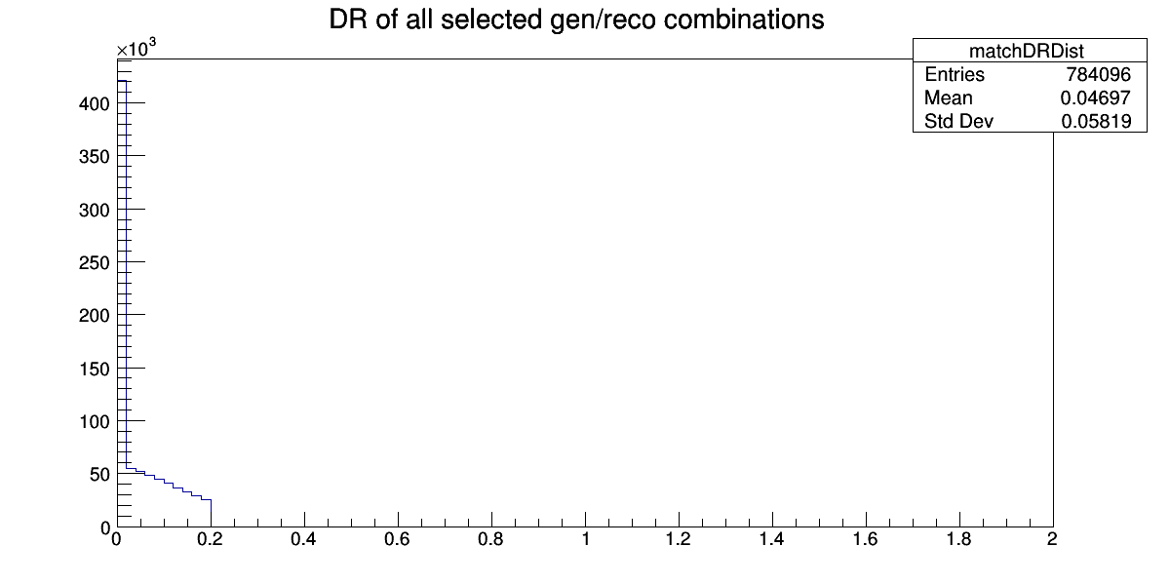
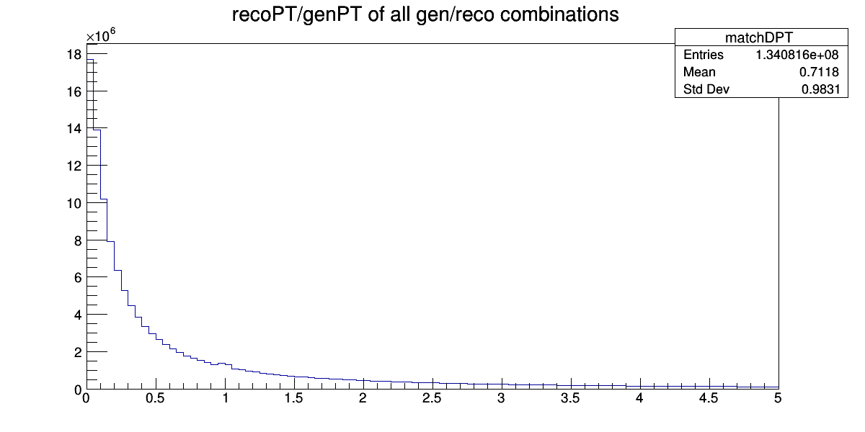
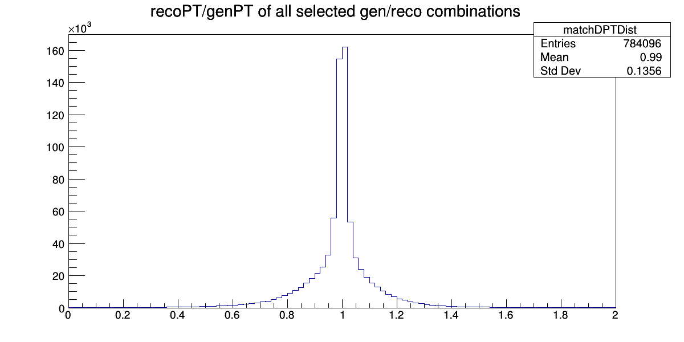
Graphs

Slide 3
Data Extracted:
Each output line consists of:
A 1 to indicate the start of a jet, a 0 to indicate otherwise
The gen particle px, py, pz, E, pdg ID
The matched reco particle px, py, pz, E, pdgID
If the reco particle is not matched to anything, the gen particle is just a list of zeros.
I reassigned the reco pdgIDs to a numbering system between -1 and 1. The dictionary is:
newPDGID = {-11.0:-1.0, -13.0:-0.8, -211:-0.6, 22.0:-0.4, 1.0:-0.2, 0.0:0.0, 2.0:0.2, 130.0:0.4, 211.0:0.6, 13.0:0.8, 11.0:1.0 };

Slide 4
Longer Models
All unmatched at end:
Loss: 6.8522e-04 - mean_absolute_error: 0.0078 - mean_squared_error: 6.8522e-04 - dPT: 1.0015 - dR: 0.0141
Pt ordered:
loss: 1.7223e-05 - mean_absolute_error: 0.0011 - mean_squared_error: 1.7223e-05 - dPT: 1.0000 - dR: 0.0061
First particle must always have a matched gen particle
Only the case 39% of the time
This messes up the sizes of jets

