Slide 1

ALPhA Fall 2020 Week 6 Presentation
Braden Kronheim
September 25, 2020

Slide 2
Summary
Considered possible issues with a single prediction model
Likely a bimodal true distribution
Single predictions can accumulate error over time
Wavenet, which is somewhat similar, uses a distribution-based approach
Considered possible distribution-based models
BNNs
Using a quantile-based loss function
Worked on training a classifier instead of the model I’ve been using which is a combination of a classifier and regression

Slide 3
Inherent issue with a single prediction
Particle added
Particle not added
Phi
Average
Eta

Slide 4
Distribution solutions
Using the quantile-based system does not transfer well to 4-d as quantiles are inherently 1-d
Could simply have 4 1-d distributions, though we wouldn’t know how they are correlated
BNN is cleanest approach
If sampling from the 4-d posterior distribution we wouldn’t have to worry about connecting 1-d distribtuions
Very time consuming to train

Slide 5
Classifier
Before going back into BNNs I looked at whether a model could be trained to classify particles as part of the jet or not
Input would be the same as the previous model, but output would just be a 1 or a 0
If the network can’t learn this it certainly can’t learn the whole problem
Dataset is unbalanced, about 5 times as many particles not in jet as in jet
This calls for weighting the particles in the jet 5 times heavier than the particles not in the jet

Slide 6
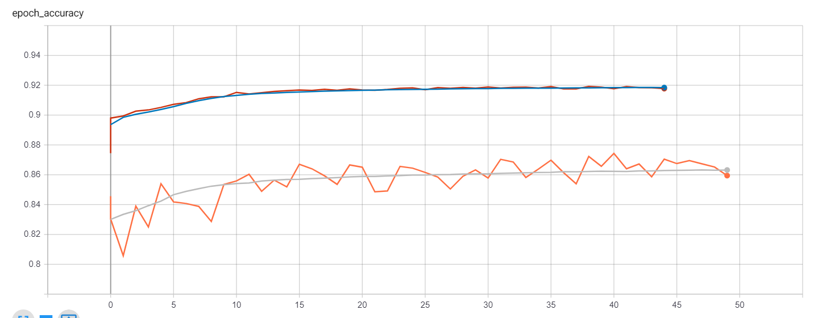
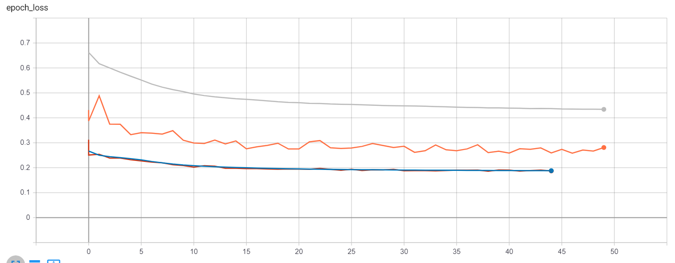
Results

Slide 7
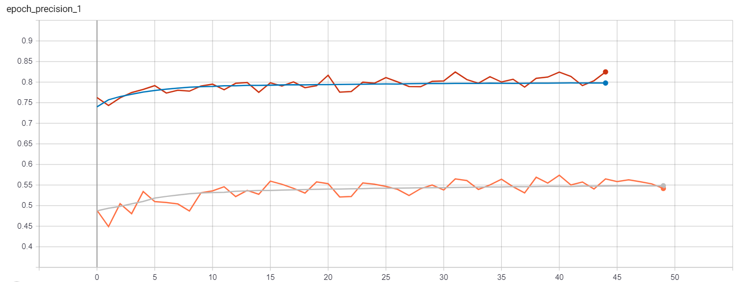
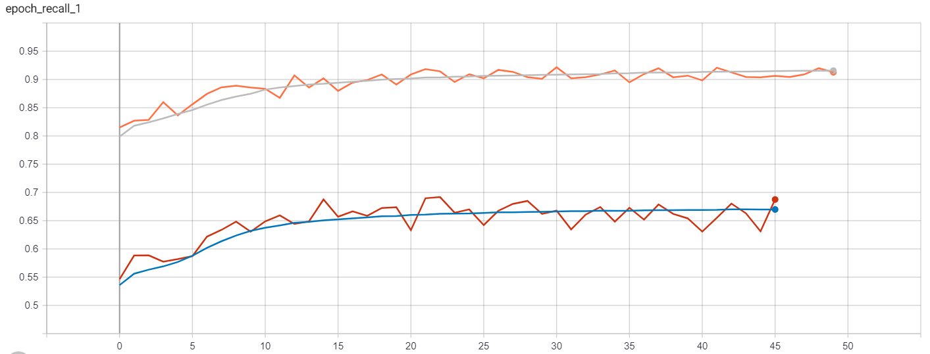
Results (continued)

Slide 8
Goals for next week
Find more information to give classifier
Track vertices perhaps
Try BNNs, maybe?

