Slide 1

ALPhA Fall 2020 Week 6
Braden Kronheim
September 18, 2020

Slide 2
Reco particles
Potentially in jet
Gen Jet
1
High pT
particles
A
B
2
4-vectors of
Reco particles
C
3
4-vectors of
particles in gen jet
4
5
6
Low pT
particles

Slide 3
Reco particles
Potentially in jet
4-vector of zeros
Gen Jet
Training inputs:
Training outputs
A
1
0
,
1
A
B
2
A
2
A
,
C
A
,
3
A
+
B
3
A
+
B
,
4
A
+
B
4
A
+
B
,
5
A
+
B
5
A
+
B
,
6
A
+
B
+
C
6

Slide 4
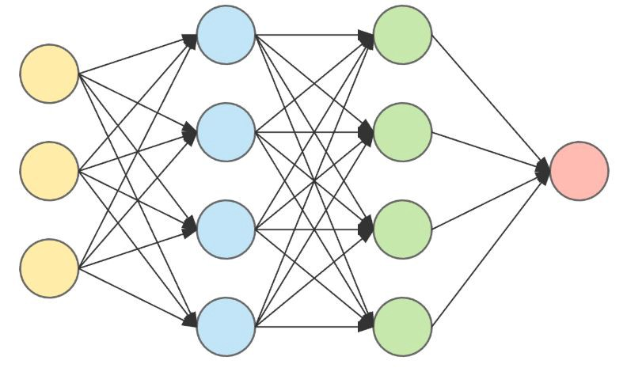
Current jet 4-vector
Updated jet
4-vector
New reco particle
4-vector
One-hot encoded
reco particle pdg id
4 inputs from current jet, 4 inputs from new particle, 11 inputs from pdg id -> 4 outputs from updated jet

Slide 5
Potential Reco particles
Real use inputs:
Real use output
1
High pT
0
,
1
a
2
a
,
2
b
b
,
3
c
3
c
,
4
d
4
d
,
5
e
5
e
,
6
f
Final jet 4-vector
6
Low pT

Slide 6
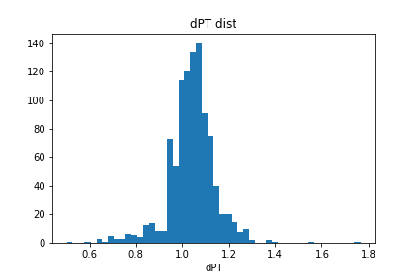
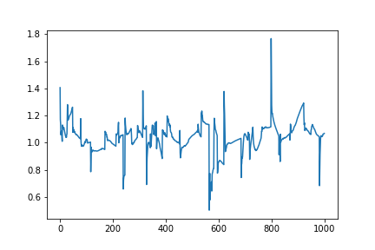
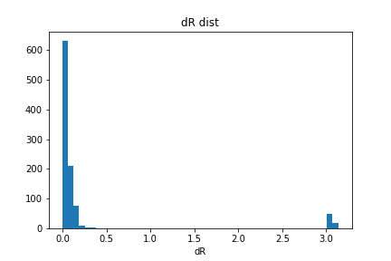
Interspersed non-jet particles
onehot val loss:
loss: 8.0194e-04 - dPT: 1.0023 - dR: 0.0189
dPT
particle

Slide 7
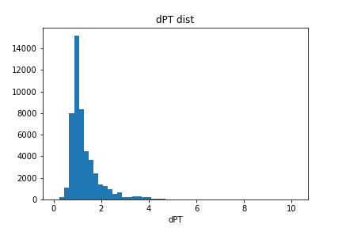
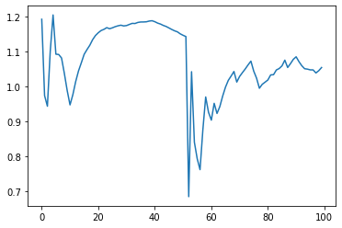
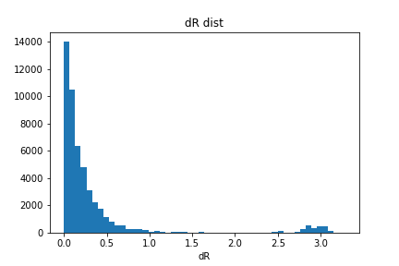
Interspersed non-jet particles
continuous val loss:
mse: 2.7543e-04 - dPT: 1.0044 - dR: 0.0186
onehot val loss:
mse: 2.6408e-04 - dPT: 1.0058 - dR: 0.0196
dPT
particle

Slide 8
Expected output for each particle
Particle added
Particle not added
Phi
Average
Eta

