Slide 1

ALPhA Fall 2020 Week 7
Braden Kronheim
October 2, 2020

Slide 2
Summary
Looked more into whether a model could be trained to classify particles as part of the jet or not
Input would be the same as the previous model, but output would just be a 1 or a 0
If the network can’t learn this it certainly can’t learn the whole problem
Dataset is unbalanced, about 5 times as many particles not in jet as in jet
This calls for weighting the particles in the jet 5 times heavier than the particles not in the jet
Started including vertex information for reco particle, as well as always including 4-vector and vertex of seed particle
Now using pt, eta, phi instead of px, py, pz
Performed a balanced training
Generated roc curves and precision-recall curves

Slide 3
Performance
Trained on balanced set, evaluated on balanced:
Recall: 0.92
Precision: 0.89
F1: 0.90
Trained on balanced set, evaluated on unbalanced set:
Recall: 0.94
Precision: 0.62
F1: 0.75
Trained on unbalanced set with weights, evaluated on unbalanced set
Recall: 0.94
Precision: 0.62
F1: 0.75
Trained on unbalanced set without weights, evaluated on unbalanced set
Recall: 0.74
Precision: 0.87
F1: 0.80

Slide 4
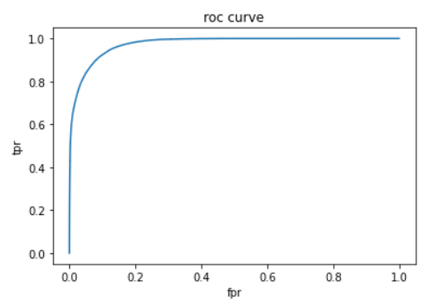
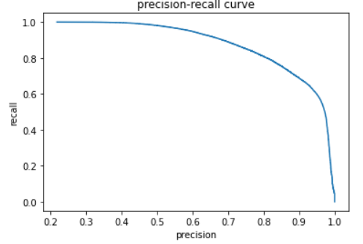
Roc curves, precision-recall curves (balanced, very similar to unbalanced with weights)

Slide 5
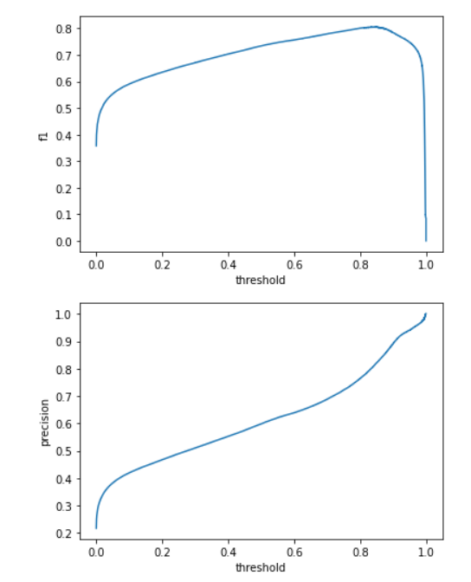
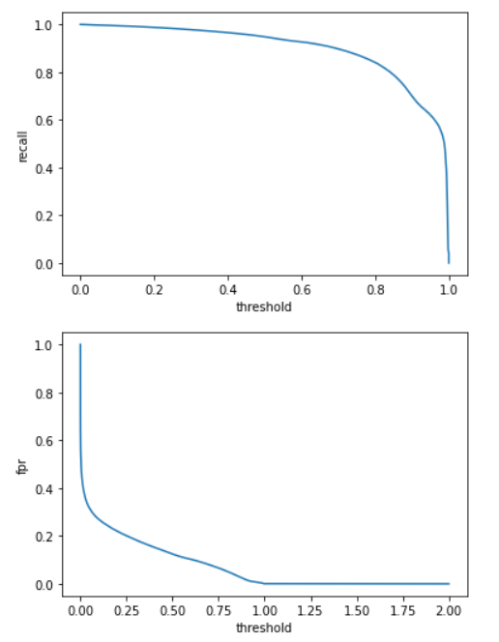
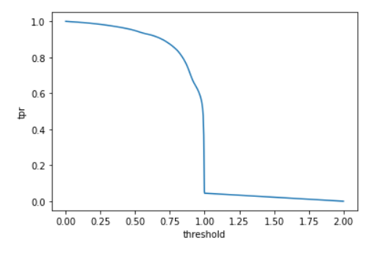
Metrics vs. threshold

Slide 6
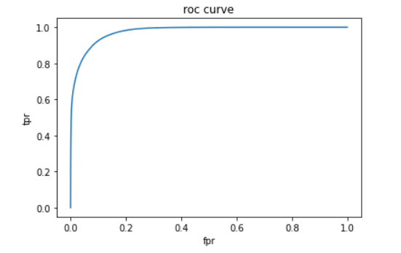
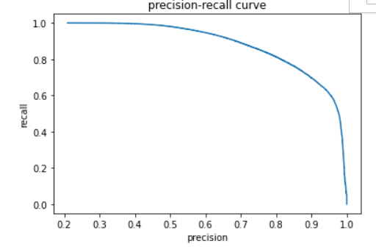
Roc curves, precision-recall curves (not balanced, no weights)

Slide 7
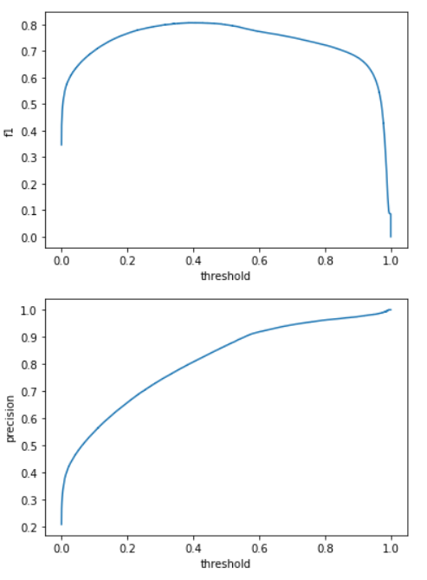
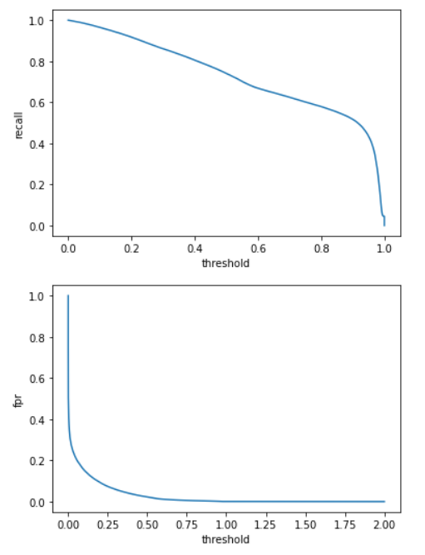
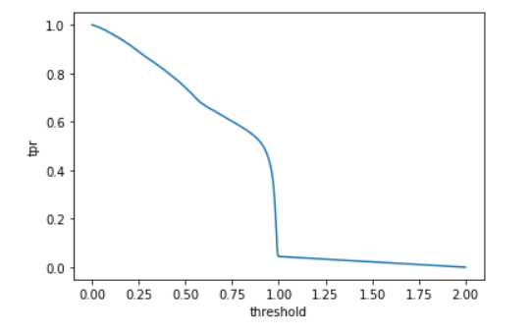
Metrics vs. threshold

Slide 8
Goals for next week
See how these work with a different model predicting four-vectors
Contemplate modifications to architecture

