Slide 1

ALPhA Fall 2020 Week 7
Braden Kronheim
September 29, 2020

Slide 2
Classifier
Before going back into BNNs I looked at whether a model could be trained to classify particles as part of the jet or not
Input would be the same as the previous model, but output would just be a 1 or a 0
If the network can’t learn this it certainly can’t learn the whole problem
Dataset is unbalanced, about 5 times as many particles not in jet as in jet
This calls for weighting the particles in the jet 5 times heavier than the particles not in the jet
Started including vertex information for reco particle, as well as always including 4-vector and vertex of seed particle
Now using pt, eta, phi instead of px, py, pz

Slide 3
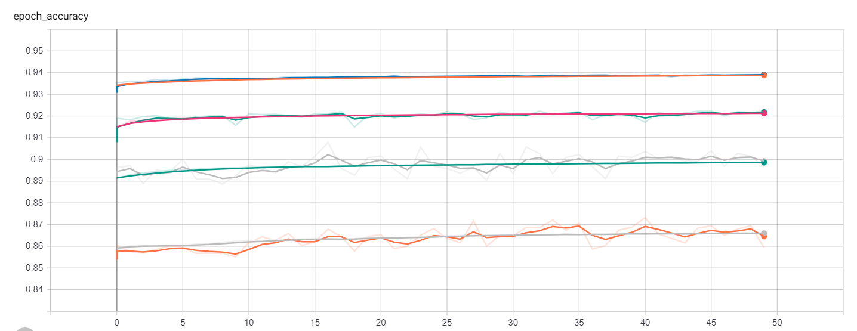
Accuracy
With seed and vertex info, no weights
No seed and vertex info, no weights
With seed and vertex info, with weights
No seed and vertex info, with weight

Slide 4
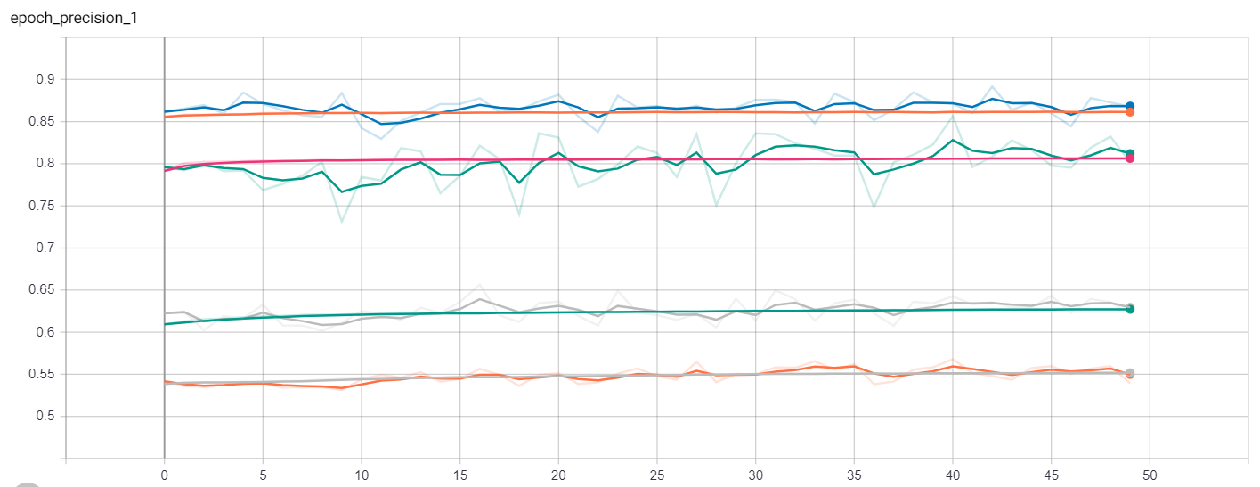
Precision
With seed and vertex info, no weights
No seed and vertex info, no weights
With seed and vertex info, with weights
No seed and vertex info, with weight

Slide 5
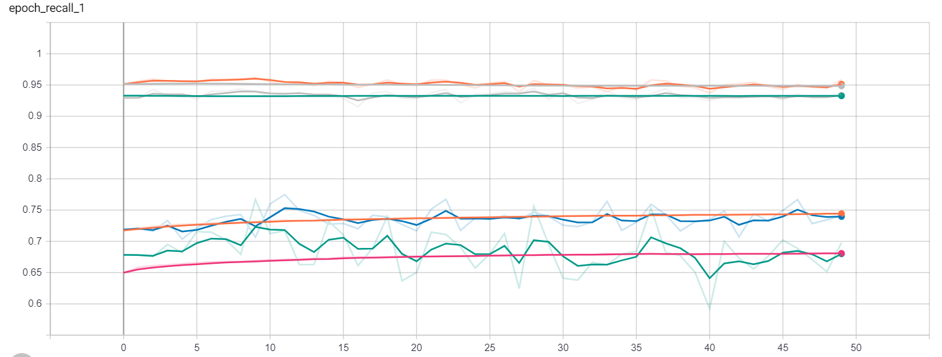
Recall
No seed and vertex info, with weight
With seed and vertex info, with weights
No seed and vertex info, no weights
With seed and vertex info, no weights

Slide 6
Jet building with no incorrect particles
dPT 1.0181631 0.1289942
dR 0.13809927 0.48437962
dPT Jet 1.0160513 0.14572494
dR Jet 0.16460945 0.47535735
dPT Base 0.97066164 0.1680445
dR Base 0.22234854 0.5502382
dPT Jet Base 0.992683 0.23499143
dR Jet Base 0.4154601 0.7370322

