Slide 1

ALPhA Fall 2020 Week 8
Braden Kronheim
October 6, 2020

Slide 2
Performance
Trained on unbalanced set with weights, evaluated on unbalanced set
Recall: 0.94
Precision: 0.62
F1: 0.75
Trained on unbalanced set without weights, evaluated on unbalanced set
Recall: 0.74
Precision: 0.87
F1: 0.80
Quantile at median:
Recall: 0.67
Precision: 0.89
F1: 0.76
Trained on balanced set, evaluated on balanced:
Recall: 0.92
Precision: 0.89
F1: 0.90
Trained on balanced set, evaluated on unbalanced set:
Recall: 0.94
Precision: 0.62
F1: 0.75
Ak4-jets:
Recall: 0.83
Precision: 0.62
F1: 0.71
Quantile at 0.7:
Recall: 0.84
Precision: 0.73
F1: 0.78

Slide 3
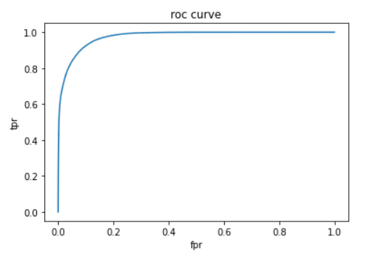
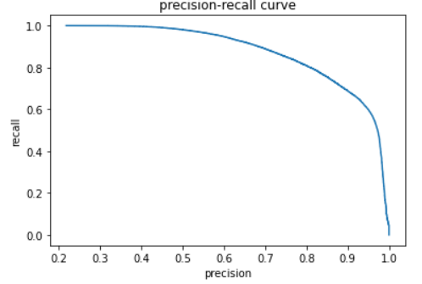
Roc curves, precision-recall curves (balanced, very similar to unbalanced with weights)

Slide 4
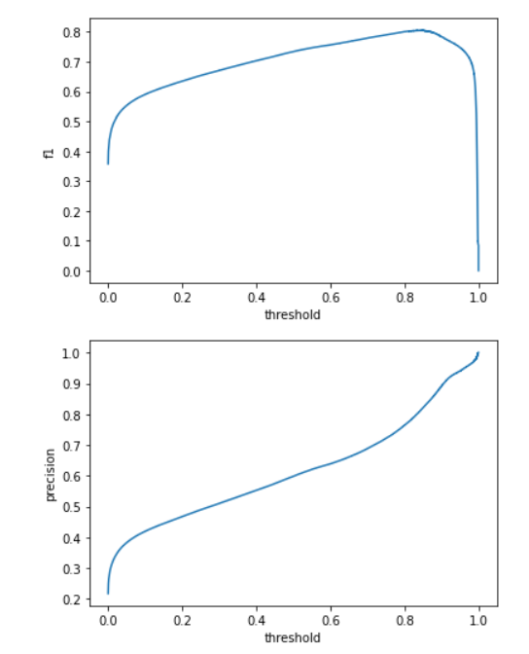
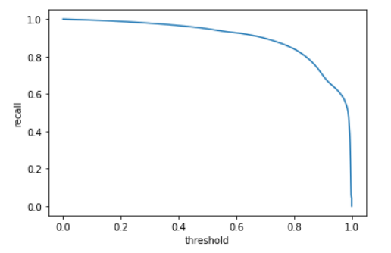
Metrics vs. threshold

Slide 5
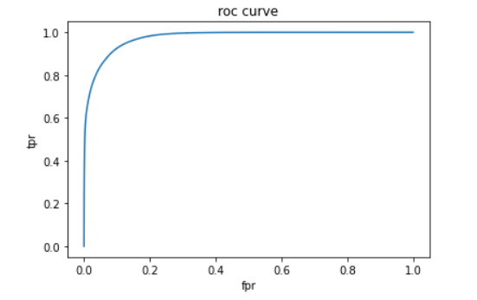
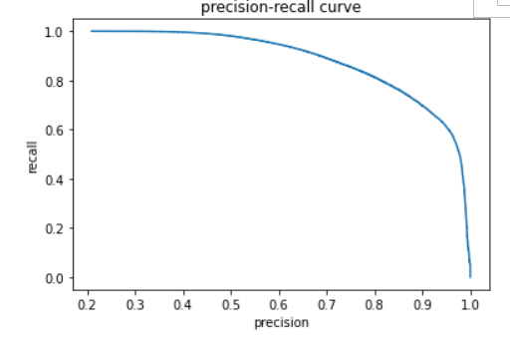
Roc curves, precision-recall curves (not balanced, no weights)

Slide 6
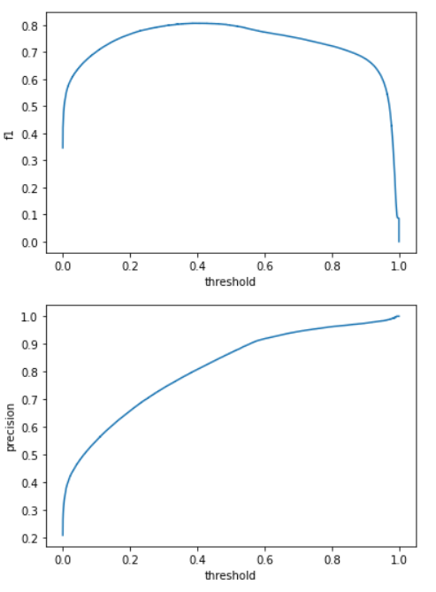
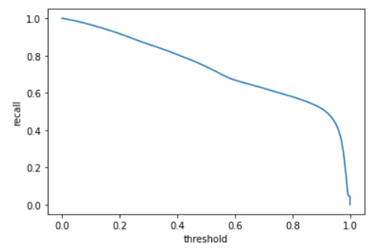
Metrics vs. threshold

Slide 7
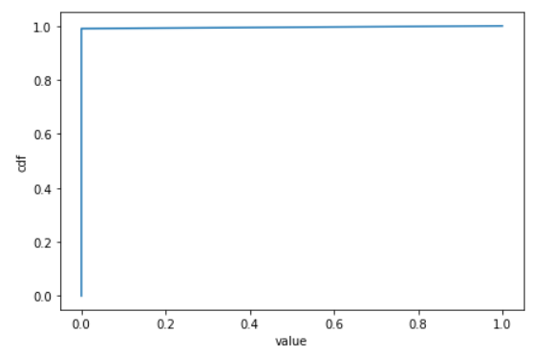
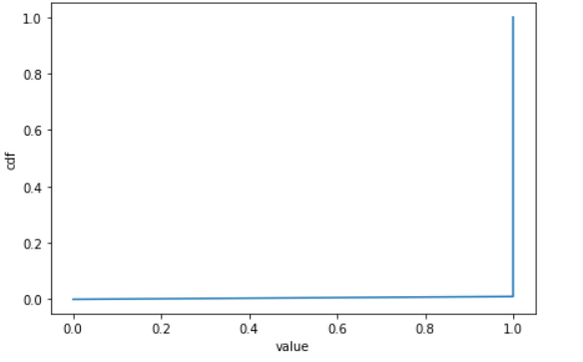
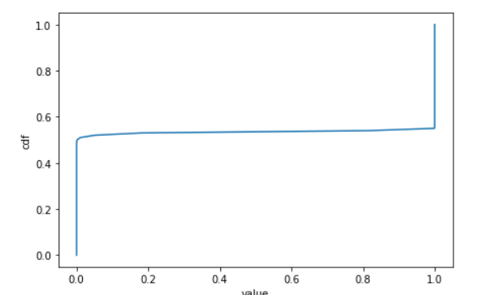
Quantile Loss CDFs

