Slide 1

ALPhA Fall 2020 Week 9
Braden Kronheim
October 13, 2020

Slide 2
Performance
Trained on unbalanced set with weights, evaluated on unbalanced set
Recall: 0.94
Precision: 0.62
F1: 0.75
Trained on unbalanced set without weights, evaluated on unbalanced set
Recall: 0.74
Precision: 0.87
F1: 0.80
Quantile at median:
Recall: 0.67
Precision: 0.89
F1: 0.76
Trained on balanced set, evaluated on balanced:
Recall: 0.92
Precision: 0.89
F1: 0.90
Trained on balanced set, evaluated on unbalanced set:
Recall: 0.94
Precision: 0.62
F1: 0.75
Ak4-jets:
Recall: 0.83
Precision: 0.62
F1: 0.71
Quantile at 0.7:
Recall: 0.84
Precision: 0.73
F1: 0.78

Slide 3
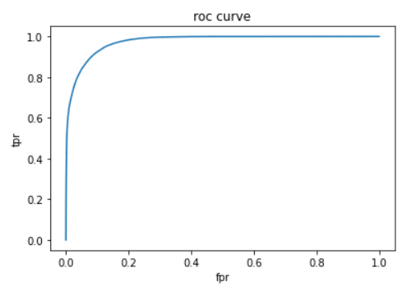
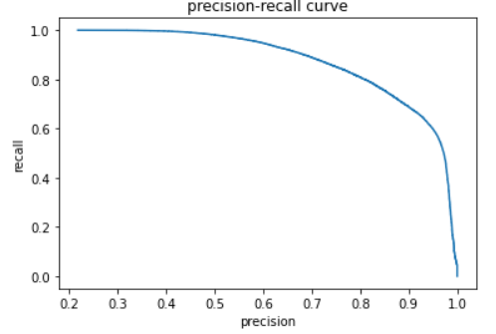
Roc curves, precision-recall curves (balanced, very similar to unbalanced with weights)

Slide 4
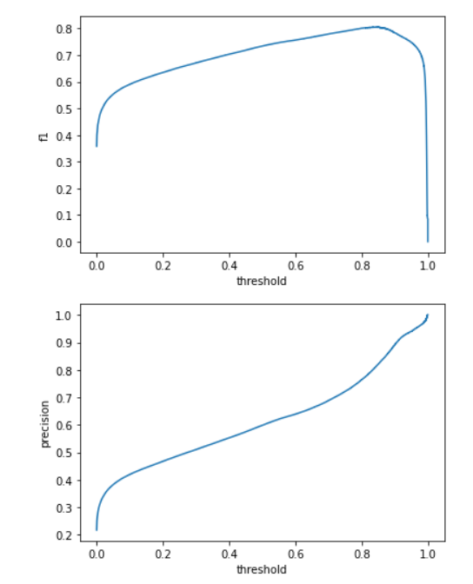
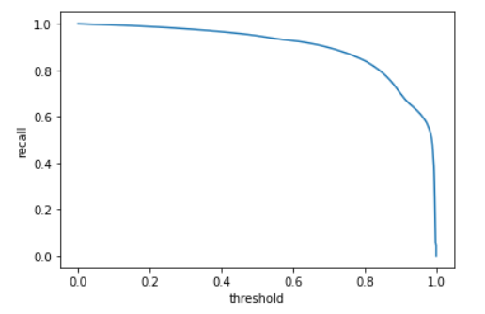
Metrics vs. threshold

Slide 5
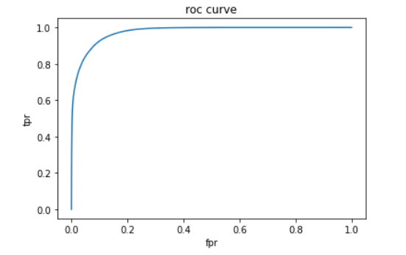
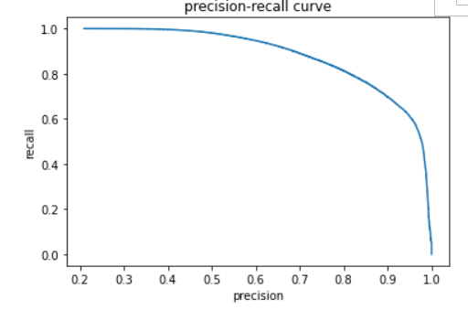
Roc curves, precision-recall curves (not balanced, no weights)

Slide 6
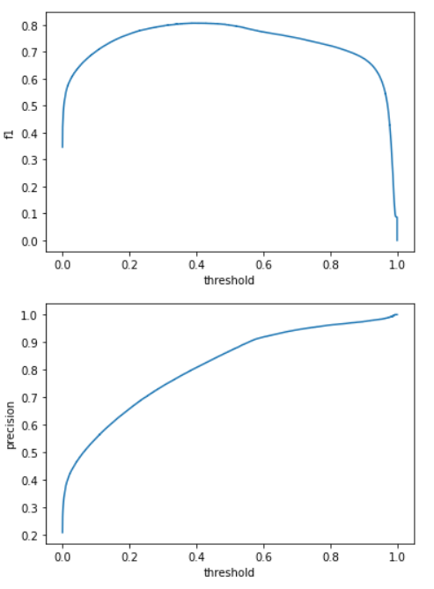
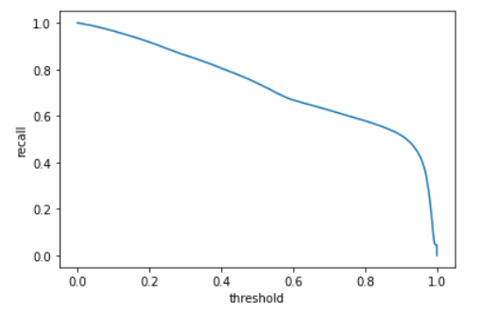
Metrics vs. threshold

Slide 7
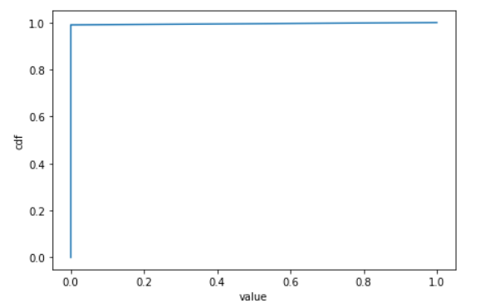
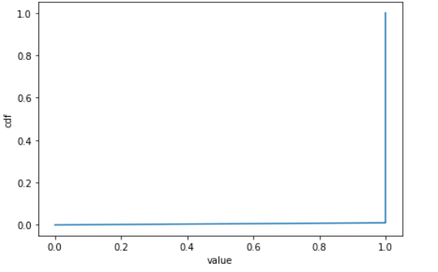
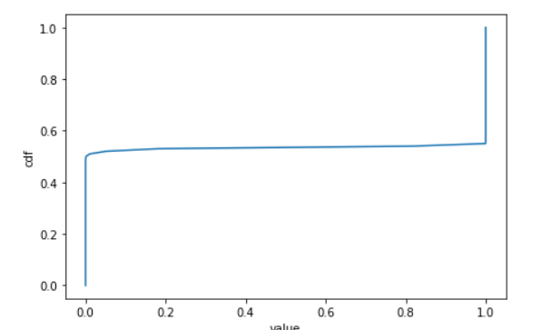
Quantile Loss CDFs

Slide 8
Combined Classifier and Regression
Classifier + Regression Realistic Case: (for final jets)
dR mean: 0.053
dR sd: 0.053
pT Ratio mean: 1.063
pT Ratio sd: 0.323
Regression without extra points: (for final jets):
dR mean: 0.047
dR sd: 0.051
pT Ratio mean: 1.088
pT Ratio sd: 0.313
Plain addition without extra points: (for final jets):
dR mean: 0.014
dR sd: 0.0195
pT Ratio mean: 0.964
pT Ratio sd: 0.109

Slide 9
Algorithm
Given: N particle flow particles
Sort particles by pt O(Nlog(N))
For each particle: O(N)
For each other particle: O(N)
If dR < 1, use classification algorithm to determine whether to add particle
Use regression algorithm to update jet
Remove added particle
Overall: O(N^2)
Fastjet: O(Nlog(N))

