Slide 1

ALPhA Spring 2021 Week 1 Presentation
Braden Kronheim
January 29, 2020

Slide 2
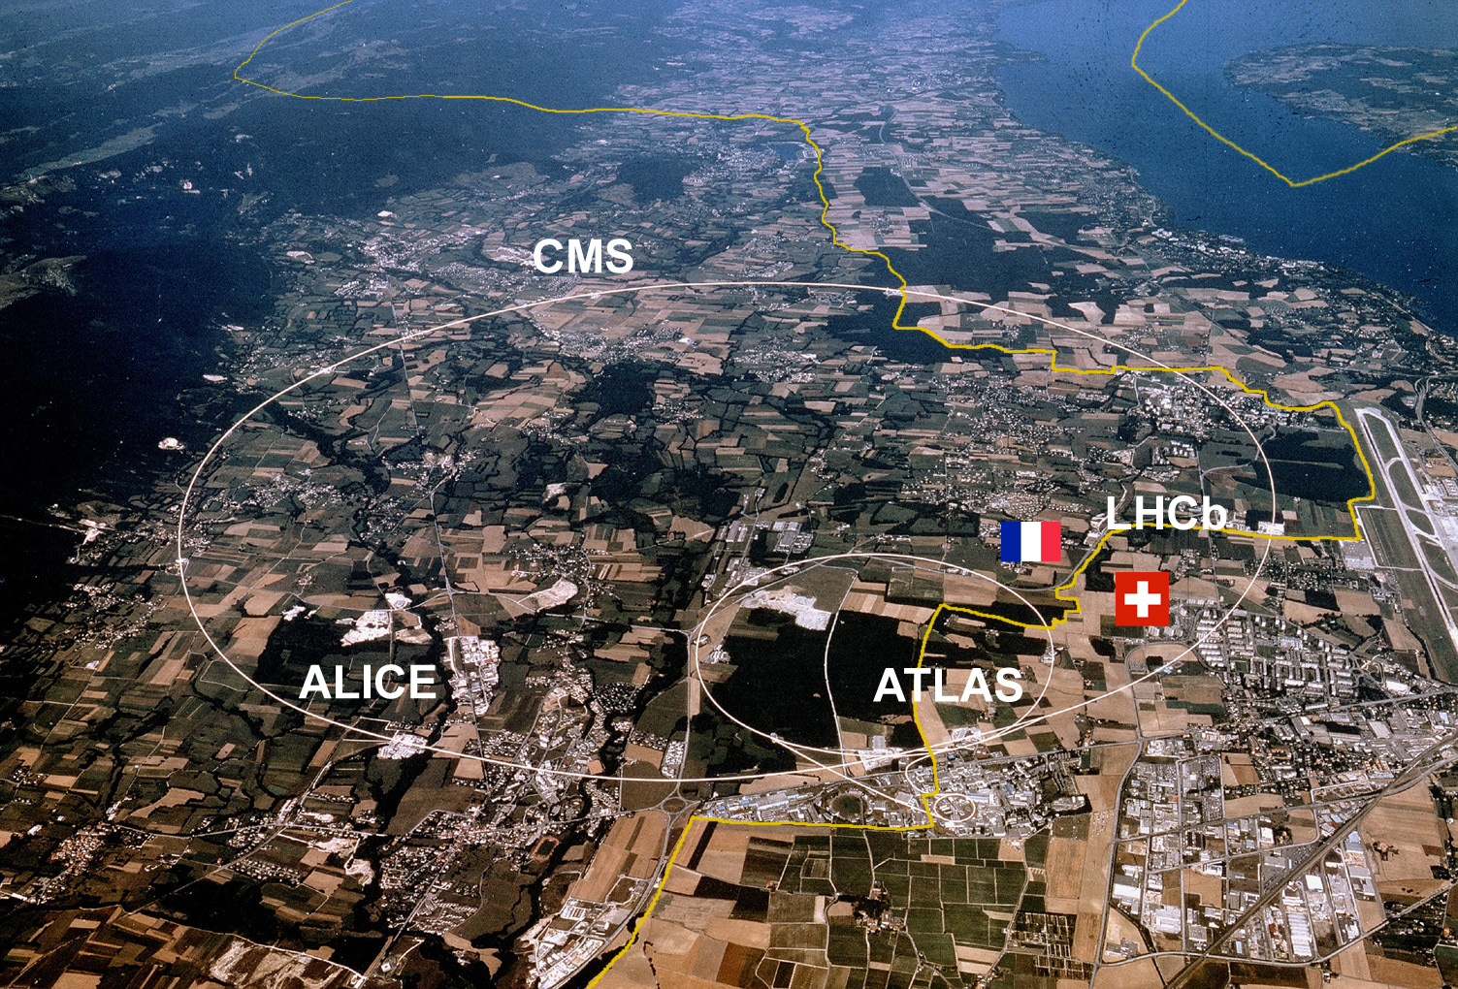
Large Hadron Collider

Slide 3
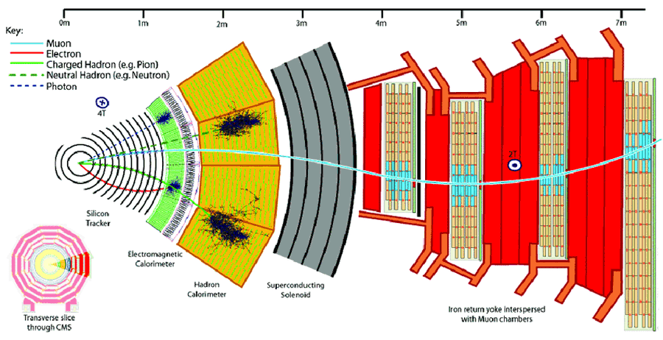
Compact Muon Solenoid (CMS)

Slide 4
Jets
Collection of hadrons which enter the detector
Starting quarks or gluons
Collection of hadrons which enter the detector

Slide 5
ML
Method from last semester:
Take a particle from the detector, set it as part of a jet
Take the other particle iteratively, classify if they are part of the jet using a neural net, then using a regression network determine what the jet should be afterwards
Use another network to correct the final output jet
New method:
Instead of pointwise regression, use a quantile network to predict full distributions
The quantile network can map from a quantile, or percentile, to the corresponding point in the distribution, normal loss functions give a mean or median.

Slide 6
Summary from break/this week
Working on a way of improving quantile neural nets
Ideas investigated
Predicting the slope of the quantile curve
Didn’t work well
Adding a loss term for negative slopes of the quantile curve
Calculated both by derivatives of the network and by differences between the quantiles
This seems to work fairly well, though sometimes a parameter which requires a minimum slope is also useful, as this helps prevents 0 slope cases, which correspond to infinite probability
Adding a loss term for zero probability at quantile 0 and 1
Corresponds to infinite slope of quantile curve, not good for a neural net
Tried using an activation function of exp(x)-exp(-x) which helped some, but still wasn’t great

Slide 7
More Summary
Current ideas:
Predict a set number of quantiles and use splines to link them up
Currently using hermite cubic splines as it is fast and easy, normal cubic splines are also a possibility
Attach the end of a specific distribution along the edges of the quantile curve to get desired decay behavior
Was thinking exponential, but optimally this would be a two-parameter distribution, maybe a gamma or a normal distribution
For multiple dimensions use multiply networks. For example, to do P(A,B|input), use a network to learn P(A|input) and then another to do P(B|A, input)
The issue though is for the 4-dimensional case of the research project we would have to do some sort of MCMC sampling to get rapid results
Semester starting point:
Make normal network to go from reco to gen
Mostly done with this, not quite there yet
Make quantile network to go from reco to gen
Then investigate particle by particle buildup

Slide 8
Goals for next week
Finish training basic reco to gen network
Train reco to gen quantile network

