Slide 1

ALPhA Spring 2021 Week 11
Braden Kronheim
April 6, 2021

Slide 2
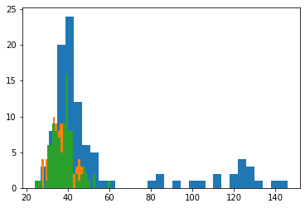
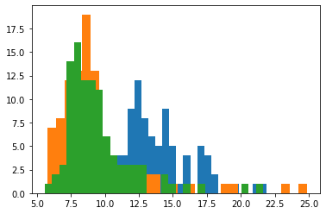
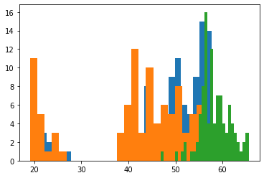
Algorithm output
- For each particle, possible jet, and simulation
In a set of particles passed to the algorithm, it
takes 250.3 microseconds on average.
Presenting 100 particles and trying to find up to
3 jets and taking 100 samples will take 7.5
seconds.
With compilation, will possibly be reduced to
Around 6 microseconds and 0.18 seconds

Slide 3
