Slide 1

ALPhA Spring 2021 Week 12
Braden Kronheim
April 13, 2021

Slide 2
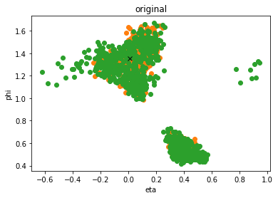
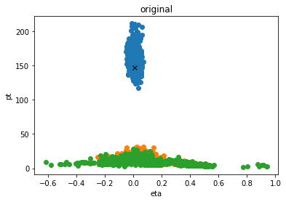
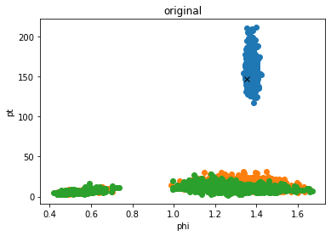
Algorithm output

Slide 3
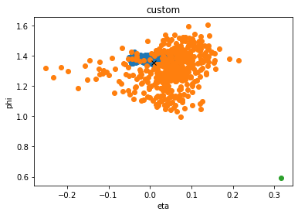
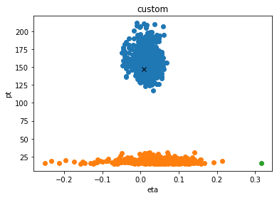
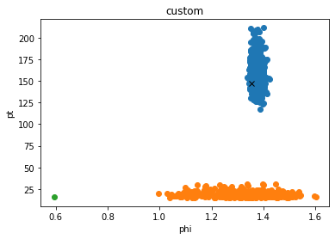
Clustering result

Slide 4
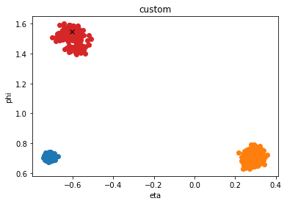
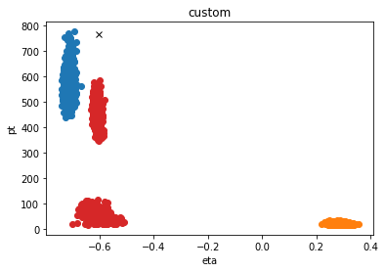
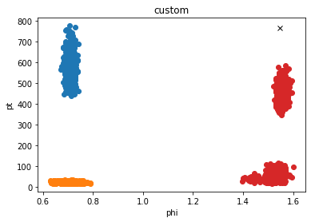
Less succesful

Slide 5
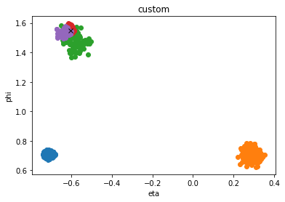
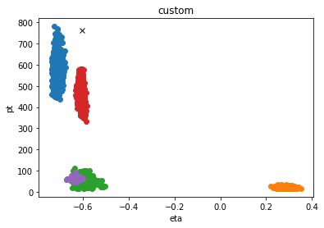
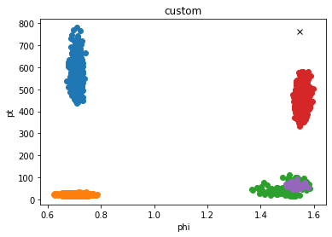
Easier to split

Slide 6
Clustering
Remove jets with pt<15 GeV
Calculate median value and standard deviation of pt, eta, phi for each cluster
Assign jets to a cluster based on the distance, which is determined by the distance in pt, eta, phi divided by the standard deviation of the variable
If the angular distance is greater than some value, such as 5 or 6, for some jet assign it to a new cluster
Limit the standard deviation of clusters based on the number of particles, that way a very diffuse cluster can’t consume all the others
Repeat for a set number of iterations

Slide 7
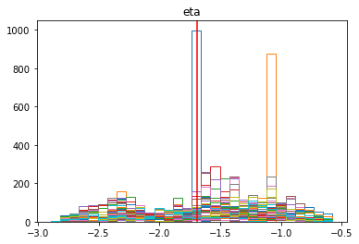
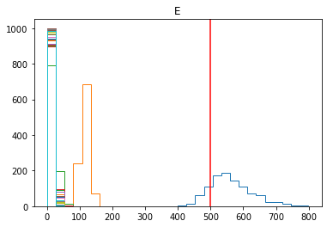
General Info
For a single collection of particles it takes the algorithm about 9 microseconds per particle, sample, and possible jet once compiled
100 potential particles with 100 samples and 3 possible jets takes 0.27 seconds
Generally get at least 30 jets, though many are very small and uniteresting

