Slide 1

ALPhA Spring 2021 Week 13
Braden Kronheim
April 20, 2021

Slide 2
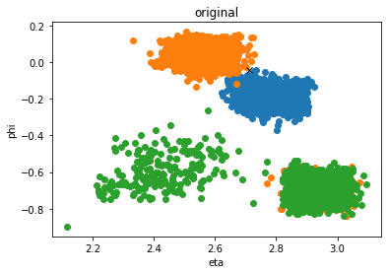
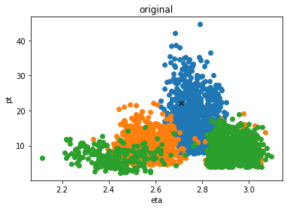
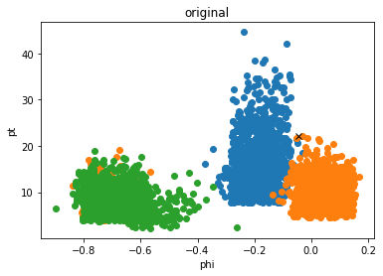
Raw output

Slide 3
Binning center selection
Do a 3d binning of log(pt), eta, phi
Find the bins with at least two counts which have more counts than any of the bordering bins

Slide 4
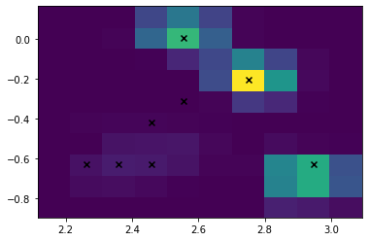
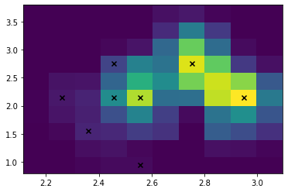
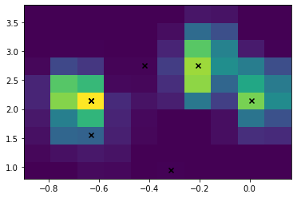
3d Binning (log(pT))

Slide 5
Clustering algorithm
Calculate squared distance between point and proposed centers, assign to closest center
Recalculate centers based on new clusters
Repeat

Slide 6
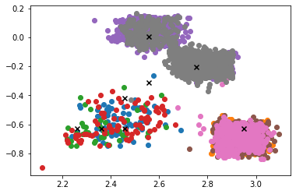
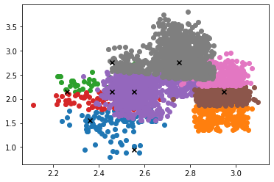
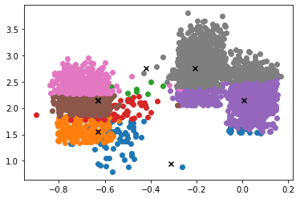
Using these as a starting point

Slide 7
Trim proposed centers
Order centers by descending count
Remove points with a dR less than 0.4 between each other and a pT ratio between 1.5 and 0.75

Slide 8
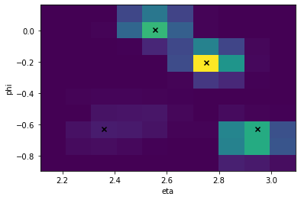
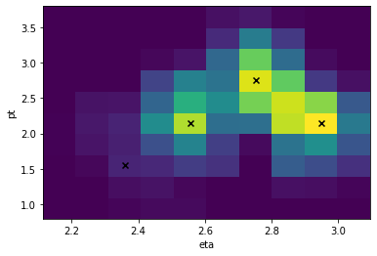
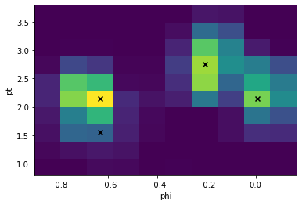
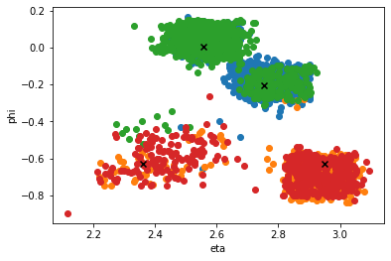
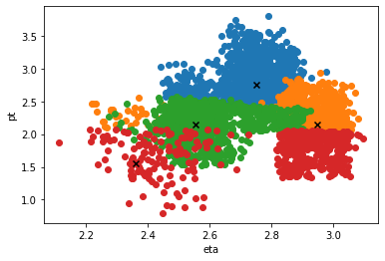
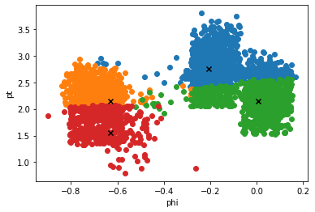
Results

Slide 9
Weight clusters based on standard deviation

Slide 10
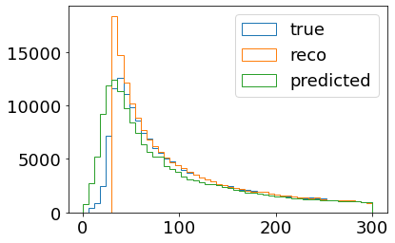
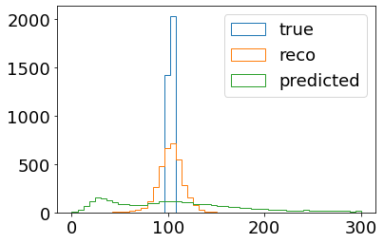
Just cluster one and use it

