Slide 1

ALPhA Spring 2021 Week 2
Braden Kronheim
February 5, 2020

Slide 2
Summary
Trained a basic reco to gen model
Trained a few quantile reco to gen models
Nice distributions over all the predictions
Bad distributions over limited pT ranges
Experimented with different quantile sampling methods

Slide 3
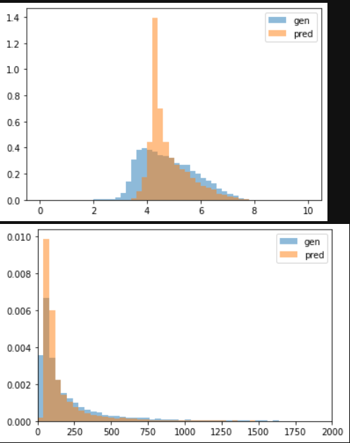
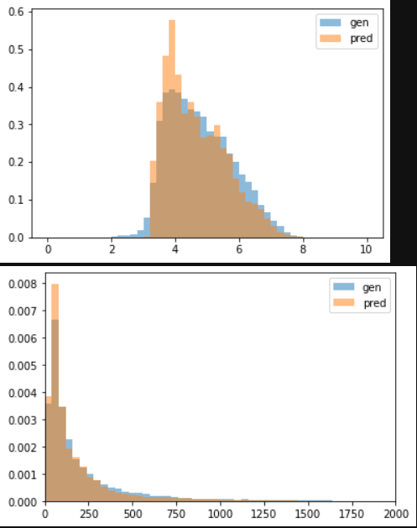
Normal neural net vs. quantile neural net
Normalized
Unnormalized
Normal neural net
Quantile neural net (25 quantiles)

Slide 4
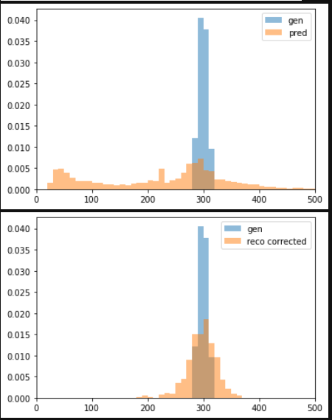
Localized gen pT (around 300 GeV)

Slide 5
Goals for next week
Keep working on improving the quantile nets

