Slide 1

ALPhA Spring 2021 Week 2
Braden Kronheim
February 2, 2020

Slide 2
Summary
Working on a way of improving quantile neural nets
Ideas investigated
Predicting the slope of the quantile curve
Didn’t work well
Adding a loss term for negative slopes of the quantile curve
Calculated both by derivatives of the network and by differences between the quantiles
This seems to work fairly well, though sometimes a parameter which requires a minimum slope is also useful, as this helps prevents 0 slope cases, which correspond to infinite probability
Adding a loss term for zero probability at quantile 0 and 1
Corresponds to infinite slope of quantile curve, not good for a neural net
Tried using an activation function of exp(x)-exp(-x) which helped some, but still wasn’t great

Slide 3
More Summary
Current ideas:
Predict a set number of quantiles and use splines to link them up
Currently using hermite cubic splines as it is fast and easy, normal cubic splines are also a possibility
Attach the end of a specific distribution along the edges of the quantile curve to get desired decay behavior
Was thinking exponential, but optimally this would be a two-parameter distribution, maybe a gamma or a normal distribution
For multiple dimensions use multiply networks. For example, to do P(A,B|input), use a network to learn P(A|input) and then another to do P(B|A, input)
The issue though is for the 4-dimensional case of the research project we would have to do some sort of MCMC sampling to get rapid results
Semester starting point:
Make normal network to go from reco to gen
Make quantile network to go from reco to gen
Then investigate particle by particle buildup

Slide 4
What the algorithm would look like
Given: N particle flow particles (either from the whole event or a previously reconstructed jet), S starting samples
Sort particles by pt O(Nlog(N))
Take S samples from regressionnetworks given the 1st particles
For each remaining particle: O(N)
Classify whether the particle should be added
Allocate sample for added and not added
Allocate the same number of not added samples to a new jet
Take the appropriate number of samples from the regression networks for the added particle case and the new jet case for each previous sample: O(S^2)
Some sort of down sampling
S+=S*p(not added)
Output is a certain number of samples showing the distribution of output jets
Overall: Worst case is p(not added)=1 every time, so S final = S*N, and the time complexity is O(S^2 N^3)

Slide 5
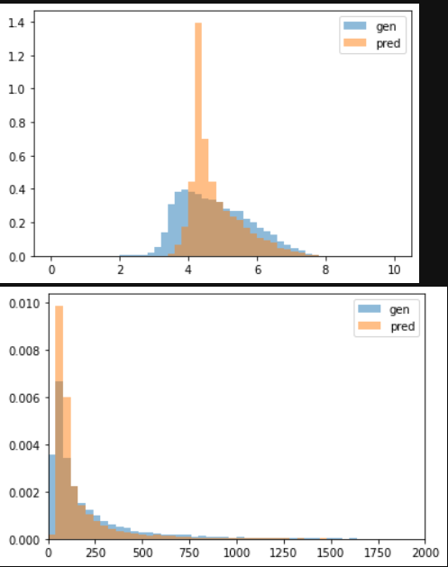
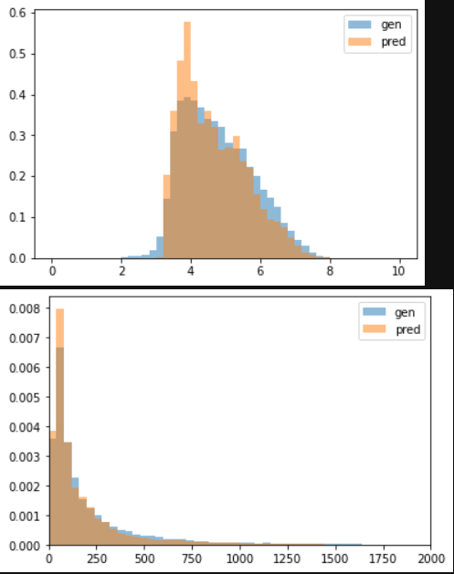
Normal neural net vs. quantile neural net
Normalized
Unnormalized
Normal neural net
Quantile neural net (25 quantiles)

