Slide 1

ALPhA Spring 2021 Week 3
Braden Kronheim
February 12, 2020

Slide 2
Summary
Working to improve quantile predictions
Increased quantiles tested – little impact
Turning off the slope penalties – little impact
Predict one quantile each time, but pick a random one.
Theoretically, this will allow the network to learn a lot of different quantiles
Still little impact
Also tried only training on 0.01 to 0.99 quantiles, didn’t have an impact
The way I’m sampling is not the issue either
Old method: calculated values for quantiles 0.01 to 0.99 in 0.01 increments, weight by 1/slope of quantile curve, which is the probability
New method: sample from a uniform distribution between the quantiles 0 and 1, calculate the corresponding values with the network, and use these with uniform weighting
I’m going to train a BNN and a GAN to do the inference next and see what happens, if I get similar results or better results

Slide 3
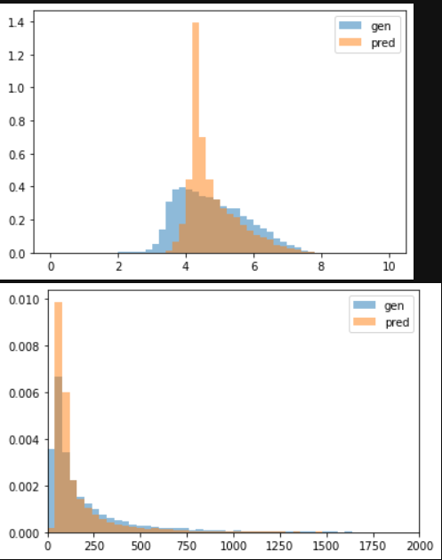
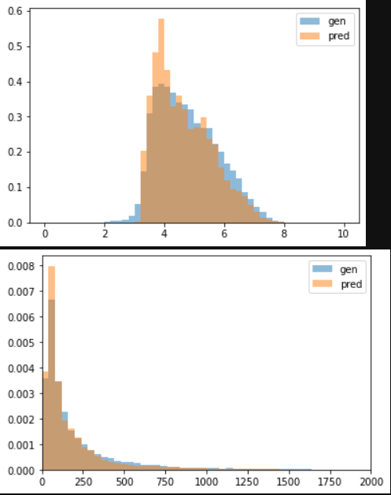
Normal neural net vs. quantile neural net
Normalized
Unnormalized
Normal neural net
Quantile neural net (25 quantiles)

Slide 4
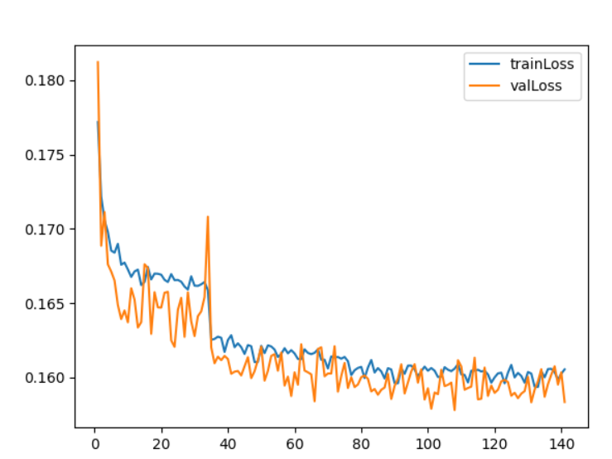
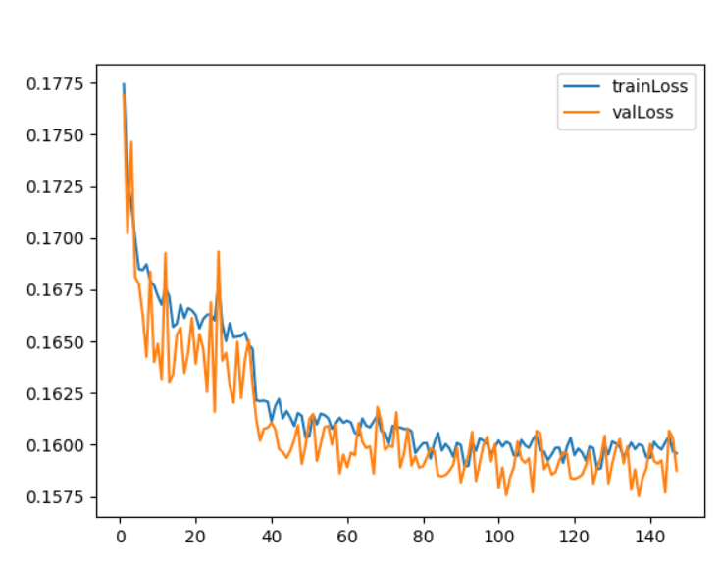
Loss curves (single, random quantile each time)
No slope penalty
Slope penalty

Slide 5
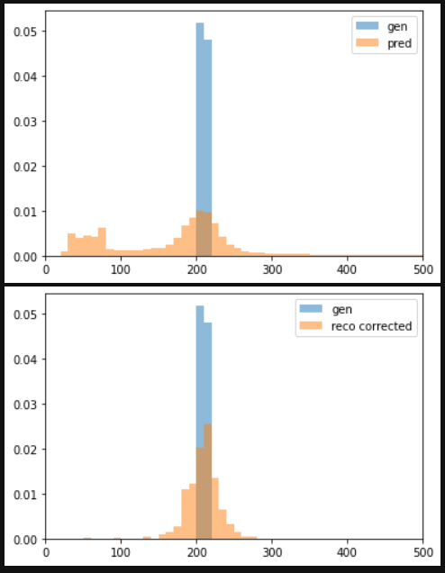
Localized gen pt (200-220 GeV)

Slide 6
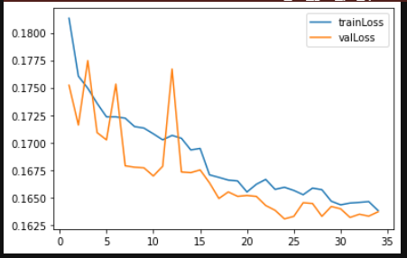
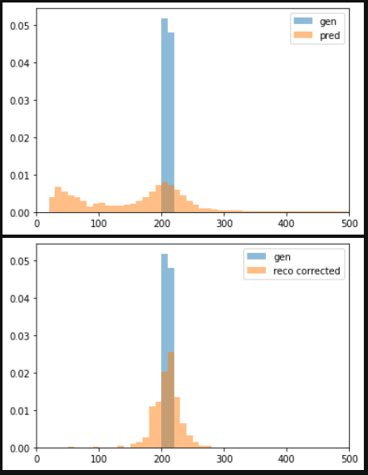
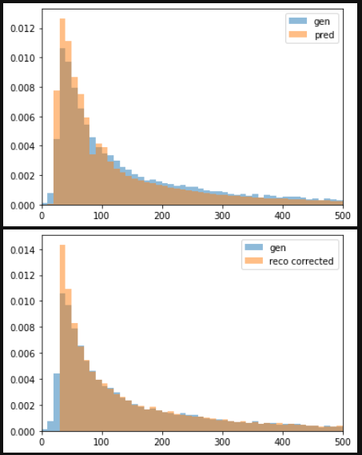
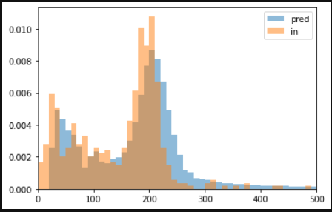
Using a leaky ReLU activation and the new sampling

Slide 7
Goals for next week
Start training a BNN to see how it does
Get code from John on his GAN and learn how to use it while the BNN is training

