Slide 1

ALPhA Spring 2021 Week 3
Braden Kronheim
February 9, 2020

Slide 2
Summary
Working to improve quantile predictions
Increased quantiles tested – little impact
Turning off the slope penalties – little impact
Predict one quantile each time, but pick a random one.
Theoretically, this will allow the network to learn a lot of different quantiles
Still little impact
Maybe the way I’m sampling is the issue.
Current method: calculated values for quantiles 0.01 to 0.99 in 0.01 increments, weight by 1/slope of quantile curve, which is the probability
New method: sample from a uniform distribution between the quantiles 0 and 1, calculate the corresponding values with the network, and use these with uniform weighting

Slide 3
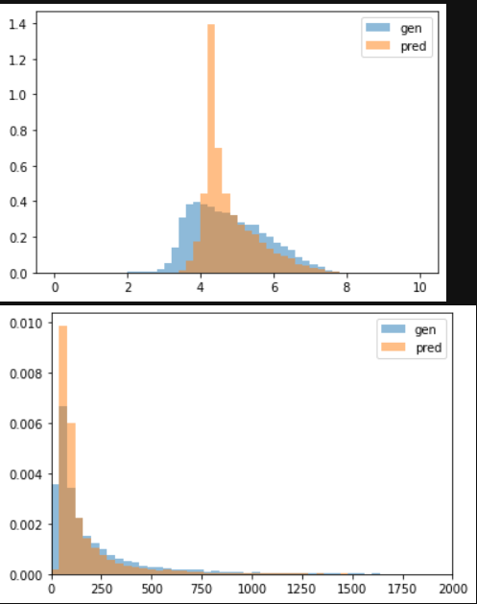
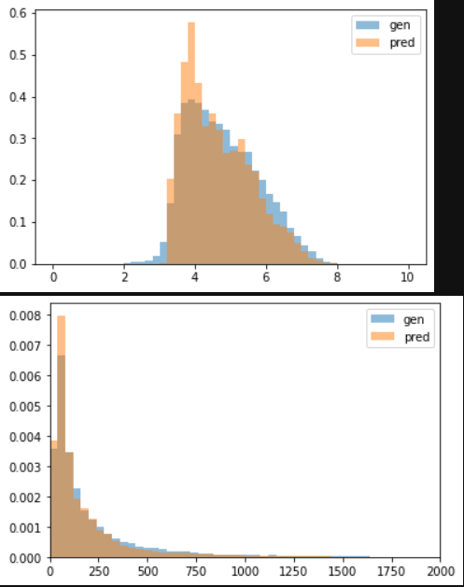
Normal neural net vs. quantile neural net
Normalized
Unnormalized
Normal neural net
Quantile neural net (25 quantiles)

Slide 4
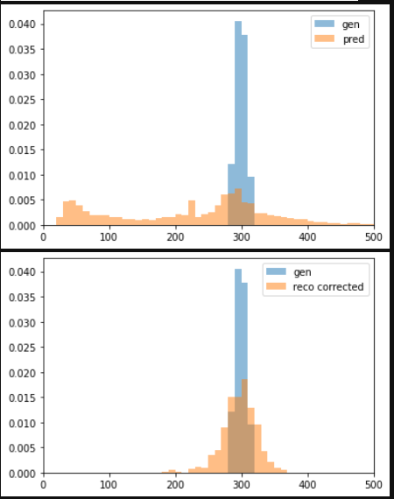
Localized gen pT (around 300 GeV)

Slide 5
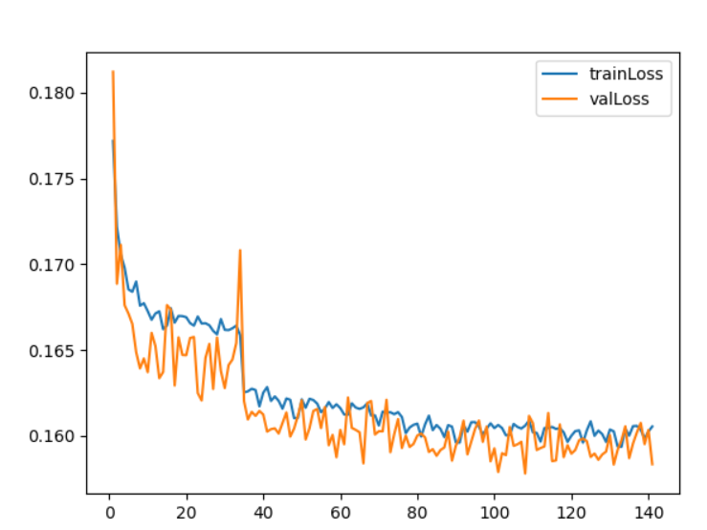
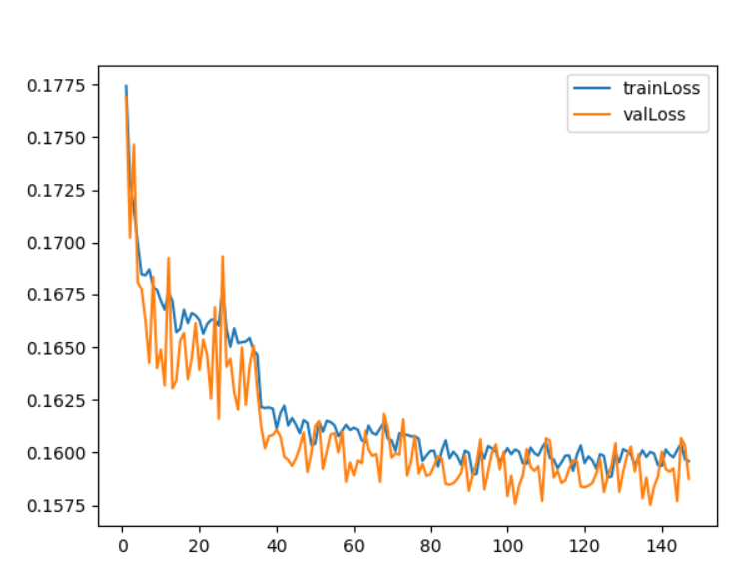
Loss curves (single, random quantile each time)
No slope penalty
Slope penalty

Slide 6
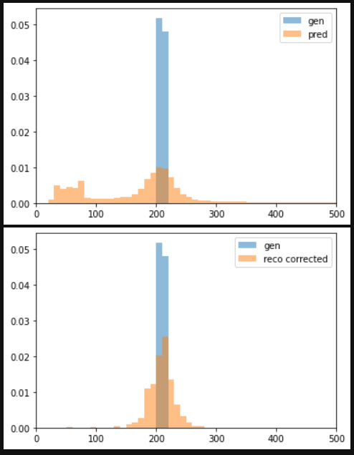
Localized gen pt (200-220 GeV)

