Slide 1

ALPhA Spring 2021 Week 4
Braden Kronheim
February 16, 2020

Slide 2
Summary
Working to improve quantile predictions
Increased quantiles tested – little impact
Turning off the slope penalties – little impact
Predict one quantile each time, but pick a random one.
Theoretically, this will allow the network to learn a lot of different quantiles
Still little impact
Also tried only training on 0.01 to 0.99 quantiles, didn’t have an impact
The way I’m sampling is not the issue either
Old method: calculated values for quantiles 0.01 to 0.99 in 0.01 increments, weight by 1/slope of quantile curve, which is the probability
New method: sample from a uniform distribution between the quantiles 0 and 1, calculate the corresponding values with the network, and use these with uniform weighting
There’s a strange bimodality in the gen to raw reco graphs
Training a BNN did not help

Slide 3
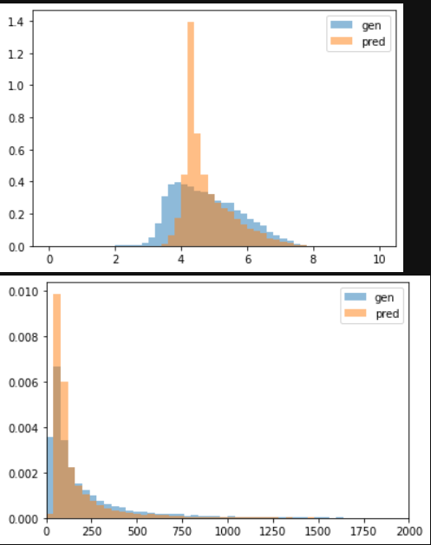
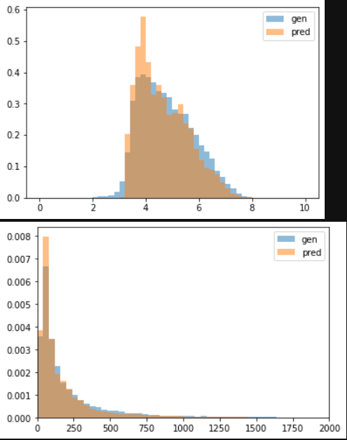
Normal neural net vs. quantile neural net
Normalized
Unnormalized
Normal neural net
Quantile neural net (25 quantiles)

Slide 4
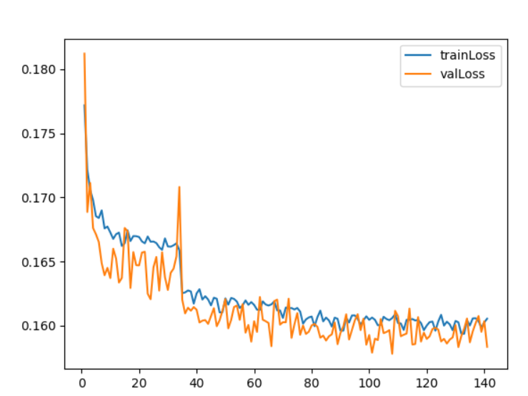
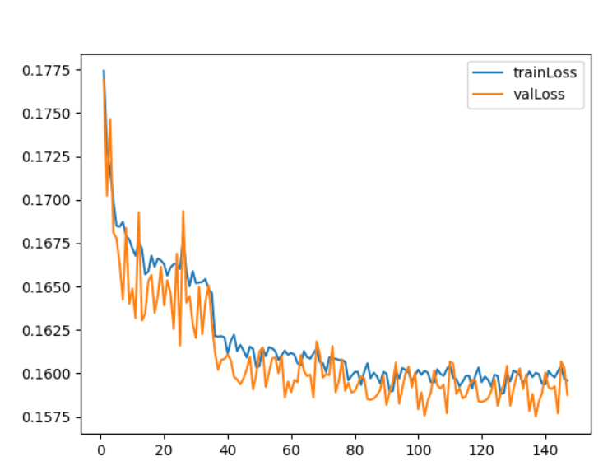
Loss curves (single, random quantile each time)
No slope penalty
Slope penalty

Slide 5
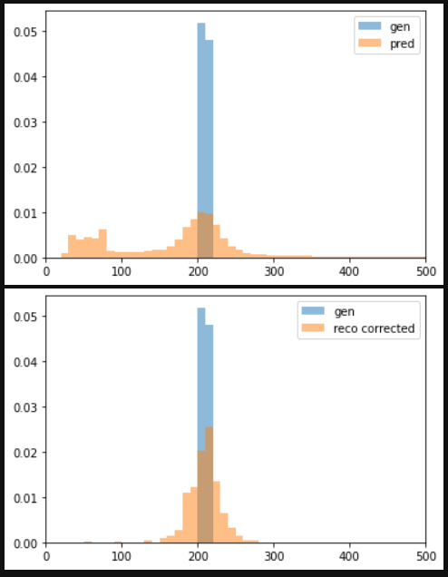
Localized gen pt (200-220 GeV)

Slide 6
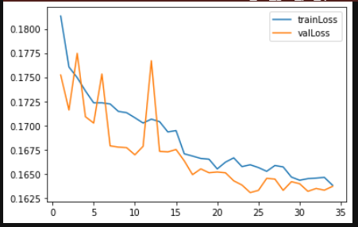
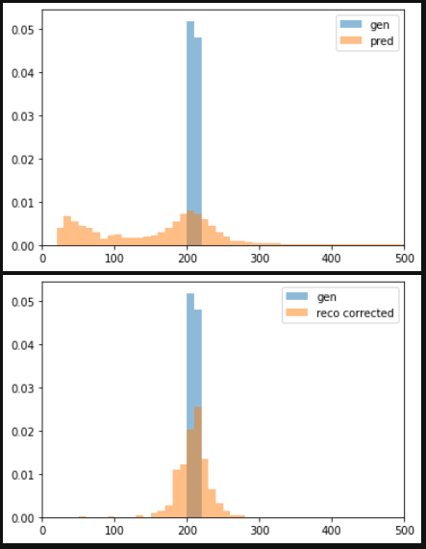
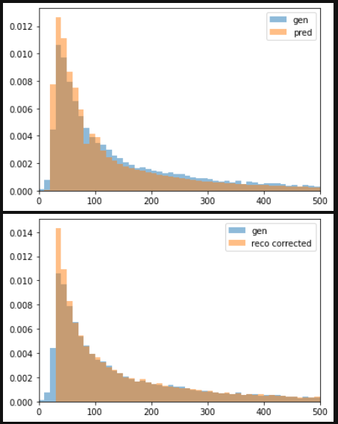
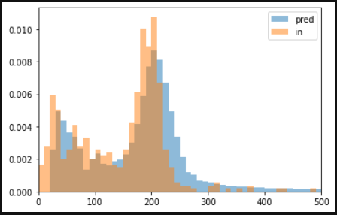
Using a leaky ReLU activation and the new sampling

Slide 7
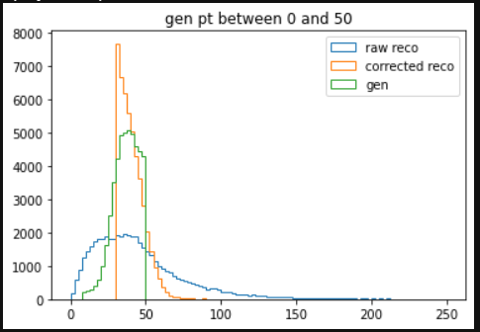
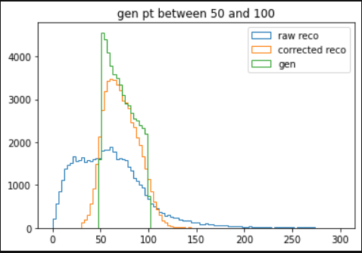
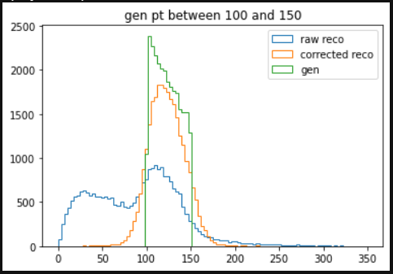
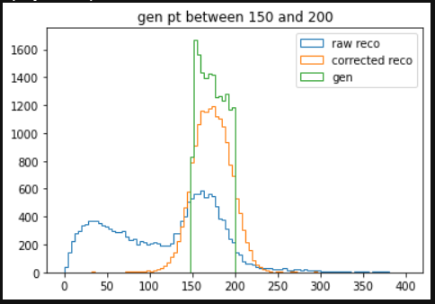
Gen to raw reco

Slide 8
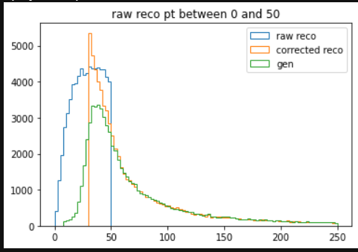
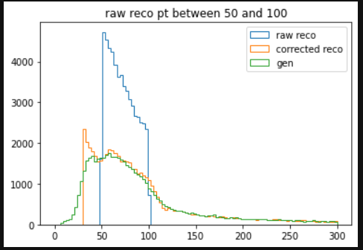
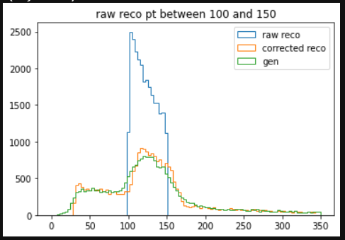
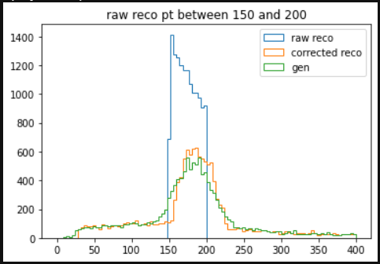
Raw reco to gen

