Slide 1

ALPhA Spring 2021 Week 5
Braden Kronheim
February 23, 2020

Slide 2
Summary
What I have been trying to do the past few weeks never had had hope of working
My quantile nets are solving the problem they are supposed to solve, but the solution to this problem is not as helpful as I had thought
In order to have a better jet reconstruction, we need to have more information than just the final jet
This brings us back to the method from last semester which, while not probabilistic, was able to solve the problem fairly well
I did experimenting with multiple dimensional predictions, the networks seem to struggle with tails, but do fine in general

Slide 3
What does the Quantile Net learn?
Gen
Reco
Detector Response
Quantile Net

Slide 4
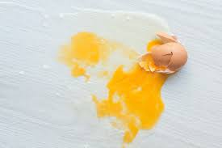
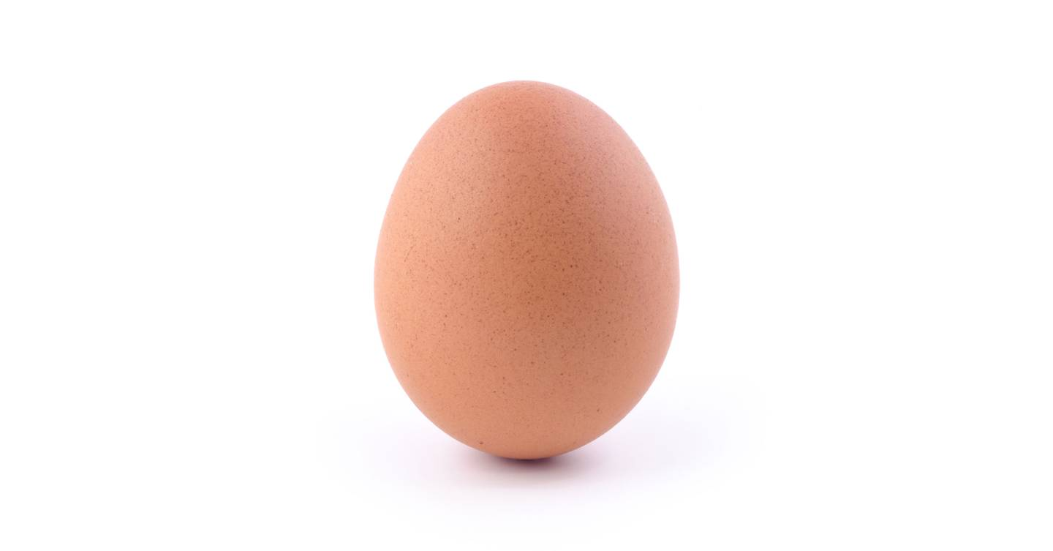
What am I trying to ask it to do?
Reco
Gen
Gen
Detector Response
Quantile Net

Slide 5
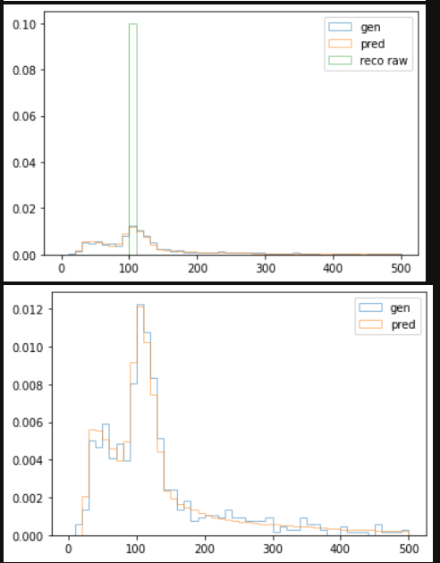
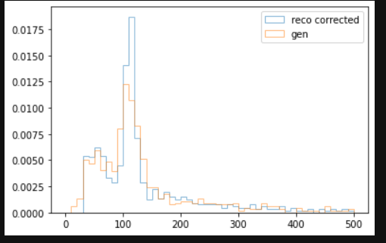
How the quantile net does
Correct Usage

Slide 6
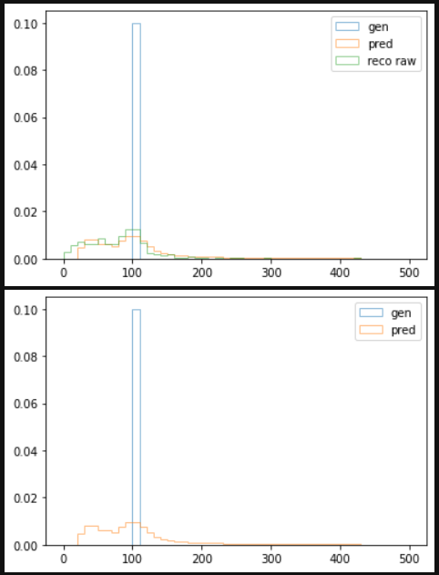
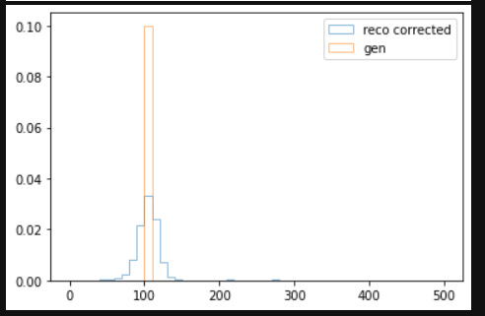
How the quantile net does
Incorrect Usage

Slide 7
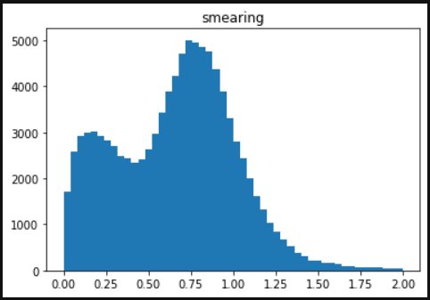
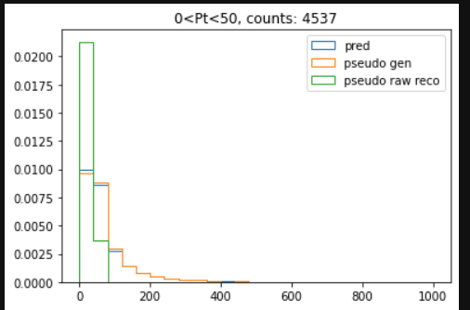
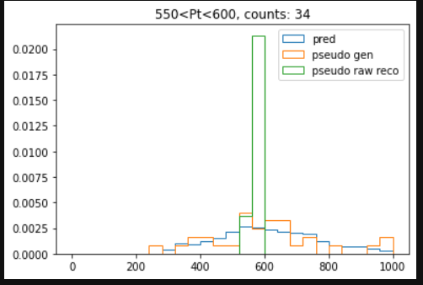
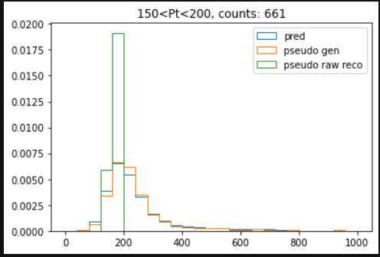
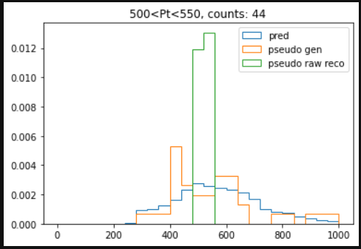
For a simpler situation:

Slide 8
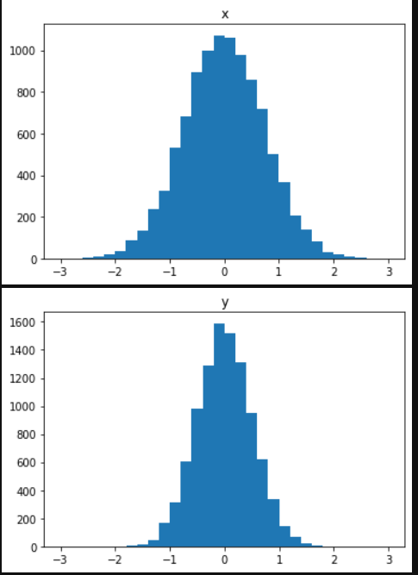
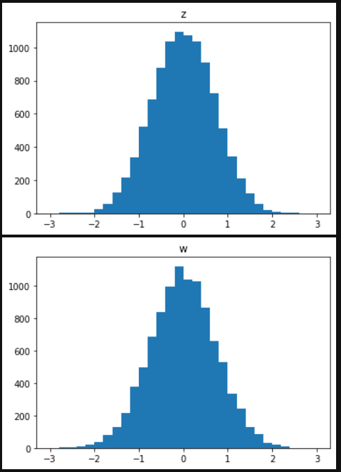
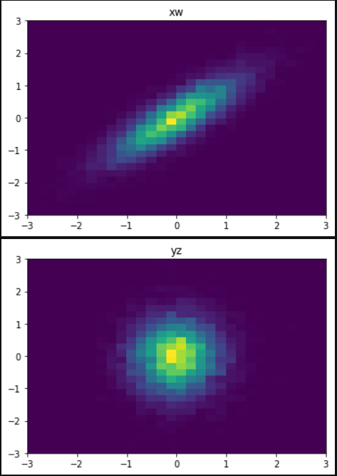
4 dimensions true

Slide 9
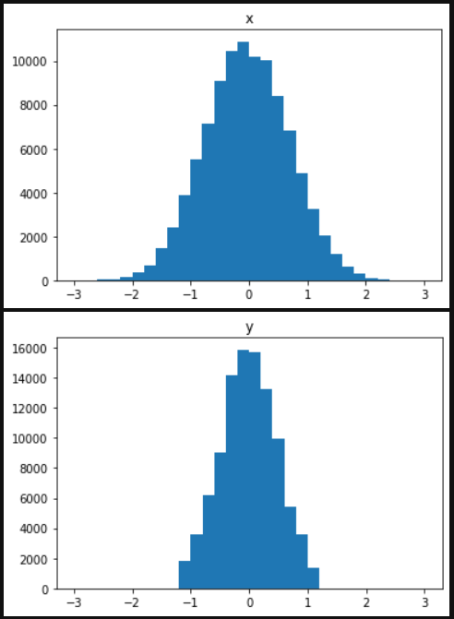
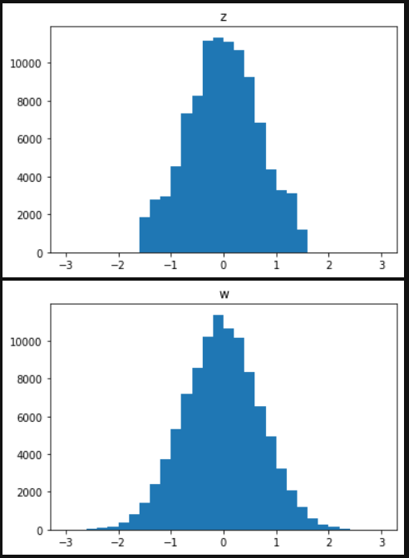
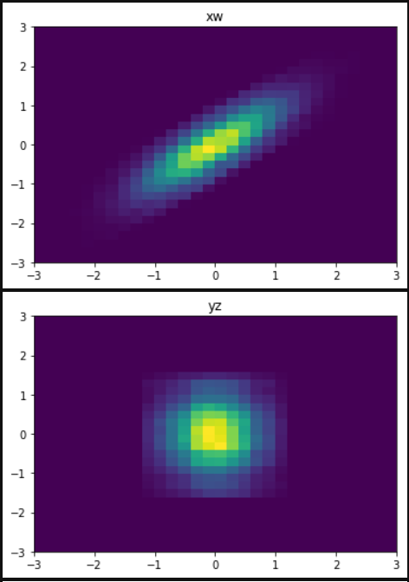
4 dimensions predicted

