Slide 1

ALPhA Spring 2021 Week 8
Braden Kronheim
March 19, 2020

Slide 2
Jacobian in training
Need to introduce a weighting factor in the quantile net training that accounts for the distribution shift due to the log scaling of pt, e
P(x)dx when doing the variable change y = log(x) becomes P(y)exp(-y)dy because dy = dx/x=dx/exp(y) = exp(-y)dy
P(x)dx when doing the variable change y = log(x) becomes P(y)dx exp(-y)dy because dy = dx/x, dx = xdy = =dx/exp(y) = exp(-y)dy
Other possibility is just to do linear normalization

Slide 3
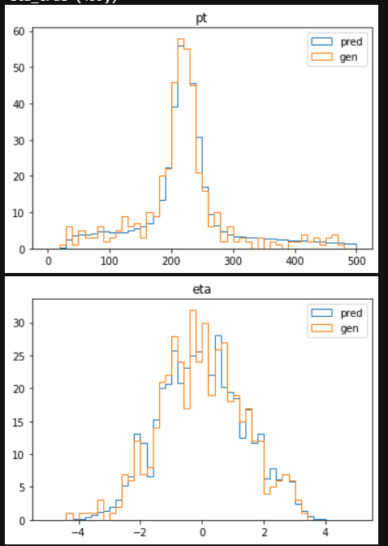
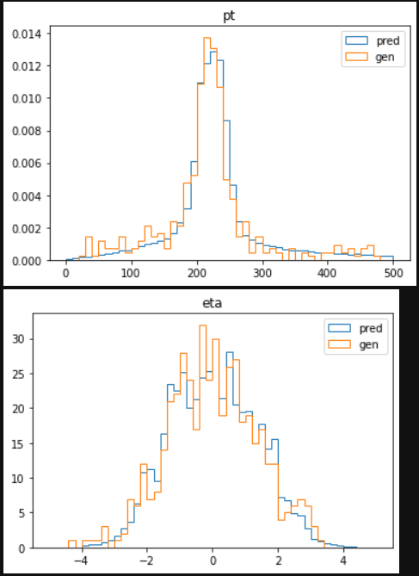
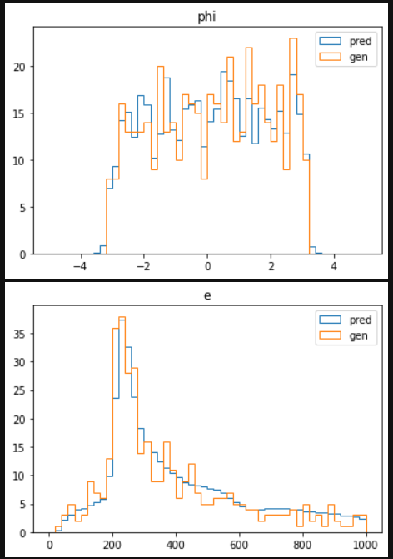
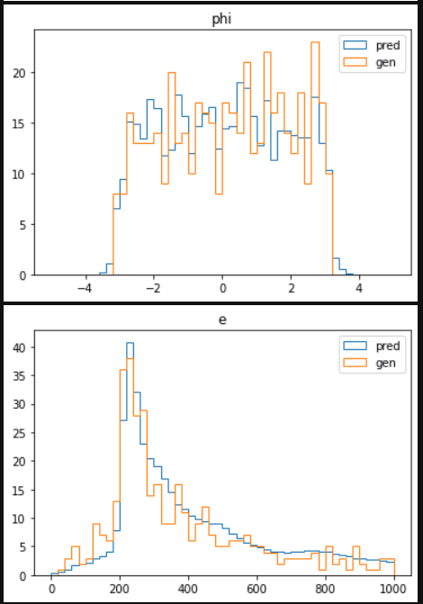
Raw reco pt between 200 and 220 GeV, 459 events (linear)

Slide 4
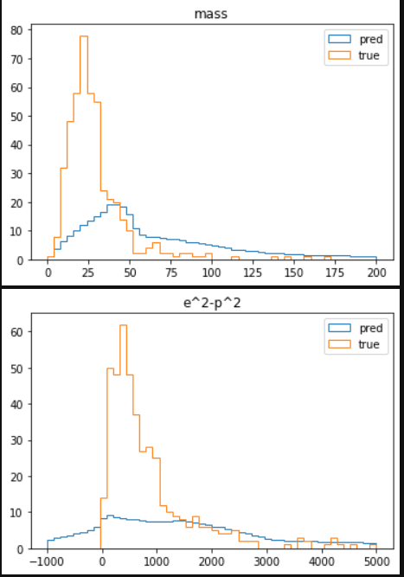
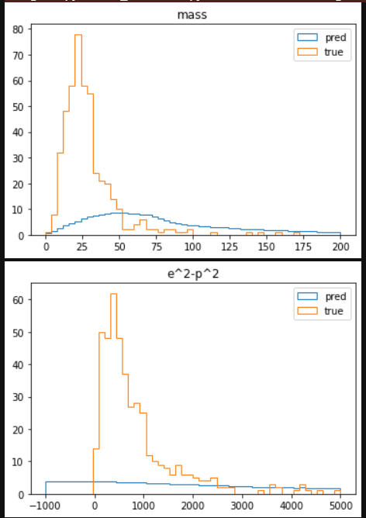
More complex relationships (pt<220 pt>200 (linear)

Slide 5
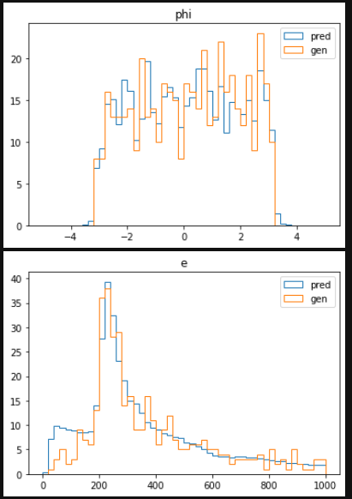
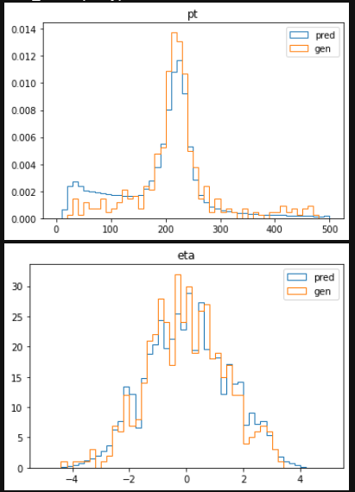
Raw reco pt between 200 and 220 GeV, 459 events (log with jacobian)

Slide 6
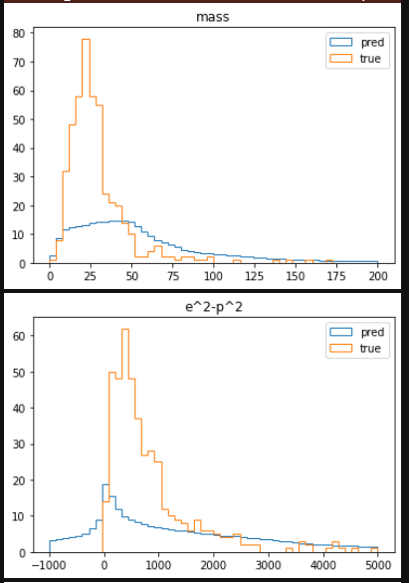
More complex relationships (pt<220 pt>200 (log with jacobian)

Slide 7
KS test along random rays
Test gives a probability that two one-d distributions are the same
Perhaps we could take this along random rays, and combine the probabilities in some fashion
Probability of same distribution | Linear Transform | Log Transform | Log Transform with Jacobian
Pt | 0.007587437297576437 | 0.05730361431291442 | 8.430287785941205e-10
Eta | 0.8612255568854156 | 0.9703919353085271 | 0.49349490458444956
Phi | 0.30008808406464693 | 0.6131878989446145 | 0.5201575706759467
E | 0.014781741917297055 | 0.11095585458991852 | 0.0011337878632319799

