Slide 1

ALPhA Spring 2021 Week 8
Braden Kronheim
March 16, 2020

Slide 2
Jacobian in training
Need to introduce a weighting factor in the quantile net training that accounts for the distribution shift due to the log scaling of pt, e
P(x)dx when doing the variable change y = log(x) becomes P(y)exp(-y)dy because dy = dx/x=dx/exp(y) = exp(-y)dy

Slide 3
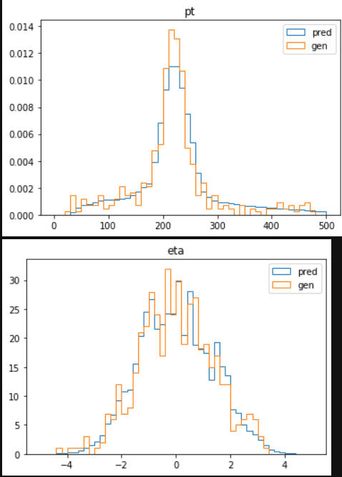
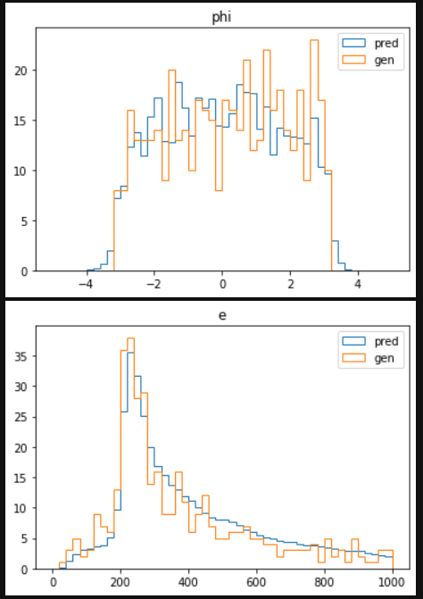
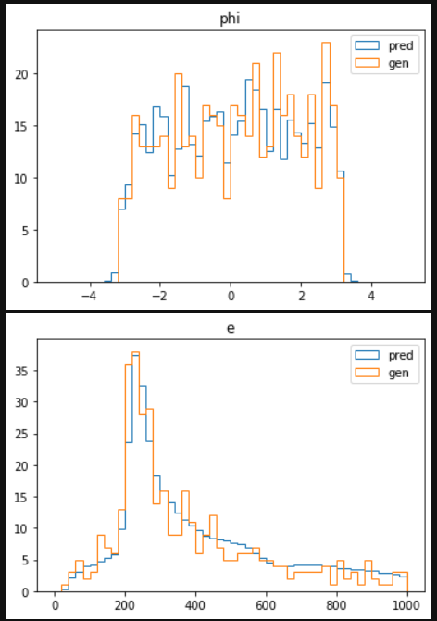
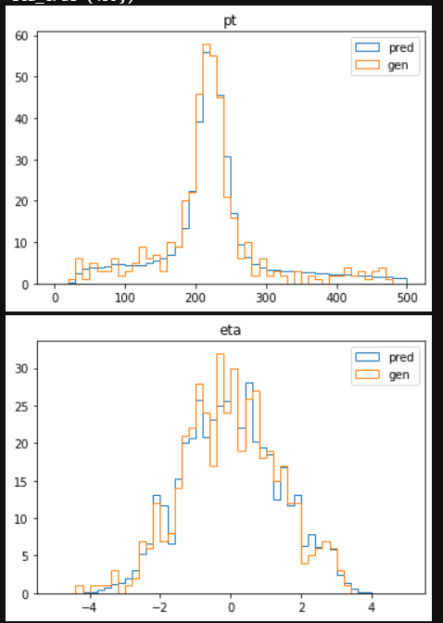
Raw reco pt between 200 and 220 GeV, 459 events

Slide 4
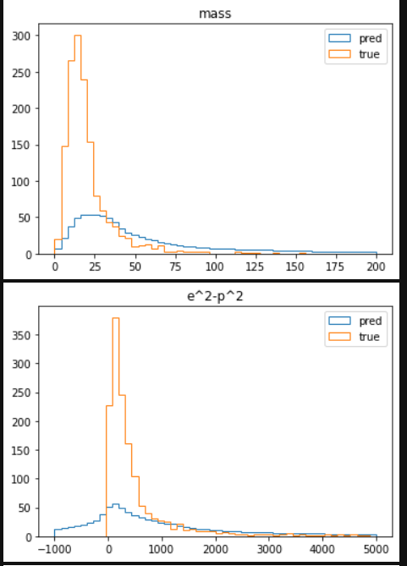
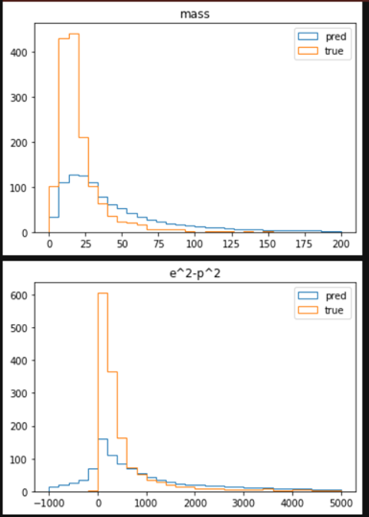
More complex relationships (pt<120 pt>100

Slide 5
KS test along random rays
Test gives a probability that two one-d distributions are the same
Perhaps we could take this along random rays, and combine the probabilities in some fashion
KS values:
Pt: 0.006489700613634786
Eta:0.9815002796336645
Phi: 0.06746276152655795
E: 0.016747452554086044

