Slide 1

ALPhA Spring 2021 Week 9
Braden Kronheim
March 26, 2020

Slide 2
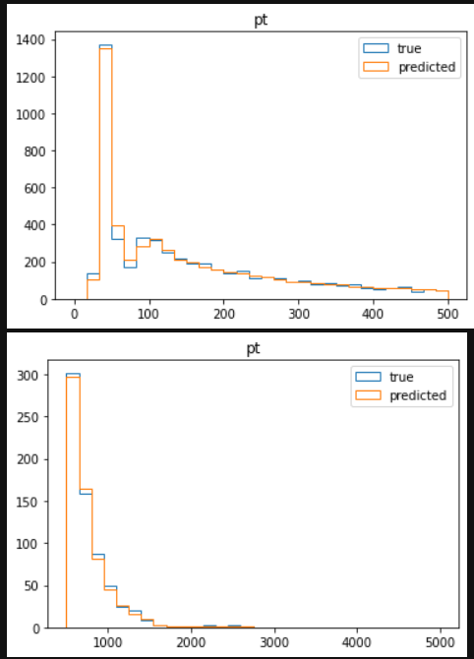
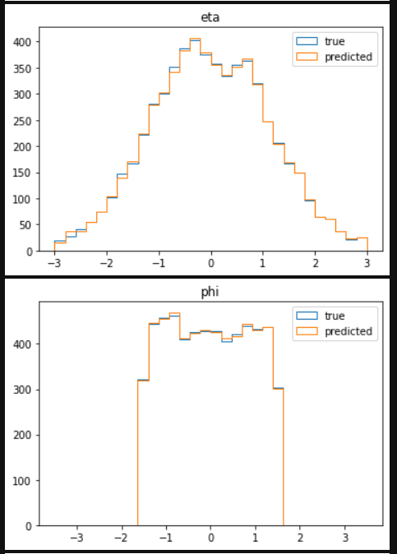
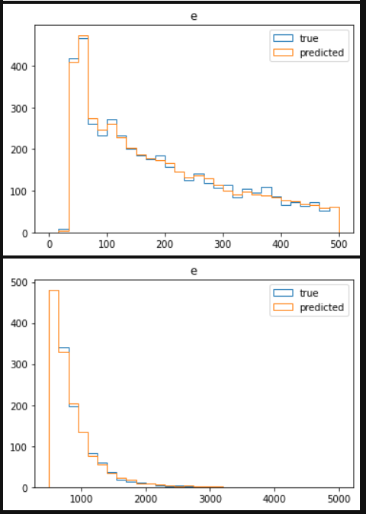
Particle by particle regression (added particle between 40, 50 GeV

Slide 3
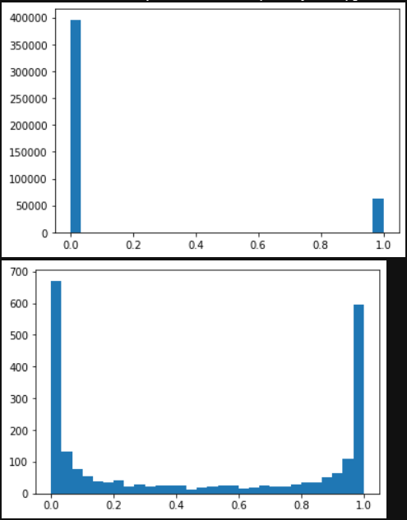
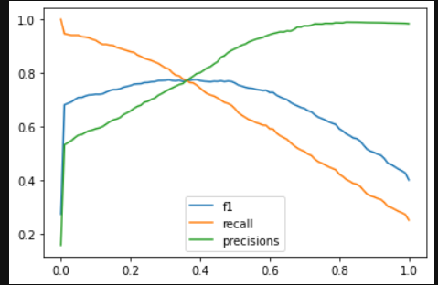
Particle by particle classification
Distribution of
Quantile predictions
Distribution of
Quantile predictions between 0.001 and 0.999
(0.5% of predictions)

Slide 4
Jet algorithm with quantiles:
Determine how many samples K are desired at the end and the maximum number of jets M that should be used.
Allocate four matrices of memory corresponding to pt, eta, phi, and e with the number of columns equal to the number of samples and the number of rows equal to the maximum number of jets.
Allocate a vector with length equal to the number of samples and initialize it to all zeros.
Sort all N particles in descending order by pT.

Slide 5
Jet algorithm with quantiles: (cont)
Start with the first particle, make K predictions from the network, and store the results in the first row of the matrix.
Run the classification algorithm for the next particle over the jets stored in the top row.
If the output is greater than the cutoff value, use the regression network to update the jet.
If the output is lower, run the particle through the regression network, store the value one row down, and increment the counting variable.
For each of the remaining particles, run the classification algorithm for each new particle for each new jet.
The first jet in a column with a positive classification receives the particles.
If there are no positive classifications and there is room left in the column, start a new jet.
The time complexity of this system will be O(NKM) in most situations, as this will overpower the O(N\log N) if a reasonably larger number of samples is used.

