Slide 1

ALPhA Spring 2021 Week 8
Braden Kronheim
March 23, 2020

Slide 2
Jacobian in training
Do not need to introduce a weighting factor in the quantile net training that accounts for the distribution shift due to the log scaling of pt, e
Cumulative distribution of Y where Y = g(X) is just C(g⁻¹(y)) where C(x) is the cumulative distribution of x
Quantile distribution is just the inverse of the cumulative distribution, so it is not affected by the scalling

Slide 3
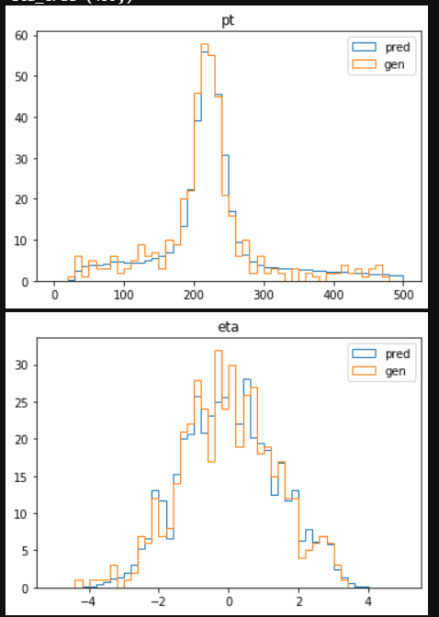
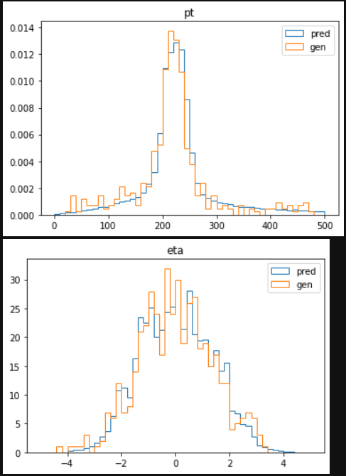
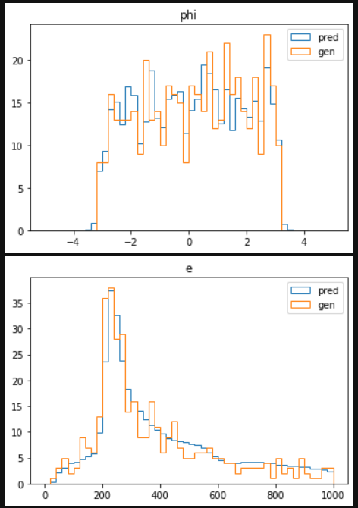
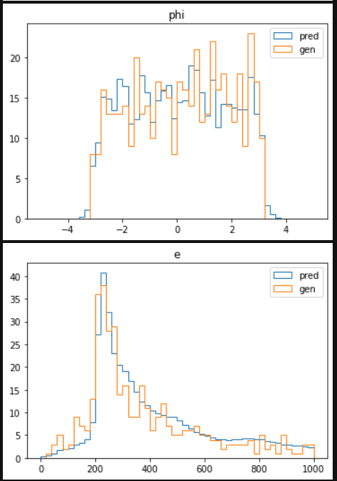
Raw reco pt between 200 and 220 GeV, 459 events (linear)

Slide 4
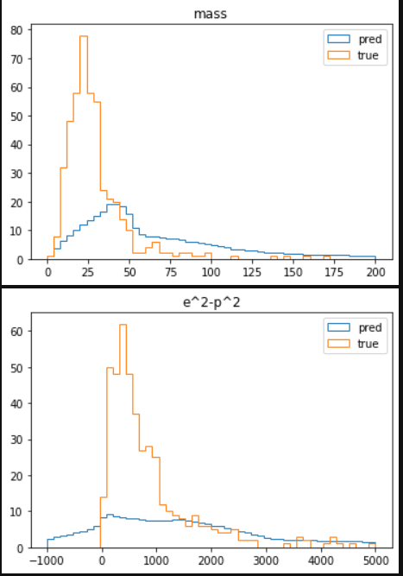
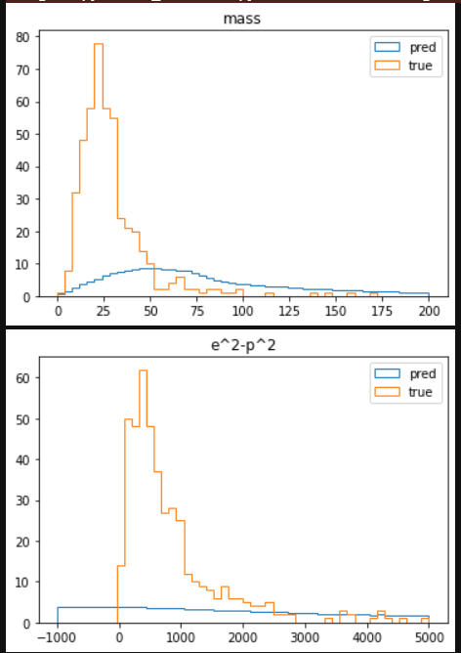
More complex relationships (pt<220 pt>200 (linear)

Slide 5
KS test along pt, eta, phi, and e for variable batch sizes
Probability of same distribution | 512 batch | 256 batch | 128 batch | 64 batch | 32 batch | 16 batch
Pt | 0.4286 | 0.0166 | 0.0088 | ~0 | 0.1009 | 0.0058
Eta | 0.9252 | 0.9983 | 0.9921 | ~0 | 0.9946 | 0.8504
Phi | 0.5182 | 0.6040 | 0.4521 | ~0 | 0.6406 | 0.0271
E | 0.1500 | 0.1216 | 0.0864 | ~0 | 0.2618 | 0.0182
Average | 0.5055 | 0.4351 | 0.3849 | ~0 | 0.4995 | 0.2254
Probability of same distribution | 32 batch | 256 batch | 512 batch | 1024 batch | 2048 batch | 5096 batch
Pt | 0.1009 | 0.0166 | 0.4286 | 0.2707 | 0.3038 | 0.0423
Eta | 0.9946 | 0.9983 | 0.9252 | 0.9739 | 0.9281 | 0.9611
Phi | 0.6406 | 0.6040 | 0.5182 | 0.6118 | 0.3258 | 0.2542
E | 0.2618 | 0.1216 | 0.1500 | 0.2588 | 0.1830 | 0.0182
Average | 0.4995 | 0.4351 | 0.5055 | 0.5288 | 0.4352 | 0.3190

Slide 6
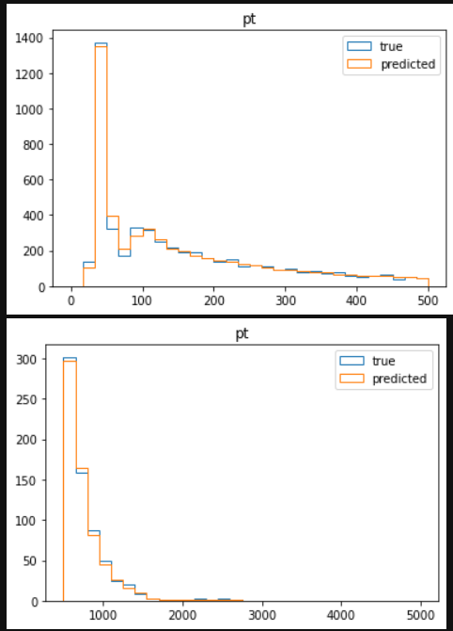
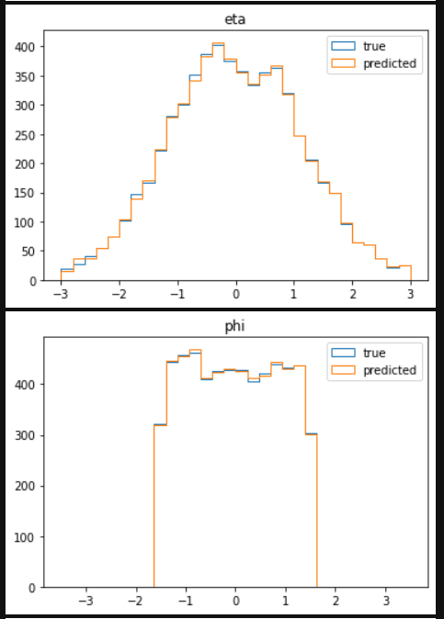
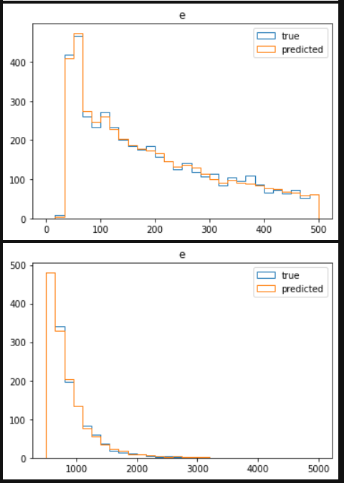
Particle by particle regression (added particle between 40, 50 GeV

Slide 7
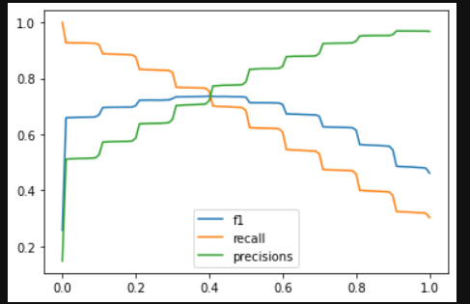
Particle by particle classification

