Slide 1

CMS Jet Reconstruction with Machine Learning
Braden Kronheim¹, Michelle Kuchera¹, Harrison Prosper², and Raghu Ramanujan¹
¹Davidson College, ²Florida State University

Slide 2
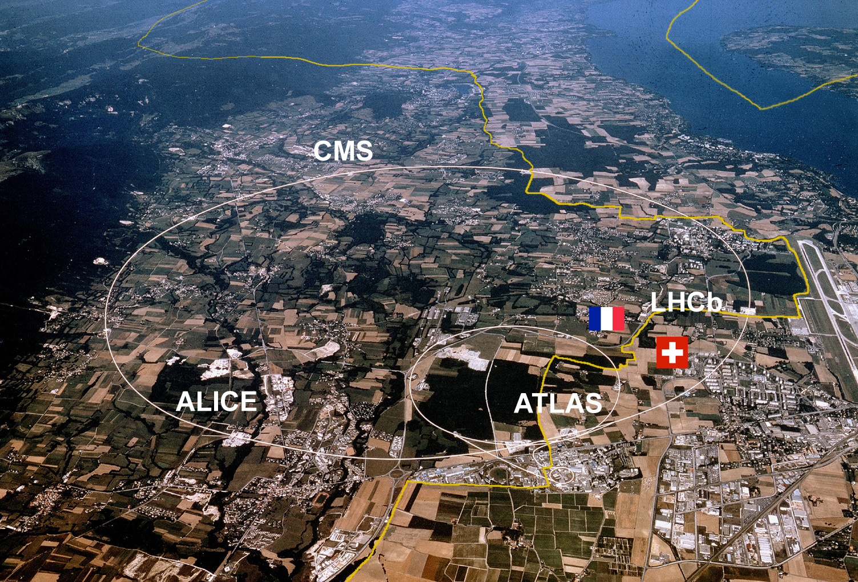
Large Hadron Collider (LHC)
Image credit: IEEE Spectrum
https://spectrum.ieee.org/computing/software/analyzing-the-lhc-magnet-quenches

Slide 3
Jets
b
Collection of hadrons which enter the detector as a jet
d
d
c
b
u
Starting quarks or gluons
s
u
s
b
b
c
c
d
Collection of hadrons which enter the detector as a jet
b
s
u
b

Slide 4
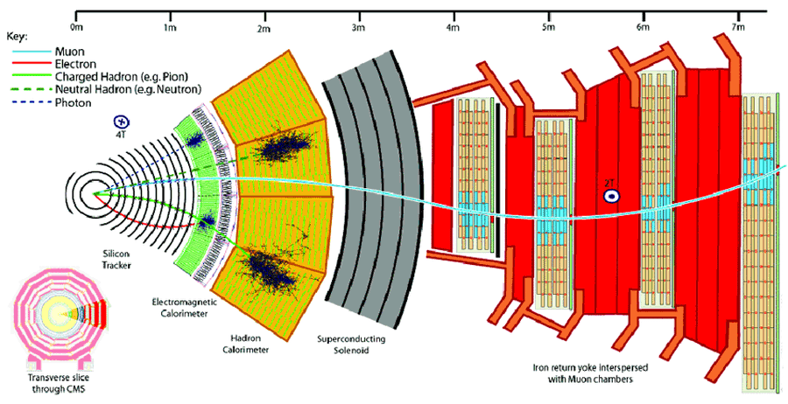
Compact Muon Solenoid (CMS)
Image Credit: Particle-flow reconstruction and global event description with the CMS Detector. Journal of Instrumentation, 12(10):P10003–P10003, Oct 2017.

Slide 5
Detector Geometry
Beam line
Transverse
Momentum (pT)
Particle
theta
eta
phi

Slide 6
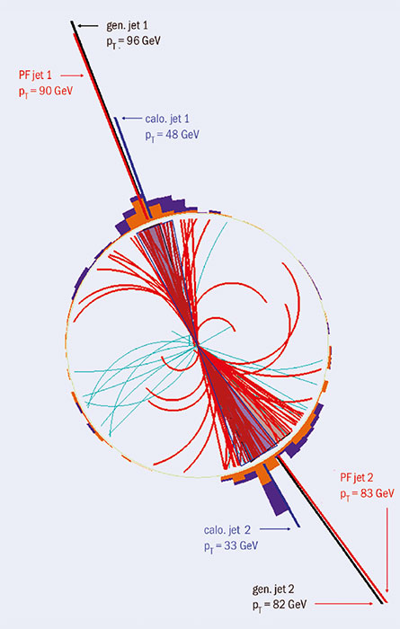
Jet Representation
Detector Effects,
Reconstruction
Methods
Hadronization
Jet Corrections
Quarks, Gluons
Gen level jet
Raw Reco Jet
Reco Jet
Image Credit: CERN Courier
https://cerncourier.com/a/particle-flow-in-cms/
Momentum written as:
(p_{x}, p_{y}, p_{z}, E)
(pT, η, φ, E)

Slide 7
Current Jet Corrections
Cluster particles and remove incorrect particles
Correct jet based on binning
Image Credit: CERN Courier
https://cerncourier.com/a/particle-flow-in-cms/

Slide 8
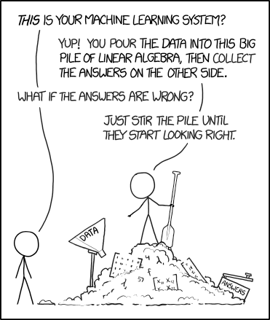
Machine Learning
Image credit: xkcd
https://xkcd.com/1838/

Slide 9
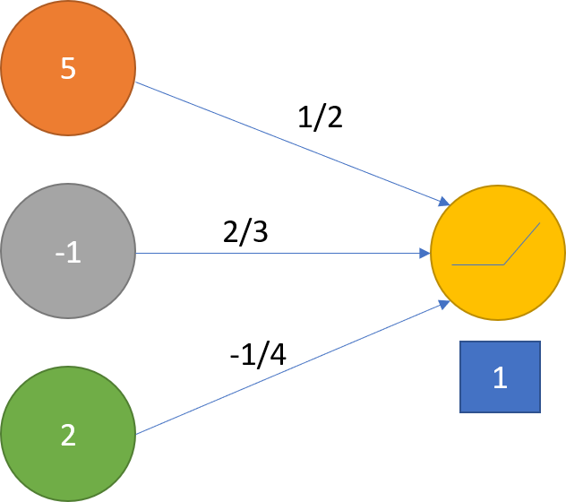
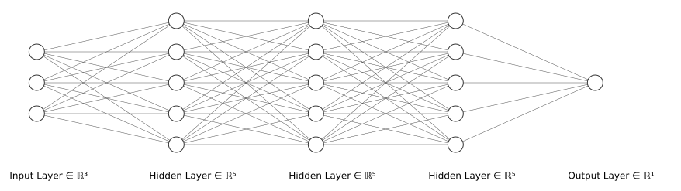
Neural Networks
7/3
Image Credit: https://alexlenail.me/NN-SVG/

Slide 10
Reco to Gen Mean Direct
Raw Reco
Gen

Slide 11
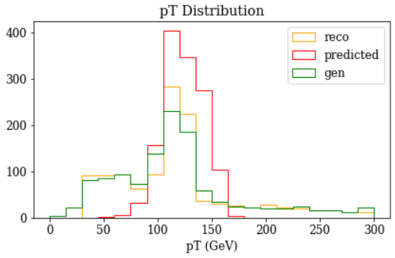
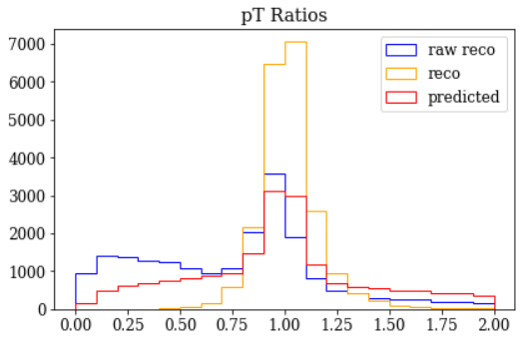
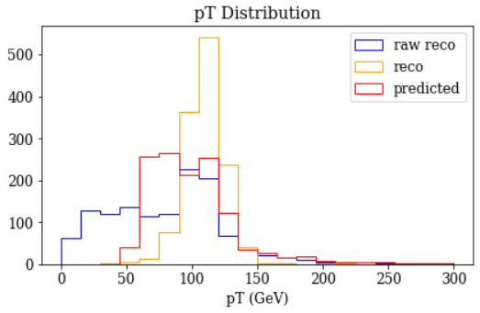
Results
Raw Reco pT between 100 and 120 GeV
Predicted pT
Gen pT between 100 and 120 GeV
Real pT

Slide 12
Reco to Gen Mean Buildup
Individual Reco
particles
Gen

Slide 13
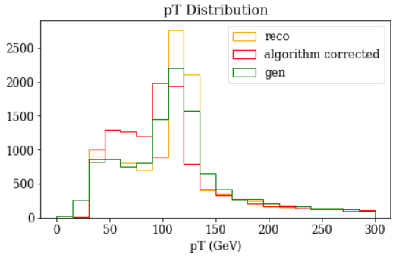
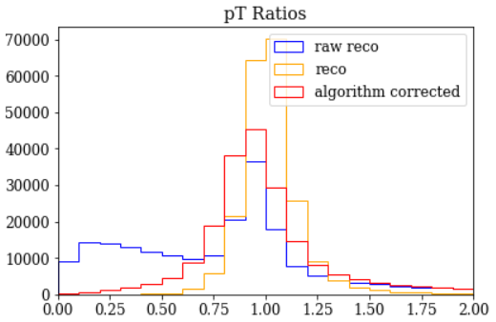
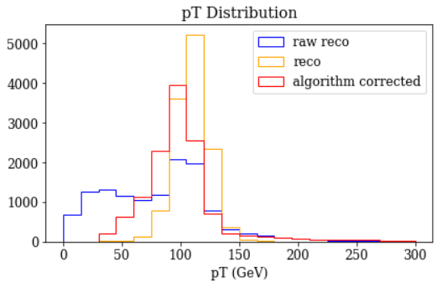
Results
Raw Reco pT between 100 and 120 GeV
Predicted pT
Gen pT between 100 and 120 GeV
Real pT

Slide 14
Reco to Gen Distribution
Raw Reco
Gen

Slide 15
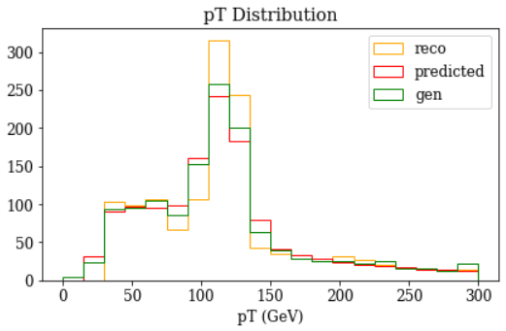
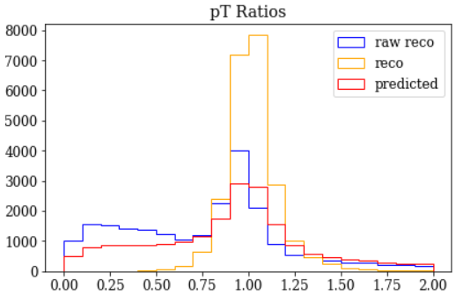
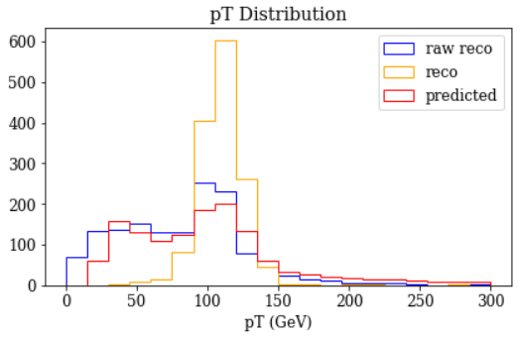
Results
Raw Reco pT between 100 and 120 GeV
Predicted pT
Gen pT between 100 and 120 GeV
Real pT

Slide 16
Reco to Gen Distribution Buildup
Individual Reco
particles
Gen

Slide 17
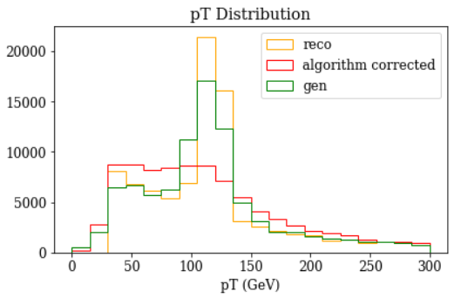
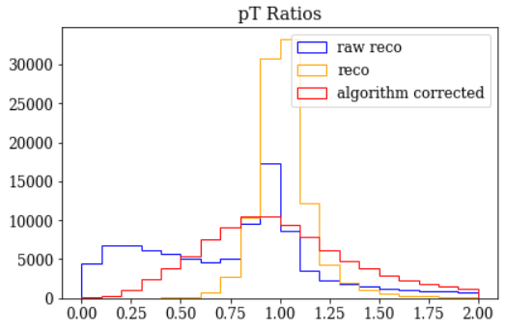
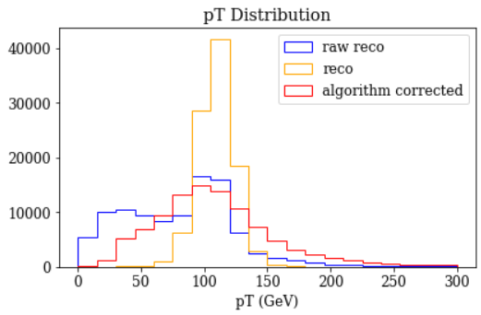
Results
Raw Reco pT between 100 and 120 GeV
Predicted pT
Real pT
Gen pT between 100 and 120 GeV

Slide 18
Further Study
How to improve initial matching
Issues with the initial matching will limit the quality of the neural nets
How to fine tune the final model
Clearly, it is not optimal yet, but some further experimentation should improve its performance
When calculating mass squared values from the output 4-vectors, we frequency get negative values, a problem which clearly needs to be fixed
Apply quantile network directly from the current reco values
Not ideal, but may provide the best overall performance

Slide 19
Questions?

Slide 20
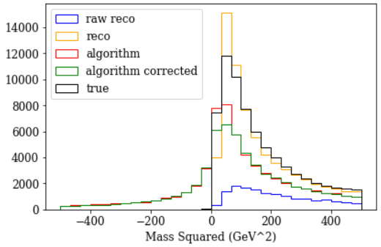
Mass Squared Distribution

Slide 21
Loss function choice
Mean Squared Error
Quantile
Function
Derivative

Slide 22
Multiple Step Single Predictions
Reco particles
Potentially in jet
Gen Jet
1
High pT
particles
A
B
2
4-vectors of
Reco particles
C
3
4-vectors of
particles in gen jet
4
5
Matching done by comparing pt and angular location of jets
6
Low pT
particles

Slide 23
Reco particles
Potentially in jet
4-vector of zeros
Gen Jet
Training inputs:
Training outputs, classifier
A
1
0
,
1
B
2
A
2
,
C
A
,
3
3
A
+
B
,
4
4
A
+
B
,
5
5
A
+
B
,
6
6

Slide 24
Reco particles
Potentially in jet
4-vector of zeros
Gen Jet
Training inputs:
Training outputs, regression
A
1
0
,
1
A
B
2
C
A
,
3
A
+
B
3
4
A
+
B
,
6
A
+
B
+
C
5
6

Slide 25
Potential Reco particles
Real use inputs:
Classifier:
Regression:
1
High pT
0
,
1
a
2
a
,
2
a
a
,
3
a
3
a
,
4
b
4
b
,
5
c
5
c
,
6
c
6
Low pT
Final jet 4-vector
d
Correction network

Slide 26
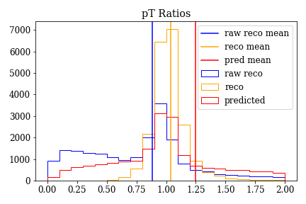
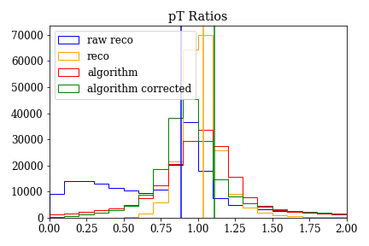
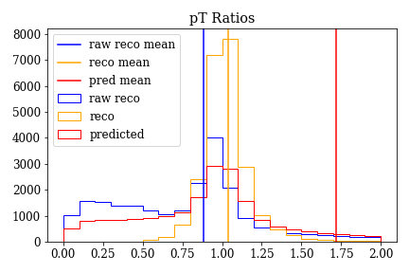
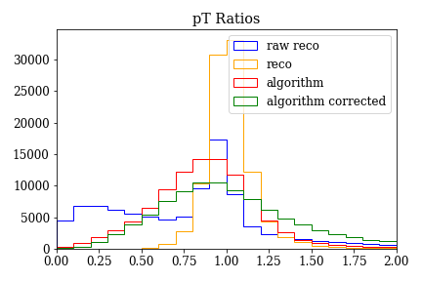
Results, pT ratio

Slide 27
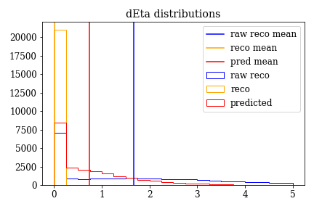
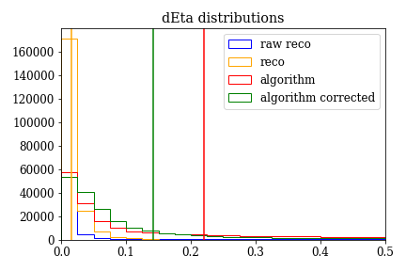
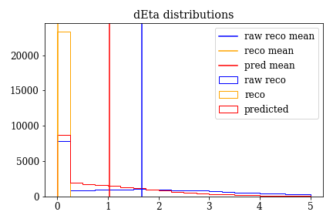
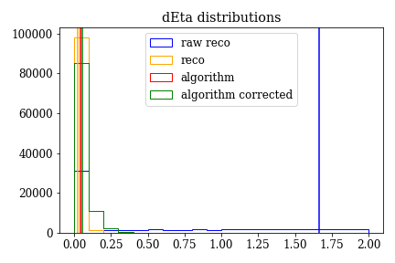
Results, dEta

Slide 28
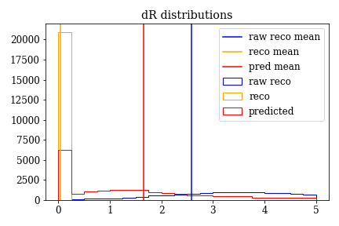
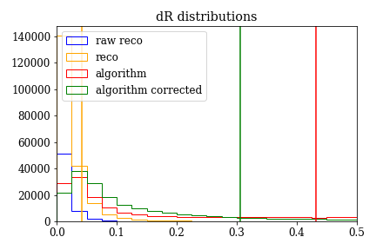
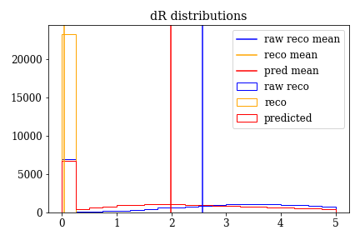
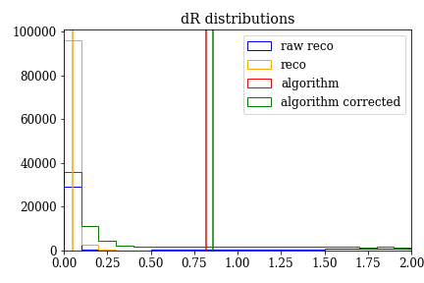
Results, dR

Slide 29
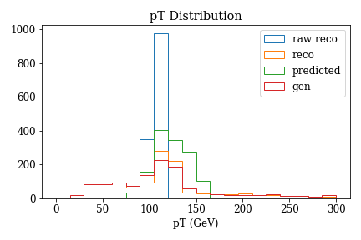
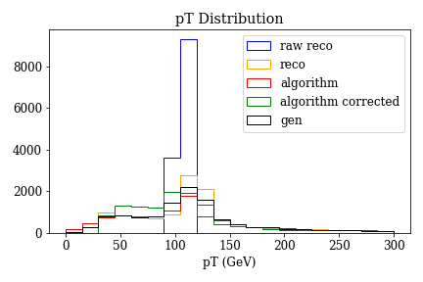
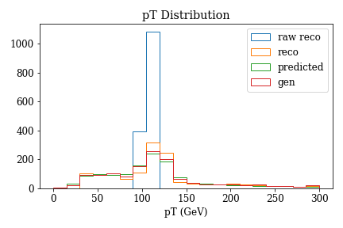
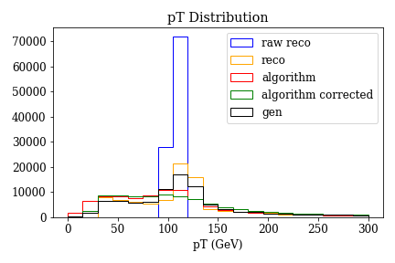
Results, pT distributions, raw reco delta

Slide 30
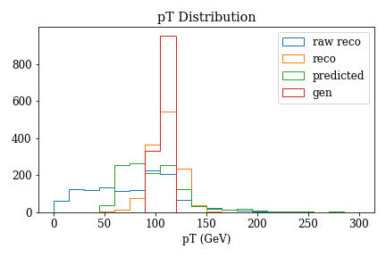
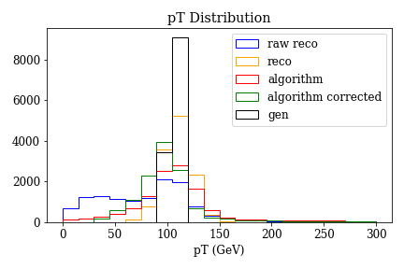
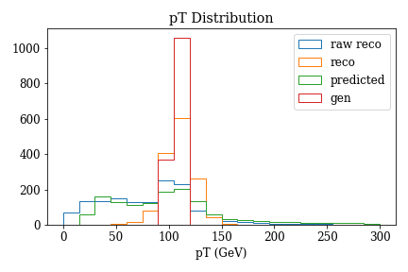
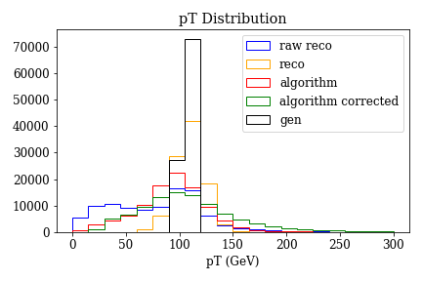
Results, pT distributions, gen delta

