Slide 1



A HYBRID MARKOV CHAIN AND SHAPLEY VALUE APPROACH TO MULTI-TOUCH ATTRIBUTION AND BUDGET OPTIMIZATION IN DIGITAL MARKETING
Presentation By Berkay Korkut
Department of Management Information Systems 2026
Supervisor: Asst. Prof. Dr. Mian Waqar Badshah
1

Slide 2






THE PROBLEM
Who deserves the credit?
Instagram
Google Search
E-mail
Direct
Purchase
Last-click attribution gives 100% credit to the final touchpoint.
All earlier channels: zero credit
2

Slide 3


THE REAL CHALLENGE
Last-Click
The Validation Gap
Many attribution methods exist.
But how do we know which one is correct?
❌ Real-world data has no ground truth.
❌ We can’t ask the customer’s mind: “what really convinced you?”
⟶ Attribution research has been a decades-old debate without a referee.
First-Click
Markov-Chain
Shapley Value
Linear
3

Slide 4



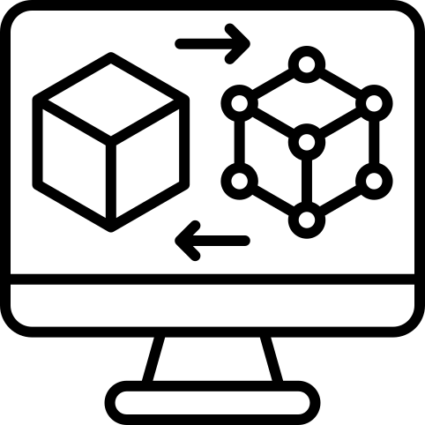

OUR APPROACH: SYNTHETIC GROUND TRUTH
Building a controlled laboratory
30,000 customer journey
5 marketing channels
Calibrated from industry benchmarks
1.18% conversion rate
Channel effects pre-defined
Monte Carlo (100k paths)
All 8 models tested against it
Synthetic Dataset
Known Ground Truth
⟶ Every method gets a fair, objective grade
4

Slide 5
THE HYBRID MODEL
Combining two complementary methods
Markov Chain
✅ Ranks channels correctly
❌ Exaggerates magnitudes
Shapley Value
✅ Calibrated magnitudes
❌ Blurs the ranking
Hybrid = α · Markov + (1−α) · Shapley
Empirically optimal: α = 0.25*
(25% Markov + 75% Shapley)
5

Slide 6
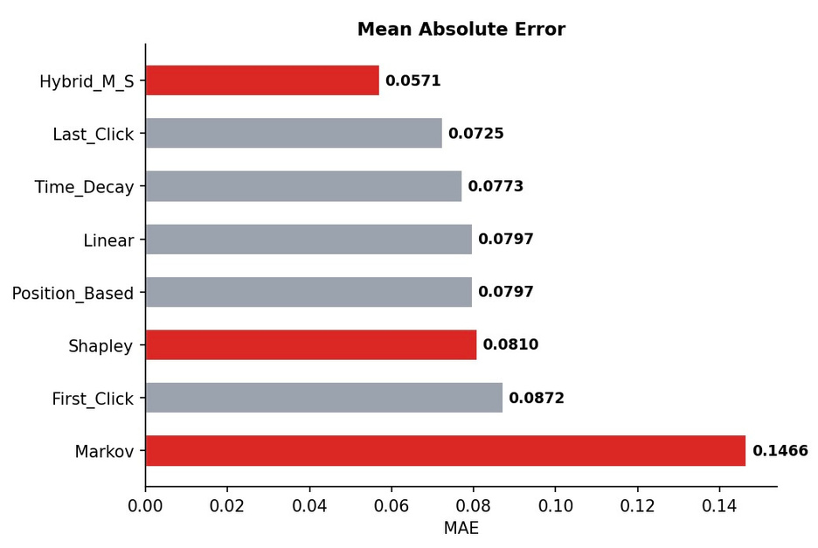

RESULTS: ATTRIBUTION ACCURACY
The hybrid model wins - by a clear margin
METRIC | LAST-CLICK | HYBRID
MAE | 0.0725 | 0.0571
SPEARMAN P | 0.300 | 0.600
RANK ACCURACY | 40% | 60%
⟶ 21.2% lower error, 2x better ranking
6

Slide 7
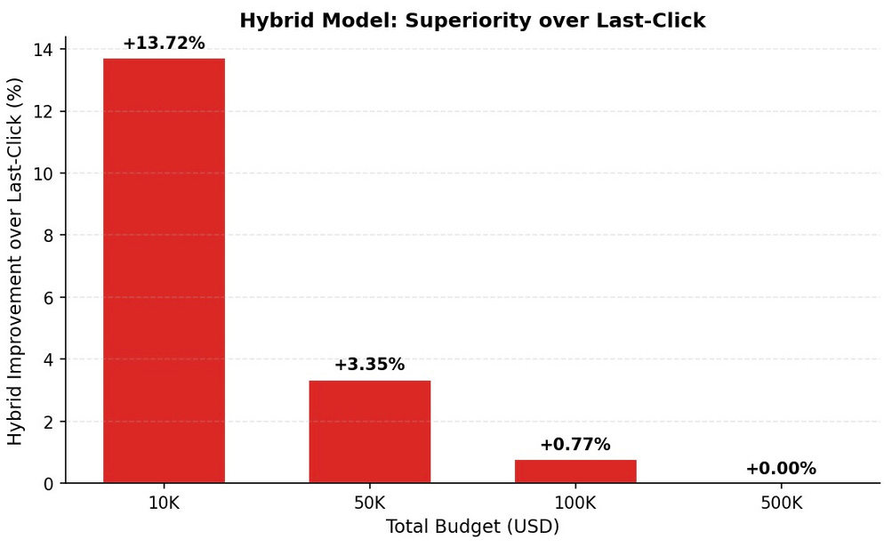

RESULTS: REVENUE IMPACT
What does this mean in dollars?
BUDGET | IMPROVEMENT
$10,000 | +13.72%
$50,000 | +3.35%
$100,000 | +0.77%
$500,000 | ≈0% (saturation)
⟶ Greatest value: small-to-medium B2C operations
7

Slide 8

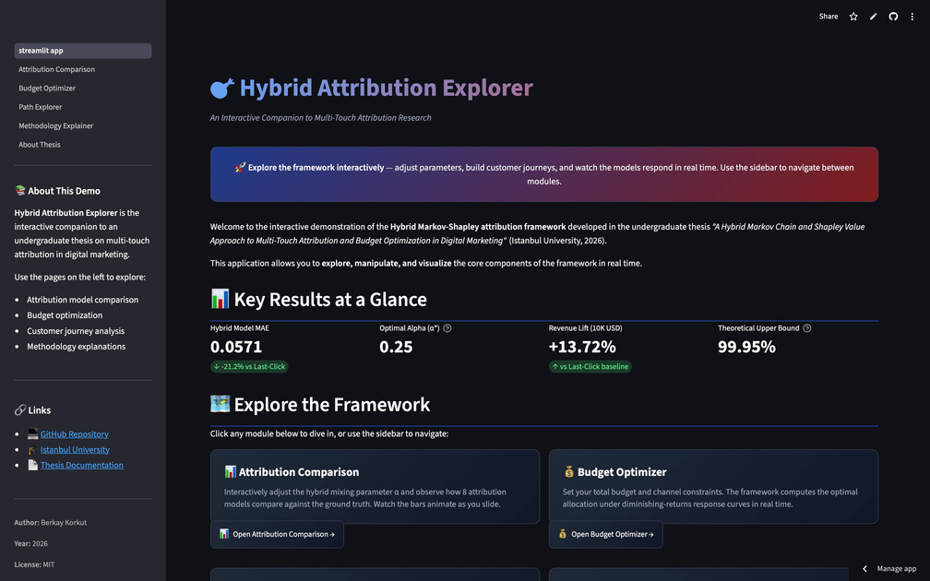
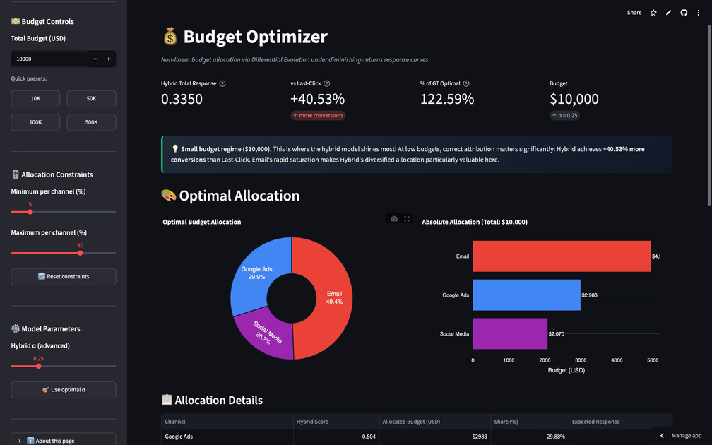

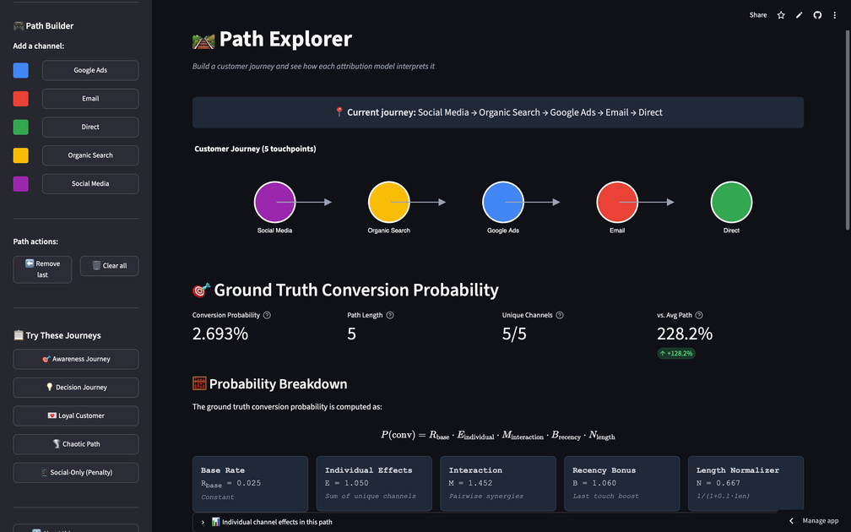
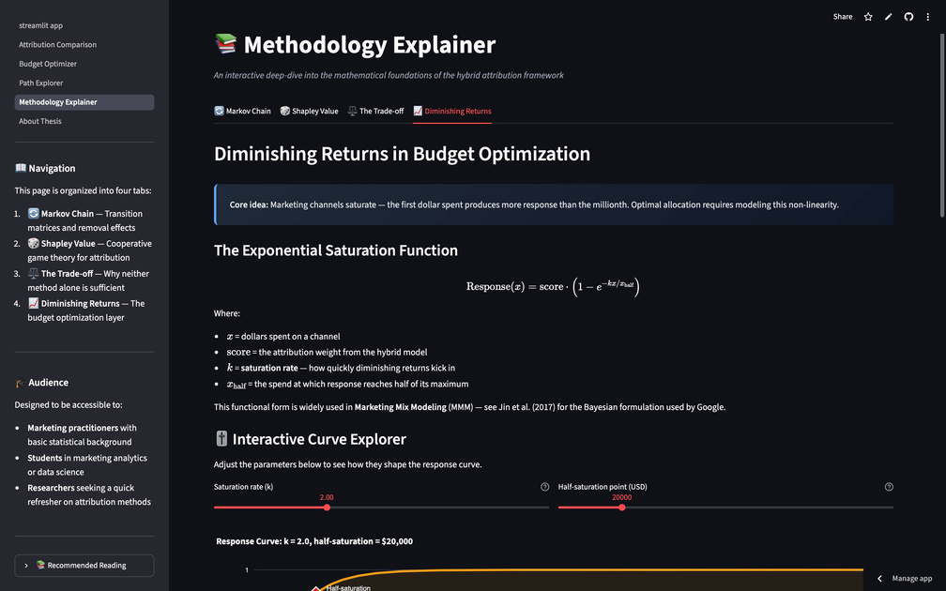
INTERACTIVE DEMO
An interactive companion - explore it yourself
🔗 hybrid-attribution-explorer.streamlit.app
🖥️ GitHub: brky48/hybrid-mta-attribution
8

Slide 9

THANK YOU SO MUCH!
Three Contributions
1️⃣ Validation framework – synthetic ground truth for objective comparison
2️⃣ Markov-Shapley trade-off – formally identified and resolved
3️⃣ Integration with budget optimization – attribution meets allocation
I would like to express my sincere gratitude to my supervisor, Professor Mian Waqar Badshah, for his guidance and support throughout this thesis.
I am also deeply grateful to all the professors of the Department of Management Information Systems for the foundation they have given me during my undergraduate studies.
Thank you.
Presentation By Berkay Korkut
Department of Management Information Systems, 2026
9

