Slide 1
D-Academe
Mid-term progress
SANGAM SUBEDI
AMIT BARAL
PRABIN SHRESTHA

Slide 2
Contents
Introduction
Project Overview
DFD
ER-Diagram
Methodology
Progress and Status
Issues
Gantt Chart

Slide 3
Introduction
Transforming Education: Our decentralized platform is designed to make education more accessible, flexible, and engaging, breaking barriers like location and rigid schedules.
Progress and Focus: With 80% of the platform complete, we are finalizing key features like live learning and course purchasing to ensure a seamless and dynamic learning experience.
Commitment to Impact: By leveraging decentralized technology, we aim to empower students and educators, fostering collaboration, trust, and greater control in the learning process.

Slide 4
Project Overview
Progress Update: Our decentralized online learning platform is 80% complete, with the final development phases focused on essential features such as live learning and course purchasing.
Vision and Commitment: We are on track to deliver an innovative, accessible, and engaging solution designed to revolutionize the learning experience for all.

Slide 5
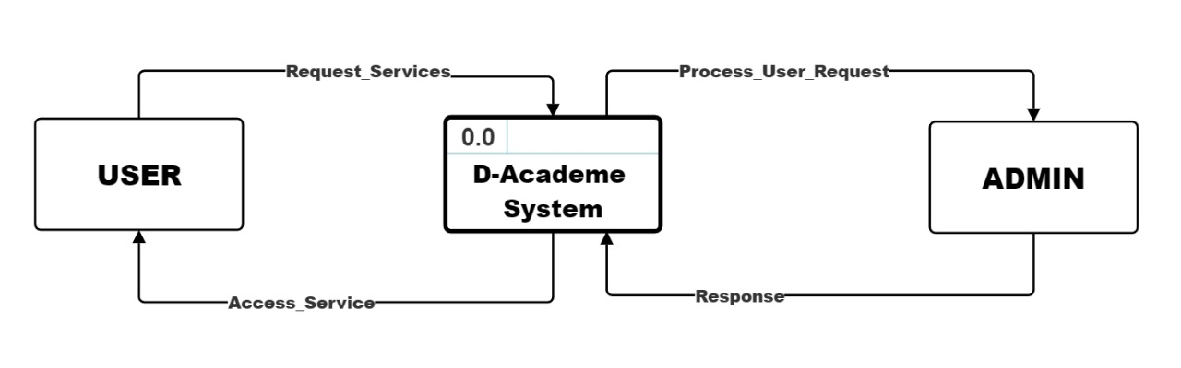
DFD
Level 0,DFD

Slide 6
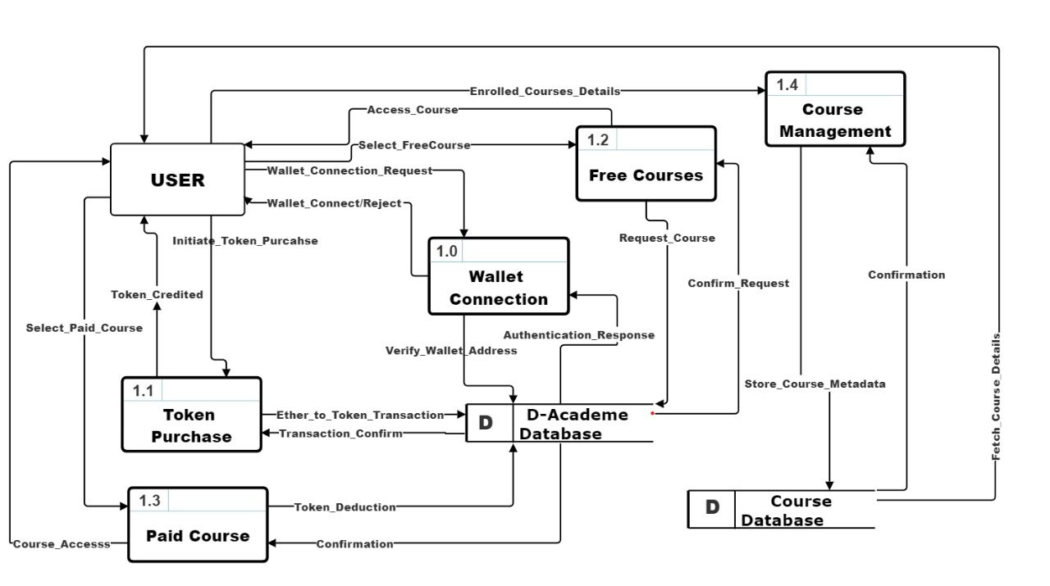
Level 1, DFD

Slide 7
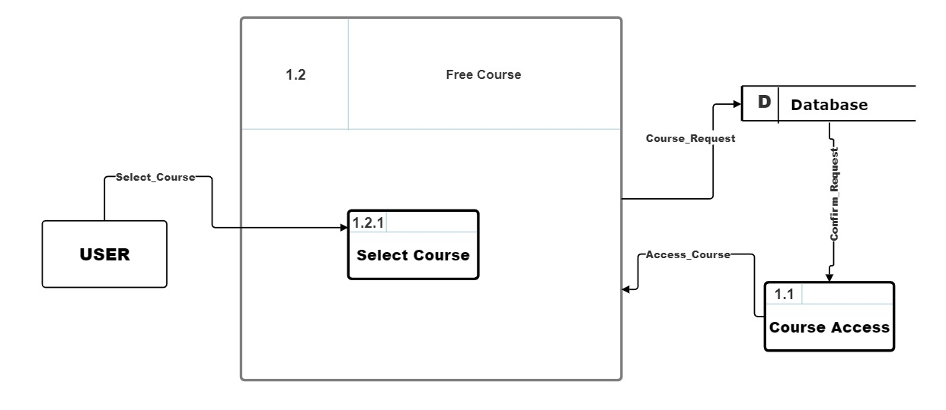
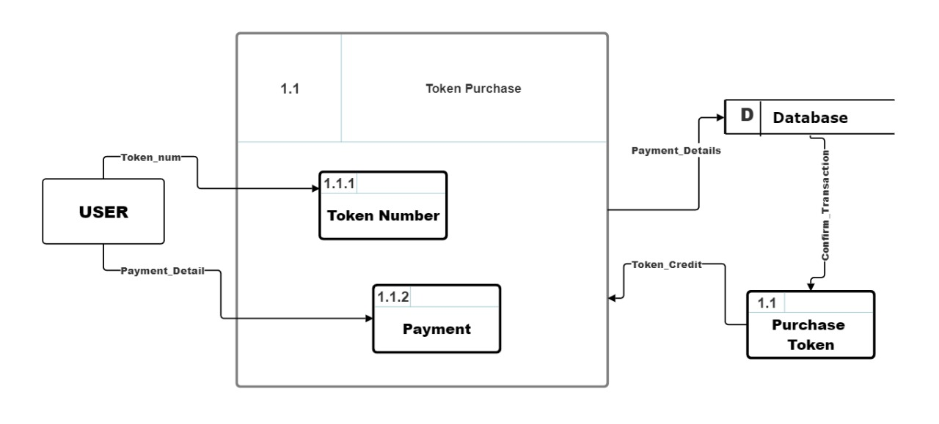
Level 2, DFD for free course
Level 2, DFD for token purchase

Slide 8
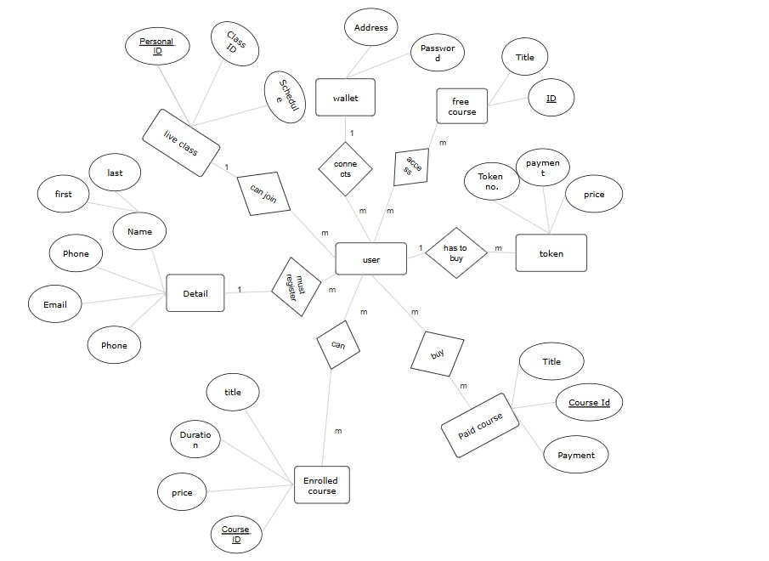
Er-Diagram

Slide 9
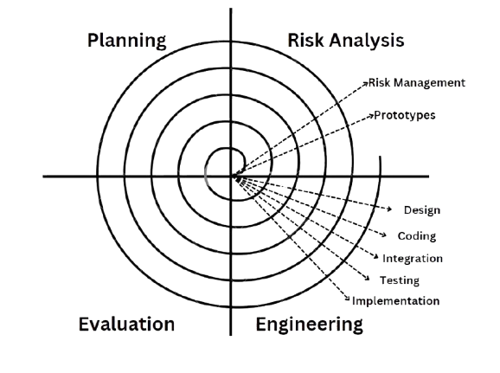
Methodology

Slide 10
Progress and Status
Completed
Dashboard
Course Contents
Login with meta mask
Token Purchase
Front End
Yet to be
Enrolled Course
Database Update
Live Class
Buy course Function
Some Css

Slide 11
Problems and Issue faced
Technical Challenges: Difficulty in implementing advanced features like live learning and secure payment systems.
Time Management: Balancing project work with other studies or responsibilities.

Slide 12
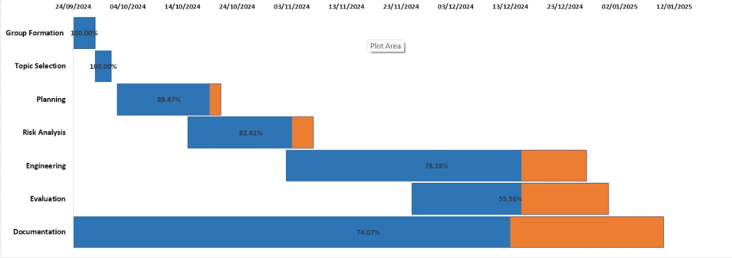
Gantt-Chart

Slide 13
Thank you

