Slide 1
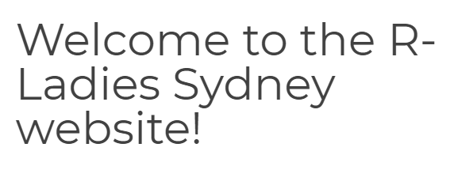

All Sources From R-Ladies Sydney
https://rladiessydney.org/courses/ryouwithme/
Modules:
BasicBasics: Install and Foundations
CleanItUp: Data Cleaning
VizWhiz: Pretty Visualizations Using ggplot2
MarkyMark: R Markdown for Analysis Reports

Slide 2
Lesson One Outcomes
1.1. Have R and RStudio installed on your machine**
1.2 Know your way around RStudio
Know how to create a Project file and a script in RStudio
Understand the idea of a working directory and where your RBasic files live
Understand what happens in the “four quadrants” of RStudio
1.3. Have adjusted your settings to make your RStudio life a little less painful
**Need to install both R and Rstudio (Use either for Mac or Windows)
https://rstudio.com/products/rstudio/download/

Slide 3
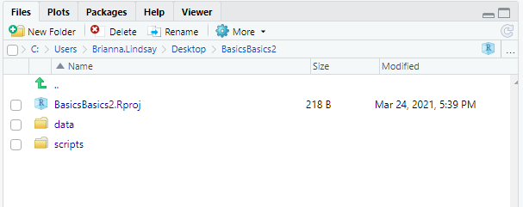
Lesson One Outcomes
1.2 Know your way around RStudio
Know how to create a Project file and a script in RStudio
Understand the idea of a working directory and where your RBasic files live
Understand what happens in the “four quadrants” of RStudio

Slide 4
Lesson Two Outcomes
2.1 Understand what a package is
2.2 Understand how to install packages from the console (quadrant 2).
2.3 Be able to use the library function to load packages at the top of your script (and understand why it is best to do it there and not in the console!)
2.4 Know how to find useful information about how to use a particular package when you are trying something new.

Slide 5
Useful Packages
Useful Symbols
tidyverse
ggplot2
dplyr
tidyr
readr
purrr
tibble
stringr
forcats
# comment
------ section
<- assign
here
janitor readme vignette
summarytools vignette
skimr
epitools

Slide 6
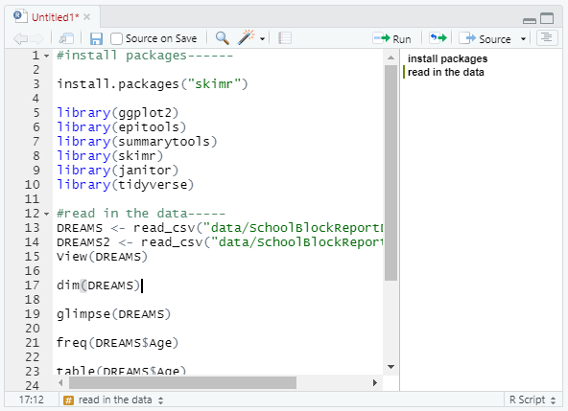
#install packages------
install.packages("skimr")
library(epitools)
library(summarytools)
library(skimr)
library(janitor)
library(tidyverse)
#read in the data-----
DREAMS <- read_csv("data/SchoolBlockReportDREAMS.csv")
DREAMS2 <- read_csv("data/SchoolBlockReportDREAMS.csv")
View(DREAMS)
dim(DREAMS)
glimpse(DREAMS)
freq(DREAMS$Age)
table(DREAMS$Age)
skim(DREAMS)
library(summarytools)
view(dfSummary(SchoolBlockReportDREAMS))
edit(SchoolBlockReportDREAMS)

Slide 7
Lesson Three Outcomes
3.1 Have the SchoolBlockReportDREAMS.csv data file saved to your RBasicBasics data folder
3.2 Know how to use the here package to tell R where your data is, how to use read_csv to read data from a .csv file, and how to use summary functions to explore your data
3.3 Have an idea of where to go to learn more about reading different kinds of data into R

Slide 8
Lesson Four Outcomes
1.1. Understand how to clean up column names automatically using clean_names() or manually using rename()
1.2 Know how to create subsets of data using select()
1.3. Be able to “pipe” %>% data through a series of dplyr functions

