Slide 1
BriannA Major
Computer Science
Millersville University

Slide 2
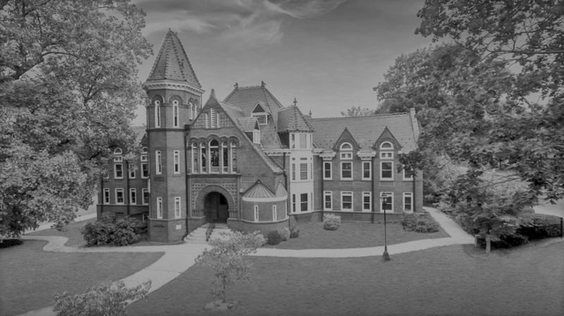
Programming Languages (Ocaml) Data Structures (C++) Database and Web Development (MySQL, HTML, CSS, JavaScript) Computational Models Computer Architecture (Intel x86_64) Operating Systems (C, Pthreads) Software Engineering (Java, JavaFX) Artificial Intelligence (Lisp, Python, Z3) Parallel Programming (C++, Pthreads, MPI) Data Mining (R, Python)
Coursework

Slide 3



Slide 4
RAJA Performance portability layer
Original Developers: Rich Hornung, Jeff Keasler Developed at: Lawrence Livermore National Laboratory

Slide 5
RAJA
Library of C++ abstractions designed to create and simplify portable parallel applications
Focus on abstracting nested loops to simplify creation of loops, transformations, data layouts, blocking, and permutations
Protect loop kernels from architecture or programming model-specific needs
Types for loop nests
Lambdas for loop kernels
Currently able to execute different model back-ends including:
Sequential, SIMD, CUDA, OpenMP
[exp] Intel Threading Building Blocks and OpenACC

Slide 6
Parallelizing the PolyBench 3D Heat Equation Using the RAJA Performance Portability Layer

Slide 7
Original Heat-3D Stencil Code
for (t = 1; t <= tsteps; t++) {
for (i = 1; i < N-1; i++) {
for (j = 1; j < N-1; j++) {
for (k = 1; k < N-1; k++) {
B[i][j][k] = A[i][j][k] +
T(0.125) * (A[i+1][j][k] - T(2.0) * A[i][j][k] + A[i-1][j][k]) +
T(0.125) * (A[i][j+1][k] - T(2.0) * A[i][j][k] + A[i][j-1][k]) +
T(0.125) * (A[i][j][k+1] - T(2.0) * A[i][j][k] + A[i][j][k-1]);
}
}
}
}
for (t = 1; t <= tsteps; t++) {
for (i = 1; i < N-1; i++) {
for (j = 1; j < N-1; j++) {
for (k = 1; k < N-1; k++) {
A[i][j][k] = B[i][j][k] +
T(0.125) * (B[i+1][j][k] - T(2.0) * B[i][j][k] + B[i-1][j][k]) +
T(0.125) * (B[i][j+1][k] - T(2.0) * B[i][j][k] + B[i][j-1][k]) +
T(0.125) * (B[i][j][k+1] - T(2.0) * B[i][j][k] + B[i][j][k-1]);
}
}
}
}

Slide 8
Original Heat-3D Stencil Code
for (t = 1; t <= tsteps; t++) {
for (i = 1; i < N-1; i++) {
for (j = 1; j < N-1; j++) {
for (k = 1; k < N-1; k++) {
B[i][j][k] = A[i][j][k] +
T(0.125) * (A[i+1][j][k] - T(2.0) * A[i][j][k] + A[i-1][j][k]) +
T(0.125) * (A[i][j+1][k] - T(2.0) * A[i][j][k] + A[i][j-1][k]) +
T(0.125) * (A[i][j][k+1] - T(2.0) * A[i][j][k] + A[i][j][k-1]);
}
}
}
}

Slide 9
Example – Loop Body
auto bodyB = [=] (int i, int j, int k) {
b(i, j, k) = a(i, j, k) + Type{0.125} * (
a(i+1, j, k) - Type{2.0} * a(i, j, k) + a(i-1, j, k) +
a(i, j+1, k) - Type{2.0} * a(i, j, k) + a(i, j-1, k) +
a(i, j, k+1) - Type{2.0} * a(i, j, k) + a(i, j, k-1));
};

Slide 10
Example – Execution
auto seg = RAJA::make_range (1, n-1);
auto segs = RAJA::make_tuple (seg, seg, seg);
for (int t = 0; t < tsteps, ++t) {
RAJA::Kernel<Policy> (segs, bodyB);
RAJA::Kernel<Policy> (segs, bodyA);
}

Slide 11
Example – Views
using View3D = RAJA::View<Type, RAJA::Layout<3>>;
Type* ompA = new Type[n * n * n];
Type* ompB = new Type[n * n * n];
View3D aOMP {aOMP, n, n, n};
View3D bOMP {bOMP, n, n, n};

Slide 12
Example – Execution Policy
using namespace RAJA::statement;
init(aOMP, bOMP, n);
using OMPPolicy = RAJA::KernelPolicy<
For<0, RAJA::omp_parallel_for_exec,
For<1, RAJA::loop_exec,
For<2, RAJA::simd_exec,
Lambda<0>>>>>;

Slide 13
Example – Execution Policy
using namespace RAJA::statement;
using CUDAPolicy = RAJA::KernelPolicy<
CudaKernel<
Tile<0, tile_fixed<32>, RAJA::cuda_block_z_loop,
Tile<1, tile_fixed<32>, RAJA::cuda_block_y_loop,
Tile<2, tile_fixed<32>, RAJA::cuda_block_x_loop,
For<0, RAJA::cuda_thread__z_loop,
For<1, RAJA::cuda_thread__y_loop,
For<2, RAJA::cuda_thread__x_loop,
Lambda<0>>>>>>>>>;

Slide 14
Performance Comparison
N (size) | Sequential | OpenMP (i7-8086K 6C12T) |  | CUDA (NVIDIA GTX 1080)
 | Time (ms) | Time (ms) | Speedup | Time (ms) | Speedup
125 | 232.46 | 53.76 | 4.32 | 6.72 | 34.59
250 | 1,881.62 | 336.00 | 5.60 | 49.68 | 37.89
500 | 15,155.50 | 2,682.39 | 5.65 | 524.46 | 28.89
750 | 51,643.41 | 9,044.38 | 5.71 | 2,283.84 | 22.60
1000 | 121,820.62 | 21,409.63 | 5.69 | 5,147.87 | 23.68

Slide 15
Results – Discussion
The obvious: OpenMP and CUDA versions are much better than sequential
Parallelizing on the GPU is 7-8x faster than multicore CPU
Stencils really lend themselves to being run on the GPU
RAJA is a great way to figure out the best way to parallelize “kernel” code without needing to rewrite!
Just change the execution policy type

Slide 16
Conclusions
If you are using nested loops (kernels), RAJA is a great tool
(Relatively) simple to use
Easy to compare/modify/iterate
Didn’t really know what I was getting into
Not as much design as I thought
Requires good understanding of what you’d like to do

Slide 17
Extending raja
Adding OpenACC support

Slide 18
About OpenACC
Improving and simplifying parallelization on accelerators
Adding to RAJA can simplify use and maintain portability across platforms
Directive based programming model
Prescriptive or descriptive programming
Currently only supports reductions through directives

Slide 19
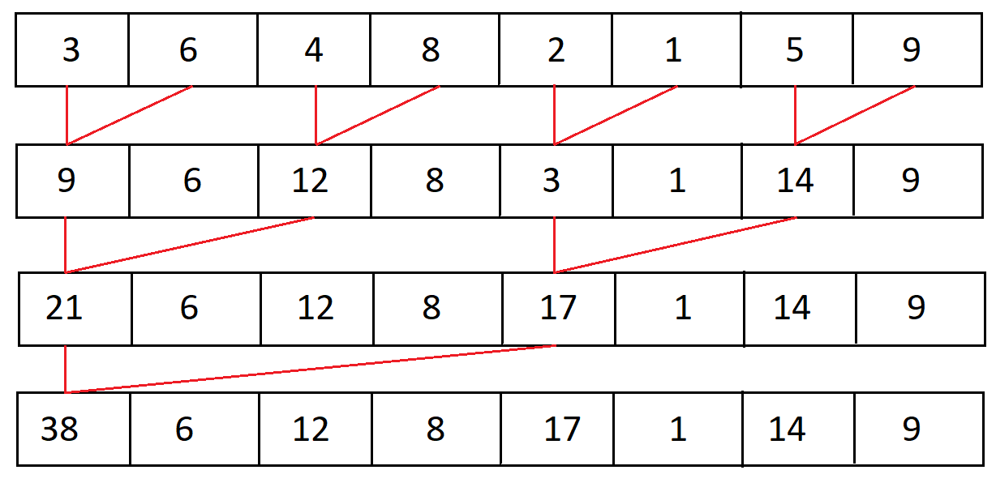
Reduction
Takes an associative operator (example uses sum)
Calculates result of operation using neighbor, leaving n/2 elements to be reduced with each step

Slide 20
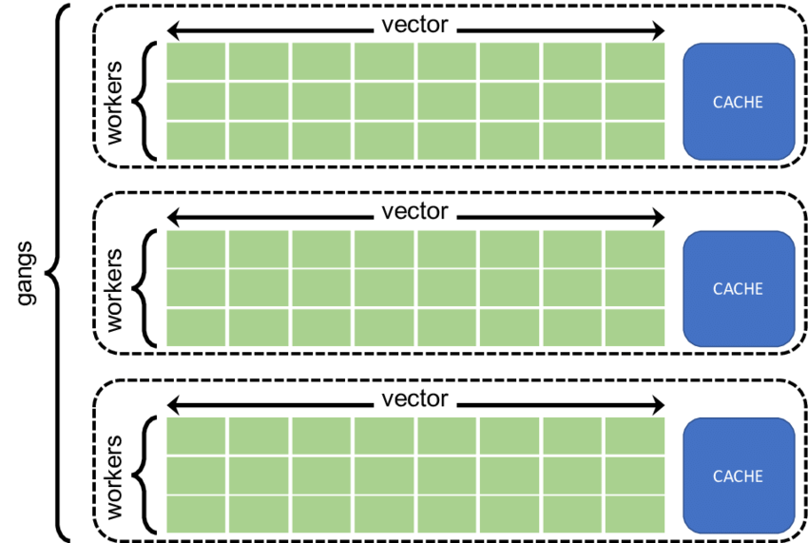
Gangs, Workers, and Vectors
Gang is the equivalent of CUDA thread block
Worker is the equivalent of CUDA warp
Vector is equivalent of CUDA threads in a warp
https://www.researchgate.net/figure/OpenACC-levels-of-parallelism_fig11_318990557

Slide 21
Gang
Gang Vector
Worker
Gang Worker
Gang Worker Vector
Vector
Worker Vector

Slide 22
Next Steps
Creation, Initialization, Copying, Destroying
Constructor, Copy Constructor, Destructor
Constructor
Allocate on the device?
How much can I allocate on GPU?
Initialize?
Now? Later?
Copy Constructor
Before copy: where are we?
Initialize?
Destructor
Where are we?
Copy sum
Free space
Need to know:
Value
Device pointer to buffer
on_device
data_on_device

Slide 23
Citations
https://github.com/Meinersbur/polybench/tree/master/polybench-code
https://raja.readthedocs.io/en/master/index.html
https://www.sciencedirect.com/science/article/pii/S0957417414006599
https://dournac.org/info/parallel_heat3d
https://www.researchgate.net/figure/OpenACC-levels-of-parallelism_fig11_318990557

Slide 24
Questions

