Slide 1
HTML Basics
An intro to HTML
JOUR352: Interactive Design & Development

Slide 2
Web markup languages
HTML: HyperText Markup Language
Basic formatting for web pages
CSS: Cascading Stylesheets
Advanced styling and layout

Slide 3
Common HTML Tags
W3Schools
HTML Dog

Slide 4
HTML
System for “tagging” or marking up content on web pages
HTML “tags” are code hidden from end user, but tell Web browsers how to display pages online

Slide 5
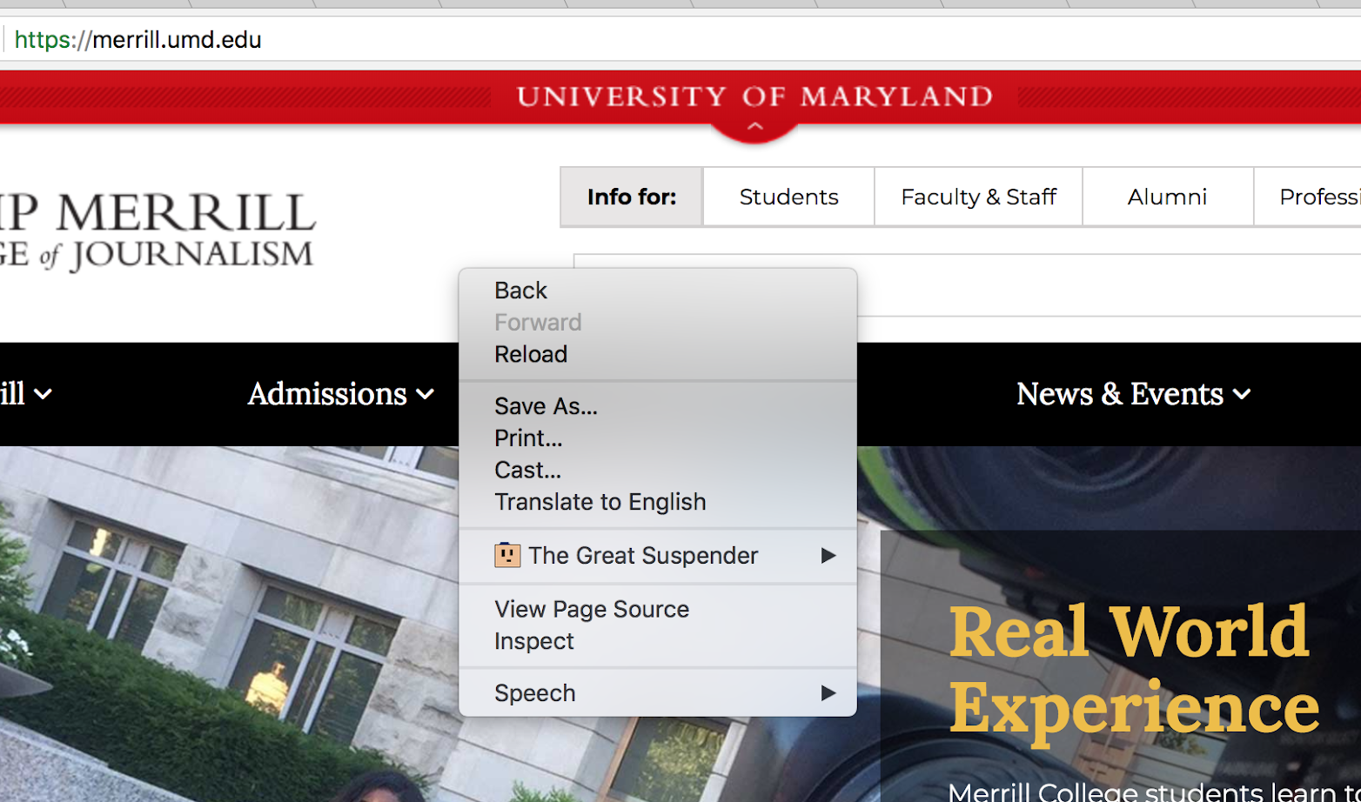
Right-click on a web page and select “View Page Source” to see the site’s HTML code.
(Right-clicking on an image will give a different set of options)

Slide 6
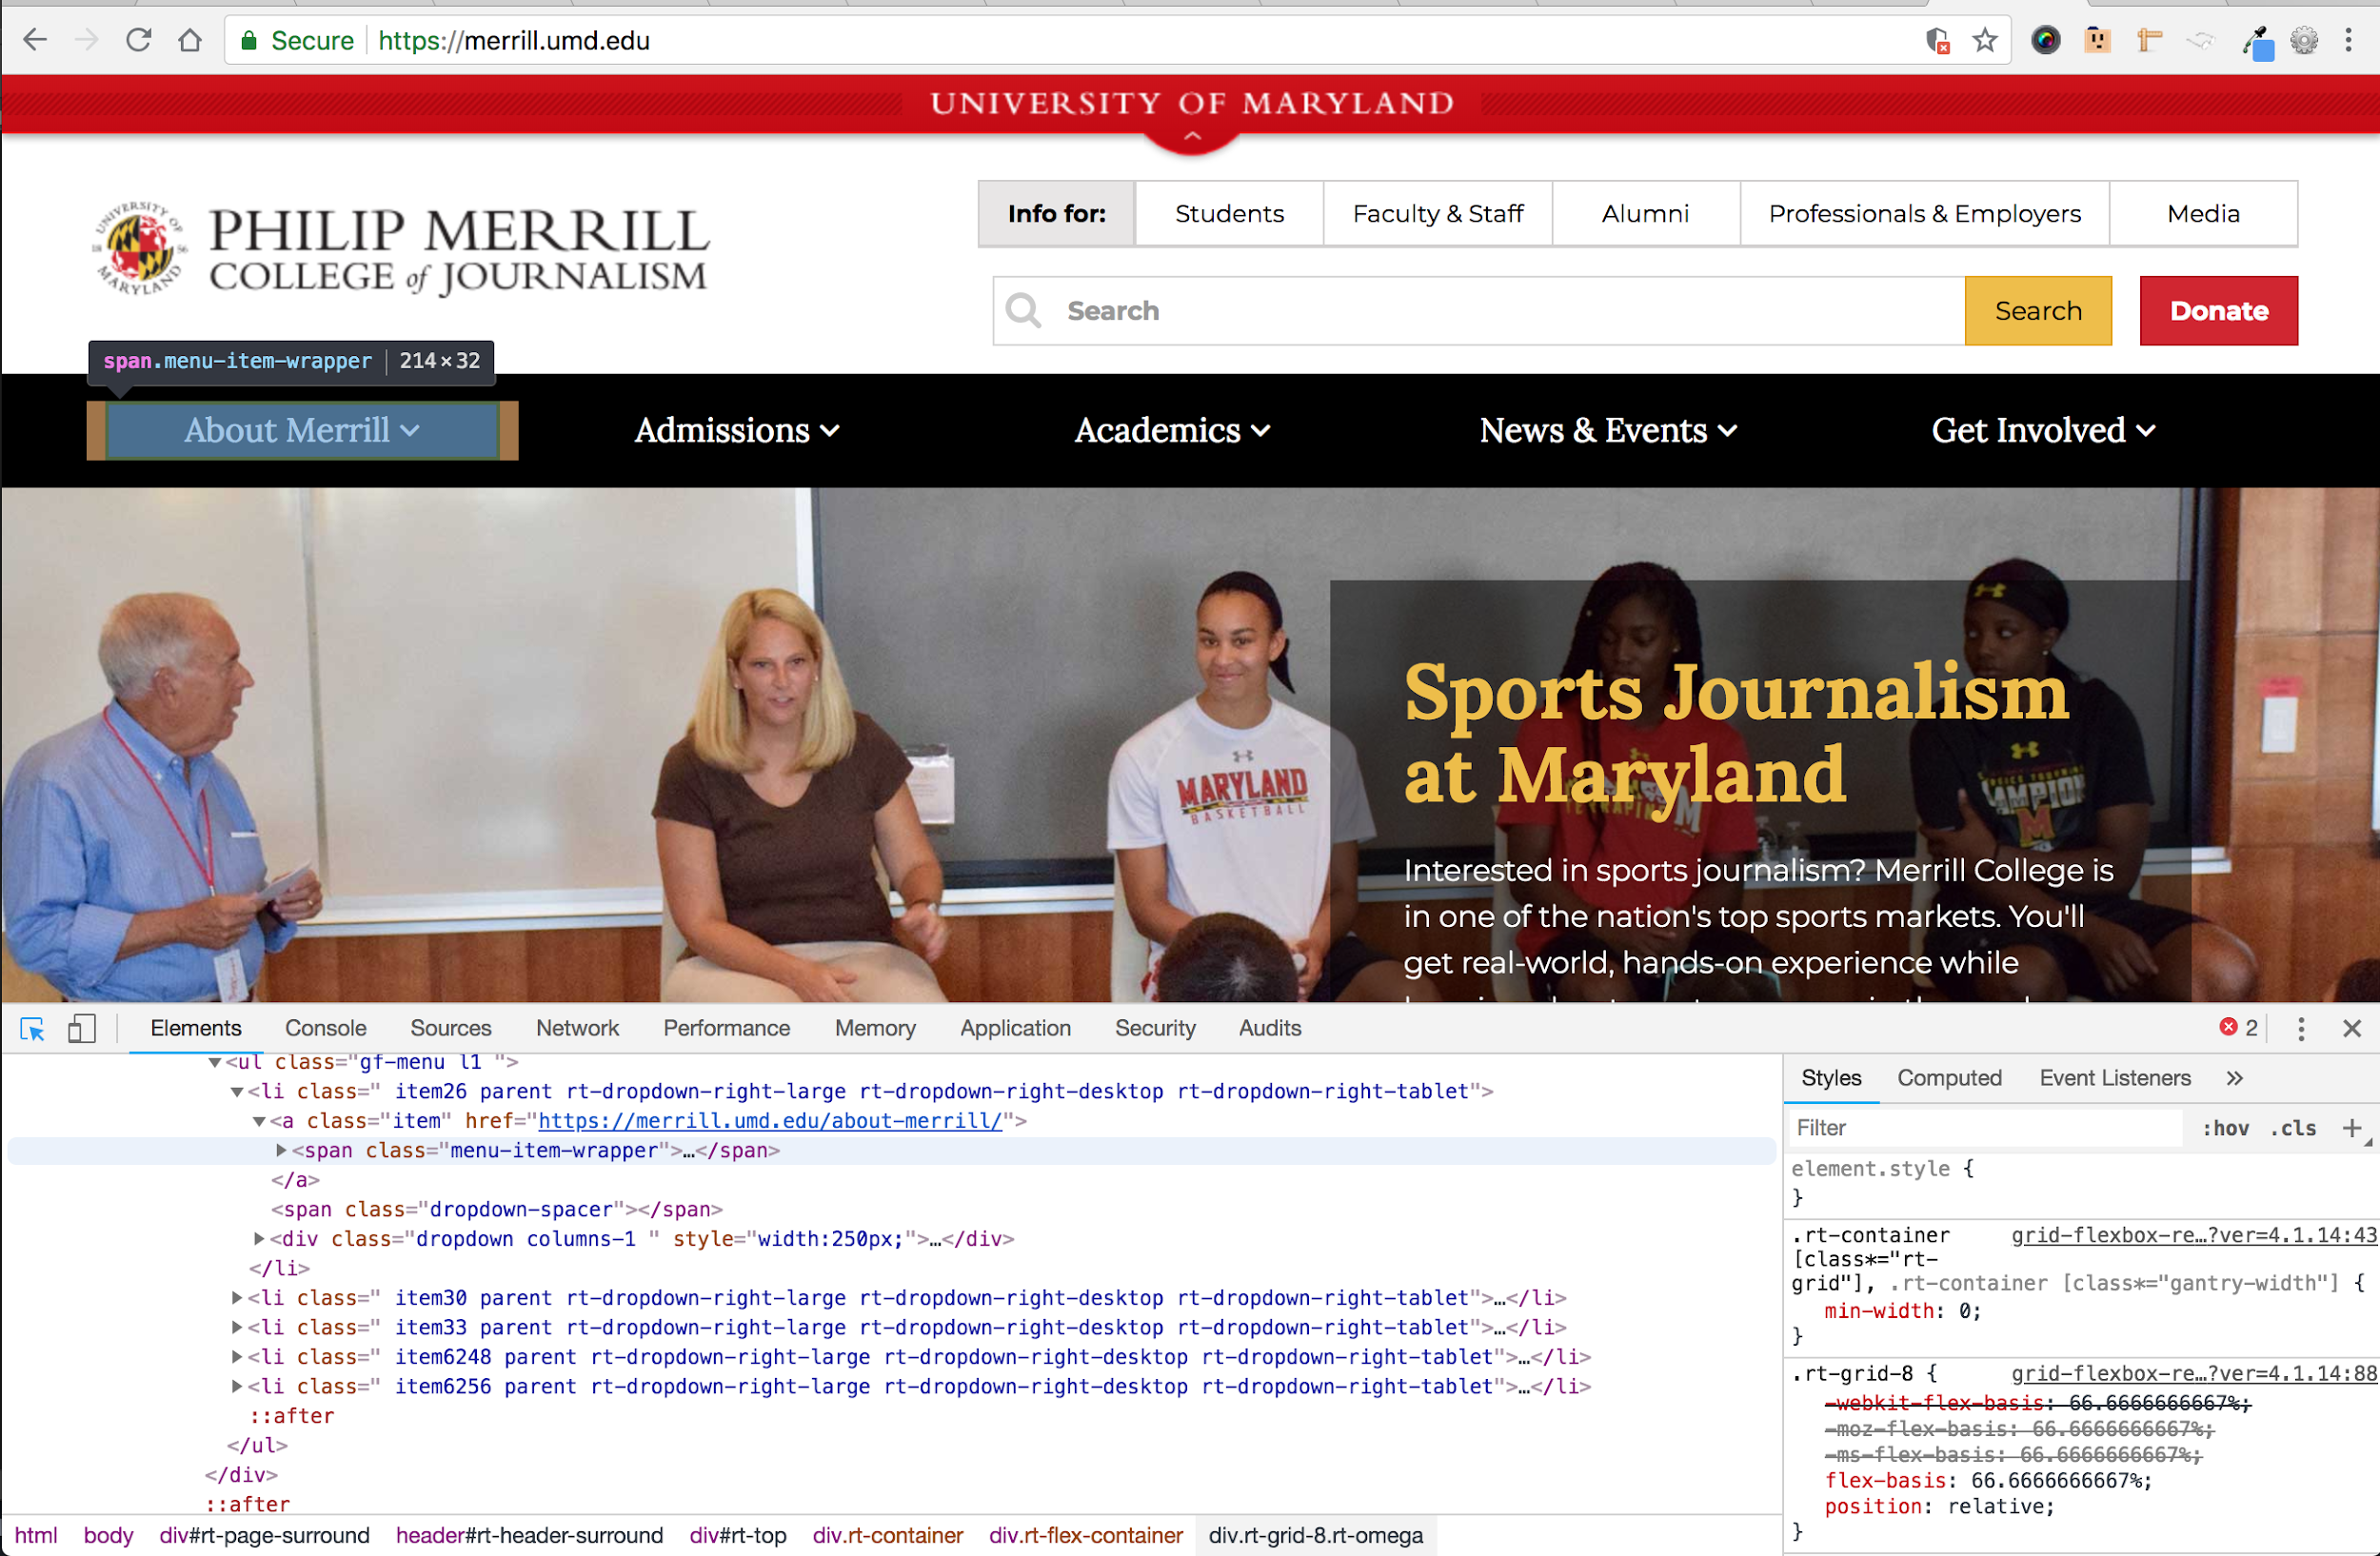
Select “Inspect” to access an essential suite of developer tools.

Slide 7
HTML Basics
Edit HTML code with a text editor (we will use Atom)
Save HTML files in plain text with .html extension
Tags/code are surrounded by < > angle brackets, but do not show when the actual page is displayed. They tell the browser how to display the text and content. Example: <p>

Slide 8
Hello world:
Let’s make a simple HTML
page together
Everyone open up the Atom text editor to get started

Slide 9
Save as “index.html” and open in a browser
<html lang="en"> <head> <title>Adam Marton</title> </head> <body> Hello world! </body> </html>

Slide 10
Page structure
Head: First part of each HTML document, contains general info about the HTML file
Body: Main part of each HTML document, contains the content to be displayed by web browser.
Tags: Commands surrounded by < > angle brackets, such as <b> for bold.

Slide 11
<html> start a web page
<head> top information of the web page</head>
<body> main body of the web page
<p> start new paragraph</p>
<br /> create a line break
<img /> insert an image
<a href=””> create “anchor” or hyperlink</a>
</body>
</html>

Slide 12
<!DOCTYPE html> <html> <body> <h1>My First Heading</h1> <p>My first paragraph.</p> </body> </html>
Try it

Slide 13
Open / Close tags
<b> Most tags require a closing tag to end the formatting, with a slash in front of the closing tag like this: </b>
<p> Each paragraph should have a p tag at the beginning to start it, and then a /p tag at the end to close the paragraph. </p>

Slide 14
<p>Some paragraph text</p> <b>Some bold text</b> <p>A paragraph of text can also include some <b>bold words</b> inside of the paragraph</p>

Slide 15
Open / Close tags
<br>
A few tags don’t require a closing tag. The line break tag is an example.* Also the image tag <img>
*<br/> Later versions of HTML encourage adding the closing backslash, so the BR tag still occurs only once, but it closes itself as soon as it’s opened.

Slide 16
Attributes
Attributes provide additional info about a tag, inc specific properties like color, size, font, etc
The image tag has two required attributes
src = the location of the image
alt = text to show if the image can’t be displayed
Example: <img src=”adam-marton-pic.jpg” alt=”profile pic of Adam Marton”>

Slide 17
Attributes
<img src= >
“src” refers to “source” and tells the web browser where to find the image.
Syntax:
<img src=“URL/name of image”>
Example:
<img src=”http://adammarton.com/wp-content/uploads/2016/10/shoot-to-kill-flat-hp.png”>

Slide 18
Attributes
<img alt= >
“Alt” (for “alternate”) specifies alternate text to display if a web browser can’t show images
Syntax:
<img src=“URL” alt=“text”>
Example:
<img src=”http://adammarton.com/wp-content/uploads/2016/10/shoot-to-kill-flat-hp.png” alt=”Shoot to Kill logo”>

Slide 19
Heading tags
<h1> - <h6> tags are used to define HTML headings
<h1>Heading 1</h1>
<h2>Heading 2</h2>
<h3>Heading 3</h3>
<h4>Heading 4</h4>
<h5>Heading 5</h5>
<h6>Heading 6</h6>

Slide 20
Linking tags
Link Syntax
<a href=“URL goes here”> words linked go here </a>
“a” stands for “anchor”
“href” stands for “hypertext reference”
close the link tag with </a>
Example: <a href=”http://www.umd.edu”>University of Maryland</a>

Slide 21
Unordered lists
Bulleted “unordered” list:
<ul> Starts the list
<li> in front of each bulleted item</li>
</li> at end of each bulleted item</li>
</ul> closes the list
Web page shows it this way:
in front of each bulleted item
at end of each bulleted item
closes the list

Slide 22
<ul> <li> List item 1</li> <li> List item 2</li> <li> List item 3</li> </ul>

Slide 23
Ordered lists
Numbered “ordered” list:
<ol> Starts the list
<li> in front of each bulleted item</li>
</li> at end of each bulleted item</li>
</ol> closes the list
Web page shows it this way:
in front of each bulleted item
at end of each bulleted item
closes the list

Slide 24
<ol> <li> List item 1</li> <li> List item 2</li> <li> List item 3</li> </ol>

Slide 25
DIVs
A DIV is a container, created by the <div> tag. This is essential for CSS.
<div>
<p>Some content here<p>
</div>
<div>
<p>Some content more here<p>
</div>

Slide 26
Create a web page
This is a basic web page.
<html> <body> This is a very basic webpage. </body> </html>

Slide 27
Add <head> and <title>
<html> <head> <title>This is the page title (not a headline.) It shows up at the top of the user’s web browser in a tab.</title> </head> <body> This is where the content goes. </body> </html>

Slide 28
Doctype
<!DOCTYPE> declaration is first thing in HTML document, even before the <html> tag.
It’s not really a tag. It just tells the browser what version of HTML the page is written in.
Most recent HTML5 doctype is simple: <!DOCTYPE html>

Slide 29
A basic HTML page:
<!DOCTYPE html> <html> <head> <title> Adam Marton's Resume </title> </head> <body> Your text and page content always goes here, between the body tags.Format it with bullets, etc. </body> </html>

Slide 30
File and folder names
Don’t use spaces or uppercase letters on the web. Not for files, not for folders, not for images.
index.html is the default file for any folder. A browser will automatically open index.html when it is pointed to a folder.

Slide 31
File and folder names
My web Folder = bad
my_web_folder = good
Index.html = bad
index.html = good
Clown photo.JPG = bad
clown-photo.jpg = good

