Slide 1
CSS 2
Cascading Stylesheets
Part 2

Slide 2
CSS Reference
W3Schools
HTML Dog

Slide 3
CSS syntax review
selector { property: value; property: value; }
body { background-color: red; color: white; }

Slide 4
Stylesheet setup review
There are three ways of setting up a CSS stylesheet
Inline styles : Styles are placed directly next to each element in the HTML
Internal stylesheet : A stylesheet is placed in the HEAD of the HTML document.
External stylesheet : The stylesheet exists as its own document and is linked to the HTML doc. This is the best method.

Slide 5
External stylesheet
Set up boilerplate HTML code and link to stylesheet.
<!DOCTYPE html> <html> <head> <title> Your Name </title> <link rel="stylesheet" type="text/css" href="style.css"> </head> <body> </html>

Slide 6
Problem solving
(and Google)

Slide 7
CSS Selectors
There are three ways of targeting an elements.
HTML Element
<p>
ID
<p id=”headline”>
Class
<p class=”subhead”>

Slide 8
Select an HTML element through it’s tag
<head> <title>CSS Sandbox</title> <style type="text/css"> p { font-size:16px; color:blue; } </style> </head> <body> <p>Some text</p> </body>

Slide 9
CSS IDs and Classes
Assign HTML elements IDs and Classes to target those elements with CSS.

Slide 10
Selectors: ID
Assign an ID to element in the HTML
<p id=”headline”>
Reference the ID in the CSS using an “#”
#headline {
font-size:16px;
color:blue;
}
An ID should only be assigned to a unique element. Use classes for reusable elements.

Slide 11
#ID
The “#” is how you tell CSS “this is an ID”
HTML
<body> <p id="headline">Some text</p> </body>
Give an element an ID of “headline”
CSS
Selects any element with the ID “headline”
#headline { font-size:16px; color:blue; }

Slide 12
<head> <title>CSS Sandbox</title> <style type="text/css"> #headline { font-size:36px; color:blue; } </style> </head> <body> <p id="headline">Some text</p> </body>

Slide 13
Selectors: Class
Assign an element a Class in the HTML
<p class="warning">
Reference the Class in the CSS using a “.”
.warning{
font-size:16px;
color:red;
}

Slide 14
.class
The “.” is how you tell CSS “this is a class”
HTML
Give an element a class of “warning”.
Multiple elements can have same class name.
<body> <p class="warning">This is a warning</p> <p class="warning">Red Alert!</p> </body>
CSS
Selects any element with the class “warning”
.warning { color:red; }

Slide 15
.class
An element can have only one ID, but can have multiple classes
CSS
.intro { background-color: blue; } .desc { color: red; }
HTML
<p class="desc intro">Hello</p> <p class="desc">Hello</p> <p class="intro">Hello</p>

Slide 16
<head> <title>CSS Sandbox</title> <style type="text/css"> .subhead { font-size:16px; color:blue; } </style> </head> <body> <p class="subhead">Some text</p> </body>

Slide 17
Set the viewport
Viewport element inside <HEAD> area:
Sets the “viewport” or user’s visible area in browser
“Width=device-width” sets width of the page to follow the screen-width of user’s device
“initial-scale=1.0” sets initial zoom level when the page is first loaded by a browser
<meta name="viewport" content="width=device-width, initial-scale=1.0">

Slide 18
index.html
<!DOCTYPE html> <html> <head> <title> Your Name </title> <link rel="stylesheet" type="text/css" href="style.css"> <meta name="viewport" content="width=device-width, initial-scale=1.0"> </head> <body> <div id="headline">Hello, world</div> </body> </html>

Slide 19
DIV element
<div> tag is a crucial HTML element that defines
a “division” or section of HTML document
<div> tag is used to group together HTML elements to format with CSS
Think of a DIV as a container.

Slide 20
DIV element
Create a DIV and target it with CSS
CSS
div { color: #000000; border: 1px solid #CCFFFF; }
HTML
<div> <p>Some content</p> </div>

Slide 21
DIV element
Target the DIV by #ID
CSS
#breakingnews { color: #000000; background: #CCFFFF; }
HTML
<div id="breakingnews"> <h3>Amtrak Accident Injures 52 People</h3> <p>An Amtrak train derailed yesterday...</p> <p>All the injuries were minor, police said.</p> </div>

Slide 22
DIV element
Use #IDs to target two DIVs separately
CSS
HTML
#top-block { font-size:12px; color:red; } #bottom-block { font-size:16px; color:blue; }
<div id="top-block"> Some content </div> <div id="bottom-block"> Some content </div>

Slide 23
DIV element
Use DIV elements to contain styles, too.
CSS
HTML
#top-block p { font-size:12px; color:red; }
<div id="top-block"> <p>Some content</p> <p>Some content</p> </div> <div id="bottom-block"> <p>Some content</p> </div>

Slide 24
DIV element
You can also use classes
CSS
HTML
.block p { font-size:12px; color:red; }
<div class="block"> <p>Some content</p> <p>Some content</p> </div> <div class="block"> <p>Some content</p> </div>

Slide 25
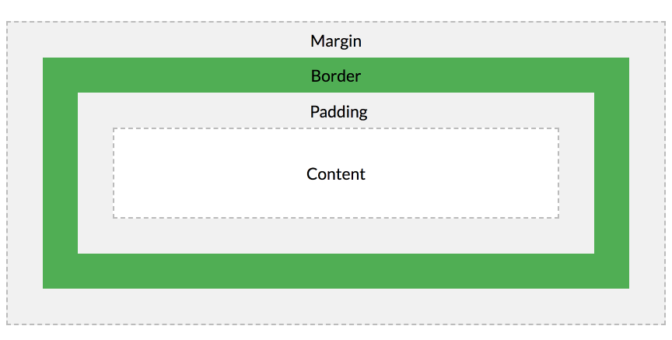
The box model
The CSS box model is essentially a box that wraps around every HTML element.
It consists of: margins, borders, padding, and the actual content.

Slide 26
The box model
Content - The content of the box, where text and images appear
Padding - Clears an area around the content. The padding is transparent
Border - A border that goes around the padding and content
Margin - Clears an area outside the border. The margin is transparent
The box model allows us to add a border around elements, and to define space between elements.

Slide 27
The box model
From W3Schools

Slide 28
The box model
div { width: 300px; border: 25px solid green; padding: 25px; margin: 25px; }
Try it

Slide 29
When styling box model elements
Remember this:
div { padding: top/bottom left/right; padding: top right bottom left; }

Slide 30
Width
Define the width of a DIV
div { width: 320px; }
You can define a height also, though it usually isn’t needed. The content, padding and margins decide the height of most DIVs.

Slide 31
Padding and margins
Add padding and margins.
Padding is the space inside of the DIV. Margin is the space outside of the DIV.
div { width: 320px; padding: 10px; margin: 0; }

Slide 32
Borders
Set a border around a DIV.
Define width, line type and color.
div { width: 320px; padding: 10px; border: 5px solid gray; margin: 0; }

Slide 33
Borders
Review these W3Schools exercises:
1 2 3 4

Slide 34
Total width of a DIV
Total width of a DIV =
Width + right padding + left padding + right margin + left margin + right border + left border
div { width: 320px; padding: 10px; border: 5px solid gray; margin: 0; }
320 + 10 + 10 + 0 +0 + 5 + 5 = 350px

Slide 35
Unordered list
Regular unordered list:
Item 1
Item 2
Item 3
HTML
CSS
<ul> <li>Item 1</li> <li>Item 2</li> <li>Item 3</li> </ul>

Slide 36
Inline unordered list
Inline unordered list:
Item 1 Item 2 Item 3
HTML
CSS
<ul> <li>Item 1</li> <li>Item 2</li> <li>Item 3</li> </ul>
li { display: inline; list-style-type: none; }

