Slide 1
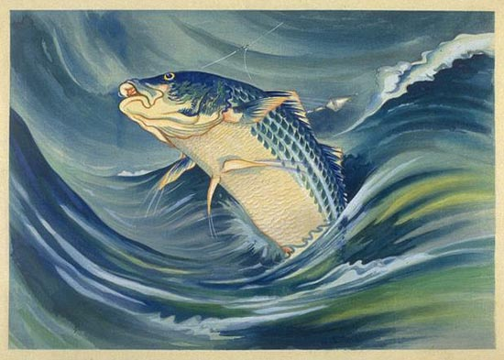
Ideogram

Slide 2
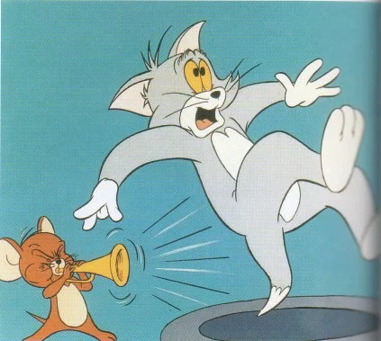
Ideogram
Revenge

Slide 3
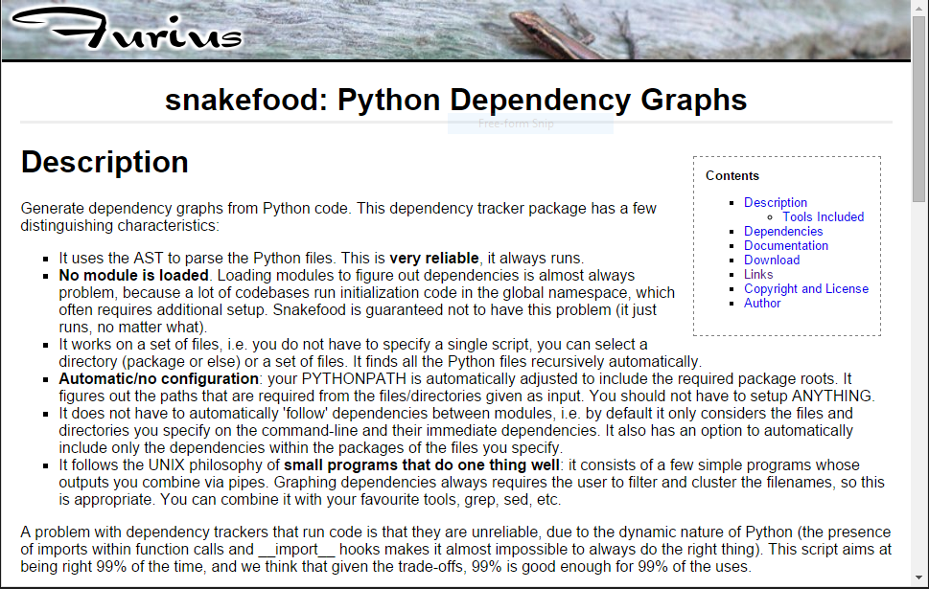
The Problem

Slide 4

Visual Fingerprint for your Code

Slide 5
Abstract Syntax Tree
Each node represents an element from the source code.
Definitions, control flow, comparisons..
Var
Name
Compare
IF
Num
Body
...
Orelse
...

Slide 6
Abstract Syntax Tree
Each node represents an element from the source code.
Definitions, control flow, comparisons..
Var
Name
Compare
x
IF
Num
7
Body
...
Orelse
...

Slide 7
Source code
AST
AST
AST
...
FDEFS
FDEFS
FDEFS
CDEFS
CDEFS
CDEFS
IMPORTS
IMPORTS
IMPORTS
CALLS

Slide 8
Where's the call's target function?
getChar()
Source code inside file
myClass.getChar()
Source code inside file
getChar() after from exe import getChar() or *
Source code outside file
myModule.getChar()
Source code outside file
myClass.getChar() after from exe import myClass
Source code outside file
ugh.getChar after import exe as ugh
Source code outside file

Slide 9
Source code
AST
AST
AST
...
FDEFS
FDEFS
FDEFS
CDEFS
CDEFS
CDEFS
IMPORTS
IMPORTS
IMPORTS
CALLS

Slide 10
CALLS
CALLS
CALLS
...
Big JSON file!
D3

