Slide 1
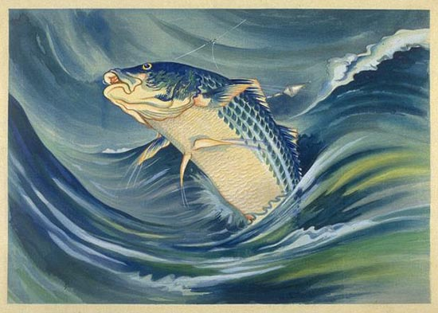
Ideograms

Slide 2
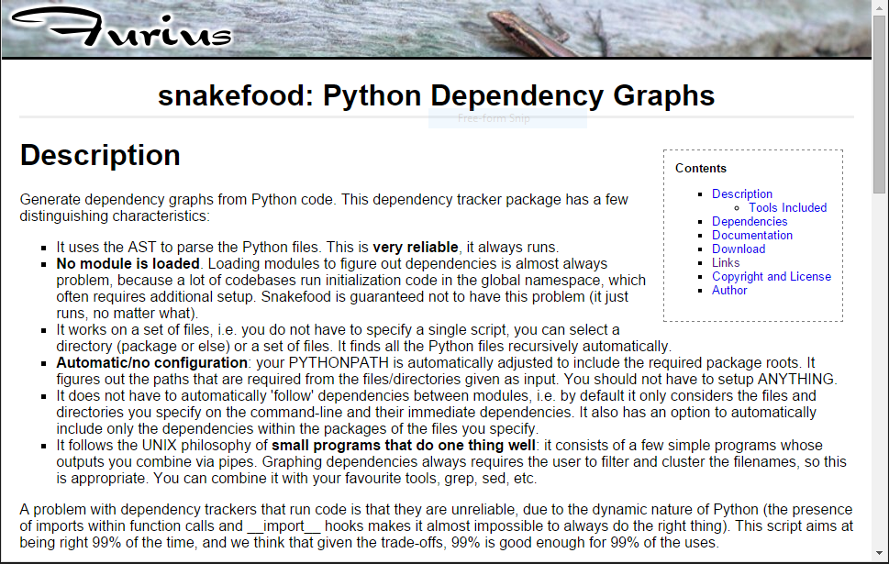
The Problem

Slide 3

Visual Fingerprint for your Code

Slide 4
Visual Fingerprint for your Code
Unique
Reflects the complexity and scale of the project
Doesn't say much about what the code really does

Slide 5
Abstract Syntax Tree
Each node represents an element from the source code.
Definitions, control flow, comparisons..
Var
Name
Compare
IF
Num
Body
...
Orelse
...

Slide 6
Abstract Syntax Tree
Each node represents an element from the source code.
Definitions, control flow, comparisons..
Var
Name
Compare
x
IF
Num
7
Body
...
Orelse
...

Slide 7
Procedure
Walk through the project, grab the ASTs for everything that ends in “.py”
Find the function defs
  Fn attributes: name, file, parent class, empty dict
Find the function calls
Called inside a function def
Source code inside file
Easy!
Called outside a function def
Source code inside file
Create “body_code” proxy fn
Called inside a function def
Source code outside file
Search using imports...
Called outside a function def
Source code outside file
Proxy & search

Slide 8
Output
Write data to JSON and display using d3!

