Slide 1



Apagón - April 28, 2025
Update: May 19, 2025
LEMUR. University of Oviedo Department of Electrical Engineering – lemur@uniovi.es

Slide 2
Disclaimers
LEMUR believes there are perfectly plausible technical explanations for the Iberian blackout of April 28, 2025.
We are focused on the technical explanations which can be justified with knowledge of the physical infrastructure. In other words, we are not, currently, considering cyber-attacks, human errors, or extraordinary meteorological conditions.
For now, we are simply presenting what data we have and will use as a basis for much more engineering analysis.
We are NOT presenting conclusions about root causes! (yet…)
LEMUR Team
Lead Authors:
Bryan Murray, P.E. – PhD Candidate
Reviewers:
Dr. Pablo García Fernández
Dr. Ángel Navarro-Rodriguez
Dr. Cristian Blanco Charro
Dr. Pablo Arboleya Arboleya
Dr. Jorge
Dr. Carlos

Slide 3


Section 1
Overview of April 28

Slide 4
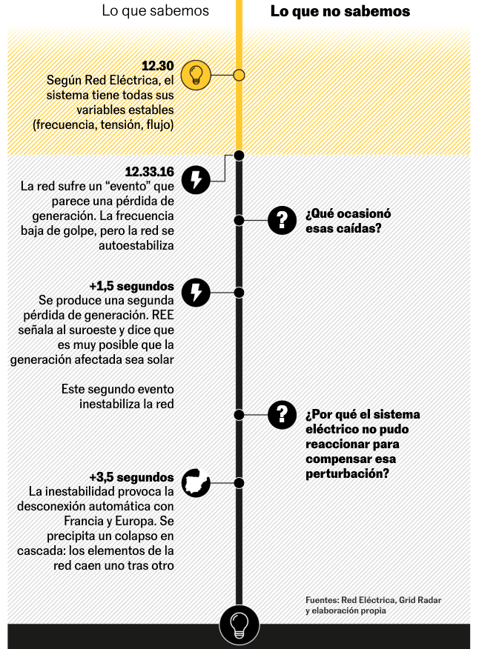
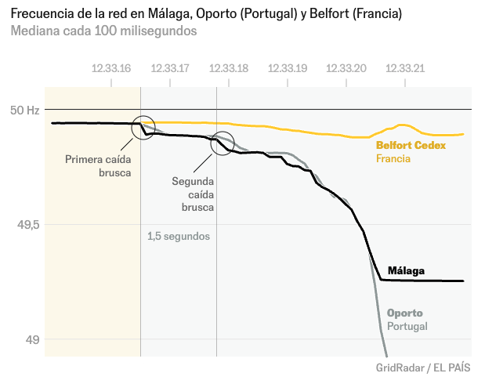
Source: El Pais, “¿Qué causó el apagón? Explicación visual y breve de lo que sabemos”

Slide 5
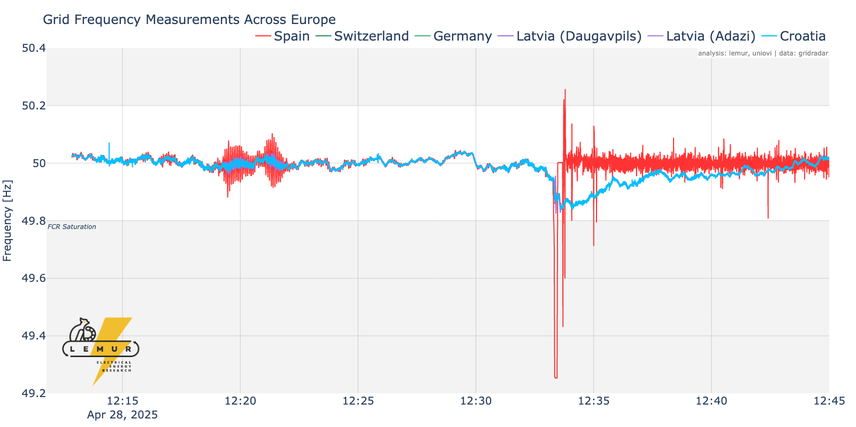
Overview of European grid Frequencies just before the Blackout
Early Oscillations
DFD
(Market Interval)
Bigger Oscillations
Iberian Separation
Suspicious Events
Normal Events
Europe Recovers

Slide 6
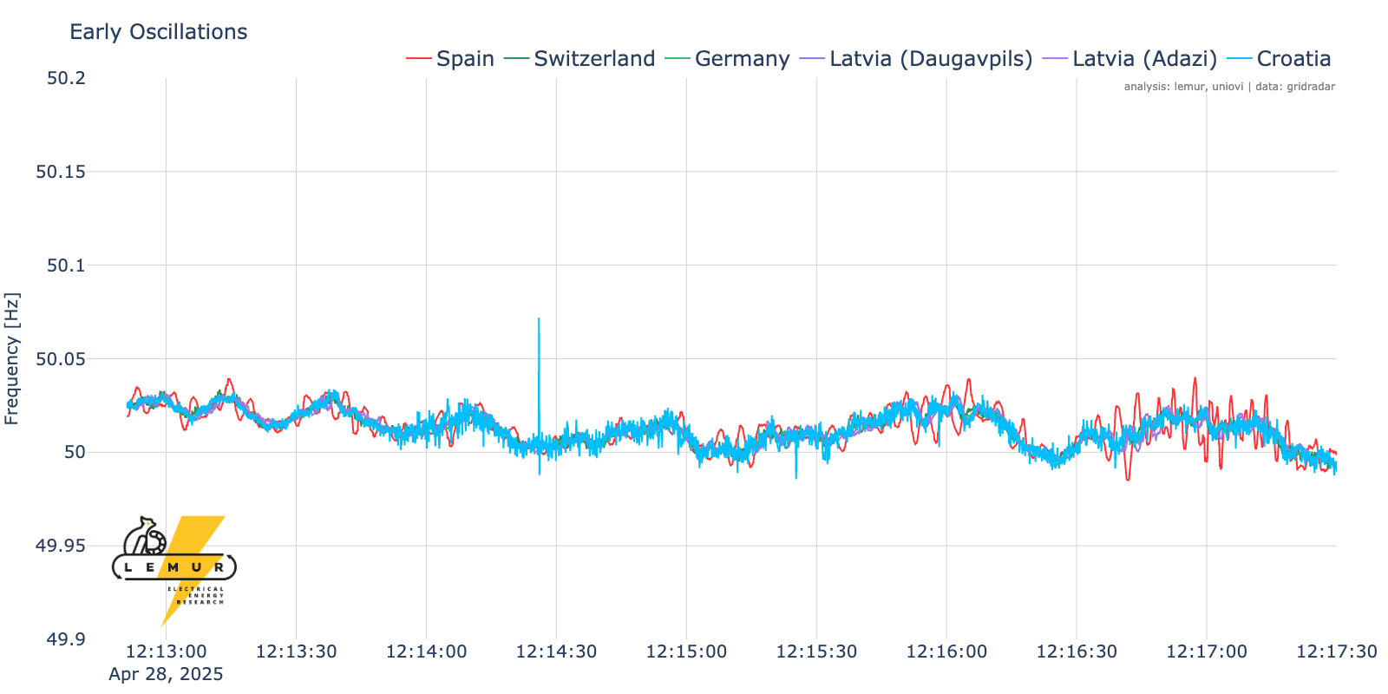
Early Oscillations hint at Instability
From at least 12:13pm we see notable frequency oscillations in the Iberian grid
Oscillation amplitudes increasing just minutes later
Minor disturbance in Croatia was properly damped and faded in <5 sec. We’ll ignore it.

Slide 7
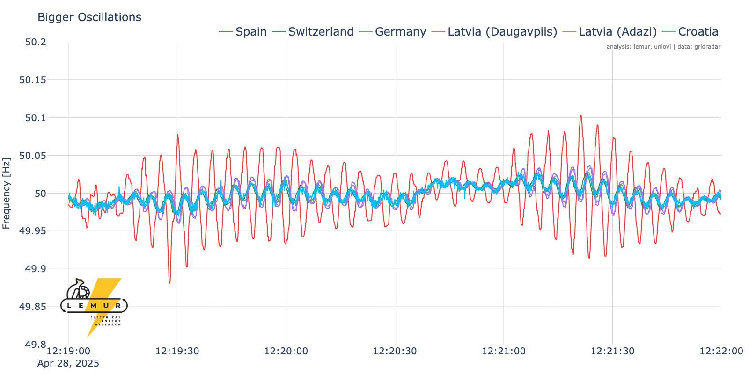
Oscillations Worsen Rapidly ~ 12:20pm
Note 180° phase shift
Undamped frequencies oscillations rapidly worsen

Slide 8
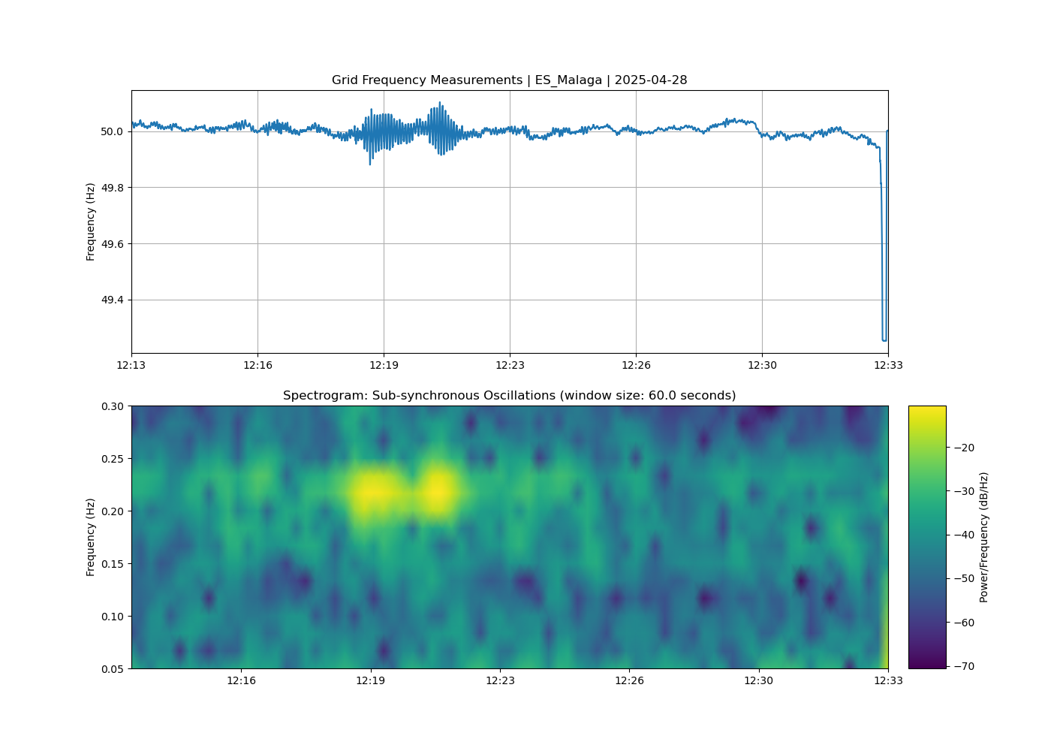
Observing Sub-Synchronous Oscillations
Oscillations ~0.23 Hz (4.3 seconds)

Slide 9
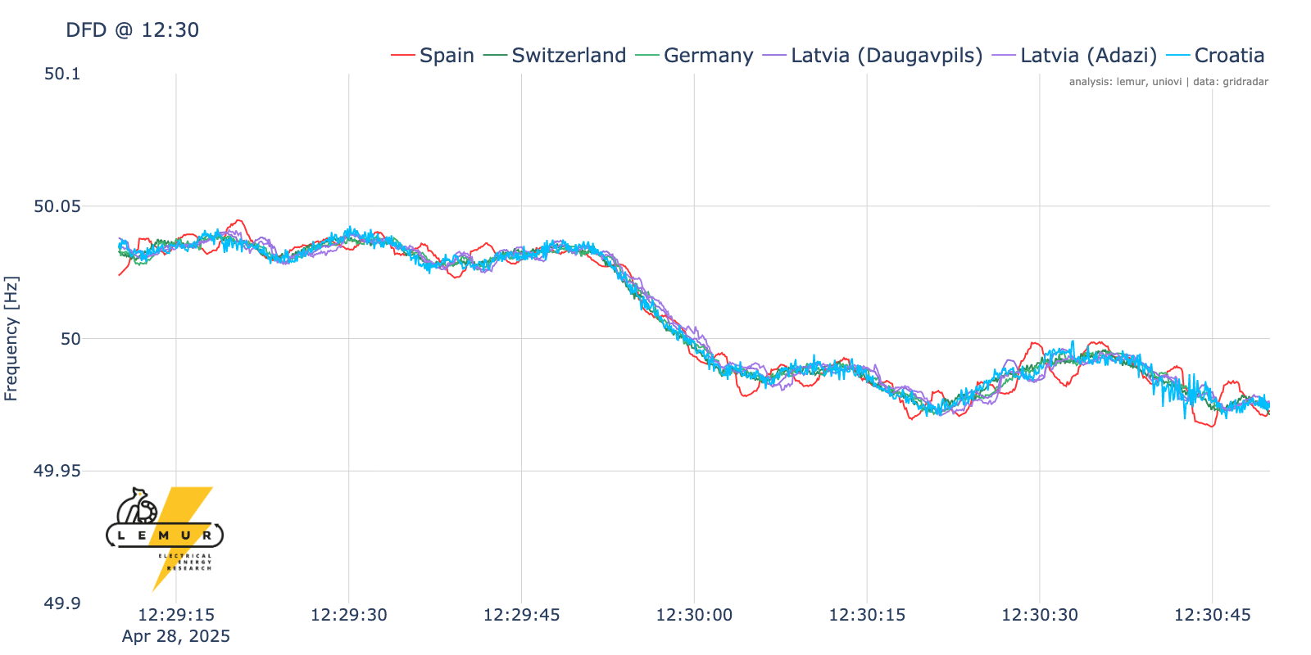
Market Change at 12:30pm – No Problem
The 15-minute electricity market means many generators change their power setpoints at 12:30pm.
The resulting change in steady-state frequency is called a “Deterministic Frequency Deviation”. These are an undesirable but expected and manageable aspect of large electricity markets.

Slide 10
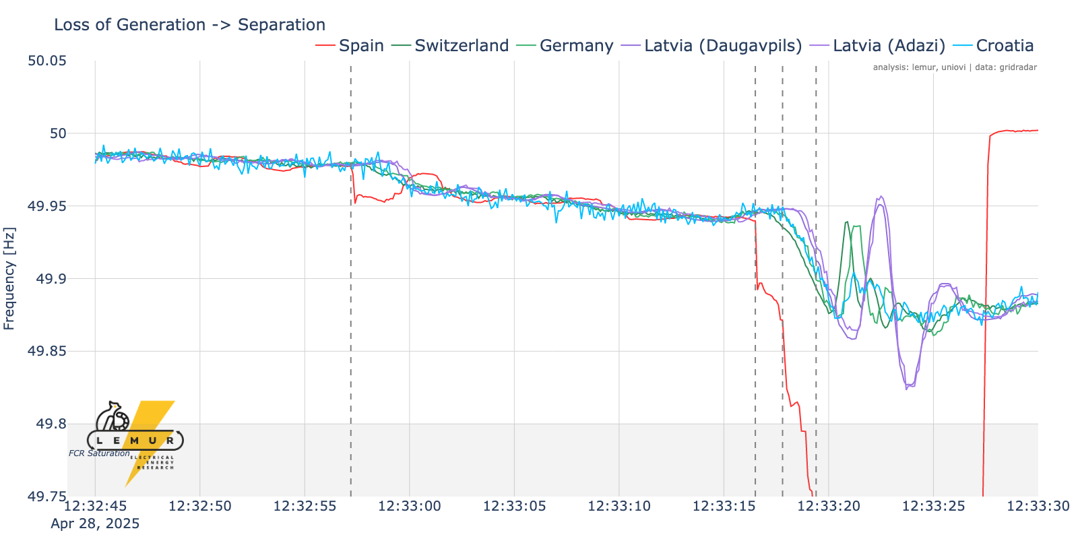
Iberia Separates from Europe
Significant frequency drop @ 12:32:57.3 due to some loss of generation
(link to news conference)
Rest of Europe actives FCR and stabilizes
Oscillations persist but Iberia stays connected until…
First ”event” @ 12:33:16.5: Likely some large source tripped and started the cascade of “15GW in 5 seconds”.**
Second “event” @ ~12:33:17.8:
Separation from France @ ~12:33:19.4: Rest of Europe recovers, Iberian frequency collapses
** ”desconexión repentina de dos centrales de generación eléctrica en el suroeste de la peninsula” [El Periodico de la Energia, 29 Abril 2025]

Slide 11
Section 2
Substation Conditions

Slide 12
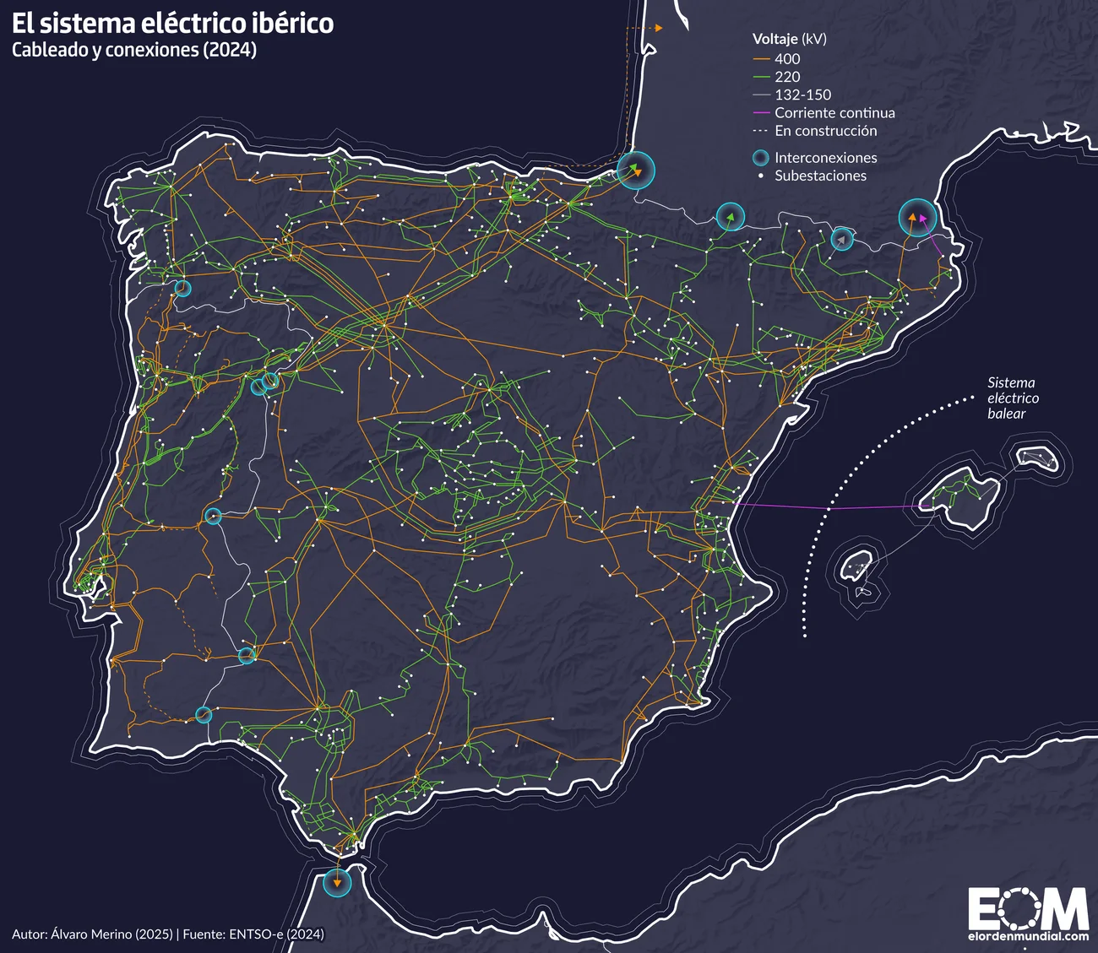
Huéneja

Slide 13
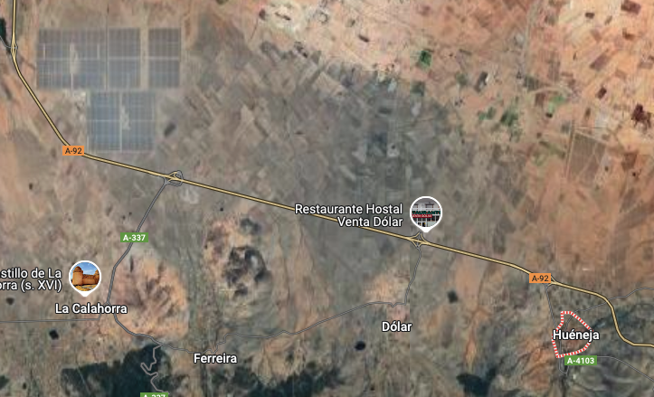
Andasol 150MW solar thermal plant
(3x 50MWe)

Slide 14
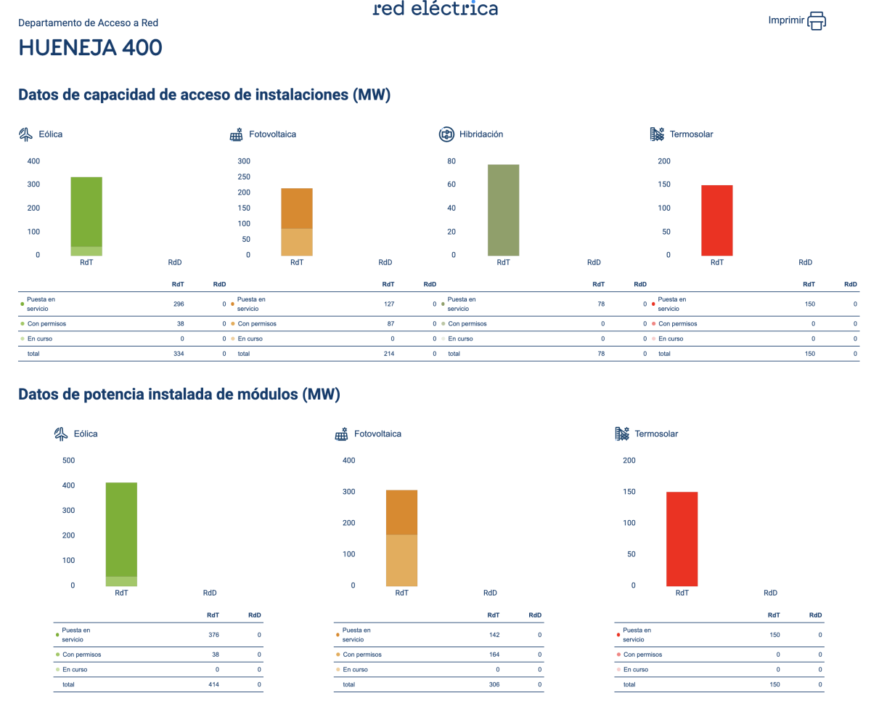

Slide 15
Section 2
Rate of Change of Frequency

Slide 16
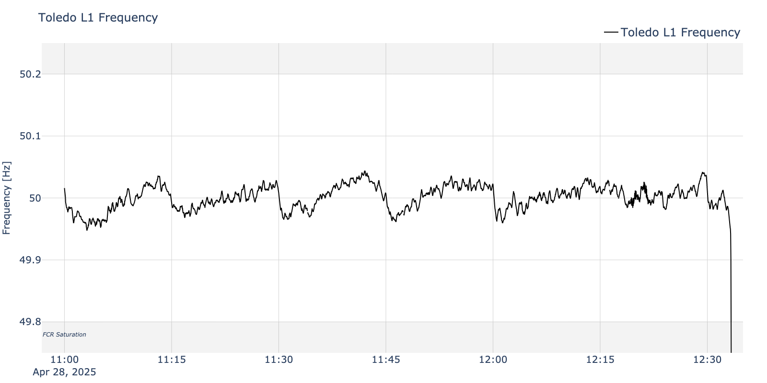
Frequency is consistently to fast all morning
frequency
ascends
within
each
market
interval!

Slide 17
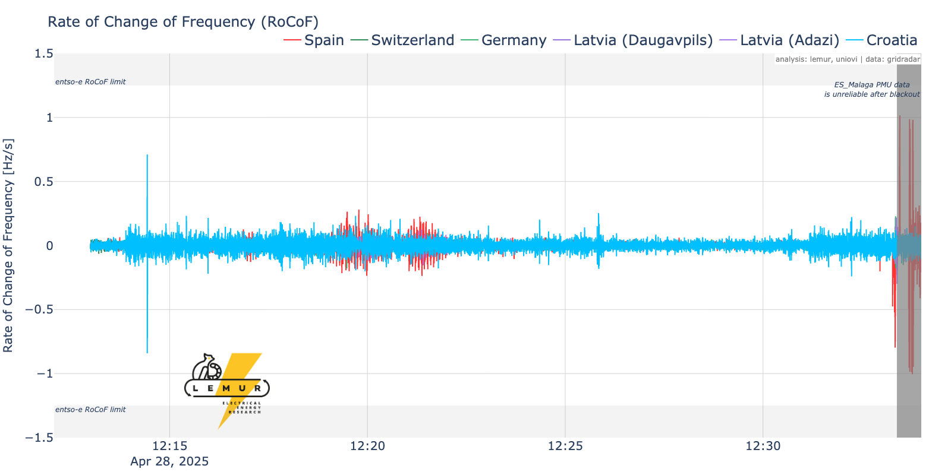
Rocof Overview
Instantaneous RoCoF = +0.71 Hz/s
ES_Malaga PMU data did not violate any of the entso-e RoCoF disconnection limits:
> 1.25 Hz/s for 500ms
> 1.5 Hz/s for 1s
> 2 Hz/s for 2s

Slide 18
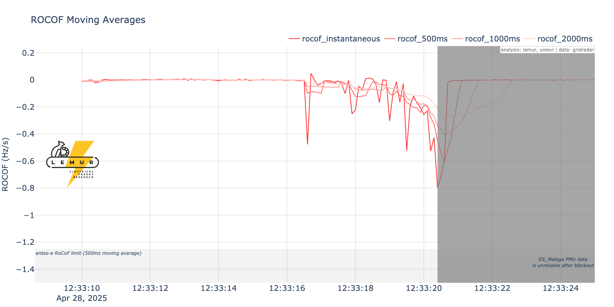
Rocof stayed within limits
RoCoF limits from “Rate of Change of Frequency (RoCoF withstand capability”, entso-e, 31 January 2018
Instantaneous RoCoF = -0.8 Hz/s
ES_Malaga PMU data* did not violate any of the entso-e RoCoF disconnection limits:
> 1.25 Hz/s for 500ms
> 1.5 Hz/s for 1s
> 2 Hz/s for 2s
*Physical RoCoF probably lower, but limited by the PMU recording

Slide 19
Section 3
Generation, Inertia, Exports

Slide 20
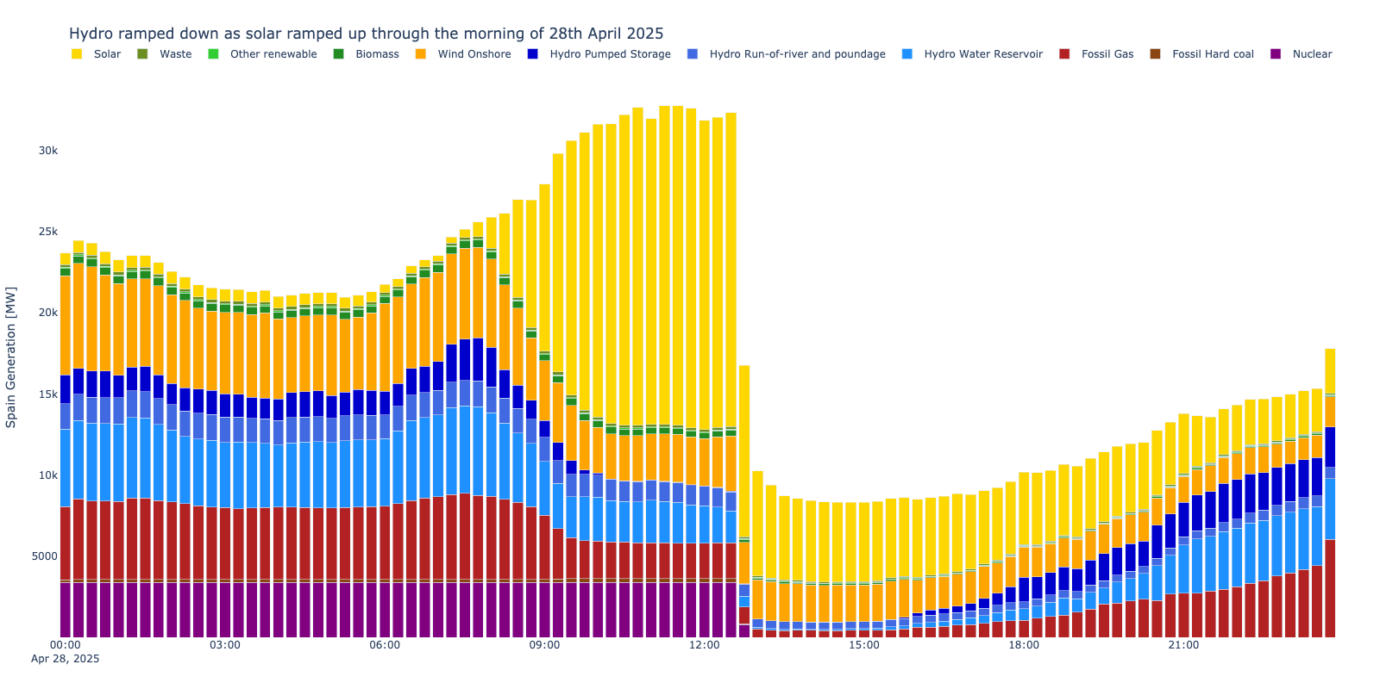
Generation MIX on April 28, 2025
Quite a lot of solar at 23:45…?
Source: ENTSO-E Transparency Platform

Slide 21
Inertia Estimation Methods – 1 of 2
Inertia estimates are inferred, not directly measured, thus subject to assumptions and limited information.
ENTSO-E ”Project Inertia” has published basic methods for estimating kinetic inertia, which we utilize in the following slides. These estimates are likely too low because they do not include:
Non-generating inertia contributors (e.g. synchronous compensators)
Inertia for plants operating below nominal capacity
”Synthetic” inertia from inverter-based resources
Inertia estimates are based on standard inertial constants for different generation categories as published in “Inertia and Rate of Change of Frequency (RoCoF)”, ENTSO-E, 16 Dec. 2020

Slide 22
Inertia Estimation Methods – 2 of 2
Our estimates are based on the simplest data available: generation [MW] by resource type at 12:30pm on April 28, 2025.
Inertia estimates by resource type are simply the product of generation [GW] and the inertia constants [s] published by ENTSO-E. Total inertia estimates are the
Generation Type | Generation @ 12:30pm (MW) | H_eq (s) | Inertia (s) | Generation (%) | Inertia (%)
Solar | 19340 | 0 | 0.00 | 59.8% | 0.0%
Wind Onshore | 3416 | 0 | 0.00 | 10.6% | 0.0%
Nuclear | 3384 | 5.9 | 0.62 | 10.5% | 46.7%
Fossil Gas | 2216 | 4.2 | 0.29 | 6.9% | 21.8%
Hydro Water Reservoir | 1952 | 3.7 | 0.22 | 6.0% | 16.9%
Hydro Run-of-river and poundage | 1184 | 2.7 | 0.10 | 3.7% | 7.5%
Biomass | 356 | 3.3 | 0.04 | 1.1% | 2.7%
Fossil Hard coal | 228 | 4.2 | 0.03 | 0.7% | 2.2%
Waste | 160 | 3.8 | 0.02 | 0.5% | 1.4%
Other renewable | 60 | 3.5 | 0.01 | 0.2% | 0.5%
Hydro Pumped Storage | 36 | 3.5 | 0.00 | 0.1% | 0.3%
Total | 32332 |  | 1.32 | 100.0% | 100.0%
Inertia estimates are based on standard inertial constants for different generation categories as published in “Inertia and Rate of Change of Frequency (RoCoF)”, ENTSO-E, 16 Dec. 2020

Slide 23
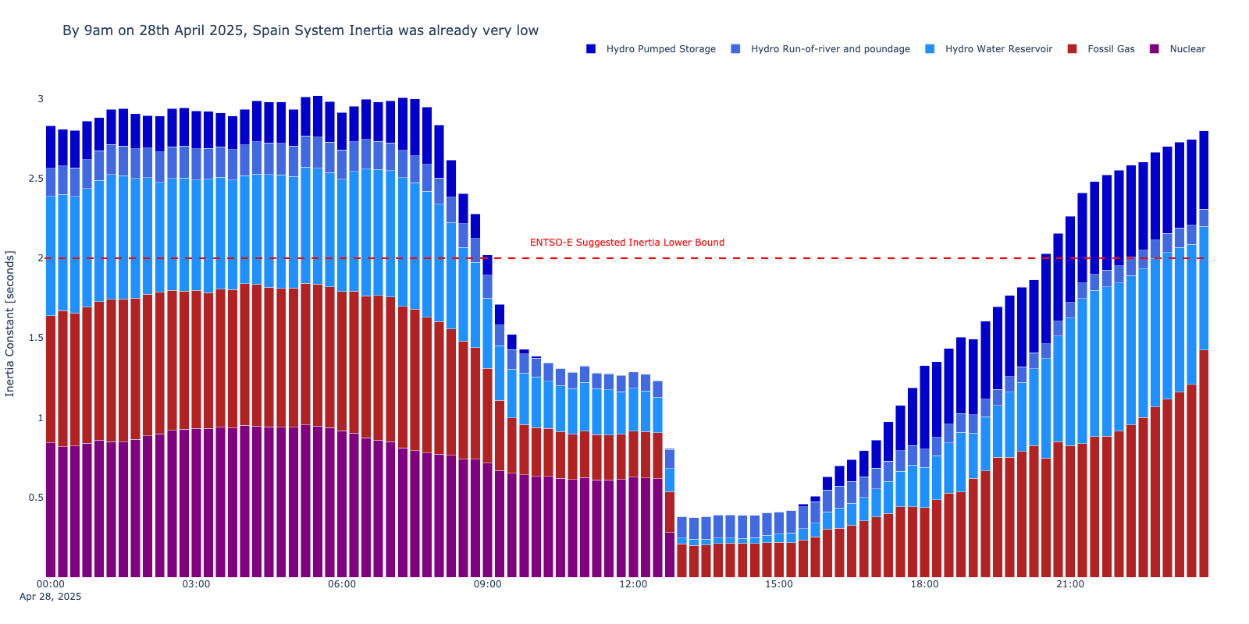
Inertia Estimates for April 28, 2025
Steep drop in Spanish grid inertia as solar comes online
~1.3 seconds
Inertia estimates are based on standard inertial constants for different generation categories as published in “Inertia and Rate of Change of Frequency (RoCoF)”, ENTSO-E, 16 Dec. 2020

Slide 24
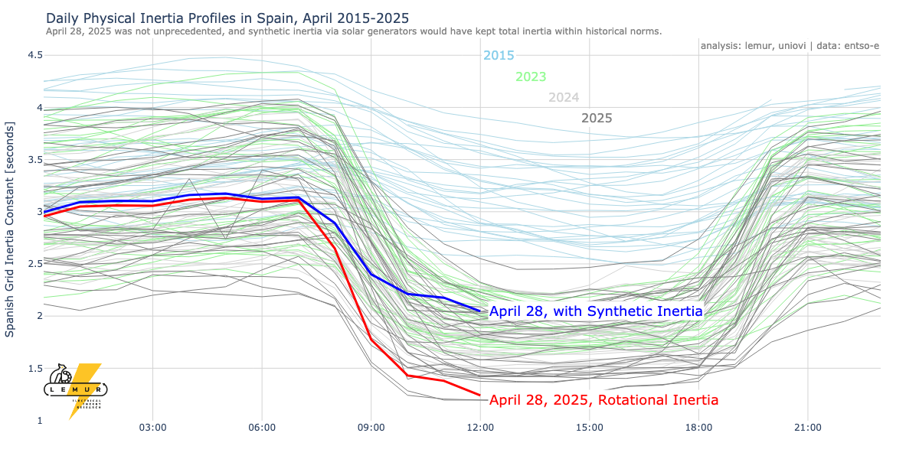
Spanish Inertia was low, but not unprecedented
Synthetic inertia could have kept total inertia above the ENTSO-E recommended minimum.
33% of all solar acting with virtual inertia of H=4 seconds
On April 28th, the Spanish grid’s total inertia was very low, but not unprecedented
Inertia estimates are based on standard inertial constants for different generation categories as published in “Inertia and Rate of Change of Frequency (RoCoF)”, ENTSO-E, 16 Dec. 2020

Slide 25
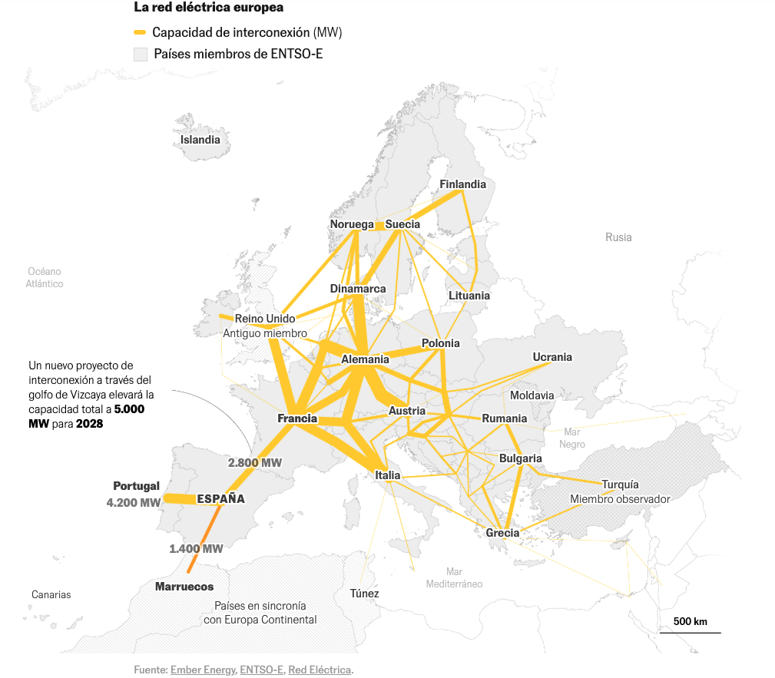
France, Germany, and Italy have relatively strong interchange capacity.
Iberian connection to France is relatively weak.
Source: El Pais, “¿Qué causó el apagón? Explicación visual y breve de lo que sabemos”

Slide 26
France, Germany, and Italy have relatively strong interchange capacity.
Iberian connection to France is relatively weak.
Source: El Pais, “¿Qué causó el apagón? Explicación visual y breve de lo que sabemos”

Slide 27
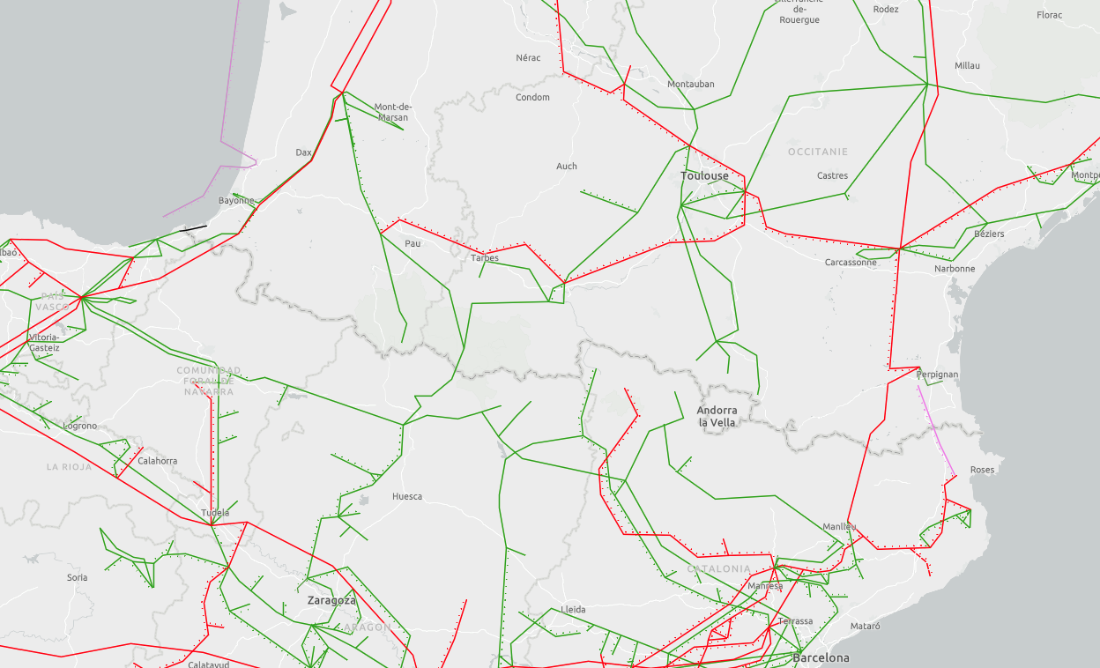
Connections with France
Additional 2.2GW HVDC line expected by 2028
Currently ~2.8GW export capacity
Map Source: ENTSO-E

Slide 28
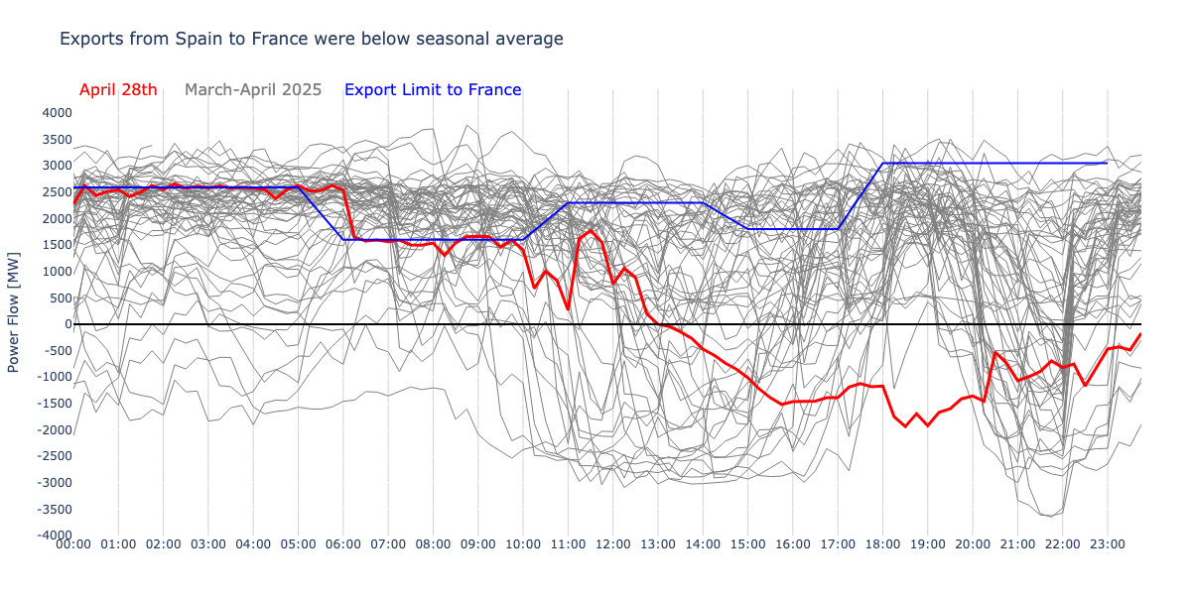
Exports to France were below average
~6am, exports to France fall below the seasonal average.

Slide 29
Conclusions
On April 28th, 2025, the operating conditions on the Spanish grid were challenging, but not unprecedented.
None of the data we currently have would have required equipment tripping (and thus the large loss of load)…
…but the conditions at an individual generator’s grid connection could be very different!
LEMUR is actively working to reconstruct the grid conditions of April 28 and will continue to publish our findings publicly.
Help us! Any feedback or relevant data is appreciated! lemur@uniovi.es

Slide 30
LEMUR

Slide 31

OUR GOAL
LEMUR is a multidisciplinary research team with researchers belonging to different knowledge areas: Electrical Engineering, Power Electronics and Automation and Control Engineering. The strength is based on looking for synergies and knowledge integration among team members in order to apply for bigger and complex research projects.

Slide 32
OUR VISION
To integrate in a laboratory an environment for testing of small scale distributed energy systems and their integration into the electrical grid. For the study and analysis, a four level approach is proposed:
Development of generation systems and power converters for the injection of electrical energy into the grid under efficiency and reliability constraints.
Development of energy storage systems for the compensation of transient demands at the electrical grid, including pulsating generation by renewable energy systems, grid contingencies and virtual zero demanding energy buildings.
Development of coordinated control strategies for all the small scale generators installed at the grid in order the system to behave as a virtual integrated power plant. Development of new power flow algorithms for considering the unbalanced conditions at weak grids (single phase loads and generation systems).
Study of new economic and infrastructure models relying on the distributed generation, which allow to maximize the benefits considering the existing and future regulations.

Slide 33
ANALYSIS AND DESIGN OF POWER CONVERTER TOPOLOGIES FOR ENERGY STORAGE
Design of power electronics converters with an emphasis of multiport topologies for energy storage applications
DYNAMIC ANALYSIS AND CONTROL OF POWER CONVERTERS FOR DISTRIBUTED RESOURCES
High dynamic performance of power converters and microgrids by advanced control systems
POWER FLOW ANALYSIS FOR HYBRID DC/AC GRIDS WITH HIGH PENETRATION OF DISTRIBUTED RESOURCES
Impact of the integration of distributed resources in the electrical grid
ENERGY DEMAND ANALYSIS AND VISUALIZATION
Analytic tools and visualization strategies for energy planning
APPLICATIONS
Industrial applications and knowledge transfer
OUR RESEARCH
LINES

Slide 34

THANK YOU!
Please get in touch!

