Slide 1



Apagón - April 28, 2025
LEMUR. University of Oviedo Department of Electrical Engineering – lemur@uniovi.es

Slide 2


Section 1
Overview of April 28

Slide 3
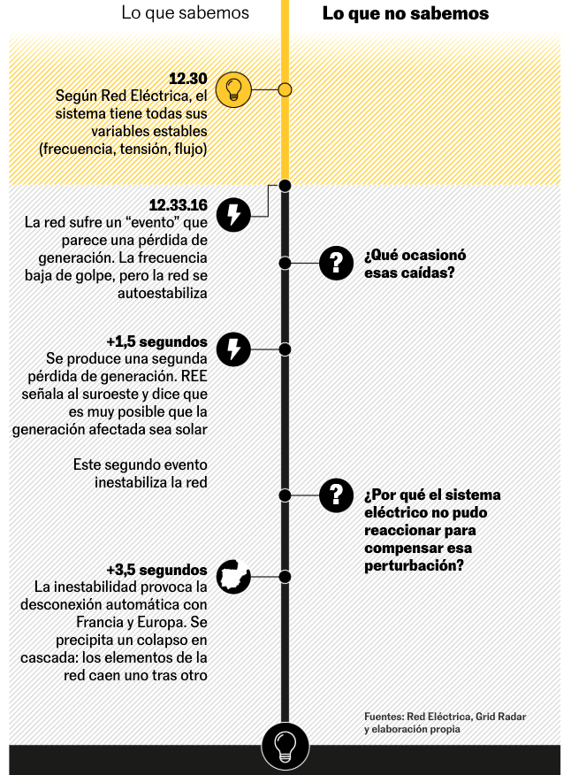
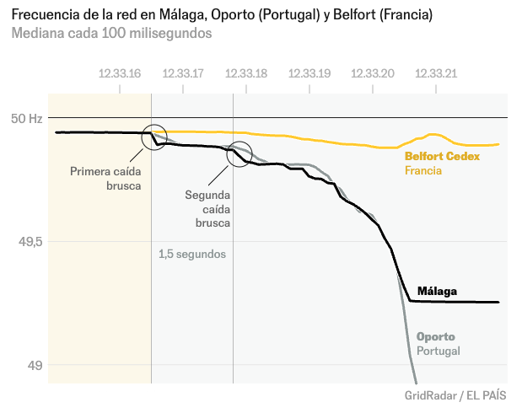
Source: El Pais, “¿Qué causó el apagón? Explicación visual y breve de lo que sabemos”

Slide 4
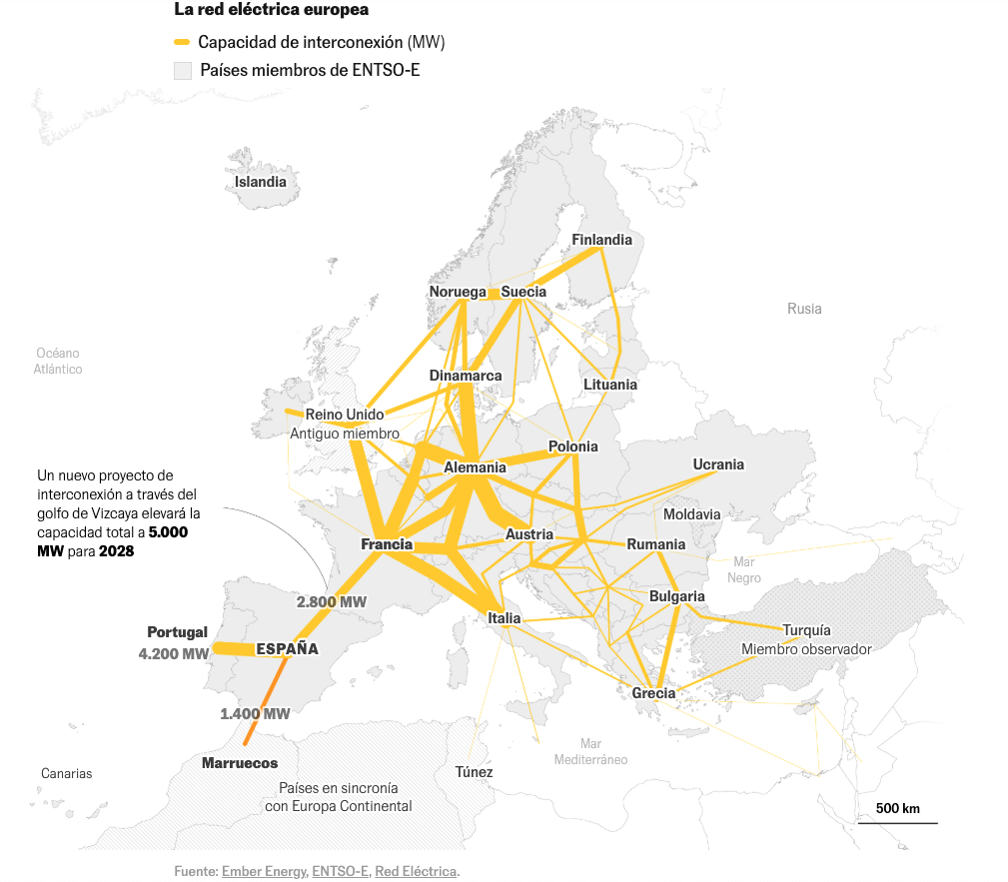
France, Germany, and Italy have relatively strong interchange capacity.
Iberian connection to France is relatively weak.
Source: El Pais, “¿Qué causó el apagón? Explicación visual y breve de lo que sabemos”

Slide 5
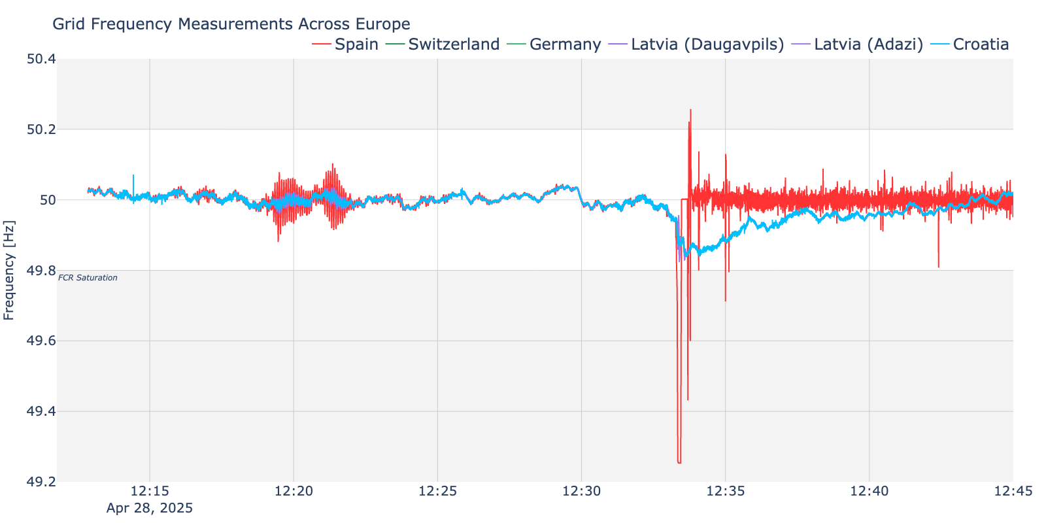
Overview of European grid Frequencies just before the Blackout
Early Oscillations
DFD
(Market Interval)
Bigger Oscillations
Iberian Separation
Europe Recovers
Suspicious Events
Normal Events

Slide 6
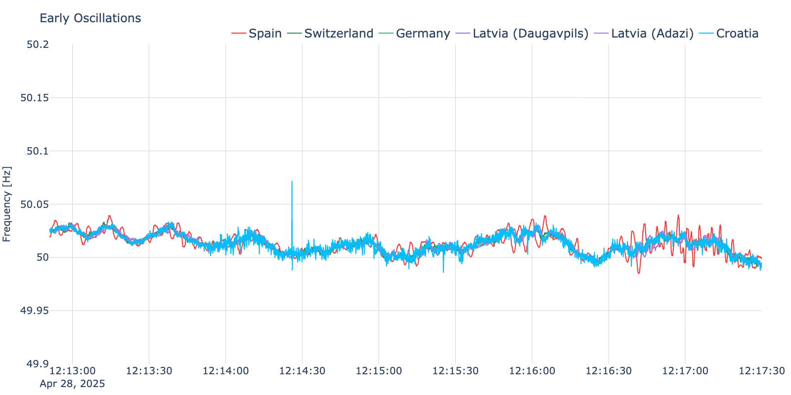
Early Oscillations hint at Instability
* LEMUR currently only has frequency data from 12:12:51pm – 13:12:50pm
From at least 12:13pm* we see notable frequency oscillations in the Iberian grid
Oscillation amplitudes increasing just minutes later
Minor disturbance in Croatia was properly damped and faded in <5 sec. We’ll ignore it.

Slide 7
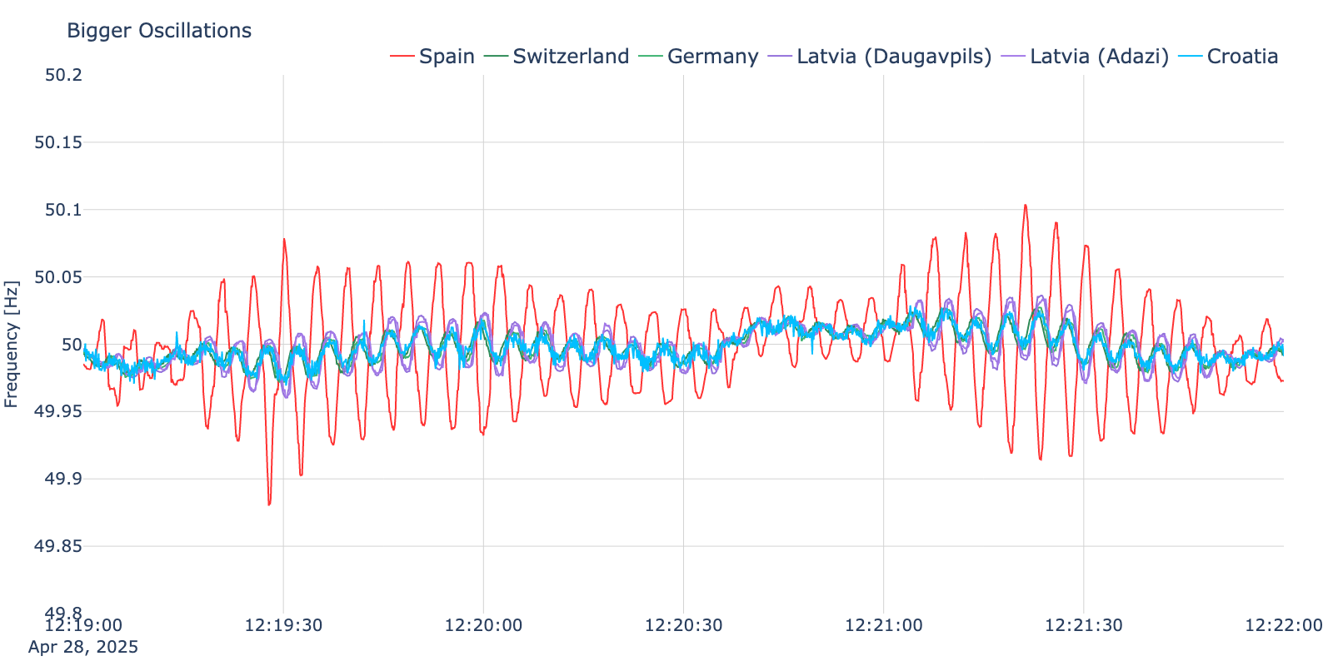
Oscillations Worsen Rapidly
Note 180° phase shift
Undamped frequencies oscillations rapidly worsen

Slide 8
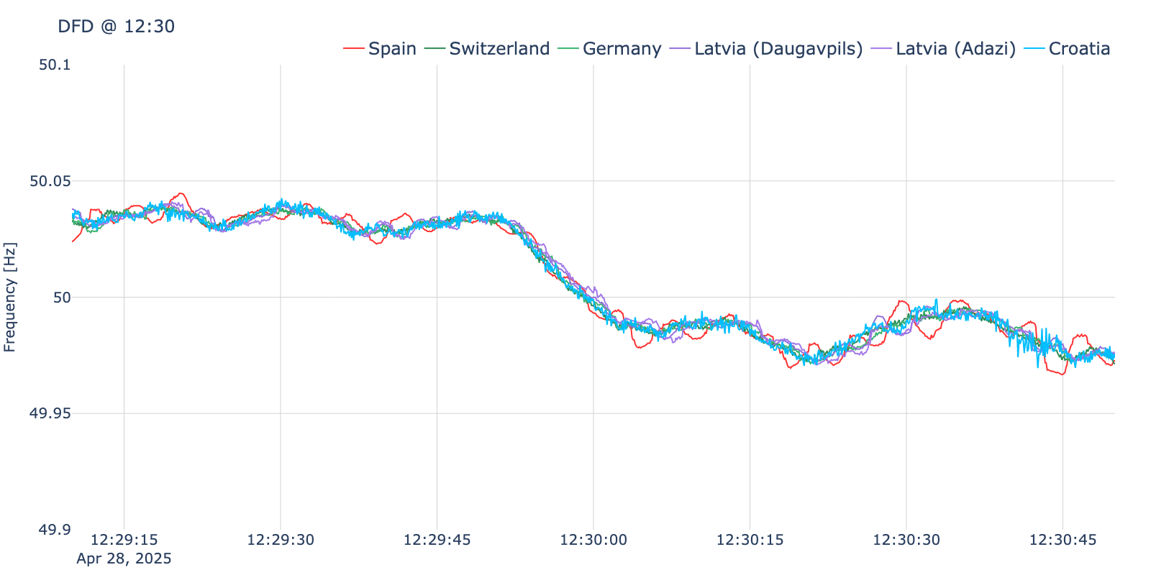
Oscillations Worsen Rapidly
The 15-minute electricity market means many generators change their power setpoints at 12:30pm.
The resulting change in steady-state frequency is called a “Deterministic Frequency Deviation”. These are an undesirable but expected and manageable aspect of large electricity markets.
Iberia still wobbly…

Slide 9
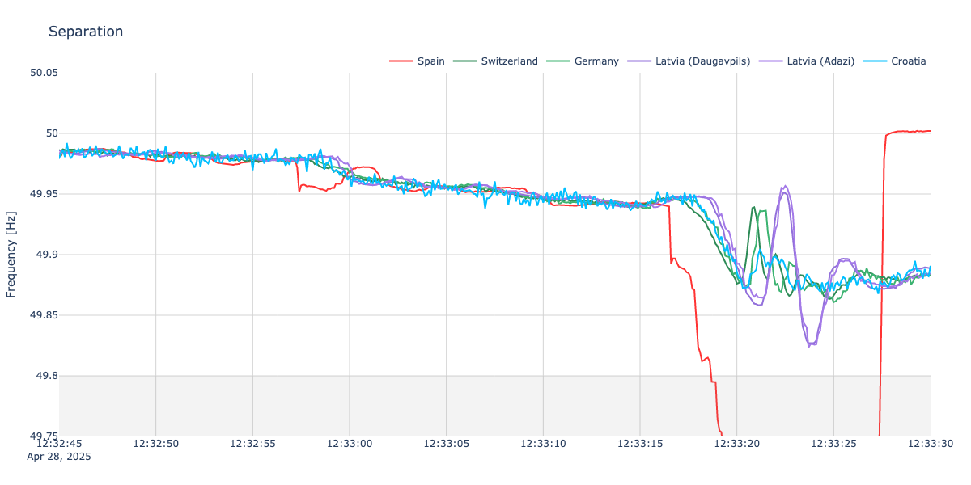
Iberia Separates from Europe
Significant frequency drop @ 12:32:57.3 is probably not the “15GW in 5 seconds”.
But what is it?
Rest of Europe actives FCR and stabilizes
Oscillations persist but Iberia stays connected until…
Fast, irreversible frequency drop starts at 12:33:16.5. Likely some large source tripped and started the cascade of “15GW in 5 seconds”.
Frequency Containment Reserve saturates within 3 seconds.

Slide 10
Section 2
Rate of Change of Frequency

Slide 11
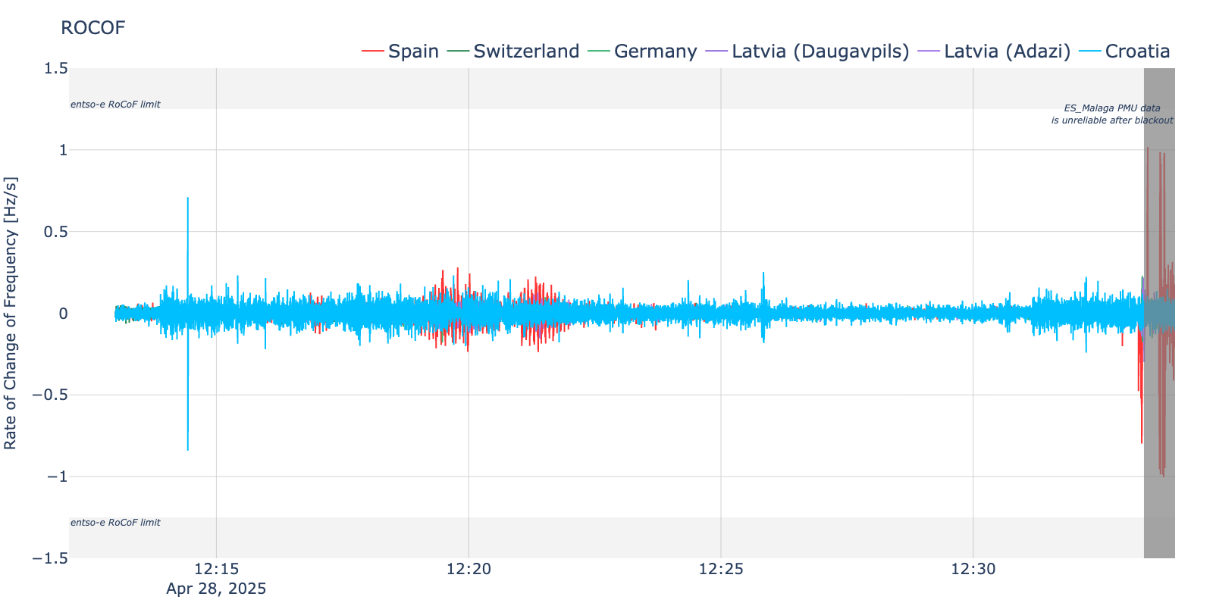
Rocof Overview
Instantaneous RoCoF = +0.71 Hz/s
ES_Malaga PMU data* did not violate any of the entso-e RoCoF disconnection limits:
> 1.25 Hz/s for 500ms
> 1.5 Hz/s for 1s
> 2 Hz/s for 2s

Slide 12
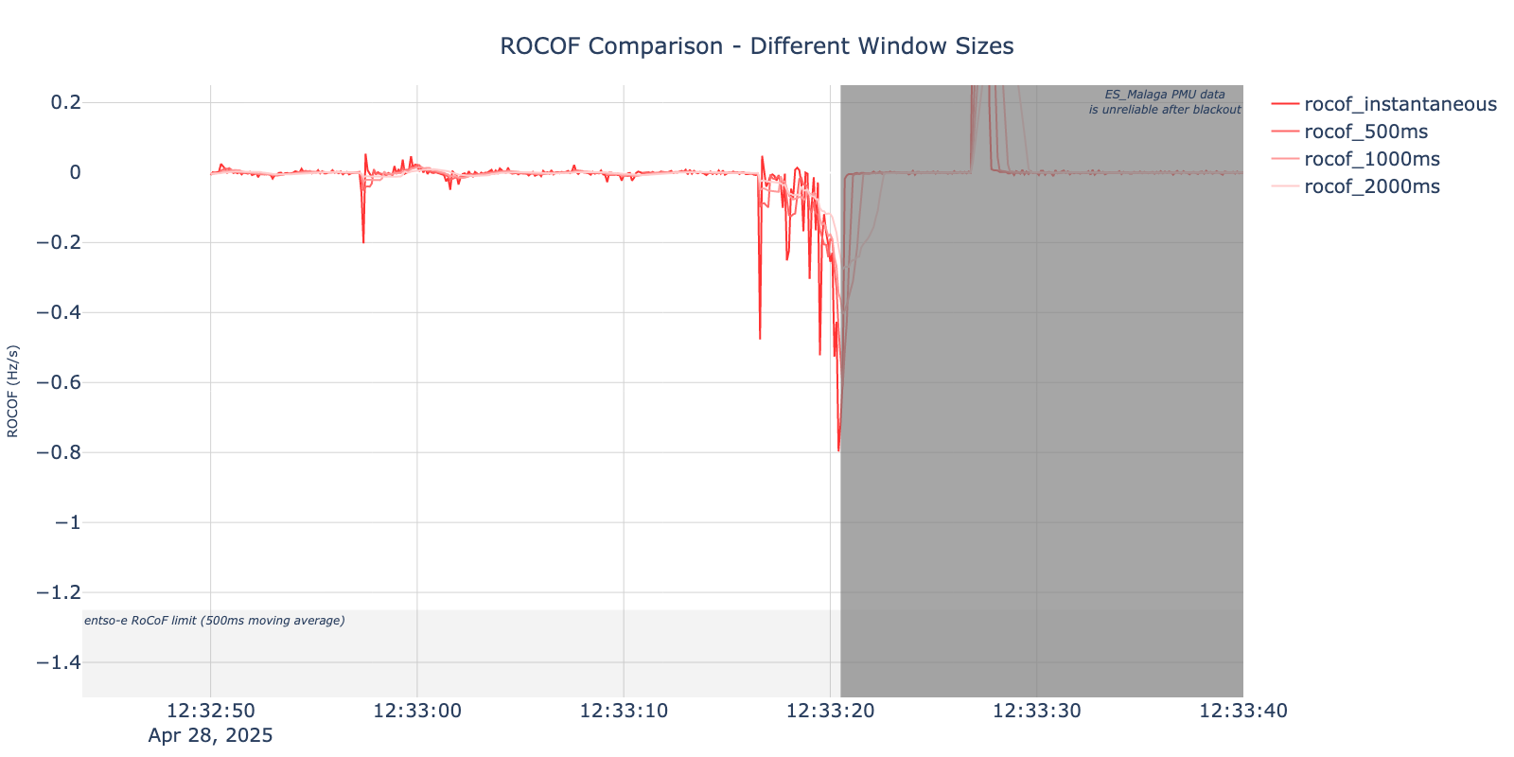
Rocof stayed within limits
ES_Malaga PMU data* did not violate any of the entso-e RoCoF disconnection limits:
> 1.25 Hz/s for 500ms
> 1.5 Hz/s for 1s
> 2 Hz/s for 2s
Instantaneous RoCoF = -0.8 Hz/s
*Physical RoCoF probably lower, but limited by the PMU recording

Slide 13
Section 3
Generation, Inertia, Exports

Slide 14
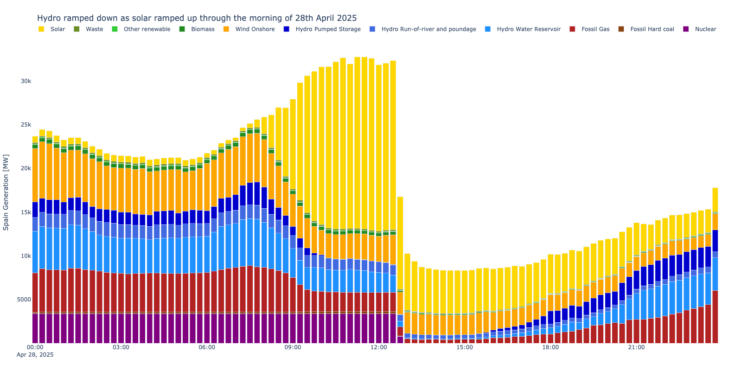
Generation MIX on April 28, 2025
Quite a lot of solar at 23:45…?

Slide 15
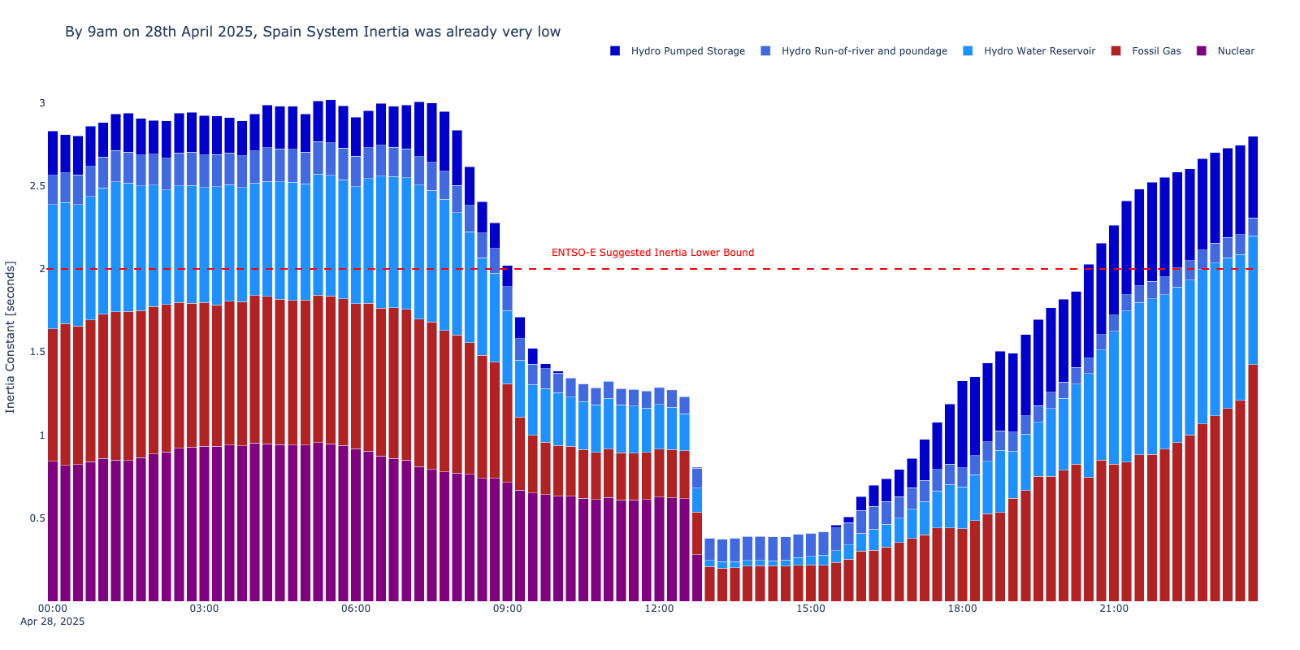
Generation MIX on April 28, 2025
Steep drop in Spanish grid inertia as solar comes online
~1.3 seconds

Slide 16
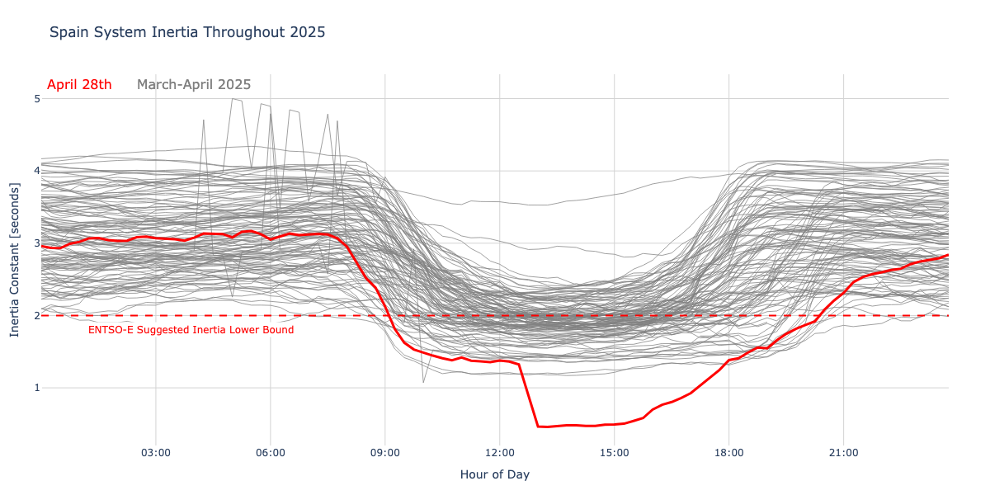
Spanish Inertia was low, but not unprecedented
On April 28th, the Spanish grid’s total inertia was very low, but not unprecedented

Slide 17
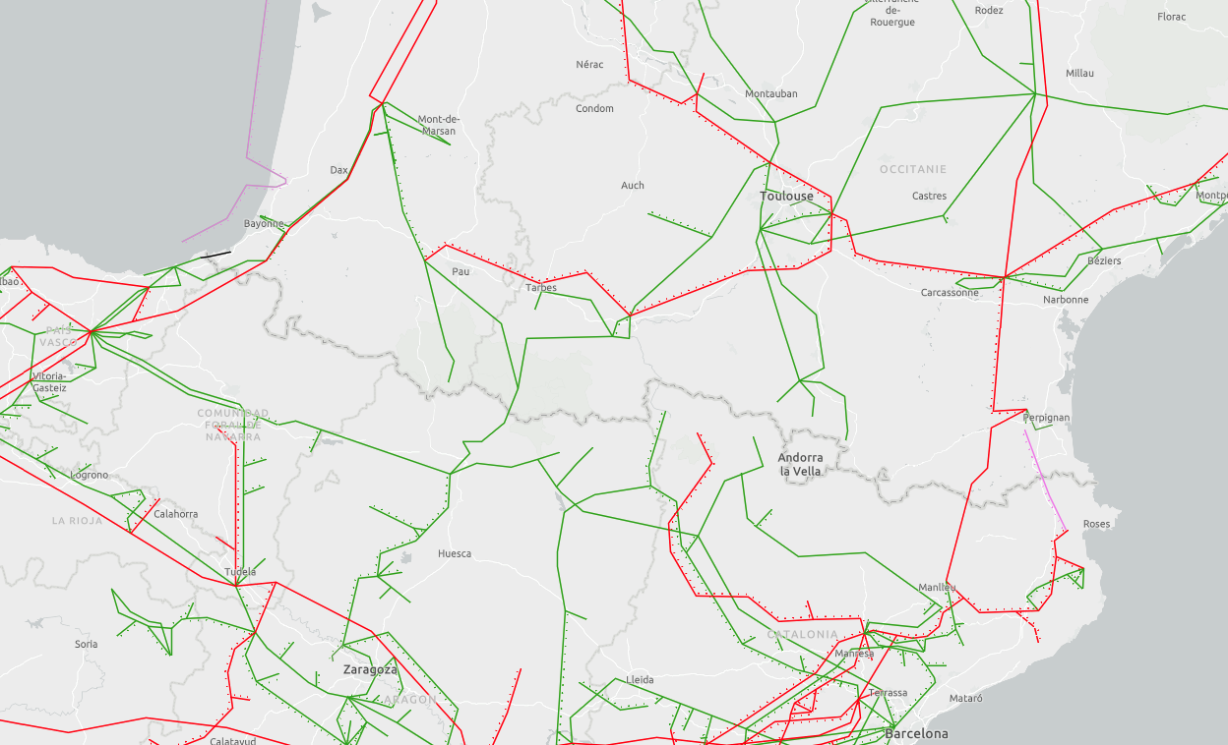
Connections with France
Additional 2.2GW HVDC line expected by 2028
Currently ~2.8GW export capacity
Map Source: ENTSO-E

Slide 18
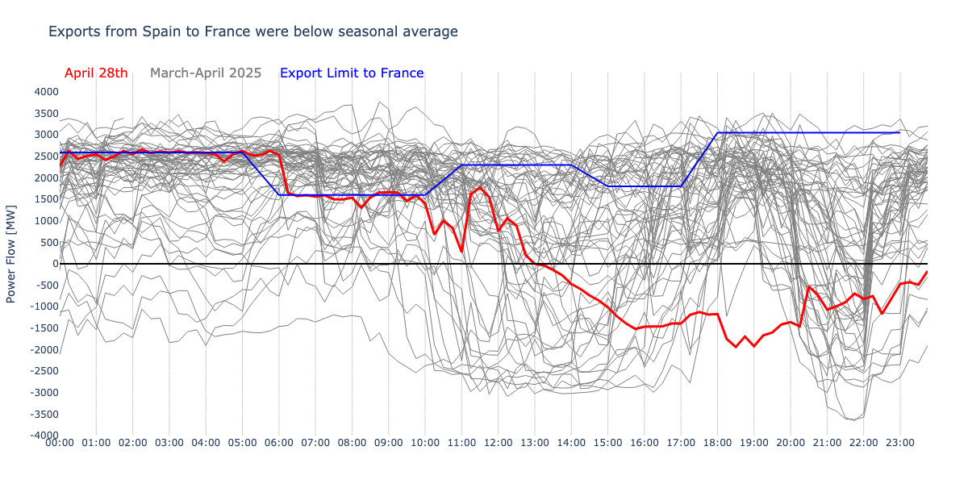
Exports to France were below average
~6am, exports to France fall below the seasonal average.

Slide 19
LEMUR

Slide 20

OUR GOAL
LEMUR is a multidisciplinary research team with researchers belonging to different knowledge areas: Electrical Engineering, Power Electronics and Automation and Control Engineering. The strength is based on looking for synergies and knowledge integration among team members in order to apply for bigger and complex research projects.

Slide 21
OUR VISION
To integrate in a laboratory an environment for testing of small scale distributed energy systems and their integration into the electrical grid. For the study and analysis, a four level approach is proposed:
Development of generation systems and power converters for the injection of electrical energy into the grid under efficiency and reliability constraints.
Development of energy storage systems for the compensation of transient demands at the electrical grid, including pulsating generation by renewable energy systems, grid contingencies and virtual zero demanding energy buildings.
Development of coordinated control strategies for all the small scale generators installed at the grid in order the system to behave as a virtual integrated power plant. Development of new power flow algorithms for considering the unbalanced conditions at weak grids (single phase loads and generation systems).
Study of new economic and infrastructure models relying on the distributed generation, which allow to maximize the benefits considering the existing and future regulations.

Slide 22
ANALYSIS AND DESIGN OF POWER CONVERTER TOPOLOGIES FOR ENERGY STORAGE
Design of power electronics converters with an emphasis of multiport topologies for energy storage applications
DYNAMIC ANALYSIS AND CONTROL OF POWER CONVERTERS FOR DISTRIBUTED RESOURCES
High dynamic performance of power converters and microgrids by advanced control systems
POWER FLOW ANALYSIS FOR HYBRID DC/AC GRIDS WITH HIGH PENETRATION OF DISTRIBUTED RESOURCES
Impact of the integration of distributed resources in the electrical grid
ENERGY DEMAND ANALYSIS AND VISUALIZATION
Analytic tools and visualization strategies for energy planning
APPLICATIONS
Industrial applications and knowledge transfer
OUR RESEARCH
LINES

Slide 23

THANK YOU!
Please be in touch!

