Slide 1
Numerical integration
connection to Lagrange polynomials

Slide 2
Newton-Cotes formulas I
named after Isaac Newton and Roger Cotes
group of formulas for numerical integration based on evaluating the integrand at equally spaced points
assume: value of a function defined on [a,b] is known at n+1 equally spaced points: a ≤ x₀ < x₁ < … < x_{n} ≤ b

Slide 3
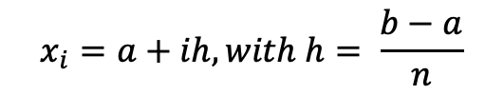
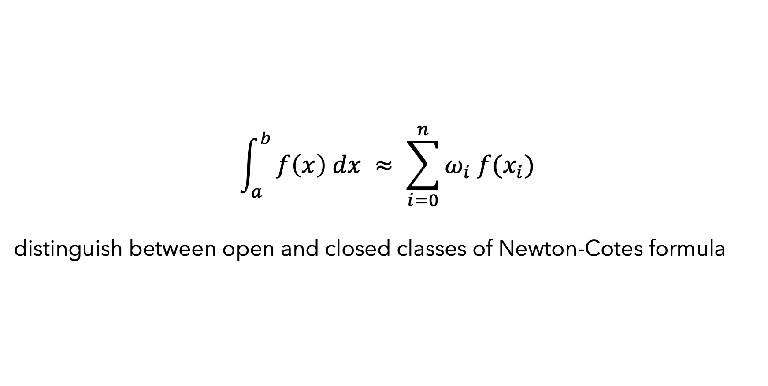

Newton-Cotes formulas II
$$\int_{a}^{b}{f\left(x\right) dx ≈ \sum_{i=0}^{n}{ω_{i} f(x_{i})}}$$
distinguish between open and closed classes of Newton-Cotes formula
closed formula
x₀ = a and x_{n} = b
use function values at endpoint
open formula
x₀ > a and x_{n} < b
don’t use function values at endpoint
$$x_{i}=a+ih, with h= \frac{b−a}{n}$$
$$x_{i}=a+\left(i+1\right)h, with h= \frac{b−a}{n+2}$$
h … step size
𝜔 ... weights, can be computed as the integral of Lagrange basis polynomials –
they depend only on x_{i} and not on the function f

Slide 4
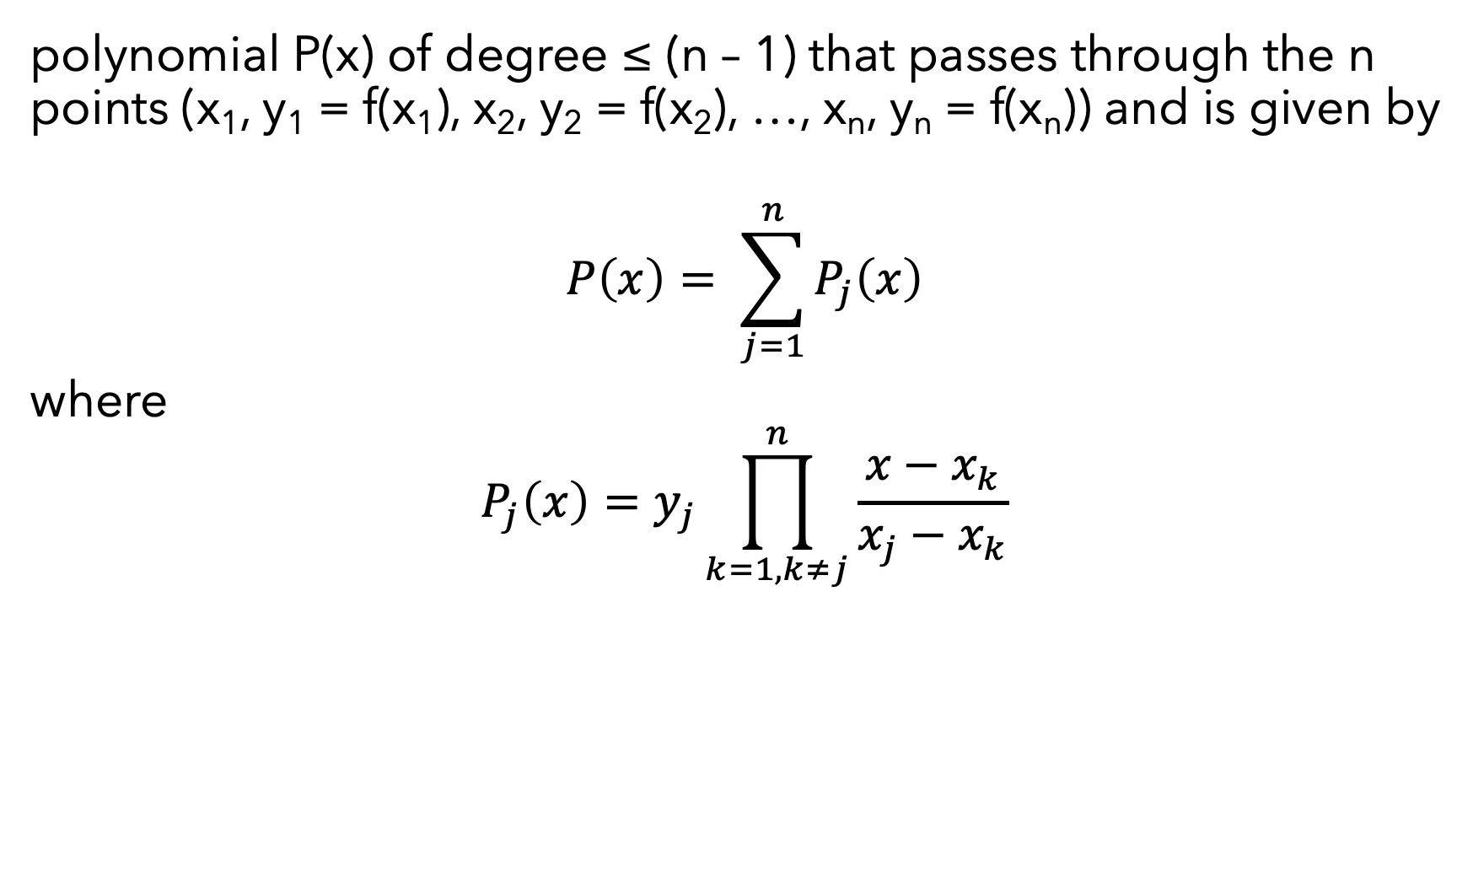
Lagrange polynomials I
polynomial P(x) of degree ≤ (n – 1) that passes through the n points (x₁, y₁ = f(x₁), x₂, y₂ = f(x₂), …, x_{n}, y_{n} = f(x_{n})) and is given by
$$P\left(x\right)= \sum_{j=1}^{n}{P_{j}\left(x\right)}$$
where
$$P_{j}\left(x\right)=y_{j}\prod_{k=1, k≠j}^{n}{\frac{x−x_{k}}{x_{j}−x_{k}}}$$

Slide 5
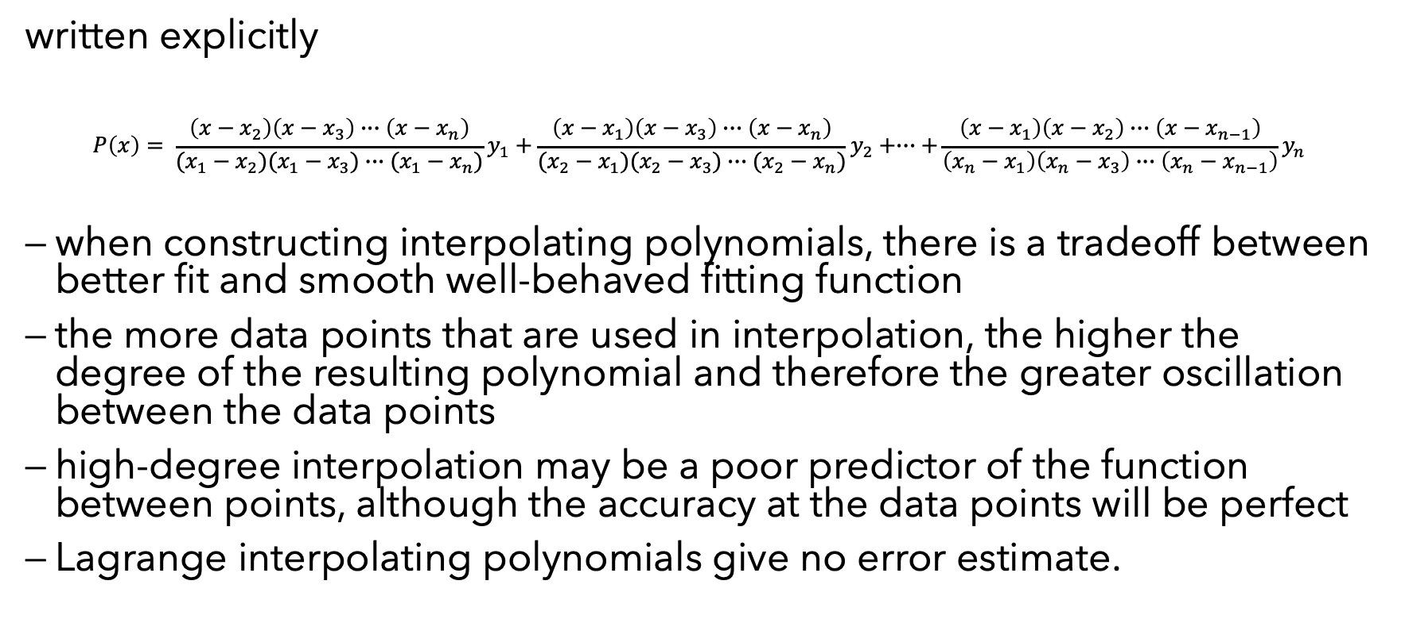
Lagrange polynomials II
written explicitly
$$P\left(x\right)= \frac{\left(x−x_{2}\right)\left(x−x_{3}\right)∙∙∙\left(x−x_{n}\right)}{(x_{1}−x_{2})(x_{1}−x_{3})∙∙∙(x_{1}−x_{n})}y_{1}+\frac{\left(x−x_{1}\right)\left(x−x_{3}\right)∙∙∙\left(x−x_{n}\right)}{(x_{2}−x_{1})(x_{2}−x_{3})∙∙∙(x_{2}−x_{n})}y_{2}+∙∙∙+\frac{\left(x−x_{1}\right)\left(x−x_{2}\right)∙∙∙\left(x−x_{n−1}\right)}{\left(x_{n}−x_{1}\right)\left(x_{n}−x_{3}\right)∙∙∙\left(x_{n}−x_{n−1}\right)}y_{n}$$
when constructing interpolating polynomials, there is a tradeoff between better fit and smooth well-behaved fitting function
the more data points that are used in interpolation, the higher the degree of the resulting polynomial and therefore the greater oscillation between the data points
high-degree interpolation may be a poor predictor of the function between points, although the accuracy at the data points will be perfect
Lagrange interpolating polynomials give no error estimate.

Slide 6
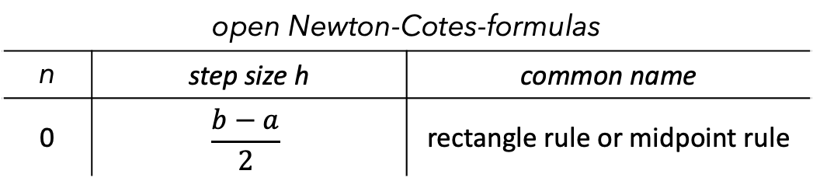
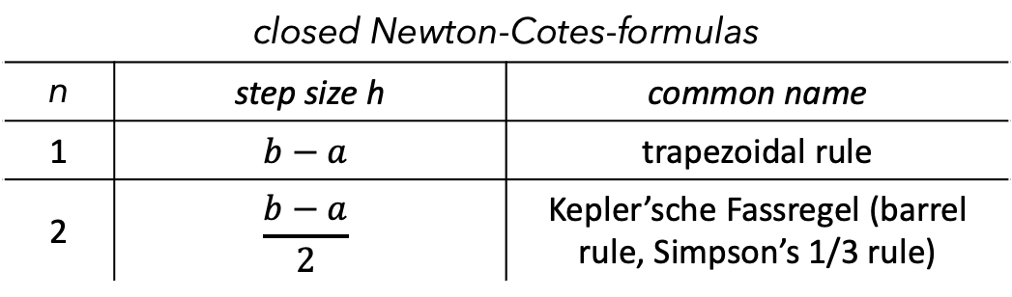
Newton-Cotes formulas III
closed Newton-Cotes-formulas
n | step size h | common name
1 | $$b−a$$ | trapezoidal rule
2 | $$\frac{b−a}{2}$$ | Kepler’sche Fassregel (barrel rule, Simpson’s 1/3 rule)
open Newton-Cotes-formulas
n | step size h | common name
0 | $$\frac{b−a}{2}$$ | rectangle rule or midpoint rule

Slide 7
Sources
https://mathworld.wolfram.com/Newton-CotesFormulas.html
https://en.wikipedia.org/wiki/Newton–Cotes_formulas
https://en.wikipedia.org/wiki/Lagrange_polynomial
https://mathworld.wolfram.com/LagrangeInterpolatingPolynomial.html

