Slide 1
B.Sc. PHYSICS · CUEA · SUPERVISOR MEETING
Measuring the
External Field
Can we measure how hard a news article pushes on what people think?
Brian Mwai 1050555
Supervisor: Dr. Songa Mutambi
21 September 2026
each arrow is one person's opinion

Slide 2

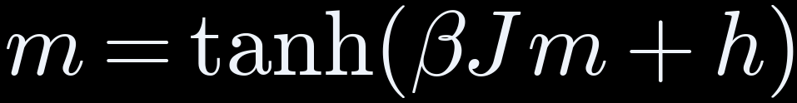




THE IDEA
Physics treats media as a push, h, on opinion. Nobody measures h
average opinion
−1 all against · +1 all for
pull toward
the people around you
how firmly people
follow that pull
media's push,
the same on everyone
Question: can h be measured from the content itself?
THE IDEA
02

Slide 3



THE IDEA
Testing the tools changed five assumptions
WE PLANNED
WE FOUND
Measure the amygdala
Model sees brain surface only, so we used surface areas
Score as a ratio
Ratio broke on 69 of 400, so we used a difference
Outrage stands out most
Fear stands out; outrage lifts both areas equally
Measure α, media's strength
Data can't pin α, so we derived its minimum
A manipulation detector
Word counting wins, so it's a measurement
All five are in the approved amendment.
THE IDEA
03

Slide 4




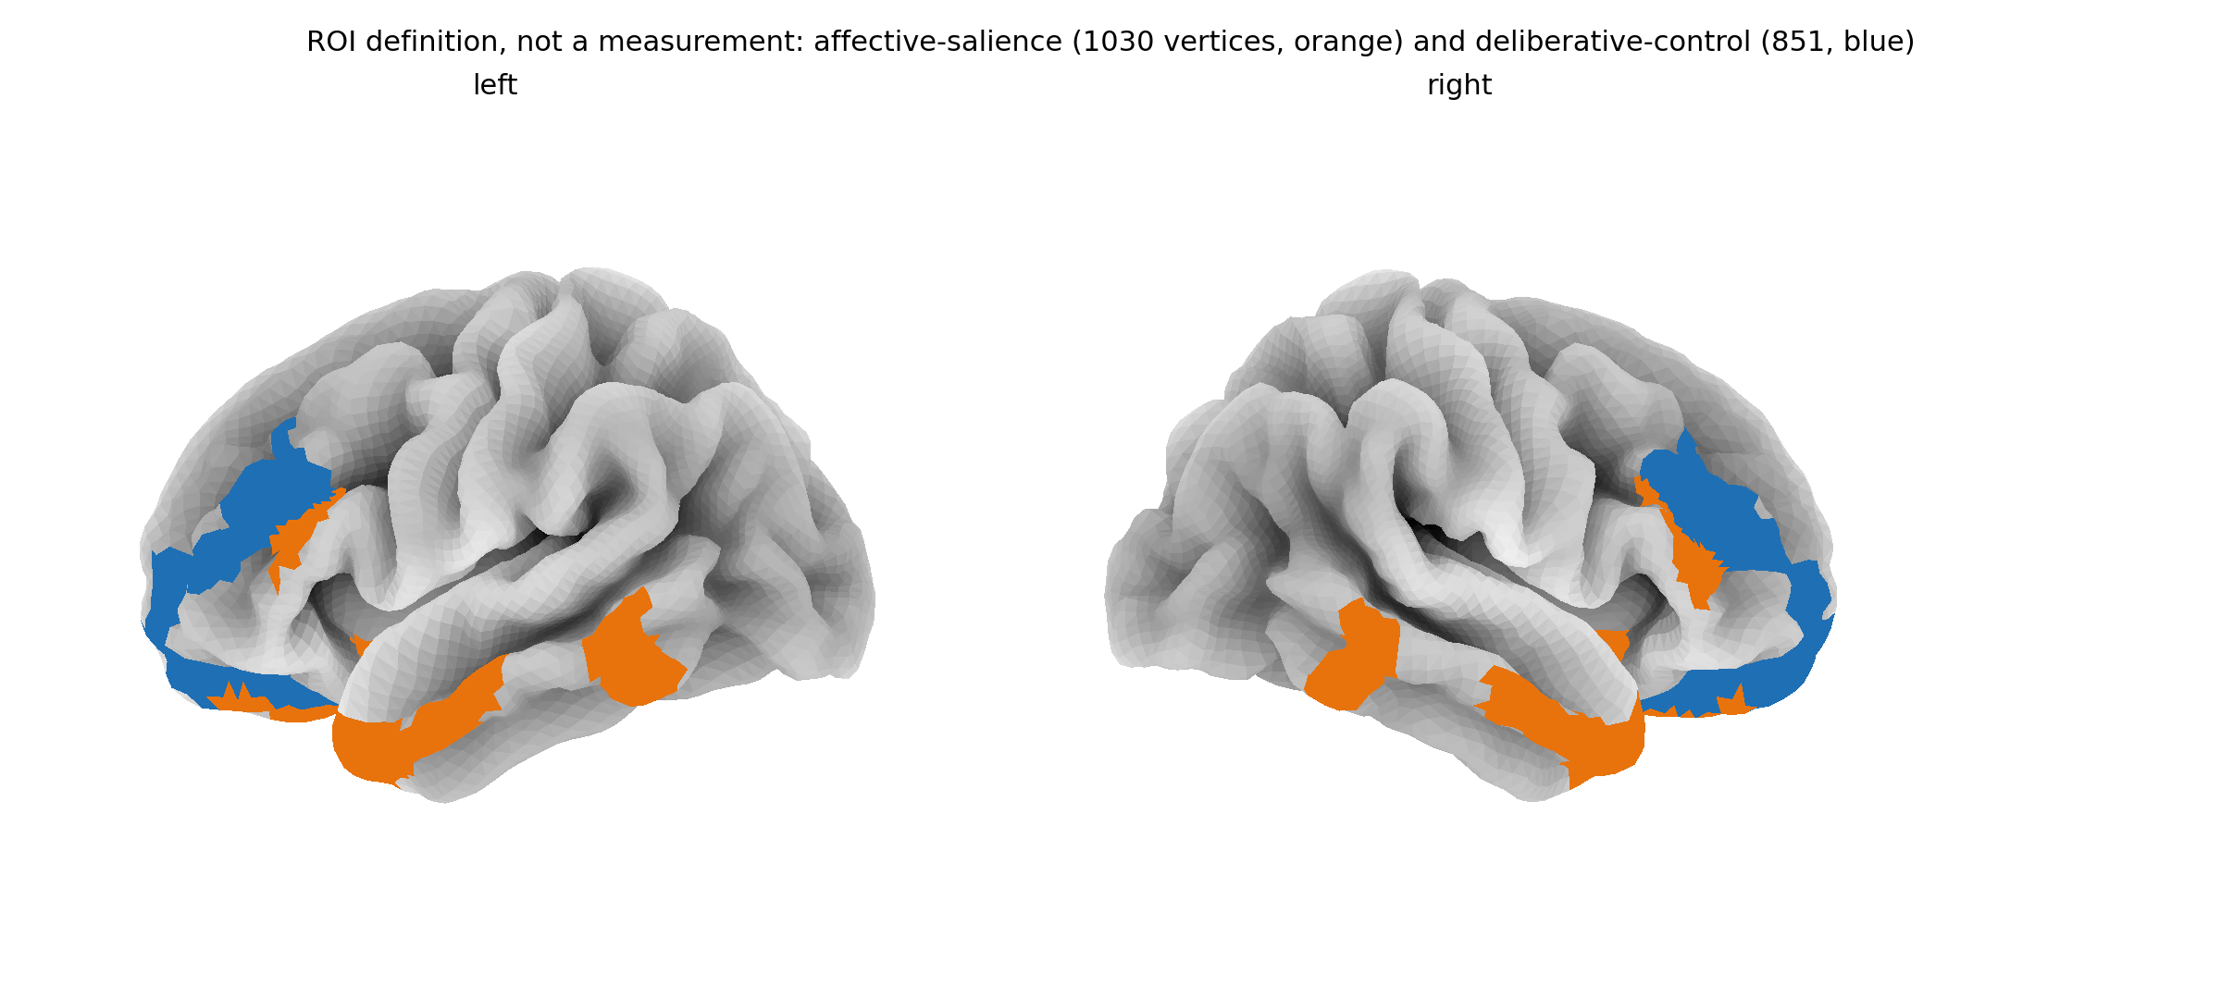
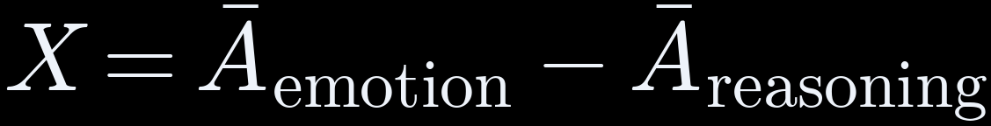

THE METHOD
How one article becomes one number
Article
400 news texts
Read aloud
text-to-speech
Word timings
timing tool
TRIBE v2
Meta, 2025
Brain map
Glasser, 2016
THE SCORE
reasoning leads
0
emotion leads
Nobody scanned: every value is predicted
orange 1,030 emotion points blue 851 reasoning points
THE METHOD
04

Slide 5
THE METHOD
400 articles, four groups, matched in length
100
Fear-driven
fake news (ISOT)
100
Outrage
partisan news (SemEval)
100
Clickbait
headlines (Webis)
100
Neutral
medical + real news
≈ 164
words per article,
all groups within 5 words
0.027
smallest effect we
could detect, set in advance
× 2
every article
scanned twice
THE METHOD
05

Slide 6

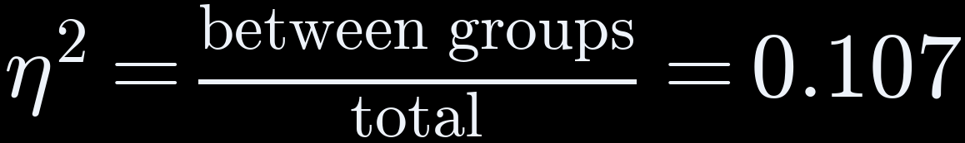
THE RESULTS
Result 1: the four groups really differ
η² ON EACH RUN, AGAINST THE SMALLEST WE COULD DETECT
11%
first run
0.107
second run
0.089
detectable
0.027
1 in a billion
chance it is luck (p = 1×10⁻⁹)
Repeats
second run agrees (0.089)
11% of the differences between articles comes from their group
Meaning: the groups differ for real, but most variation is from one article to the next.
THE RESULTS
06

Slide 7
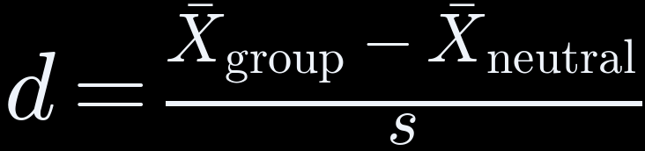
THE RESULTS
Result 2: fear drives it; outrage lifts both sides equally
distance from neutral, in spreads (s)
small
medium
large
fear-driven
0.94
clickbait
0.32
outrage
0.03
+0.61
FEAR
+0.51
+0.49
OUTRAGE
big gap: score moves
no gap: score stays flat
-0.10
emotion
reasoning
emotion
reasoning
THE RESULTS
07

Slide 8

THE RESULTS
Result 3: scores repeat for groups, not single articles
0.87
agreement between two runs (ICC)
51 of 400
flipped sign between runs
0 none
1 identical
● saw 51 ▌noise predicts 55 (shaded 44 to 67)
Meaning: trust group averages. Never judge one article: its score sits near zero and noise can tip it.
THE RESULTS
08

Slide 9
THE RESULTS
Honest check: word counting beats our score
How well each method sorts manipulative from neutral articles (AUC)
our score 0.63
word counting 0.98
0.5 coin toss
1.0 perfect
sentiment 0.54
WHY: EACH GROUP CAME FROM ONE SOURCE
66%
words guess the source
(chance: 25%)
So our score is a measurement for the physics, not a detector.
fear
ISOT fake
outrage
SemEval
clickbait
Webis
neutral
PubMed + ISOT
THE RESULTS
09

Slide 10
THE RESULTS
Does the brain model match real brains? Weakly, yes
Tested on public brain scans of people watching Friends (Algonauts 2025). Higher = closer match (r).
people vs each other,
full episode
0.152
best possible,
2-minute clip
0.096
our model,
2-minute clip
0.028
≈ 30%
of the best possible on the clip
p = 0.048
just under the 5% cut-off
3 bugs
found and fixed along the way
Meaning: weak but positive, not the opposite of real brains. A longer run will settle it (Paper 3).
THE RESULTS
10

Slide 11

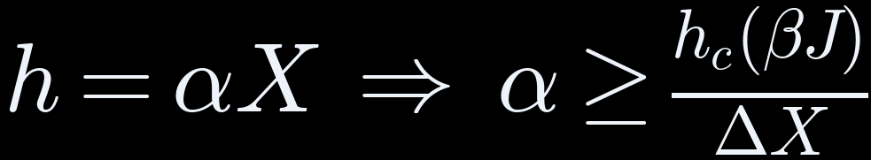



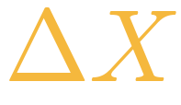
THE PHYSICS
The minimum push media would need
α required
strength of the push per unit of score
smallest push that flips the majority
how strongly people copy each other
copying strength βJ →
spread of our scores = 0.124
α ≥ 4.29 at βJ = 2
a bar any claim must clear
THE PHYSICS
11

Slide 12

WHAT'S NEXT
Can it analyse any content, even what children watch?
CAN DO
NOT YET
WOULD TAKE
Score video, audio and text
Model learned from adult brains
Child brain data, with ethics approval
Compare groups of content
Only news text was tested
A children's video test set
Rate content, never the viewer
One show alone is unreliable
Safeguards against targeting children
Short answer: technically possible, but not yet valid for children.
WHAT'S NEXT
12

Slide 13
WHAT'S NEXT
Each limit points to the next study
LIMIT
NEXT STUDY
Predictions, not brain scans
Check against more real brain data
Group mixed up with source
New set: every source has every type
Brain surface only
A model that predicts deep areas
α not measured
Link scores to real opinion data (polls)
Brain check is 2 minutes
Longer clips, one run each
WHAT'S NEXT
13

Slide 14


WHAT'S NEXT
Taking it further: where this research can go
PUBLISH
EXTEND THE SCIENCE
OPPORTUNITIES
Paper 1 → Physica A
Kenya: 2024 Finance Bill coverage
Postgraduate research topic
Paper 2 → Physica A
Video and audio content
Neuroscience + media collaborations
Paper 3 → Imaging Neuroscience
Measure α with opinion data
Open tool, already online
Preprints first (arXiv)
Children's media, ethically
Group-level media audits
Live instrument: monarch-4iy.pages.dev · Code and data: github.com/brn-mwai/monarch
WHAT'S NEXT
14

Slide 15
WHAT'S NEXT
Three papers, and what I need from you today
PAPER 1 · Physica A
The minimum push
12 pp · ready
PAPER 2 · Physica A
The measuring tool
16 pp · ready
PAPER 3 · Imaging Neurosci.
Matching real brains
8 pp · one longer run
TODAY I AM ASKING FOR
1 Any corrections
2 Signature, page iii
3 Library clearance by Thu 24
4 Co-authorship view
WHAT'S NEXT
15

