Slide 1
B.Sc. PHYSICS · CUEA · SUPERVISOR MEETING
Measuring the
External Field
Can we measure how hard a news article pushes on what people think?
Brian Mwai 1050555
Supervisor: Dr. Songa Mutambi
21 September 2026
each arrow is one person's opinion
Notes:
SCRIPT (about 1 min)
Good morning, Dr. Songa, and thank you for the time. I'll go through what I set out to do, how I did it, what I found, what the work cannot claim, where it can go next, and the three papers. About fifteen minutes, and I'll end with what I need from you.
NUMBERS TO SAY
- About 15 minutes
- End with the four requests

Slide 2
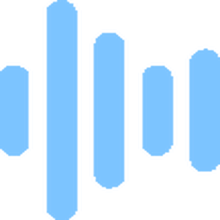
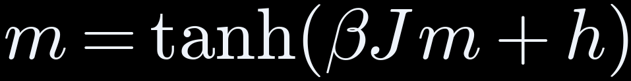
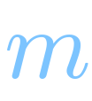



THE IDEA
Physics treats media as a push, h, on opinion. Nobody measures h
average opinion
−1 all against · +1 all for
pull toward
the people around you
how firmly people
follow that pull
media's push,
the same on everyone
Question: can h be measured from the content itself?
THE IDEA
02
Notes:
SCRIPT (about 1 min)
Physicists model a group forming an opinion the same way they model tiny magnets lining up. The equation is m equals tanh of beta J m plus h. m is the group's average opinion, from minus one, everyone against, to plus one, everyone for. J is how strongly each person is pulled toward the people around them. Beta is how firmly they follow that pull instead of acting at random. And h is the push from media, the same on everyone. In every study I read, h is chosen by hand. My question: can we measure h from the content itself?
NUMBERS TO SAY
- m: average opinion, -1 to +1
- J: pull toward neighbours
- beta: how firmly people follow the pull
- h: media's push

Slide 3



THE IDEA
Testing the tools changed five assumptions
WE PLANNED
WE FOUND
Measure the amygdala
Model sees brain surface only, so we used surface areas
Score as a ratio
Ratio broke on 69 of 400, so we used a difference
Outrage stands out most
Fear stands out; outrage lifts both areas equally
Measure α, media's strength
Data can't pin α, so we derived its minimum
A manipulation detector
Word counting wins, so it's a measurement
All five are in the approved amendment.
THE IDEA
03
Notes:
SCRIPT (about 1.5 min)
Before the results, here is what changed from the proposal once we tested the tools. Five things. We planned to measure the amygdala, but the model only sees the brain's surface. The ratio score broke, so we used a difference. Outrage didn't stand out; fear did. We couldn't measure alpha, so we derived the minimum instead. And the score turned out to be a measurement, not a detector. All of this is in the amendment you approved.
NUMBERS TO SAY
- 5 changes, all in the approved amendment
- Ratio broke on 69 of 400
IF ASKED
Q: Why no amygdala?
A: The released model only predicts the brain's surface. The amygdala is deep inside, so we make no claim about it.

Slide 4




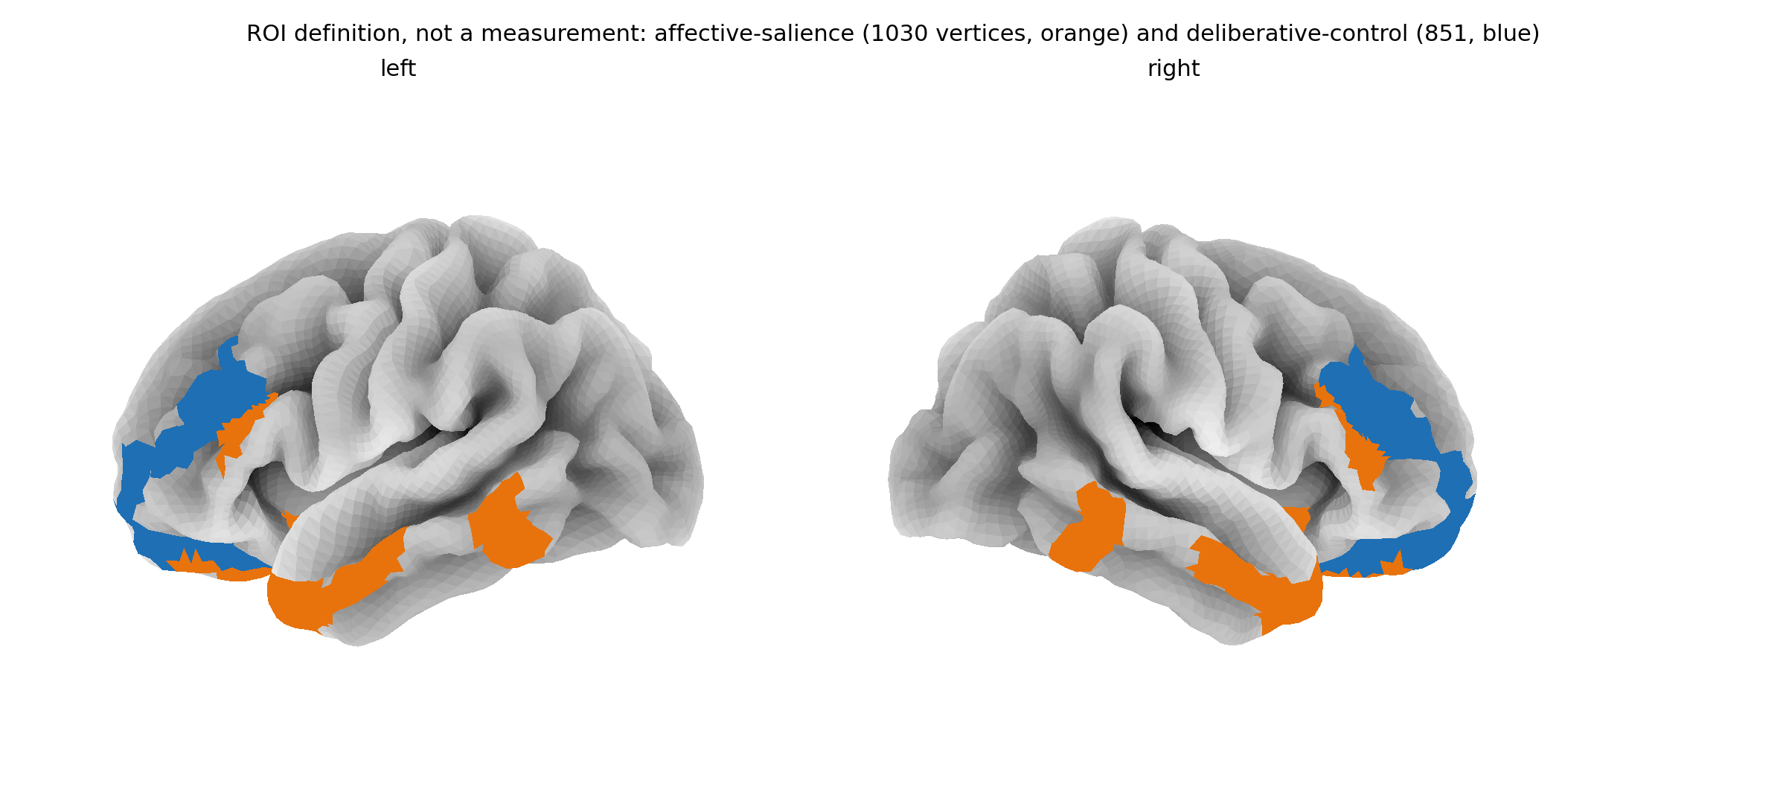
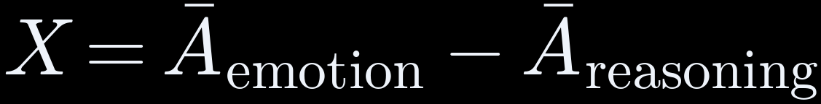

THE METHOD
How one article becomes one number
Article
400 news texts
Read aloud
text-to-speech
Word timings
timing tool
TRIBE v2
Meta, 2025
Brain map
Glasser, 2016
THE SCORE
reasoning leads
0
emotion leads
Nobody scanned: every value is predicted
orange 1,030 emotion points blue 851 reasoning points
THE METHOD
04
Notes:
SCRIPT (about 1.5 min)
This is how one article becomes one number. The article is read aloud by a text-to-speech voice, because the brain model was built on people listening. A timing tool marks when each word is said. Then TRIBE v2, a model from Meta's research lab trained on brain scans of adult volunteers watching TV, predicts activity at 20,484 points on the brain's surface. A standard brain map picks 1,030 points linked to emotion and 851 linked to reasoning. The score X is the emotion average minus the reasoning average. Nobody was scanned: every value is a prediction.
NUMBERS TO SAY
- 20,484 points on the brain surface
- 1,030 emotion, 851 reasoning
- About 70 seconds per article on a free Kaggle GPU
IF ASKED
Q: Was anyone scanned? Is it reading minds?
A: No. Nobody was scanned. The scores are predictions of a typical adult brain. The tool rates content, not people.
Q: Why read the articles aloud?
A: The model was trained on people watching and listening, so it expects speech with word timings.
Q: Is it okay to use Meta's model?
A: Yes, for research. It's under a non-commercial licence, cited throughout, and this project makes no money from it.

Slide 5
THE METHOD
400 articles, four groups, matched in length
100
Fear-driven
fake news (ISOT)
100
Outrage
partisan news (SemEval)
100
Clickbait
headlines (Webis)
100
Neutral
medical + real news
≈ 164
words per article,
all groups within 5 words
0.027
smallest effect we
could detect, set in advance
× 2
every article
scanned twice
THE METHOD
05
Notes:
SCRIPT (about 1 min)
We scored 400 articles from four public collections, 100 each: fear-driven fake news, outrage-style partisan news, clickbait, and neutral writing. Lengths are matched so no group wins by being longer. We worked out before scanning that 400 could detect an effect as small as 0.027, and we scanned every article twice.
NUMBERS TO SAY
- 4 groups x 100
- About 164 words each
- Smallest detectable 0.027
- Scanned twice
IF ASKED
Q: Why only 400 articles?
A: We calculated before scanning that 400 detects an effect of 0.027. Each article costs about a minute of GPU time, and we ran them twice.

Slide 6

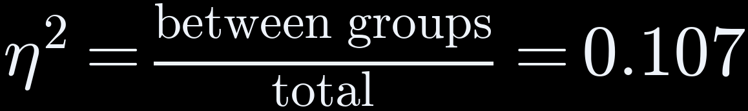
THE RESULTS
Result 1: the four groups really differ
η² ON EACH RUN, AGAINST THE SMALLEST WE COULD DETECT
11%
first run
0.107
second run
0.089
detectable
0.027
1 in a billion
chance it is luck (p = 1×10⁻⁹)
Repeats
second run agrees (0.089)
11% of the differences between articles comes from their group
Meaning: the groups differ for real, but most variation is from one article to the next.
THE RESULTS
06
Notes:
SCRIPT (about 1 min)
First result: the groups really differ. The measure is eta squared, 0.107. The ring shows what that means: about 11 percent of the differences between articles come from which group they are in, and the rest is article to article. The chance this is luck is about one in a billion, and the second run gave 0.089, both far above the 0.027 we could detect.
NUMBERS TO SAY
- 0.107 = 11% explained by group
- p about 1 in a billion
- Second run 0.089

Slide 7
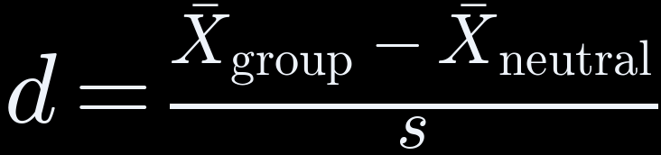
THE RESULTS
Result 2: fear drives it; outrage lifts both sides equally
distance from neutral, in spreads (s)
small
medium
large
fear-driven
0.94
clickbait
0.32
outrage
0.03
+0.61
FEAR
+0.51
+0.49
OUTRAGE
big gap: score moves
no gap: score stays flat
-0.10
emotion
reasoning
emotion
reasoning
THE RESULTS
07
Notes:
SCRIPT (about 1 min)
Which group drives it? Fear. Measured against neutral articles, fear sits 0.94 spreads away, which is large. Clickbait is small and outrage is almost zero. The two small charts show why. Fear raises the emotion areas and leaves reasoning flat, so the gap, our score, moves. Outrage raises both by the same amount, so the gap stays flat. The proposal expected outrage to be strongest, and this is why it isn't.
NUMBERS TO SAY
- Fear 0.94 large, clickbait 0.32 small, outrage 0.03
- Outrage: emotion +0.51, reasoning +0.49
- Fear: emotion +0.61, reasoning -0.10

Slide 8

THE RESULTS
Result 3: scores repeat for groups, not single articles
0.87
agreement between two runs (ICC)
51 of 400
flipped sign between runs
0 none
1 identical
● saw 51 ▌noise predicts 55 (shaded 44 to 67)
Meaning: trust group averages. Never judge one article: its score sits near zero and noise can tip it.
THE RESULTS
08
Notes:
SCRIPT (about 1 min)
Can we trust the score? Running all 400 articles twice gives agreement of 0.87, where 1 means identical. That is high. 51 articles flipped sign between runs, but noise alone predicts about 55, and they all sit near zero where a tiny wobble tips them. So group averages are trustworthy, and we never judge a single article.
NUMBERS TO SAY
- Agreement 0.87 (1 = identical)
- 51 flipped, 55 expected (44 to 67)

Slide 9
THE RESULTS
Honest check: word counting beats our score
How well each method sorts manipulative from neutral articles (AUC)
our score 0.63
word counting 0.98
0.5 coin toss
1.0 perfect
sentiment 0.54
WHY: EACH GROUP CAME FROM ONE SOURCE
66%
words guess the source
(chance: 25%)
So our score is a measurement for the physics, not a detector.
fear
ISOT fake
outrage
SemEval
clickbait
Webis
neutral
PubMed + ISOT
THE RESULTS
09
Notes:
SCRIPT (about 1.5 min)
The most important honest check. Plain word counting sorts manipulative from neutral articles far better than our score: 0.98 against 0.63, where 0.5 is a coin toss. That's because each group came from a different source, and the words give the source away. So we cannot say the difference comes from writing style alone. Our score is a measurement for the physics, not a manipulation detector.
NUMBERS TO SAY
- Word counting 0.98, ours 0.63, sentiment tool 0.54
- Words guess the source 66% vs 25% chance
IF ASKED
Q: If word counting does better, why not use that?
A: Word counting mostly learns the source. Our score is meant to be the push h in the opinion model. The comparison is there to be honest.

Slide 10
THE RESULTS
Does the brain model match real brains? Weakly, yes
Tested on public brain scans of people watching Friends (Algonauts 2025). Higher = closer match (r).
people vs each other,
full episode
0.152
best possible,
2-minute clip
0.096
our model,
2-minute clip
0.028
≈ 30%
of the best possible on the clip
p = 0.048
just under the 5% cut-off
3 bugs
found and fixed along the way
Meaning: weak but positive, not the opposite of real brains. A longer run will settle it (Paper 3).
THE RESULTS
10
Notes:
SCRIPT (about 1 min)
Does the brain model match real brains? A company audit claimed it was the opposite, so we tested it on public brain scans of people watching Friends. Real people agree with each other at 0.152 over the episode; that's the ceiling. On a two-minute clip, the best possible is 0.096 and the model reaches 0.028, about 30 percent of the way, with p of 0.048. Weak but positive. We also found and fixed three hidden bugs. This is Paper 3.
NUMBERS TO SAY
- Ceiling 0.152 (full episode)
- Clip: model 0.028 vs best 0.096
- p = 0.048
- 3 bugs fixed

Slide 11

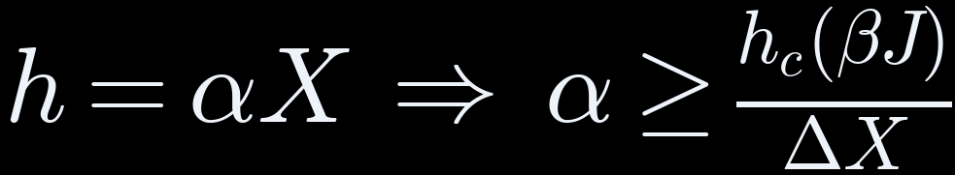



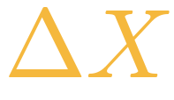
THE PHYSICS
The minimum push media would need
α required
strength of the push per unit of score
smallest push that flips the majority
how strongly people copy each other
copying strength βJ →
spread of our scores = 0.124
α ≥ 4.29 at βJ = 2
a bar any claim must clear
THE PHYSICS
11
Notes:
SCRIPT (about 1.5 min)
The physics result. We link our score to the model with h equals alpha X: the push is the score times a strength, alpha. We couldn't measure alpha, so we asked how big it must be to flip a majority. The model gives h c, the smallest push that flips it, which grows with the copying strength beta J. Dividing by the spread of our scores, delta X of 0.124, gives the curve. At beta J of 2, alpha must be at least 4.29. It is a bar any future claim must clear, not a claim that media flips opinion.
NUMBERS TO SAY
- h = alpha X
- Delta X = 0.124 (-0.070 to +0.054)
- alpha >= 4.29 at beta J = 2
IF ASKED
Q: Why is this physics?
A: The opinion model is statistical physics, the maths of magnets lining up. The contribution is measuring the push and deriving its minimum.
Q: What does alpha >= 4.29 mean in practice?
A: It's a bar. Any claim that such content flips a strongly connected group must use alpha of at least 4.29, or the model says it can't.

Slide 12

WHAT'S NEXT
Can it analyse any content, even what children watch?
CAN DO
NOT YET
WOULD TAKE
Score video, audio and text
Model learned from adult brains
Child brain data, with ethics approval
Compare groups of content
Only news text was tested
A children's video test set
Rate content, never the viewer
One show alone is unreliable
Safeguards against targeting children
Short answer: technically possible, but not yet valid for children.
WHAT'S NEXT
12
Notes:
SCRIPT (about 1 min)
At my first presentation I was asked whether this could analyse any content, even what children watch. Technically yes: it takes video and audio, so it could score a cartoon. But the model learned from adult brains, so it can't say how a child reacts. We only tested news text, and one show on its own isn't reliable. For children we'd need child brain data and ethics approval first.
NUMBERS TO SAY
- Adult-trained model
- 1 in 8 items flip between runs
IF ASKED
Q: Can this analyse any content, even what children watch?
A: Technically it can score video and audio. But the model learned from adult brains, so it can't say how a child reacts, and we only tested news text. It would need child brain data and ethics approval first.
Q: Could a parent or a regulator use it to rate one show?
A: Not yet. About 1 in 8 items flip between runs, so single scores aren't reliable. It is only trustworthy for comparing groups of content.
Q: What would it take for children's media?
A: Child brain scans with ethics approval and consent, a children's video test set, and content where source and type are mixed.

Slide 13
WHAT'S NEXT
Each limit points to the next study
LIMIT
NEXT STUDY
Predictions, not brain scans
Check against more real brain data
Group mixed up with source
New set: every source has every type
Brain surface only
A model that predicts deep areas
α not measured
Link scores to real opinion data (polls)
Brain check is 2 minutes
Longer clips, one run each
WHAT'S NEXT
13
Notes:
SCRIPT (about 0.5 min)
Every limit here points to the next study. Predictions need checking against more real brain data. Group and source need separating with a new set of articles. Deep brain areas need a model that predicts them. Alpha needs real opinion data. And the brain check needs longer clips.
NUMBERS TO SAY
- 5 limits, each stated in the thesis

Slide 14


WHAT'S NEXT
Taking it further: where this research can go
PUBLISH
EXTEND THE SCIENCE
OPPORTUNITIES
Paper 1 → Physica A
Kenya: 2024 Finance Bill coverage
Postgraduate research topic
Paper 2 → Physica A
Video and audio content
Neuroscience + media collaborations
Paper 3 → Imaging Neuroscience
Measure α with opinion data
Open tool, already online
Preprints first (arXiv)
Children's media, ethically
Group-level media audits
Live instrument: monarch-4iy.pages.dev · Code and data: github.com/brn-mwai/monarch
WHAT'S NEXT
14
Notes:
SCRIPT (about 1 min)
Where this can go. First, publishing the three papers, with preprints first. Second, extending the science: the Kenyan case study from the proposal, coverage of the 2024 Finance Bill; video and audio content; measuring alpha against real opinion data; and children's media once the data and ethics allow. Third, opportunities: this is a natural postgraduate topic, it invites collaboration with neuroscience and media researchers, and the tool is already public online.
NUMBERS TO SAY
- Kenya 2024 Finance Bill case
- Tool live: monarch-4iy.pages.dev
IF ASKED
Q: Could someone use it to make content more manipulative?
A: It's a real risk for any content measure. That's why it reports group results only, for research, and the model's licence is non-commercial.

Slide 15
WHAT'S NEXT
Three papers, and what I need from you today
PAPER 1 · Physica A
The minimum push
12 pp · ready
PAPER 2 · Physica A
The measuring tool
16 pp · ready
PAPER 3 · Imaging Neurosci.
Matching real brains
8 pp · one longer run
TODAY I AM ASKING FOR
1 Any corrections
2 Signature, page iii
3 Library clearance by Thu 24
4 Co-authorship view
WHAT'S NEXT
15
Notes:
SCRIPT (about 1.5 min)
Three papers come out of this. Paper 1 is pure physics, the minimum-push rule. Paper 2 is the measuring tool and the 400 articles, including the word-counting comparison. Paper 3 is the check against real brains. The dissertation comes first. I'm asking for any corrections, your signature on the declaration page, clearance for the library by Thursday, and your view on co-authorship.
NUMBERS TO SAY
- Bound copy by Thu 24 Sep
- Clearance by Mon 28 Sep

